Slide 1
Why Economists Disagree: A Common Blindspot
Professor Steve Keen
Head of Economics, History & Politics
Kingston University London
IDEAeconomics
Minsky Open Source System Dynamics www.debtdeflation.com/blogs

Slide 2
Recap/Coming Up
Recap. Last week: The Post Keynesians
Dispute “theory of value” used by Neoclassicals & Austrians
Cost of production for value/price
Limited knowledge & Uncertainty vs Utility Maximisation
Uncertainty, Macroeconomics, Money & (some) Disequilibrium
This week: shared blindspot for all Schools of thought
The environment
Related: “Where does ‘stuff’ come from?”
Warning
Difficult concepts
Will seem removed from economics for a while
But we’ll come back to it in the end
Blindspots are normally unique to each school
As Netherlands Rethinking Economics students note…

Slide 3
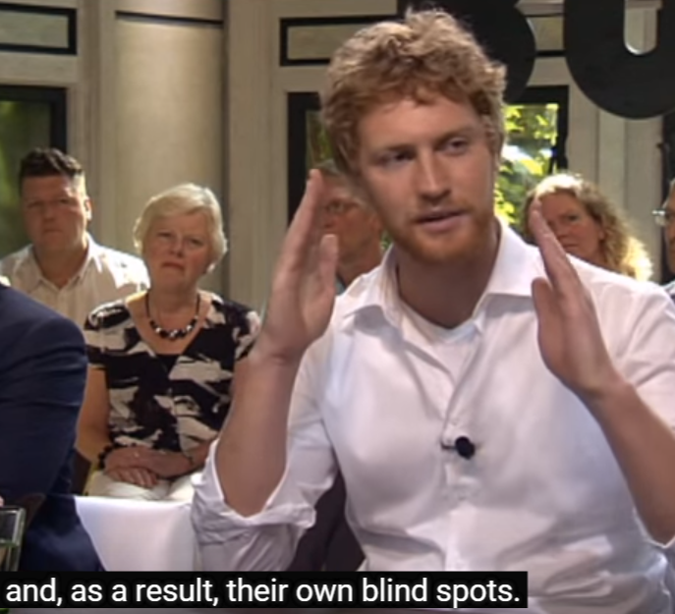
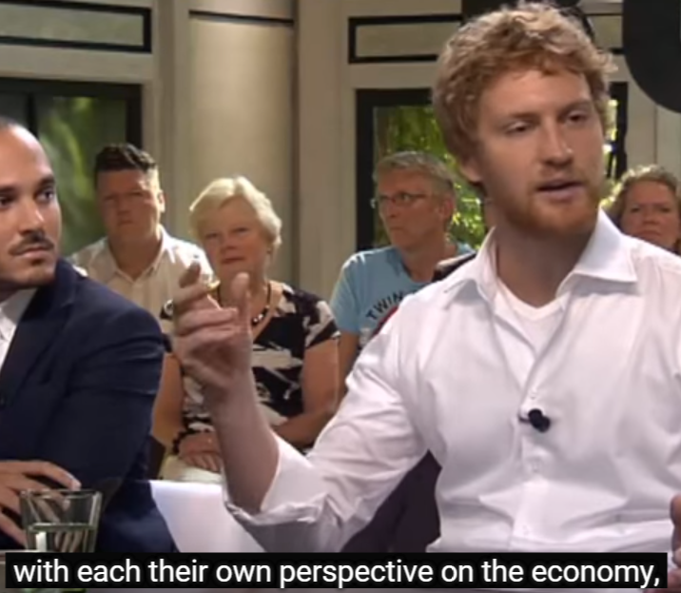
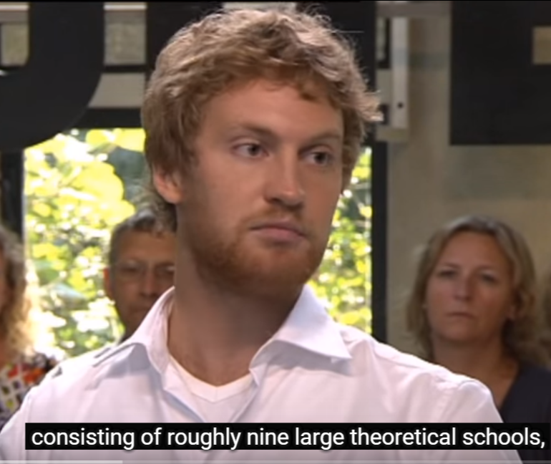
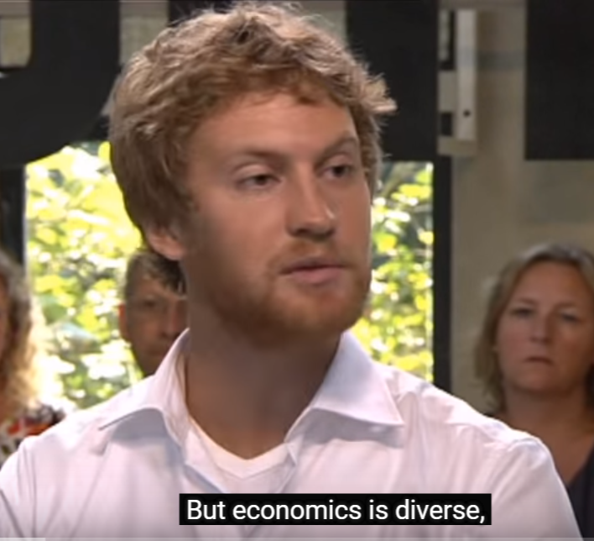
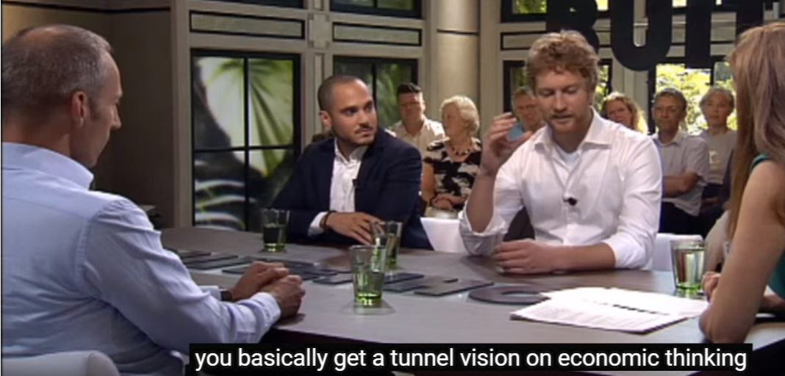
Blindspots in economics…

Slide 4
Blindspots in economics…
But there can be shared blindspots too
Most important one today: the environment
Schools attempt to address from within own paradigm
Neoclassical School:
Price signals are wrong because pollution is an “externality”
Solution?: put a price on carbon
Austrian School:
Absence of property rights over environment is the problem
Solution?: impose & enforce property rights
Post Keynesian
Admit issue is poorly integrated into theory at present
Solution?: Complicated. but State likely to play leading role
Dedicated School of Ecological Economics also exists “because a hundred years of disciplinary specialization in scientific inquiry has left us unable to understand or to manage the interactions between the human and environmental components of our world”
But minority School & relatively inactive given issue’s importance…

Slide 5
The environmental blind-spot in economics
Why do economists find it so hard to think about the environment?
My hunch: they are trained in Mainstream premises that trivialise it…
“Perfect competition”
“The Circular Flow”
Most non-Mainstream economists offer little on ecology either…

Slide 6
The environmental blind-spot in economics
“Perfect competition”
Implies that “perfection”—zero waste is possible
Consumer Surplus
Supply
Price
“Perfection” of “No Deadweight Loss”
Producer Surplus
Demand
Quantity

Slide 7
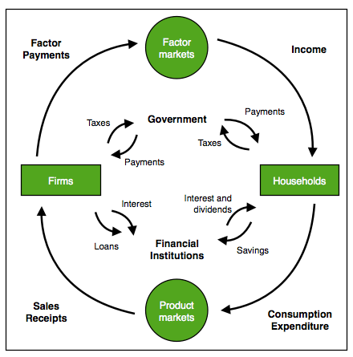
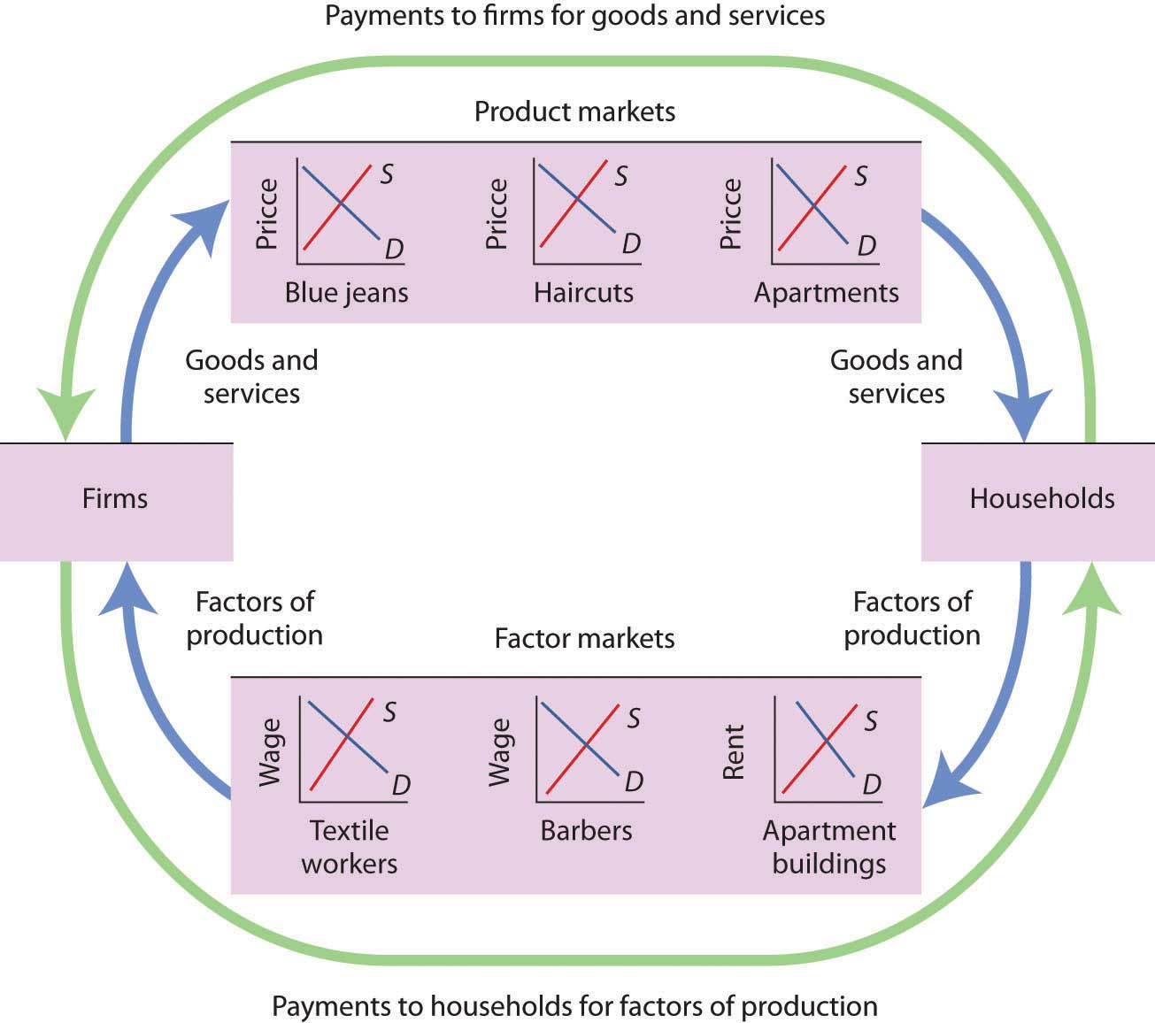
The environmental blind-spot in economics
“The Circular Flow Diagram”
Treats economy in complete isolation from environment
Some samples…
Misleading because there is no “non-economic” input
No input that wasn’t produced by the economy itself
Implies that closed system can produce increasing output over time
Which it can’t
And that production without waste is possible
Which isn’t true…

Slide 8
The environmental blind-spot in economics
“Circular flow” only possible because we exploit energy already existing in the environment
Solar energy; fossil fuels; nuclear energy
We cannot “produce” energy
This is the “1st Law of Thermodynamics”
We can only exploit energy that already exists
Including converting matter into energy (“nuclear power”)
Exploiting that energy necessarily generates waste
Waste can be minimised but not eliminated
These are the 2nd and 3rd Laws of Thermodynamics
Minimum modification needed to make “circular flow” diagram realistic is to add
Energy inputs from the (not man-made) environment
Waste injected back into the environment…

Slide 9
The environmental blind-spot in economics
Something like this…
Energy
Useful work
Waste

Slide 10
The environmental blind-spot in economics
Why can’t we
Produce without using already existing energy?
Produce without creating waste?
The “Laws of Thermodynamics”
Empirically absolutely true rules about energy
Discovered in late 19th century
After Neoclassical economics started to develop
Complicated rules require advanced maths to really understand
Basics are best conveyed by a “Big Bang Theory” Sheldon-type joke…

Slide 11
The environmental blind-spot in economics

Slide 12
The environmental blind-spot in economics
The “joke” version of the Laws of Thermodynamics
You can’t win
You can’t break even
You can’t leave the game…
Slightly more informative version:
You can't win, you can only break even.
You can only break even at absolute zero.
You can never reach absolute zero.
Translation:
Energy can neither be created nor destroyed
Only its form can be changed
The maximum amount of energy you can use to perform work is limited by the background temperature in which the work is done
Only if the background temperature is Absolute Zero can you turn all available energy into work
There is no place in the Universe that is at Absolute Zero

Slide 13
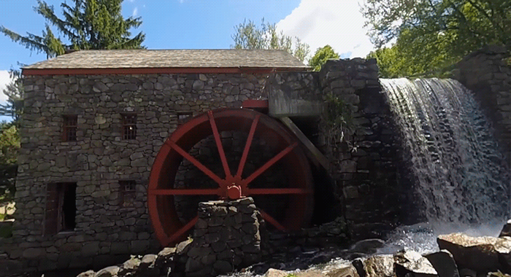
The environmental blind-spot in economics
Why wasted energy is inevitable…
Using energy requires turning potential energy into work
E.g., using a waterfall to turn a mill…
Pity this wheel isn’t actually turning!
You can’t generate power unless there is a gap between where the water starts and where it ends
Same thing for energy in general: maximum you can extract depends on gap between energy of source and where it is used…

Slide 14
The environmental blind-spot in economics
Waterfall can be source of power if height > 0
Same idea for energy in general
Work can be done if energy of source greater than surroundings
Basic idea is a “heat pump”
Work can be done if heat of “source” (Heat of engine)
Greater than heat of “sink” (Heat of surrounding air)
Engine (say 500C)
Environment (say 25C)
Flow of Heat
Energy can be harnessed
Engine (say 500C)
Environment (say 500C)
No Flow of Heat
Energy can’t be harnessed

Slide 15
The environmental blind-spot in economics
So work done by an energy source doesn’t just depend on how powerful it is (measured by the heat it can generate)
It also depends on how cold the surroundings are: the colder the better
Heat of Source
Maximum usable energy
So maximum we can get out of a given source depends on how cold the surroundings can be
What’s the coldest surrounding temperature?
Absolute Zero: -275.15 degrees Celsius
Is there anywhere that is that cold?
No! That’s the 3rd Law of Thermodynamics
Average temperature of the Universe is about 2.73 degrees above Absolute Zero (“2.73 degrees Kelvin”)
Heat of Sink
What’s the average temperature of the Earth?
About 16 degrees Celcius—or 292 degrees above Absolute Zero
So on earth about 290°C of energy can’t be accessed
At least this much potential energy is wasted by any power extraction system on this planet…

Slide 16
The environmental blind-spot in economics
Even with ideal engine
No friction, no leakages, etc.
Maximum efficiency must be less than 100%
Heat of Source
(S)
Maximum work (W)
Efficiency of perfect engine is
W = 1 – D/S
With temperature measured from Absolute Zero
So if S = 1000°K (car engine) and D = 300°K (hot summer day!)
Maximum efficiency = 1 – (300/1000) = 70%
Heat of Dump (D)
So “perfect” efficiency is impossible
30% of energy wasted even with ideal car engine
Actual wastage will be much higher…

Slide 17
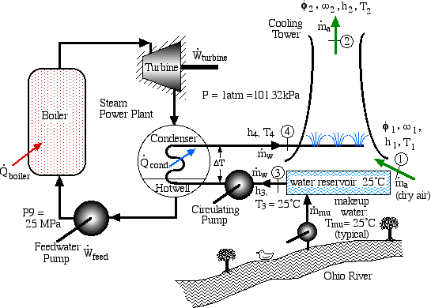
The environmental blind-spot in economics
It gets worse… The 2nd Law of Thermodynamics:
Heat must be exchanged with an “external system”
Otherwise no energy can be extracted, because…
A closed system degrades to uniform temperature over time
Power generation works because waste heat dumped in environment:
Because this dumps waste heat into the environment
This generates power…
If this bit were completely isolated from the environment…

Slide 18
The environmental blind-spot in economics
Then the temperature of the whole system would become the same…
And the turbine wouldn’t spin
Basic principle applies to energy in general, everywhere
Closed and isolated systems go from high order to uniform order over time
High order described as “low entropy”
Uniform order described as “high entropy”
Turbine
Boiler
For example, this is “low entropy”
Most of the gas atoms are on the left hand side of the piston; very few on the right hand side
This will tend to happen over time…
This is “high entropy”—fairly uniform pressure
This is a universal tendency: Universe goes from low entropy (highly organised) to high entropy (disorganised) over time…

Slide 19
The environmental blind-spot in economics
It’s a bit like this…
So what’s this got to do with economics?...

Slide 20
The environmental blind-spot in economics
Two key things:
Waste can be reduced but not eliminated; it is unavoidable
So economics and ecology are intimately linked
No school of economic thought does this properly
Even environmental economics: not developed enough yet
Energy is essential for production to occur at all; but
Production goes in the opposite direction to the 2nd Law
We take disordered stuff—raw materials, etc.
And turn it into ordered stuff—iPhones, cars, pizzas…
And since the 2nd Law is an unbreakable law of the Universe…
Then production must increase disorder while it creates products
So some big questions have complex answers:
How can growing economies produce a surplus
More outputs than inputs?
Can we use market mechanisms—like a price for carbon—to avoid environmental problems?
Can we grow forever on a finite planet?

Slide 21
The environmental blind-spot in economics
How can growing economies produce a surplus?
That is, how can 0utputs exceed inputs
And be more ordered than inputs
Surplus in an isolated and closed system is impossible
In fact such a system degrades over time (The 2nd Law)
So production is only possible because Earth is an Open system
Receives incoming energy from the Sun
And has stored solar energy—as “Fossil Fuels”
And has stored cosmic energy—as “Nuclear Fuels”
Farms and factories exploit these to produce more outputs than inputs
More order in outputs (iPhones) than in inputs (silica from sand)
But necessarily creates more disorder than order
Entropy (“Disorder”) of outputs (iPhones + waste)
Exceeds entropy (“disorder”) of inputs (original + energy)
How consistent are different Schools of Economic Thought with this?
Only one School of Thought has even been close to being correct…

Slide 22
The environmental blind-spot in economics
One you probably haven’t heard of
The “Physiocrats”
18th century French school centred on doctor for the King of France (Louis 15th), Francois Quesnay
Inspired by recent discovery of arteries & veins in the body
Circulation model with money and goods flowing from one economic organ to another—like circular flow today
BUT also argued that surplus arises only in agriculture
Logic: agriculture the only industry that receives “free gift of Nature”:
“The husbandman [Farmer] is the only one whose industry produces more than the wages of his labour.
He, therefore, is the only source of all Wealth.
The soil, independent of any other man, or of any agreement, pays him immediately the price of his toil.
Nature … What she grants … is a physical consequence of the fertility of the soil” (Turgot 1795)

Slide 23
The environmental blind-spot in economics
They divided society into 3 classes:
Productive class: agricultural workers
Create value because of the “free gift” of Nature
Surplus easily seen in agriculture:
Plant one seed, yield a whole plant
Sterile class: industrial workers
Transform value received from agriculture but do not add to it
Proprietor class: the owners
Wrong to think that only agriculture harnessed “free gift” of Nature
But correct that Nature—as in Energy—is the source of surplus
Insights lost as Classical economics (Smith, Ricardo, Marx) saw labour as source of surplus
Lost even further when Neoclassicals ignored issue of where surplus comes from

Slide 24
The environmental blind-spot in economics
Revisions for economics to comply with Laws of Thermodynamics
Economy & environment necessarily linked (while production remains “on planet”)
Production necessarily requires Energy
Labour and capital cannot be substituted for Energy
Efficiency of energy use can be improved but never “perfect”
Production produces 3 types of outputs (not just goods)
Useful work transforming matter into useful products/services
Waste energy
Some unavoidable due to Laws of Thermodynamics
Some reducible by higher efficiency
Waste products
Some unavoidable: burning coal necessarily produces CO₂
Some reducible by new technology (e.g. 3D printing reducing machine tooling waste)
Visualising this…

Slide 25
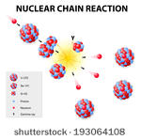
The environmental blind-spot in economics
Economy an activity within the environment
Produces surplus because harnesses free energy from Sun, fossil fuels, & nuclear
Waste
Both physical & energy
Both necessarily generated,
& due to inefficiencies
& state of technology
dumped back into Biosphere
Biosphere
Energy
Useful work powers economy
Labour and capital needed to harness energy and direct work to produce output
Waste
Useful work
Biosphere affected by waste
Can undermine production process
Biosphere slows transmission of waste energy into Space

Slide 26
The environmental blind-spot in economics
Can economics be made consistent with Laws of Thermodynamics?
Not the Neoclassicals
See source of surplus as “increase in utility”
But don’t explain how this is possible
Use “production functions” that say “output is a function of technology, labour and capital”:
Omits any explicit role for energy
Implies energy can be treated as “just another form of capital”
But capital (machinery) is manufactured
Energy cannot be manufactured (The 1st Law)
Production function the mirror image of model of consumption
Consumption
Commodities easily substituted to generate utility
Serious problems with model but not inherently wrong
Production
Inputs (capital & labour) easily substituted to produce output
Inherently wrong: cannot substitute capital & labour for energy

Slide 27
The environmental blind-spot in economics
Also imagines that “perfect” efficiency is possible in markets
“Perfect” (wasteless) production is impossible (2nd & 3rd Laws)
Theory of income distribution no longer works
Links income of “factors of production” to “marginal productivity”
Incomes (prices) completely account for output
When energy (non-manufactured) included, this is no longer possible
Labour & capital together cannot account for all output
Prices of “factors of production” no longer match “marginal products”
Neoclassical theory doesn’t conform to the Laws of Thermodynamics
Would require serious revision to fit

Slide 28
The environmental blind-spot in economics
Post Keynesian theory also doesn’t conform at present
But revisions to make it fit would be easier
Also treats output as function of capital & labour only
But doesn’t treat them as smoothly substitutable (more realistic)
Doesn’t match incomes to “marginal product” but rather to relative bargaining power

Slide 29
The environmental blind-spot in economics
Can we use market mechanisms—like a price for carbon—to avoid environmental problems?
Total effect of production—producing goods and waste—necessarily increases “disorder” (entropy)
Full price for waste effects of production would make production unprofitable
“Free gifts of Nature” partly have to be free for production to occur
“Shadow prices” for forms of pollution can encourage efficiency but never reduce waste below limits set by Thermodynamics
Market can’t work out carbon price that will stop Antarctica melting…

Slide 30
The environmental blind-spot in economics
Can we grow forever on a finite planet?
Ultimately no—because of 2nd Law
Production necessarily requires energy
Production necessarily generates waste energy
This alone—even without “Greenhouse Effect” will limit production
Interesting blog post on this
“Exponential Economist Meets Finite Physicist”
Discussion over dinner between a Physicist (who knows Thermodynamics) and an Economist (who doesn’t)
Physicist starts with “I claim that economic growth cannot continue indefinitely… Earth’s physical resources—particularly energy—are limited and may prohibit continued growth within centuries”
Economist disagrees…

Slide 31
The ultimate limits to growth
“I don’t think energy will ever be a limiting factor to economic growth.
Sure, conventional fossil fuels are finite.
But we can substitute non-conventional resources like tar sands, oil shale, shale gas, etc.
By the time these run out, we’ll likely have built up a renewable infrastructure of wind, solar, and geothermal energy—plus next-generation nuclear fission and potentially nuclear fusion.
And there are likely energy technologies we cannot yet fathom in the farther future.”
Physicist concedes these things could develop, but focuses on pure use of energy usage in Watts per year:
“if you plot the U.S. energy consumption in all forms from 1650 until now, you see a phenomenally faithful exponential at about 3% per year over that whole span.
The situation for the whole world is similar…”

Slide 32
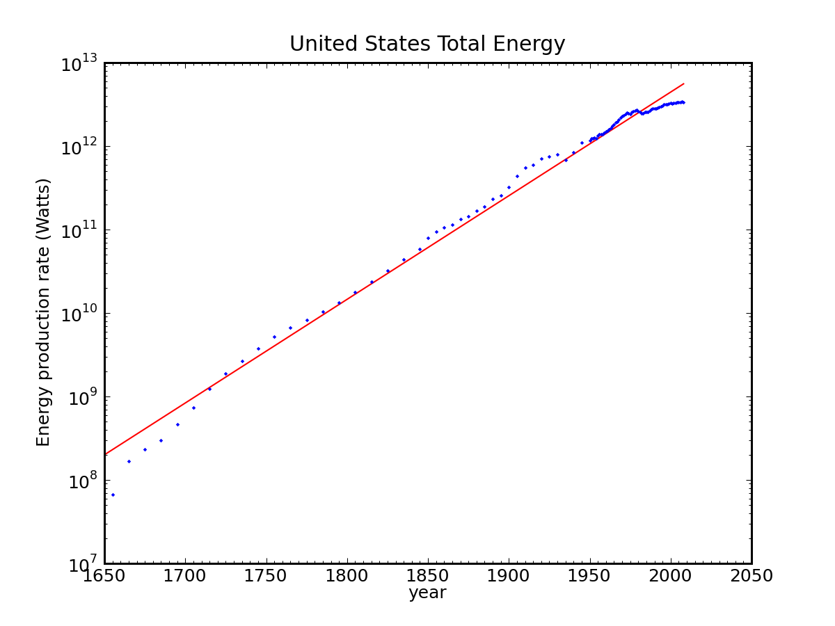
The ultimate limits to growth
This is energy use over time in the USA…

Slide 33
The ultimate limits to growth
Physicist asks economist “So how long do you think we might be able to continue this trend?” (even if population stopped growing)
“the Earth has only one mechanism for releasing heat to space, and that’s via (infrared) radiation.
We understand the phenomenon perfectly well, and can predict the surface temperature of the planet as a function of how much energy the human race produces.
The upshot is that at a 2.3% growth rate (conveniently chosen to represent a 10× increase every century), we would reach boiling temperature in about 400 years.”
This is even without global warming (caused by water vapour, CO₂, Methane trapping infrared radiation)
Slowing down rate of growth is not a solution
Halving a growth rate doubles time to get to same position
Growth rate of 1.15% per year means in 800 years, surface temperature of the planet would boil water…

Slide 34
The ultimate limits to growth
Growth rate of 0.5525% per year would mean this happens in 1600 years
Physicist hammers point about unsustainability of exponential growth:
“At that 2.3% growth rate, we would be using energy at a rate corresponding to the total solar input striking Earth in a little over 400 years.
We would consume something comparable to the entire sun in 1400 years from now.
By 2500 years, we would use energy at the rate of the entire Milky Way galaxy—100 billion stars!
I think you can see the absurdity of continued energy growth.
2500 years is not that long, from a historical perspective. We know what we were doing 2500 years ago.
I think I know what we’re not going to be doing 2500 years hence.”
(And efficiency gains can’t prevent this outcome)
So laws of energy use mean ultimately growth in energy consumption must end
What about today’s biosphere issues?

Slide 35
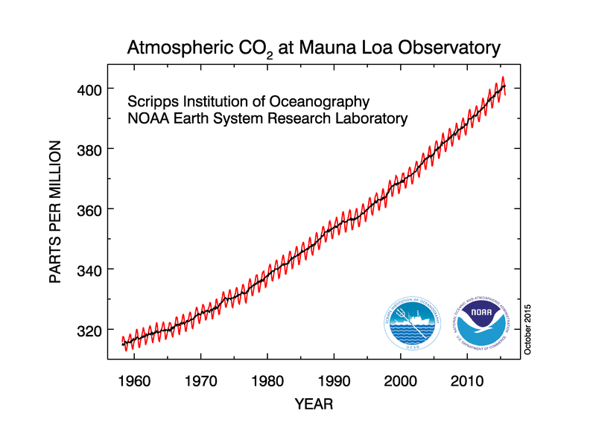
The immediate environmental issues
Global Warming
Additional retention of infra-red waste heat due to rising CO₂ levels

Slide 36
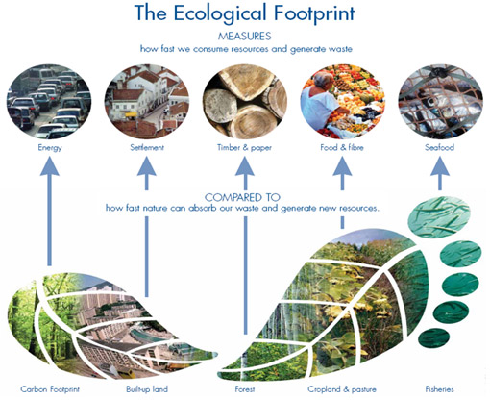
The immediate environmental issues
“Human Ecological Footprint”
Calculates resources used to sustain human life
Converts into number of hectares of arable land used
Compares to number of arable hectares there actually are

Slide 37
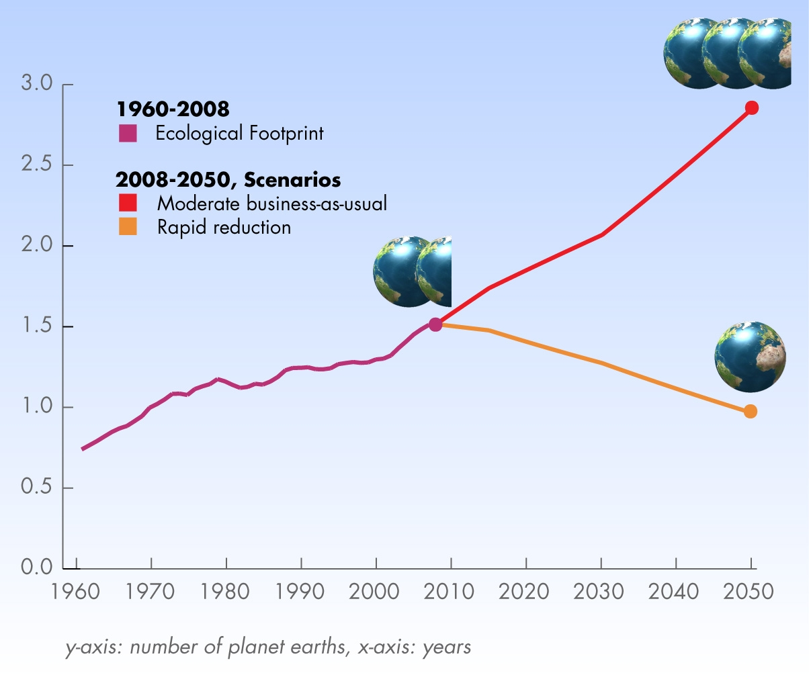
The immediate environmental issues
We reached point where humanity alone uses 1 sustainable Earth per year in 1970
We’re now using 1.5 sustainable Earths per year
Continuing trend will mean we use 3.0 Earths per year by 2050

Slide 38
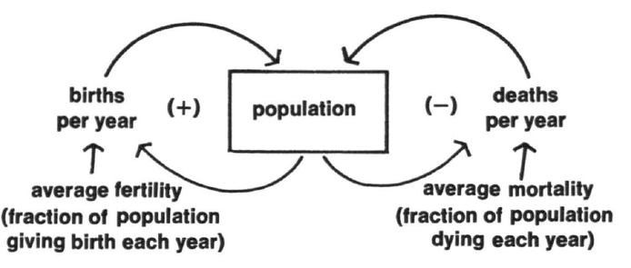
How do we model economy as part of ecology?
Fundamentally non-equilibrium thinking needed
Equilibrium doesn’t make sense in exponentially growing world
We have already well overshot sustainable (“equilibrium”) levels
First dynamic attempt to model ecology & economy together was “Limits to Growth” report by Club of Rome in 1972
Modeled major factors linking ecology to economy as feedback processes
Population; Pollution; Energy;…

Slide 39
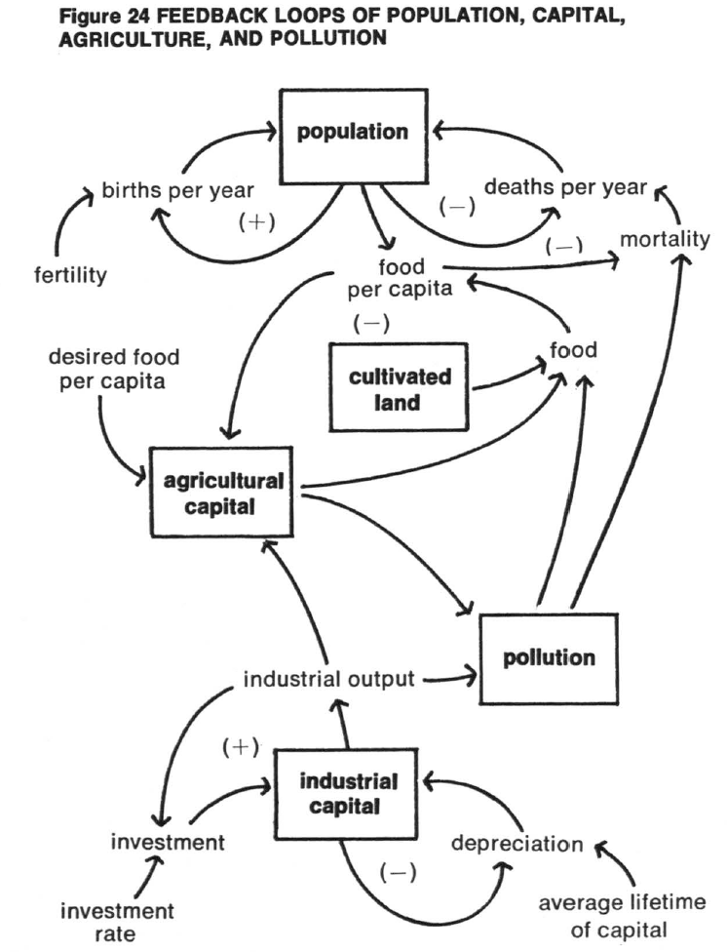
How do we model economy as part of ecology?
Complex pattern of feedbacks modelled…

Slide 40
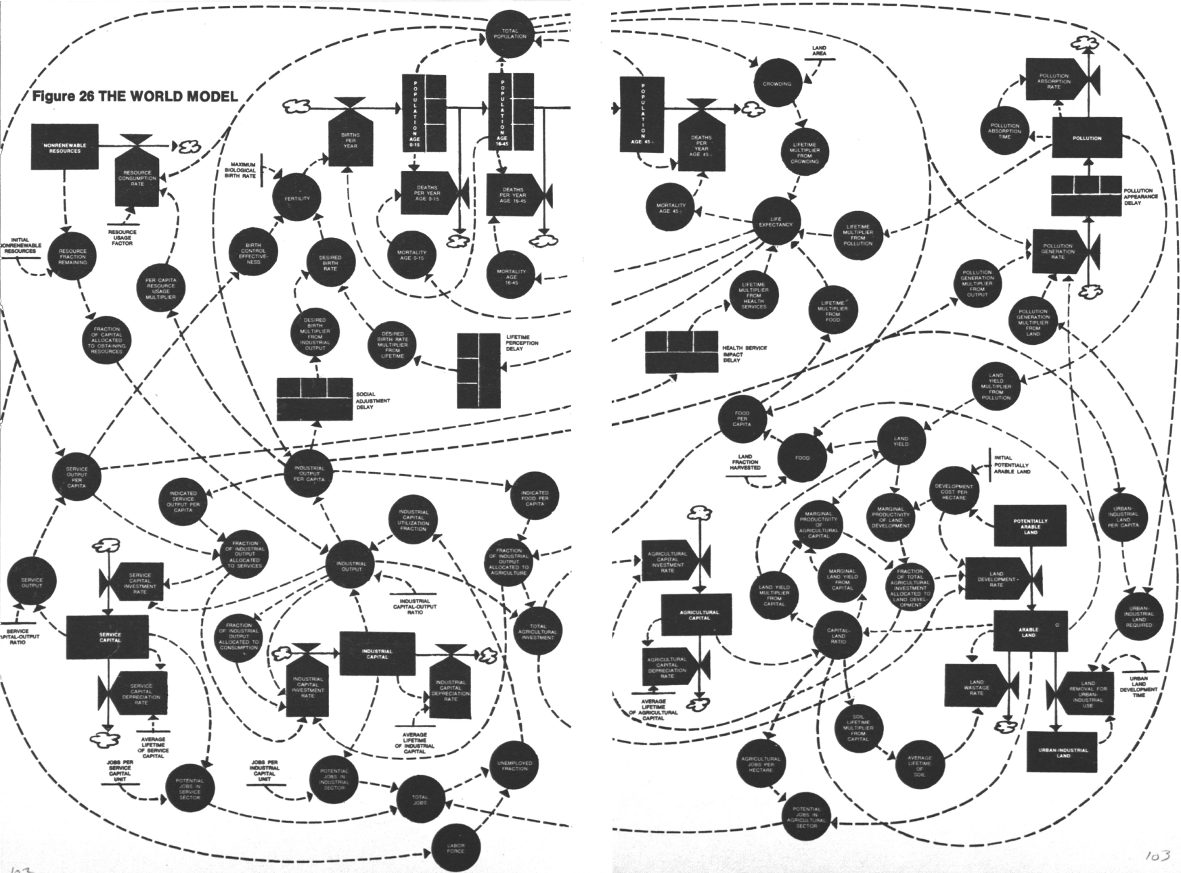
How do we model economy as part of ecology?
Complicated but all interconnected—no “ceteris paribus”

Slide 41
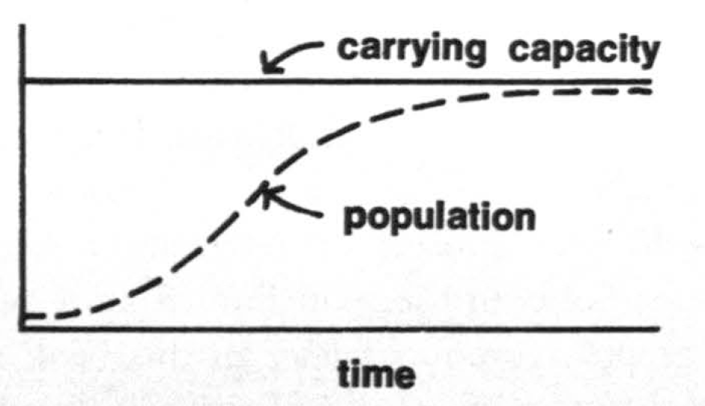
How do we model economy as part of ecology?
Birth of “system dynamics”
Widely adopted by engineers since then
Ignored by economists—and conclusions of study derided by them
Study saw several possible outcomes
Smooth taper to carrying capacity of the planet…

Slide 42
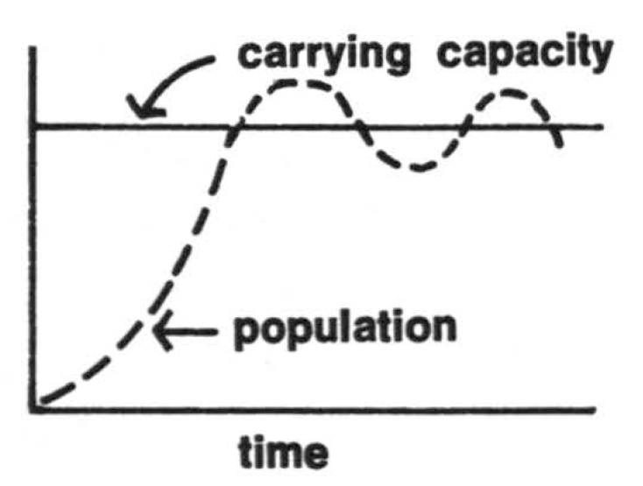
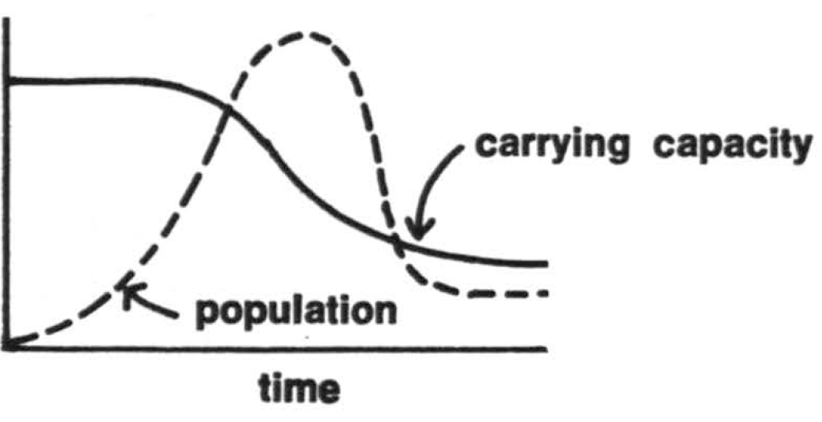
How do we model economy as part of ecology?
Overshoot and oscillations
Least desirable: serious overshoot, diminish planet’s carrying capacity, population plunge to below capacity…

Slide 43
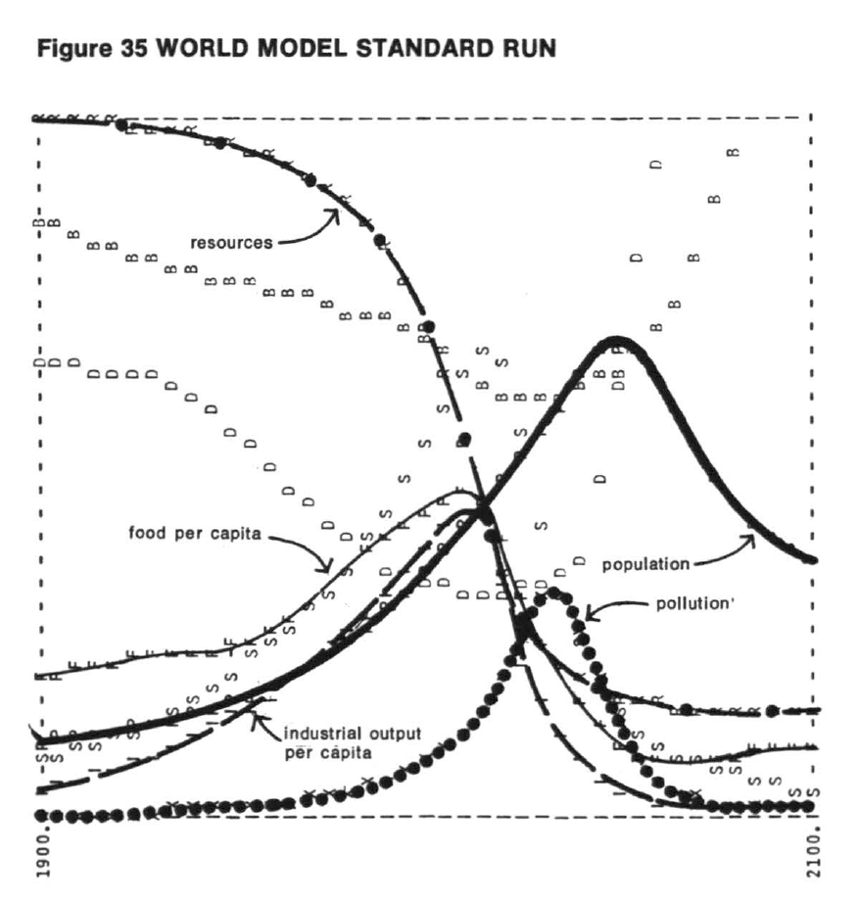
How do we model economy as part of ecology?
“Standard run”—business as usual from 1972 on—predicted ecological collapse in mid-21st century

Slide 44
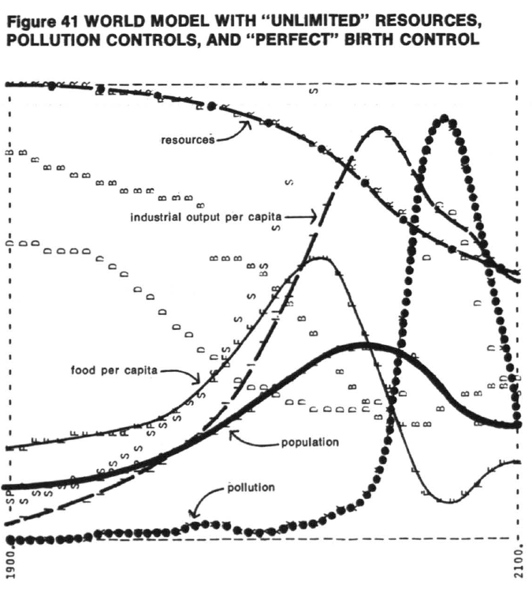
How do we model economy as part of ecology?
Many other scenarios modelled—”unlimited resources” for example

Slide 45
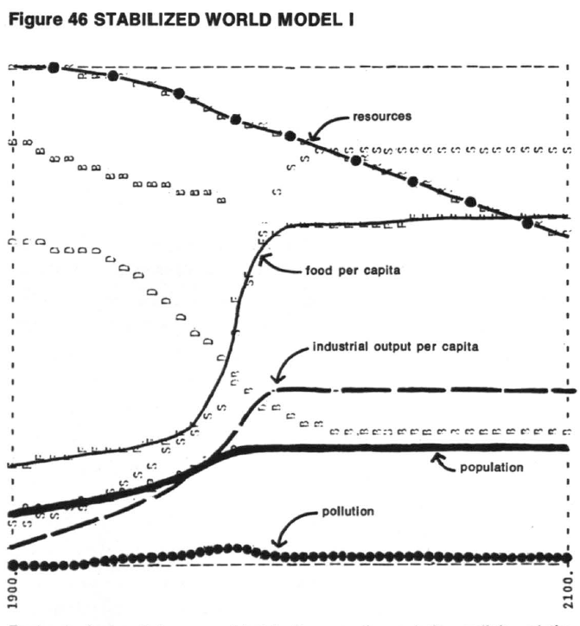
How do we model economy as part of ecology?
Sustainable future possible with numerous controls from 1975 on…

Slide 46
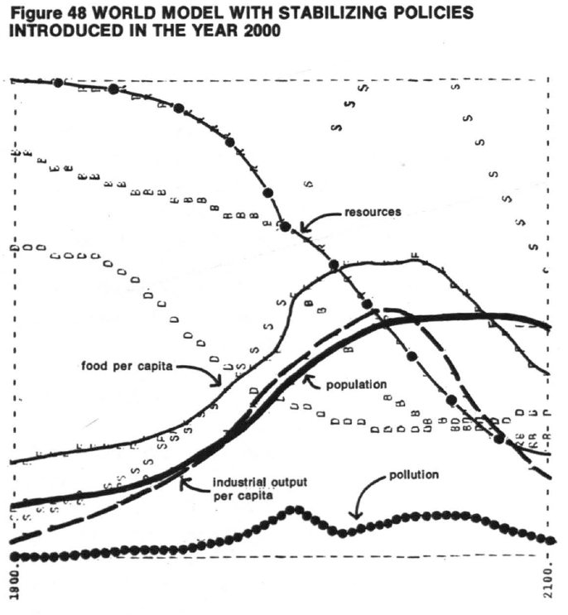
How do we model economy as part of ecology?
But crises if policies introduced too late…

Slide 47
Conclusion
Economic theory must integrate itself into ecological theory
A task for the current and your generation of economists!

