Slide 1

Why Economists Disagree: Post Keynesians
Professor Steve Keen
Head of Economics, History & Politics
Kingston University London
IDEAeconomics
Minsky Open Source System Dynamics
www.debtdeflation.com/blogs

Slide 2

Recap/Coming Up
Recap. Last week: The Austrians
  Same “theory of value” as Neoclassicals
  Diverging over Limited knowledge, Disequilibrium and Money
This week: The Post Keynesians
  And now for something completely different…

Slide 3
Post Keynesians: Realism, Uncertainty, Money
Despite differences, Austrians & Neoclassicals have much in common:
  Utilitarian theory of value: utility determines value
  Supply & demand analysis
    Marginal utility, marginal cost, marginal revenue, etc.
  Equilibrium as a natural state of a market economy
  “A priori” or “deductive” approach to economic method
Post Keynesians reject all of the above—and much more
  Overlap with Austrians on some issues
    Incomplete knowledge—or “fundamental uncertainty”
    Vital role for money versus mainstream “barter myth”
  But differ on “fundamentals” of both Neoclassicals & Austrians
    Lean towards “effort theory of value” of Classical School
    Reject supply & demand analysis
    Don’t regard equilibrium as “normal”
    Empirical or “inductive” approach to economic method

Slide 4
Post Keynesians: Realism, Uncertainty, Money
  Key question: “What caused the Great Depression, and can it happen again?”
  Key difference with Neoclassicals: Realism vs Unrealism
    Walras’s hypothetical mega-market didn’t actually exist
    Supply & demand analysis an “armchair” model of competition
    Method: “unreal assumptions OK”:
      “Truly important and significant hypotheses will be found to have "assumptions" that are wildly inaccurate descriptive representa­tions of reality, and, in general, the more significant the theory, the more unrealistic the assumptions” (Friedman)
    Equilibrium also assumed—but is it ever seen in reality?
  Post Keynesians:
    Let’s look at actual markets rather than hypothetical ones
    Supply & demand analysis doesn’t pass empirical tests
    Realism is vital:
    Non-equilibrium models used (as well as many equilibrium ones)

Slide 5
Post Keynesians: Realism, Uncertainty, Money
Key motivating event for Post Keynesians was The Great Depression
Deepest and longest crisis in the history of capitalism
Followed huge stock market boom and bust…
September 1929: 381 points
“Roosevelt Recession”
Market fell 90% from peak to trough
Recovery faltered in 1937
June 1932: 41 points

Slide 6
Post Keynesians: Realism, Uncertainty, Money
Nominal GDP virtually halved from 1929-1932
“Roosevelt Recession”
Recovery faltered in 1937

Slide 7
Post Keynesians: Realism, Uncertainty, Money
Rate of growth of nominal GDP as low as minus 23% a year
“Roosevelt Recession”

Slide 8
Post Keynesians: Realism, Uncertainty, Money
Unemployment rose from 0 to 25%; stayed above 10% till WWII
“Roosevelt Recession”
Recovery faltered in 1937

Slide 9
Post Keynesians: Realism, Uncertainty, Money
Mild deflation before crisis: severe deflation after it
“Roosevelt Recession”
Prices Falling at 10%/year

Slide 10
Post Keynesians: Realism, Uncertainty, Money
Government surplus 1% of GDP for most of the 1920s
  Mainstream thought this was good fiscal policy…
“Roosevelt Recession”
Sustained surpluses before the crash
Deficits after it until Roosevelt persuaded to “return to surplus”

Slide 11
Post Keynesians: Realism, Uncertainty, Money
Before Great Depression, no serious mainstream “Macroeconomics”
Instead mainstream accepted “Say’s Law”
  “General gluts” or “general slumps” impossible
  Crises caused by “disproportionality” only
    Excess supply in one market, excess demand in others
  Solution to crisis is let price of commodities in excess supply fall
    i.e., If wages fall, then unemployment will fall too…
  Argument
    Money only an intermediary in barter
    People sell only to buy again (increase in utility the object)
      Each person’s supply generates his/her demand
    Sum of all supply thus cannot exceed sum of all demand (no “general gluts”);
    But slump in one market can occur if supply of X exceeds demand for X, at price producers of X want; however
      Price of X falls, demand for X rises: return to equilibrium...
        Unless government regulations, monopolies intervene

Slide 12
Post Keynesians: Realism, Uncertainty, Money
  In Say’s words… “What do you conclude from this?
  That the more the purchasers produce, the more they have to purchase with, and that the productions of the one procure purchasers to the other.
It appears to me, that if the buyers only purchased by means of their products, they have generally more products than money to offer in payment.
  Every producer asks for money in exchange for his products, only for the purpose of employing that money again immediately in the purchase of another product;
  for we do not consume money, and it is not sought after in ordinary cases to conceal it: thus, when a producer desires to exchange his product for money, he may be considered as already asking for the merchandise which he proposes to buy with this money.
  It is thus that the producers, though they have all of them the air of demanding money for their goods, do in reality demand merchandise for their merchandise.”
?
?
?
?
?

Slide 13
Post Keynesians: Realism, Uncertainty, Money
“Then the more merchandise there is produced, the more animated is the demand for merchandise?
  Without doubt.”
Say asserts that there is never a problem with demand—always with supply (or with price being above equilibrium because of monopolies, trade unions, government interference…)
  Accepted by all mainstream economists—even Ricardo from preceding “Classical” School:
    “M. Say has, however, most satisfactorily shown, that there is no amount of capital which may not be employed in a country, because demand is only limited by production.” (Ricardo, Principles, Ch. 21)
  Mainstream believed aggregate demand could not be insufficient
    Because to them aggregate supply was aggregate demand
      “Sellers only sell in order to buy again immediately”
  Mainstream reaction to crisis initially was that wages must be too high
    “Cut wages & crisis will be over”
    But wages fell and the crisis got worse…

Slide 14
Post Keynesians: Realism, Uncertainty, Money
Money wages fell for most of the 1930s; real wages fell from 1929-33

Slide 15
Post Keynesians: Realism, Uncertainty, Money
Wages & unemployment went in opposite directions—contradicting mainstream (and Austrian) theory
“Roosevelt Recession”

Slide 16
Post Keynesians: Realism, Uncertainty, Money
Austrians (Hayek’s descendants) blamed low interest rates for causing boom before the crisis
  But interest rates were high throughout 1920s (& 1930s)
  So whatever kicked off the 1920s boom, it wasn’t low interest rates

Slide 17
Post Keynesians: Realism, Uncertainty, Money
  Austrians also blame excessive increase in money supply during the 1920s by The Fed for causing 1920s boom, and hence 1930s bust…
Today’s mainstream “New Keynesian” economists also blame the Fed for 1930s—but for not increasing the money supply enough:
  “The monetary data for the United States are quite remarkable, and tend to underscore the stinging critique of the Fed’s policy choices by Friedman and Schwartz (1963)…
  U.S. nominal money growth was precisely zero between 1928:IV and 1929:IV…The year 1930 was even worse in this respect: between 1929:IV and 1930:IV, nominal money in the United States fell by almost 6%
  The proximate cause of this decline in M₁ was continued contraction in the ratio of base to reserves, which reinforced rather than offset declines in the money multiplier.
  This tightening … locates much of the blame for the early (pre-1931) slowdown … with the Federal Reserve. (Bernanke 2000, p. 153)

Slide 18
Post Keynesians: Realism, Uncertainty, Money
The money supply collapsed—but bank money M₁, not Fed money M₀…

Slide 19
Post Keynesians: Realism, Uncertainty, Money
Federal Reserve Money (M₀) and bank money (M₁) moved in same direction during 1920s, but generally opposite direction during 1930s…
“Roosevelt Recession”
  But Fed increases M₀ from 1931 & yet M₁ falls
  Fed money does fall here, as Bernanke emphasises

Slide 20
Post Keynesians: Realism, Uncertainty, Money
Important sub-issue in Great Depression—the “Roosevelt Recession”
  Roosevelt persuaded to return budget to surplus (after 4-5% of GDP deficits) since unemployment fell from 26% (1932) to 11% (1937)
  Federal Reserve increased reserve requirements
Economy tanked: GDP fell, unemployment rose back to 20%
  Unemployment explodes again
Private & Central bank money growth goes negative
Government reduces its deficit

Slide 21
Post Keynesians: Realism, Uncertainty, Money
Economics in disarray in the 1930s
Compounded by 1937 crisis when government attempted to run surplus
Enter Keynes’s General Theory of Employment, Interest & Money
Argued that crisis caused by insufficient aggregate demand
  i.e., a “general glut”: aggregate demand insufficient to employ all those who wish to work
Heresy for mainstream economists (& Austrians)—and even for Keynes
  “For a hundred years or longer, English Political Economy has been dominated by an orthodoxy.
  In that orthodoxy, in that continuous transition, I was brought up. I learnt it, I taught it, I wrote it. To those looking from outside I probably still belong to it. Subsequent historians of doctrine will regard this book as in essentially the same tradition.
  But I myself in writing it, and in other recent work which has led up to it, have felt myself to be breaking away from this orthodoxy, to be in strong reaction against it, to be escaping from something, to be gaining an emancipation.” (Keynes 1939)

Slide 22
Post Keynesians: Realism, Uncertainty, Money
Keynes attempted to develop a theory of the macroeconomy where what applied to the individual did not necessarily apply to the whole:
  “I am chiefly concerned with the behaviour of the economic system as a whole,
    with aggregate incomes, aggregate profits, aggregate output, aggregate employment, aggregate investment, aggregate saving rather than with the incomes, profits, output, employment, investment and saving of particular industries, firms or individuals.
  And I argue that important mistakes have been made through extending to the system as a whole conclusion which have been correctly arrived at in respect of a part of it taken in isolation.”
Keynes’s first point on this: applying micro model of labour market to macroeconomy is a “fallacy of composition”
  That is, what applies to an individual doesn’t apply to society
  As Yanis Varoufakis explains here…

Slide 23

Post Keynesians: Realism, Uncertainty, Money

Slide 24
Post Keynesians: Realism, Uncertainty, Money
Micro analysis: supply and demand independent
Applied to market for Labour, you get this:
Unemployment
Supply
Supply
Real Wage
Unemployment caused by real wage being too high…
Real Wage
Equilibrium Wage
Above Equilibrium Wage
Demand
Demand
Employment
Employment
Actual Employment
Full Employment
Want job at this wage
Micro-based solution: cut real wage and unemployment will disappear
  Higher demand for workers; and also…
    Less workers will want a job at the lower wage (??)

Slide 25
Post Keynesians: Realism, Uncertainty, Money
Keynes challenged this argument, given the Depression at the time:
  “the contention that the unemployment which characterises a depression is due to a refusal by labour to accept a reduction of money-wages is not clearly supported by the facts.
  It is not very plausible to assert that unemployment in the United States in 1932 was due either to labour obstinately refusing to accept a reduction of money-wages
  or to its obstinately demanding a real wage beyond what the productivity of the economic machine was capable of furnishing.
  Wide variations are experienced in the volume of employment without any apparent change either in the minimum real demands of labour or in its productivity.
  Labour is not more truculent in the depression than in the boom—far from it. Nor is its physical productivity less.
  These facts from experience are a prima facie ground for questioning the adequacy of the [Neo]-classical analysis.”

Slide 26
Post Keynesians: Realism, Uncertainty, Money
Keynes argues that at the macro level, supply and demand are not independent
  Wages a major source of demand
    Lower wage may mean lower demand for goods
    And hence lower demand for labour…
  Wages also a major cost; and
  Wage bargains are over money wage, not real wage
    Reducing money wages may reduce money prices too & leave the real wage unaltered
      Actual situation may be more like this…
Supply
Unemployment
Money Wage
Demand
Employment
Actual Employment
Full Employment
Only way to restore full employment is to boost aggregate demand
Had to rely on government here because private investment depressed by low expectations of profit…

Slide 27
Post Keynesians: Realism, Uncertainty, Money
Slump occurred because of collapse of investor expectations:
  “The theory can be summed up by saying that, given the psychology of the public, the level of output and employment as a whole depends on the amount of investment...
  More comprehensively, aggregate output depends
    on the propensity to hoard,
    on the policy of the monetary authority as it affects the quantity of money,
    on the state of confidence concerning the prospective yield of capital-assets,
    on the propensity to spend and
    on the social factors which influence the level of the money-wage.
  But of these several factors it is those which determine the rate of investment which are most unreliable,
  since it is they which are influenced by our views of the future
    about which we know so little.”

Slide 28
Keynes on Uncertainty
Key element in Keynes’s thinking was uncertainty about the future:
  “By "uncertain" knowledge, let me explain, I do not mean merely to distinguish what is known for certain from what is only probable.
  The game of roulette is not subject, in this sense, to uncertainty…
  Or, again, the expectation of life is only slightly uncertain.
  The sense in which I am using the term is that in which the prospect of a European war is uncertain, or the price of copper and the rate of interest twenty years hence, or the obsolescence of a new invention, or the position of private wealth-owners in the social system in 1970.
  About these matters there is no scientific basis on which to form any calculable probability whatever. We simply do not know.
  Nevertheless, the necessity for action and for decision compels us as practical men to do our best to overlook this awkward fact
  and to behave exactly as we should if we had behind us a good Benthamite calculation of a series of prospective advantages and disadvantages, each multiplied by its appropriate probability, waiting to be summed.”

Slide 29
Keynes and Investment under Uncertainty
Investment necessarily involves expectations about future returns
Given uncertainty, investors form fragile expectations about the future
  By presuming that “the present is a much more serviceable guide to the future than a candid examination of past experience would show it to have been hitherto”
  By believing that “the existing state of opinion as expressed in prices and the character of existing output is based on a correct summing up of future prospects”
  By relying on mass sentiment: “we endeavour to fall back on the judgment of the rest of the world which is perhaps better informed.” (Keynes 1936: 214)
    (Watch great video here about how real people make decisions under uncertainty)
Fragile basis for expectations thus affects prices of financial assets
  Volatility of financial assets affects willingness to invest
  Makes economy itself unstable…

Slide 30
Keynes’s “Revolution”: Investment & Savings
Putting this in the form of (verbal!) equations
Investment (determined by expectations, output, capital stock) determines income via multiplier
  Investment=FunctionOf(Expectations, Output, Existing Capital)
    I=f(E,Y,K)
    Expectations component highly volatile, so most important determinant
  Income and Output are primarily functions of investment
    Y=f(I)
Consumption a function of income
  C=a + c.Y (stable relationship)
Y=C+I=C+S (ex-post Investment = ex-post Savings)
Savings a residual function of income:
  S=Y-C
Attempt to increase Savings may reduce expectations of profit
Which will reduce investment & hence output

Slide 31
Post Keynesians: Realism, Uncertainty, Money
Much more to Keynes than just this (covered in our Macro lectures)
But mainstream economists found him very hard to understand
They relied instead on interpretation of Keynes by John Hicks: “Mr Keynes & The ‘Classics’”:
  “IT WILL BE ADMITTED by the least charitable reader that the entertainment value of Mr. Keynes’ General Theory of Employment is considerably enhanced by its satiric aspect.
  But it is also clear that many readers have been left very bewildered by this Dunciad.
  Even if they are convinced by Mr. Keynes’ arguments and humbly acknowledge themselves to have been "classical economists" in the past, they find it hard to remember that they believed in their unregenerate days the things Mr. Keynes says they believed.”
Hicks re-interpreted Keynes’s arguments to make them more consistent with accepted theory…

Slide 32
Post Keynesians: Realism, Uncertainty, Money
Instead, Hicks asserted that Keynes assumed that:
  Money demand was a function of income and interest rates
  Investment demand was a function of interest rates
    No mention of (volatile) expectations of profit, or capital gain
  Savings were a function of Income
Whatever Happened to Uncertainty & Expectations?
  Hicks: I=f(i): Investment demand a stable function of interest rate
  Keynes: Expectations both crucial & non-rational “Our knowledge of the factors which will govern the yield of an investment some years hence is usually very slight and often negligible”
  “It would be foolish, in forming our expectations, to attach great weight to matters which are very uncertain... therefore, [we are] guided ... by the facts about which we feel somewhat confident, .... the facts of the existing situation enter … disproportionately, into the formation of our long-term expectations…”
  Hicks ignored this and developed an equilibrium model in which uncertainty (and expectations) had no role…

Slide 33
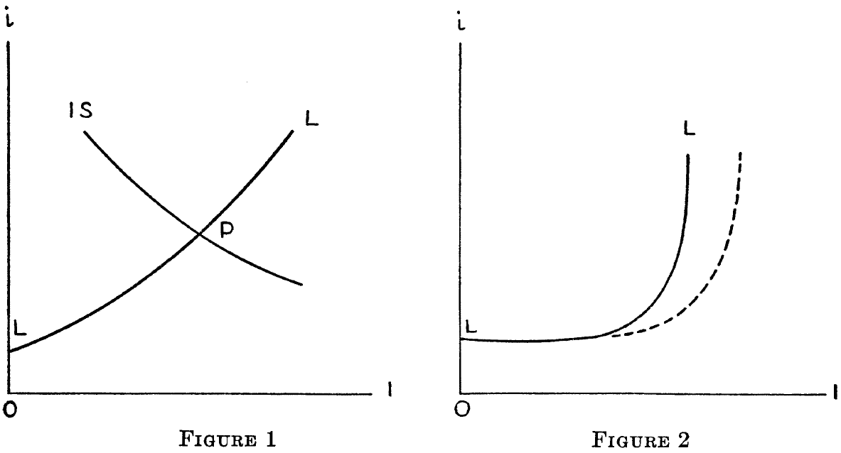
Post Keynesians: Realism, Uncertainty, Money
“With this revision, Mr. Keynes takes a big step back to Marshallian orthodoxy, and his theory becomes hard to distinguish from the revised and qualified Marshallian theories… Is there really any difference between them, or is the whole thing a sham fight?
Let us have recourse to a diagram…”
Hicks invented the “IS-LM” interpretation of Keynes:
Back to the classic “Marshallian scissors”
Hicks argues Keynes’s innovation is slope of “Supply” curve
Keynesian region: boosting demand boosts employment
Classical region: boosting demand boosts prices
Upward-sloping “Supply”, downward sloping “Demand”

Slide 34
Post Keynesians: Realism, Uncertainty, Money
Hicks’s version of Keynes was quite consistent with accepted theory:
  “Income and the rate of interest are now determined together at P, the point of intersection of the curves LL and IS.
  They are determined together; just as price and output are determined together in the modern theory of demand and supply.
  Indeed, Mr. Keynes’ innovation is closely parallel, in this respect, to the innovation of the marginalists.”
“Post Keynesians” diverged from the Mainstream at this point
Saw Hicks’s model as preserving the old in Keynes & rejecting the new
  Post Keynesians instead developed the new and rejected the old…
    Many different strands to Post Keynesian approach
    Empirical approach to competition & production
      Critique of “supply and demand”: marginal costs don’t rise
    Pro-modelling—unlike Austrians
    But insist on realism—unlike Neoclassicals…
    Fundamental role for money in macroeconomics
    Structural approach to modelling the economy

Slide 35

Post Keynesians: Realism, Uncertainty, Money
  Incorporated ideas from many sources—including Irving Fisher…
Before 1929, Fisher was world’s most famous Neoclassical economist
  Also a newspaper columnist for the New York Times
On Wednesday, October 15, 1929, he wrote “Stock prices have reached what looks like a permanently high plateau.
  I do not feel that there will soon, if ever, be a fifty or sixty point break below present levels, such as Mr. Babson has predicted.
  I expect to see the stock market a good deal higher than it is today within a few months.”
On October 23rd, 1929, Black Wednesday: Dow Jones lost almost 10% in a single day
In the next few years, Irving Fisher lost US$12 million dollars!
  That’s more than US$110 million in today’s prices
Fisher’s reputation destroyed by wrong predictions
Fisher, like many others, was wiped out by 1929 stock market crash thanks to “Margin Loans”…

Slide 36
Post Keynesians: Realism, Uncertainty, Money
Fisher put down 10% deposit ($10 million in today’s money)
Bought $100 million worth of shares
If shares went up by 10% to $110 million, he made 100% profit
But they fell 10% in one day
  He had to “make up the difference” (“margin call”)—didn’t have another $10 million, so effectively went bankrupt
In aftermath, developed theory to explain the crash
  “The Debt Deflation Theory of Great Depressions”
Argued that the “two dominant factors” which cause depressions are “over-indebtedness to start with and deflation following soon after”
  “Thus over-investment and over-speculation are often important; but they would have far less serious results were they not conducted with borrowed money.
  That is, over-indebtedness may lend importance to over-investment or to over-speculation. The same is true as to over-confidence.
  I fancy that over-confidence seldom does any great harm except when, as, and if, it beguiles its victims into debt.” (Fisher 1933)

Slide 37
Post Keynesians: Realism, Uncertainty, Money
“(1) Debt liquidation leads to distress selling and to
(2) Contraction of deposit currency, as bank loans are paid off, and to a slowing down of velocity of circulation. This … causes
(3) A fall in the level of prices… Assuming … that this fall of prices is not interfered with by reflation or otherwise, there must be
(4) A still greater fall in the net worths of business, precipitating bankruptcies and
(5) A like fall in profits, which … leads the concerns which are running at a loss to make
(6) A reduction in output, in trade and in employment of labor. These losses, bankruptcies, & unemployment, lead to
(7) Pessimism and loss of confidence, which in turn lead to
(8) Hoarding and slowing down still more the velocity of circulation. The above eight changes cause
(9) Complicated disturbances in the rates of interest … a fall in the nominal … rates and a rise in the real …rates of interest.” (1933: 342)
Fisher’s argument was fundamentally non-equilibrium in nature…

Slide 38
Post Keynesians: Realism, Uncertainty, Money
“9. We may tentatively assume that … almost all, economic variables tend, in a general way, toward a stable equilibrium…
it follows that, unless some outside force intervenes, any "free" oscillations about equilibrium must tend progressively to grow smaller and smaller, just as a rocking chair set in motion tends to stop…
11. But the exact equilibrium thus sought is seldom reached and never long maintained
New disturbances are, humanly speaking, sure to occur, so that, in actual fact, any variable is almost always above or below the ideal equilibrium…
Theoretically there may be—in fact, at most times there must be—over-or under-production, over-or under-consumption, over-or under-spending, over-or under-saving, over-or under-investment, and over or under everything else.
It is as absurd to assume that … the variables in the economic organization … will “stay put,” in perfect equilibrium, as to assume that the Atlantic Ocean can ever be without a wave.” (Fisher 1933, p. 339)

Slide 39
Post Keynesians: Realism, Uncertainty, Money
Question from a class member after last week’s lecture:
  “How can you model without equilibrium?”
Here’s how…
Every model you’ve learnt so far uses “simultaneous equations”
  Take one variable—such as “Demand is a function of price”
  Take another—”Supply is a function of price too”
  Work out where they’re equal—equilibrium price
  A familiar equilibrium model (which assumes equilibrium is stable)
But there are also “differential equations”
  Take the rate of change of one variable
    Growth rate of fish as a function of
      How many fish there are
      AND how many sharks there are
  Take the rate of change of another
    Growth rate of sharks as a function of number of fish and sharks
  See how they interact…

Slide 40
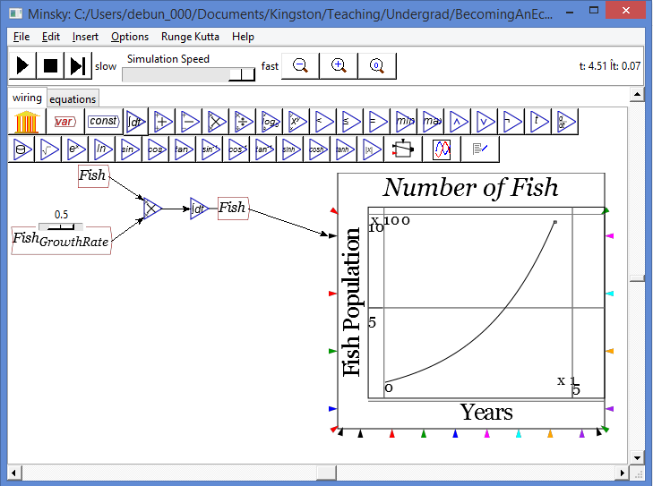
Post Keynesians: Realism, Uncertainty, Money
How many fish would there be if there were no sharks?
  Simplest situation: fish population would grow constantly:
    “Number of Fish grows by (for example) 50% each year”
    As an equation this becomes “Growth in the number of fish each year is 0.5 times the number of fish alive now”
    This results in “exponential population growth”:

Slide 41
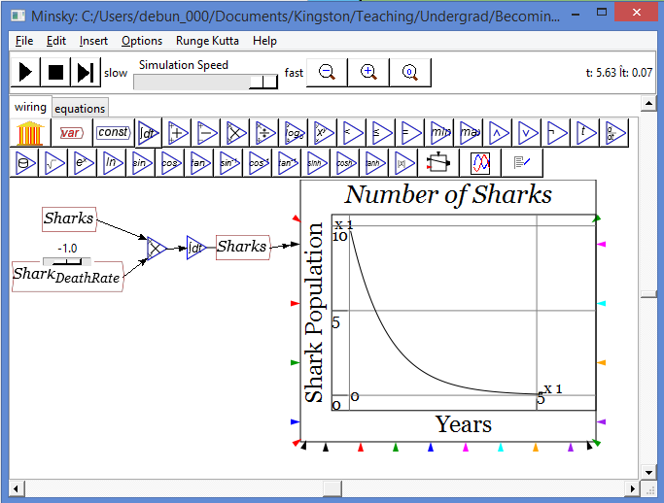
Post Keynesians: Realism, Uncertainty, Money
How many sharks would there be if there were no fish?
  Simplest situation: shark population would fall constantly:
    “Number of Sharks falls by (for example) 100% each year”
    As an equation this becomes “Growth in the number of sharks each year is minus 1 times the number of sharks alive now”
    This results in “exponential population decay”:

Slide 42
Post Keynesians: Realism, Uncertainty, Money
How many fish are there when there are sharks as well?
  Simplest situation: fish population would grow at the rate without sharks, minus some number times how many sharks there are:
    “Number of Fish grow by 50% each year, minus 0.07 times how many sharks there are”
    As an equation this becomes “Growth in the number of fish each year is 0.5 times the number of fish alive now, minus 0.07 times the number of sharks times the number of fish”
How many sharks when there are fish as well?
  Simplest situation: shark population would fall at the rate without fish, plus some number times how many fish there are:
    “Number of Sharks falls by (for example) 100% each year”, plus 0.007 times how many fish there are”
    As an equation this becomes “Growth in the number of sharks each year is minus 1 times the number of sharks alive now, plus 0.003 times the number of fish times the number of sharks”

Slide 43
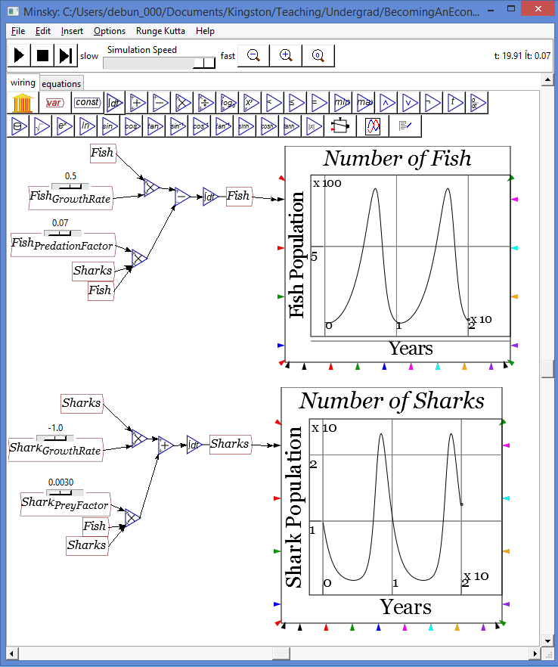
Post Keynesians: Realism, Uncertainty, Money
Does the system reach an equilibrium number of fish & sharks?...
Nope: cycles continue indefinitely
That’s biology…
Could there be anything like this in economics?
A simple Post Keynesian economic model (Richard Goodwin 1967)…

Slide 44
Post Keynesians: Realism, Uncertainty, Money
Output depends (roughly speaking) on how many factories you have
Number of factories (“Capital”) determines Employment
Employment determines rate of change of Wage Rate (“Phillips Curve”)
Output minus Wages (Wage times Employment) determines Profit
Profit determines investment
Investment is the rate of change of Capital
What happens when we put this in the simplest possible model?
  Physical Output is Capital divided by a constant (say 3)
  Employment is Output divided by a constant (say 1)
  Change in the Wage Rate depends on the Employment Rate
  Total Wages equal Employment times the Wage Rate
  Output minus Total Wages is Profit
  All Profit becomes Investment
  Investment is the rate of change of Capital

Slide 45
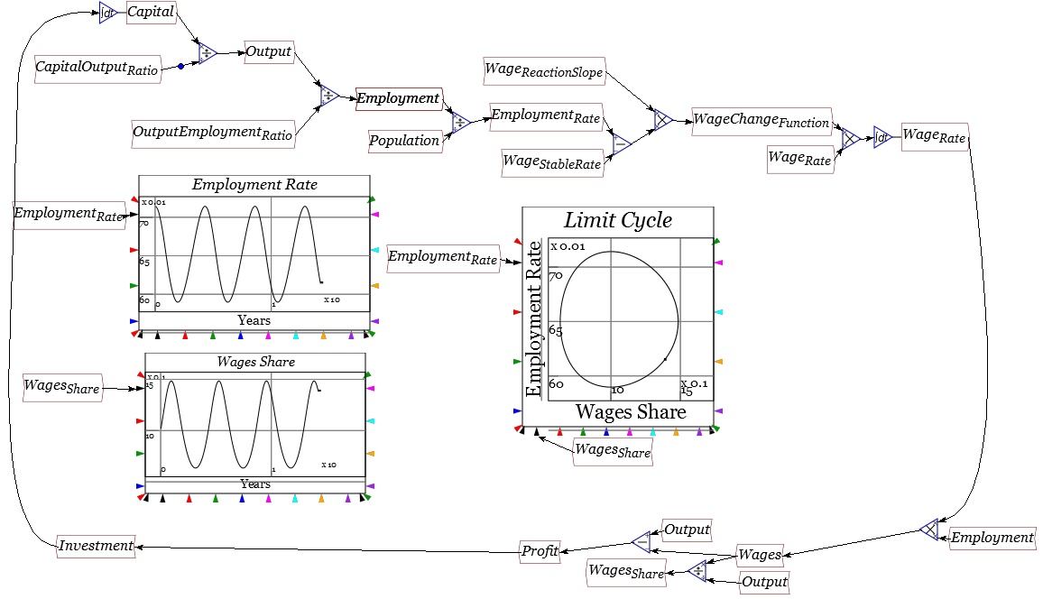
Post Keynesians: Realism, Uncertainty, Money
Does the system reach an equilibrium level of wages & employment?
Nope: cycles continue indefinitely
Economy can generate sustained cycles, rather than “reaching equilibrium”
Post Keynesians build both equilibrium & non-equilibrium models
Keynes, Fisher, Schumpeter major inspirations for Post Keynesians
Major issues for Post Keynesians: Endogenous Money (Basil Moore)
  Stock-Flow Consistent Modeling (Wynne Godley)
  Financial Instability (Hyman Minsky)

Slide 46
Post Keynesians: Realism, Uncertainty, Money
Neoclassicals ignored banks, debt & money before the 2008 crisis
Starting to incorporate them now as source of “frictions”
Post Keynesians (like Austrians) assert money essential
Unlike Austrians, consider links between banks, money and debt
Essential assertion
  Banks create money by making loans
  Makes fundamental difference to macroeconomics
Rejected by mainstream (even after the crisis), which asserts
  Banks just “intermediaries” between savers and borrowers
  Most of the time, nothing lost by ignoring them…

Slide 47
Post Keynesians: Realism, Uncertainty, Money
In the words of prominent mainstreamer Paul Krugman
  “Reading the comments on my Steve Keen post, I had an insight: banking is where left and right meet.
  Both the Austrians who believe that whatever the market does is right, unless it's fractional reserve banking, which is somehow terrible
  and the self-proclaimed true Minskyites view banks as institutions that are somehow outside the rules that apply to the rest of the economy, as having unique powers for good and/or evil…
  As I (and I think many other economists) see it, banks are a clever but somewhat dangerous form of financial intermediary…
  Banks don't create demand out of thin air any more than anyone does by choosing to spend more; and banks are just one channel linking lenders to borrowers.
  I know I'll get the usual barrage of claims that I don't understand banking; actually, I think I do, and it's the mystics who have it wrong.”

Slide 48
Post Keynesians: Realism, Uncertainty, Money
The Bank of England has come out on the side of Post Keynesians:
  “Unlike currency, which is created by the Bank of England, bank deposits are mostly created by commercial banks themselves.
  Although the stock of bank deposits increases whenever someone pays banknotes into their account, the amount of bank deposits is also reduced any time anyone makes a withdrawal.
  Moreover, as Chart 1 shows, the amount of currency is very small compared to the amount of bank deposits.
  Far more important for the creation of bank deposits is the act of making new loans by banks.
  When a bank makes a loan to one of its customers it simply credits the customer’s account with a higher deposit balance.
  At that instant, new money is created.”
Does it matter?

Slide 49
Post Keynesians: Realism, Uncertainty, Money
Modeling “Banks as Intermediaries”—Mainstream Neoclassical vision
  A simple banking model in Minsky Open Source modelling program
  Households lend to Firms
  Households earn Wages and Interest
  Households consume
  Firms repay debt
Showing this in an accounting double-entry bookkeeping table:
 | Assets | Liabilities |  | Equity
 | Reserves | Firms | Households | Bank
Lend money |  | To | From
Repay Debt |  | From | To
Pay Interest |  | From | To
Pay Wages |  | From | To
Consume |  | To | From
Consume |  | To |  | From

Slide 50
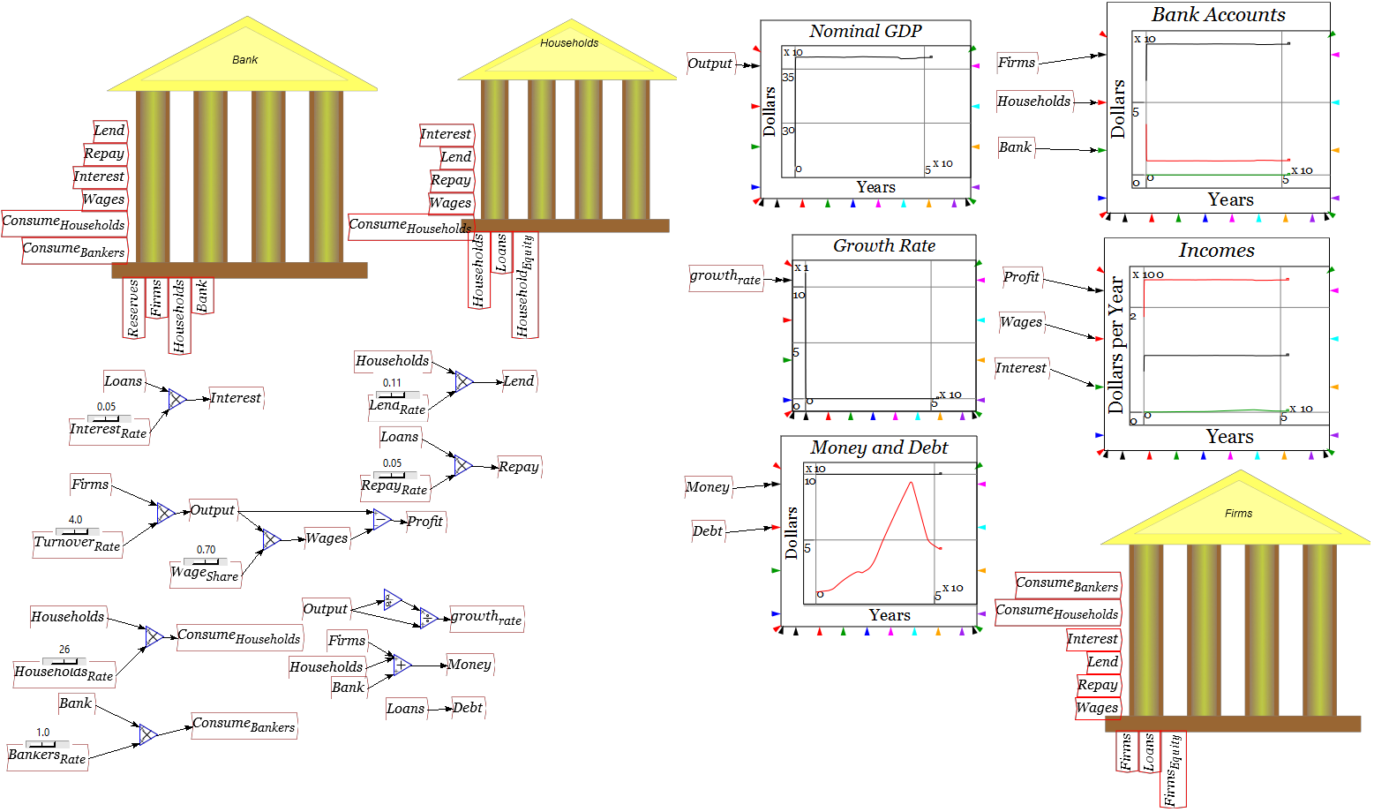
Post Keynesians: Realism, Uncertainty, Money
In a Minsky model

Slide 51
Post Keynesians: Realism, Uncertainty, Money
But what if we model that Banks lend?
 | Assets |  | Liabilities |  | Equity
 | Reserves | Loans | Firms | Households | Bank
Lend money |  | From | To
Repay Debt |  | To | From
Pay Interest |  |  | From |  | To
Pay Wages |  |  | From | To
Consume |  |  | To | From
Consume |  |  | To |  | From
Just a few changes—does it matter?

Slide 52
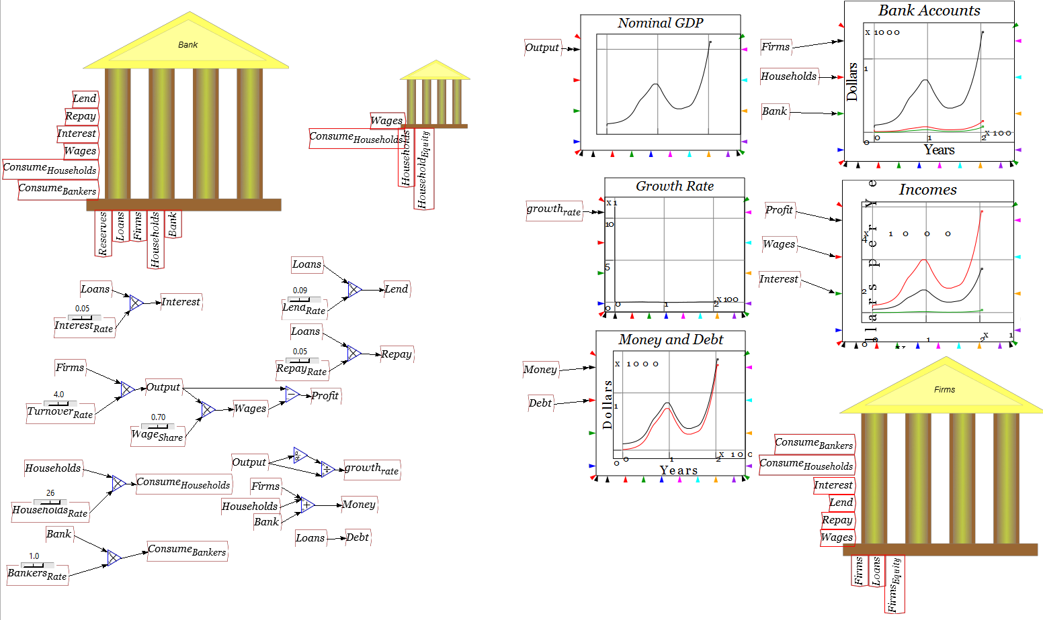
Post Keynesians: Realism, Uncertainty, Money
Dramatic difference: Lending creates money, demand & income…

Slide 53
Post Keynesians: Realism, Uncertainty, Money
Stock-Flow Consistent Modeling
  Economy is fundamentally monetary
  All flows “start somewhere and end up somewhere”
  Keep track of existing flows (money and goods)
    Basic accounting: Flow of £X from Sector A to Sector B means
      Surplus of positive £X for Sector B and
      Deficit of negative £X for Sector A
  Account for changing stocks as well
    Constant flow of new debt means rising stock of debt
  Can therefore estimate what sustained current trends imply
    E.g., if current growth depends on household debt rising 2% faster than GDP, can this be sustained?
  Make predictions based on sustainability of current trends
Used by Wynne Godley to predict that crisis was inevitable from 1998
Versus Neoclassical claims (a) that crises would never occur again
(b) That when this one did, it was a “Black Swan”…

Slide 54

Post Keynesians: Realism, Uncertainty, Money

Slide 55
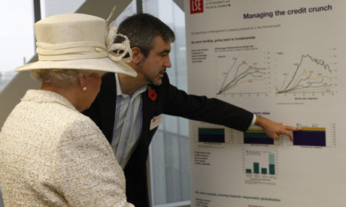

“Nobody could have seen it coming…”
“The Queen asked me: ‘If these things were so large, how come everyone missed them? Why did nobody notice it?’.”
  When Garicano explained that at “every stage, someone was relying on somebody else and everyone thought they were doing the right thing”, she commented: “Awful.”
Two Post-Keynesian approaches
  Stock-Flow Consistent Modeling
  Financial Instability Hypothesis

Slide 56
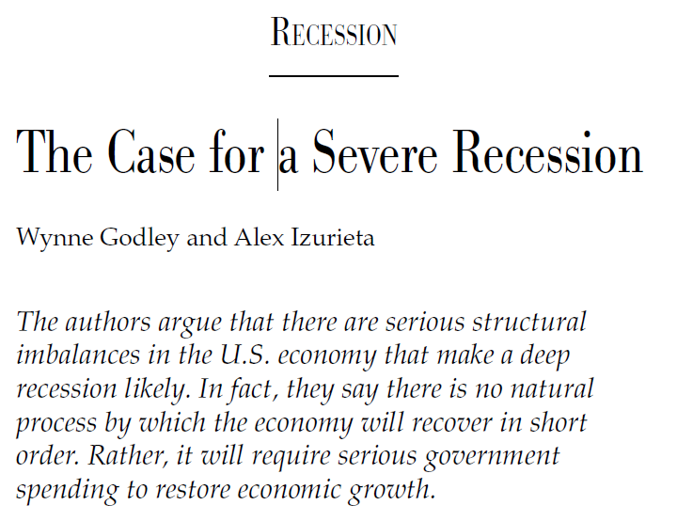
Post Keynesians: Realism, Uncertainty, Money
Godley in Challenge, March 2002:

Slide 57
Post Keynesians: Realism, Uncertainty, Money
The “Sectoral Balances” Approach
  Divide economy into sectors
  Flow out of Sector A into Sector B
    Sector’s A’s Deficit is Sector B’s Surplus
  Flows (e.g., new mortgages) add to stocks (e.g., household debt to banks)
  If flow implies unsustainable trend
    E.g., household debt rising faster than income every year
  And current growth rate depends on this trend
    Houshold borrowing financing goods purchases, imports
  Then you can predict that the trend must reverse at some point
    Households stop borrowing, start repaying debt, go bankrupt
  So economic growth must end as well
Basis of Godley’s predictions from 1998

Slide 58
Post Keynesians: Realism, Uncertainty, Money
Godley reasoned that private sector debt growth could not continue
  When it stopped, economy would have a serious recession
  Government would be forced into larger deficits
  Trade deficit would fall because of lower import demand…

Slide 59
Post Keynesians: Realism, Uncertainty, Money
A simple way to visualise sectoral balances…
  Draw a rectangle & divide it into 3 bits
    Private; Government; External
      Any flow out of one sector is identically equal to the flow into another sector
Private
Government
External

Slide 60
Post Keynesians: Realism, Uncertainty, Money
Now consider “Fiscal Compact” objective of a Government surplus
Most government revenue comes from private sector
Most government spending is on private sector
What does a government surplus imply for private sector?
  If government surplus = “+NetGov”, private deficit is “-NetGov
Private
Government
Deficit = NetGov
Surplus = NetGov
External

Slide 61
Post Keynesians: Realism, Uncertainty, Money
So government “saving” means reduction in money in private sector
If private sector wants to keep its money constant, where can it get it?
  (a) Borrow from Banks; or
  (b) Gain from net exports (ignoring foreign borrowing for now)
A UK trade surplus is not going to happen
So private sector must borrow from banks
So sustained government surplus means private non-bank sector must borrow from banks to keep money supply constant
Sustained government surplus means rising private sector debt
Godley used this to predict that a crisis was inevitable…
Private Banks
Government
Deficit = NetBank
Surplus = NetBank
Private Non-Banks
Deficit = NetGov
Surplus = NetGov
0= NetGov + NetBank
External

Slide 62
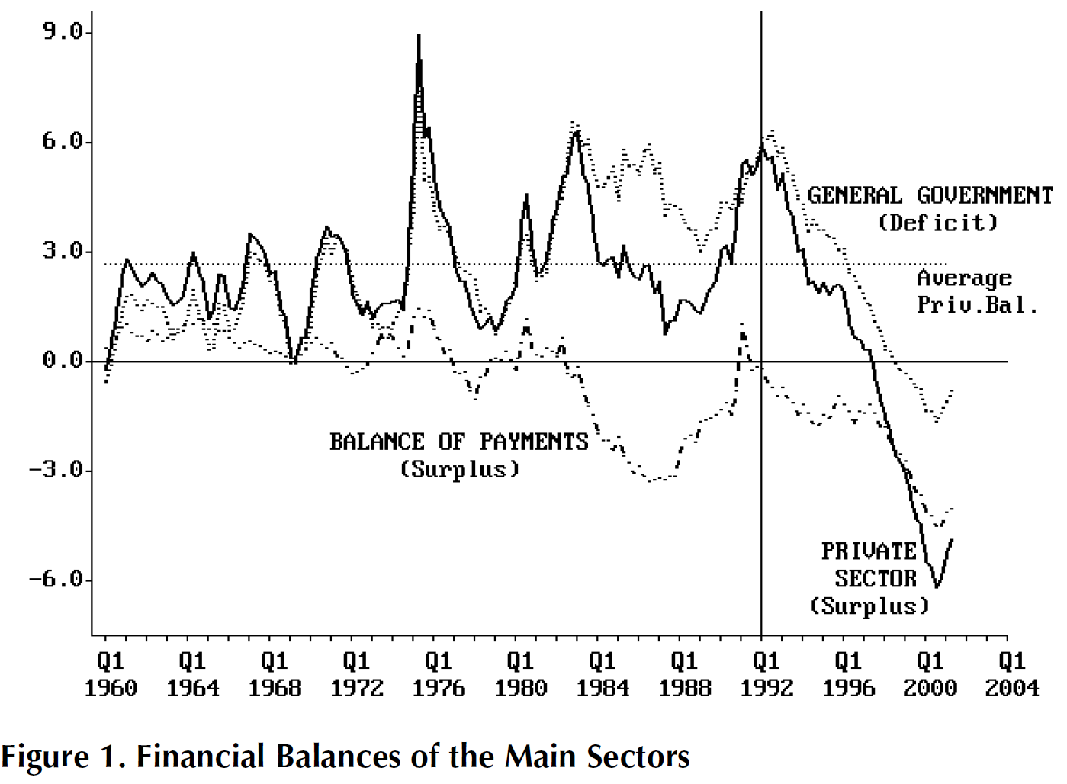
Post Keynesians: Realism, Uncertainty, Money
Early 2000 growth relied on massive increase in private sector debt
Could not be sustained; crisis when private debt growth stopped…

Slide 63
Post Keynesians: Realism, Uncertainty, Money
  Long before the 2008 crisis, Hyman Minsky posed question that defines Post Keynesian economics:
  “Can “It”—a Great Depression—happen again?
  And if “It” can happen,
    why didn't “It” occur in the years since World War II?
  These are questions that naturally follow from both the historical record and the comparative success of the past thirty-five years.
  To answer these questions it is necessary to have an economic theory which makes great depressions one of the possible states in which our type of capitalist economy can find itself.” (Minsky 1982, p. xii)

Slide 64
Financial Instability Hypothesis
Minsky’s vision:
  “One polar view in the stability of capitalism is … that serious depressions are due to man-made imperfections in the financial system…
  “The alternative polar view, which I call unreconstructed Keynesian, is that capitalism is inherently flawed, being prone to booms, crises and depressions.
  This instability, in my view, is due to characteristics the financial system must posses if it is to be consistent with full-blown capitalism.
  Such a financial system will be capable of both generating signals that induce an accelerating desire to invest and of financing that accelerating investment.” (1969: 224)
Minsky blended Keynes & Fisher to produce the “Financial Instability Hypothesis”…

Slide 65
Financial Instability Hypothesis
Economy in historical time
Debt-induced recession in recent past
Firms and banks conservative re debt/equity ratios, asset valuation
Only conservative projects are funded
Recovery means conservative projects succeed
Firms and banks revise risk premiums
  Accepted debt/equity ratio rises
  Assets revalued upwards
Self-fulfilling expectations
  Decline in risk aversion causes increase in investment
    Investment expansion causes economy to grow faster
  Asset prices rise, making speculation on assets profitable
  Increased willingness to lend increases money supply (endogenous money)
  Riskier investments enabled, asset speculation rises

Slide 66
The Euphoric Economy
The emergence of “Ponzi” financiers
  Cash flow from “investments” always less than debt servicing costs
  Profits made by selling assets on a rising market
  Desperate demand for debt since fundamentally insolvent
    Must borrow to service existing debt before asset sales
  Interest-rate insensitive demand for finance
Initial profitability of asset speculation
  drives up supply of and demand for finance
  market interest rates rise
But eventually:
  Ponzis necessarily losing money
    Debts accumulate, while shares in Ponzi firms purchased widely
  Many “euphoric expectations” investments fail
  Rising rates make once conservative projects speculative
  Non-Ponzi investors attempt to sell assets to service debts
  Entry of new sellers floods asset markets
  Rising trend of asset prices falters or reverses

Slide 67
The Assets Boom and Bust
Initial profitability of asset speculation:
  reduces debt and interest rate sensitivity
  drives up supply of and demand for finance
  market interest rates rise
But eventually:
  Ponzis necessarily losing money—debts accumulate, while shares in Ponzi firms purchased widely
  Many “euphoric expectations” investments fail
  Rising rates make once conservative projects speculative
  Non-Ponzi investors attempt to sell assets to service debts
  Entry of new sellers floods asset markets
  Rising trend of asset prices falters or reverses

Slide 68
Crisis and Aftermath
Ponzi financiers go bankrupt:
  can no longer sell assets for a profit
  debt servicing on assets far exceeds cash flows
Asset prices collapse, drastically increasing debt/equity ratios
Endogenous expansion of money supply reverses
Investment evaporates; economic growth slows or reverses
Economy enters a debt-induced recession ...
High Inflation?: Debts repaid by rising price level
  Economic growth remains low: Stagflation
  Renewal of cycle once debt levels reduced
Low Inflation?: Debts cannot be repaid
  Chain of bankruptcy affects even non-speculative businesses
  Economic activity remains suppressed: a Depression
Big Government?
  Anti-cyclical government spending enables debts to be repaid
  Renewal of cycle once debt levels reduced
Minsky ignored by mainstream … Until “The Monster Crash”…

Slide 69
Post Keynesians: Realism, Uncertainty, Money
Fisher & Minsky focus on private debt—ignored by Mainstream (& Austrians) as potential explanation for Great Depression
Debt Ratio rose in early 1930s even though level of debt actually fell
Rising Ratio
“Roosevelt Recession”
Falling Level

Slide 70
Post Keynesians: Realism, Uncertainty, Money
Can dynamics of debt explain 1920s and the Great Depression?

Slide 71
Post Keynesians: Realism, Uncertainty, Money
Can dynamics of debt explain 1920s and the Great Depression?

Slide 72
Post Keynesians: Realism, Uncertainty, Money
Crisis preceded by apparent improving economy: “Great Moderation”
Ex-Federal Reserve Chairman Ben Bernanke—like most mainstream economists—saw this as a great thing. Speaking in 2004:
  “the low-inflation era of the past two decades has seen not only significant improvements in economic growth and productivity
  but also a marked reduction in economic volatility, both in the United States and abroad, a phenomenon that has been dubbed “the Great Moderation”.
  Recessions have become less frequent and milder, and quarter-to-quarter volatility in output and employment has declined significantly as well.
  The sources of the Great Moderation remain somewhat controversial, but as I have argued elsewhere, there is evidence for the view that improved control of inflation has contributed in important measure to this welcome change in the economy.”
Then it “without warning” gave way to the “Great Recession”

Slide 73
Post Keynesians: Realism, Uncertainty, Money
Can dynamics of debt explain “Great Moderation” & “Great Recession”?

Slide 74
Post Keynesians: Realism, Uncertainty, Money
Can dynamics of debt explain “Great Moderation” & “Great Recession”?

Slide 75
Post Keynesians: Realism, Uncertainty, Money
Can dynamics of debt explain “Great Moderation” & “Great Recession”?

Slide 76
Post Keynesians: Realism, Uncertainty, Money
My model of Minsky (1992/5)
“From the perspective of economic theory and policy, this vision of a capitalist economy with finance requires us to go beyond that habit of mind which Keynes described so well,
The excessive reliance on the (stable) recent past as a guide to the future.
The chaotic dynamics explored in this paper should warn us against accepting a period of relative tranquility in a capitalist economy as anything other than a lull before the storm.” (Keen 1995)

Slide 77
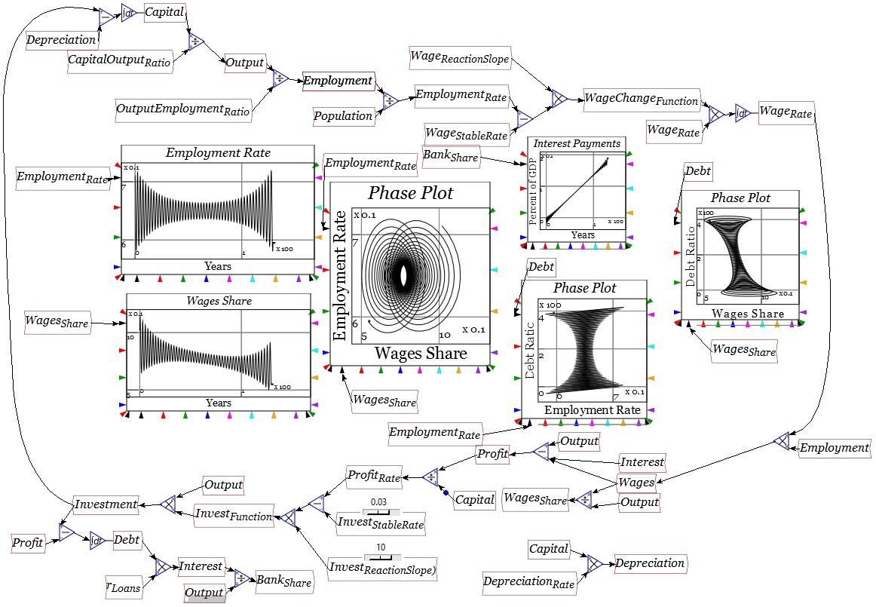
Post Keynesians: Realism, Uncertainty, Money
Modeling this: add two factors to earlier Goodwin model
  Capitalists invest more during booms, less during slumps
  Borrow money when desired investment exceeds profits

Slide 78
Post Keynesians: Realism, Uncertainty, Money
Post Keynesian school more realistic than Neoclassical or Austrian
But all schools omit important issues
Next week—the thing all major approaches to economics do badly
  Incorporate the environment into economics
    Or should that be incorporate economics into the environment?

