Slide 1

Why Economists Disagree: The Austrians
Professor Steve Keen
Head of Economics, History & Politics
Kingston University London
IDEAeconomics
Minsky Open Source System Dynamics
www.debtdeflation.com/blogs

Slide 2
Recap/Coming Up
Recap
  Last week: The Mainstream
    Utilitarian theory of value—break with Classical “effort” theory
    Equilibrium-oriented, mathematical models
      Persisted with equilibrium despite proof of instability
This week: The Austrians
  Key question: “How does innovation & change occur in capitalism?”
  Many common features with Neoclassicals
  But like most other alternative schools in economics, evolved because of perceived weaknesses in the mainstream approach
    Emphasis on incomplete knowledge rather than “certainty”
    See the market as best way to process limited information
    Reject mathematical approach due to complexity of economy
    Regard disequilibrium as essential feature of capitalism
    Focus on explaining cycles rather than equilibrium
    See money as playing an essential role in a capitalist economy
    Believe government shouldn’t try to manage economy …

Slide 3
Criticism of equilibrium analysis
Key difference with Neoclassicals: treatment of knowledge
Neoclassicals make absurd assumptions about knowledge to preserve their equilibrium approach:
  Nobel Prize winner Gerard Debreu’s frankly insane assumptions about knowledge producers (Debreu 1959):
    “For a producer … a production plan (made now for the whole future) is a specification of the quantities of all his inputs and all his outputs. The certainty assumption implies that he knows now what input-output combinations will be possible in the future (although he may not know the details of technical processes which will make them possible)…
    The analysis is extended in this chapter to the case where uncertain events determine … the economy…
    This new definition of a commodity allows one to obtain a theory of uncertainty … formally identical with the theory of certainty developed in the preceding chapters.”

Slide 4
Criticism of equilibrium analysis
Hayek on the other hand (Hayek 1963):
  “We know the general character of the self-regulating forces of the economy and the general conditions in which these forces will function or not function,
  but we do not know all the particular circumstances to which they bring about an adaptation.
  This is impossible because of the general interdependence of all parts of the economic process…
  The chief task of economic policy would thus appear to be the creation of a framework in which the individual not only can freely decide for himself what he wants to do, but in which also this decision is based on his particular knowledge which will contribute as much as possible to aggregate output.”
  “The fact that much more knowledge contributes to form the order of a market economy than can be known to any one mind … is the decisive reason why a market economy is more effective than any known type of economic order”.

Slide 5
Criticism of equilibrium analysis
Hayek argued that Neoclassical concept of equilibrium required knowledge of the future that was impossible for actual people to have:
    “the concept of equilibrium itself can be made definite and clear only in terms of assumptions concerning foresight…”
His logic: we can easily define an individual as being “in equilibrium”—for example, when consumption is “in equilibrium” given a consumer’s budget and tastes
But equilibrium in a market or whole economy means everyone’s plans are consistent with everyone else’s
  Since our plans involve not just plans for now but plans for the future, only way to achieve “equilibrium” is if all plans are consistent
  That’s only possible if everyone’s expectations about the future are (a) the same and (b) correct!
    “we are really passing into a different sphere and silently introducing a new element of altogether different character when we apply it to the explanation of the interactions of a number of different individuals.” (Hayek 1937)

Slide 6
Criticism of equilibrium analysis
Prescient about timeless nature of equilibrium as used by Neoclassicals:
  “since equilibrium is a relationship between actions, and since the actions of one person must necessarily take place successively in time, it is obvious that the passage of time is essential to give the concept of equilibrium any meaning.
  This deserves mention since many economists appear to have been unable to find a place for time in equilibrium analysis and consequently have suggested that equilibrium must be conceived as timeless.
  This seems to me to be a meaningless statement.” (Hayek 1937)
Since equilibrium must be “in time” rather than “timeless”, for it to apply people’s expectations of the future must be both shared and correct:
  “It appears that the concept of equilibrium merely means that the foresight of the different members of the society is in a special sense correct.” (Hayek 1937)

Slide 7
Criticism of equilibrium analysis
“It must be correct in the sense that every person’s plan is based on the expectation of just those actions of other people which those other people intend to perform,
and that all these plans are based on the expectation of the same set of external facts, so that under certain conditions nobody will have any reason to change his plans.” (Hayek 1937)
So equilibrium at the level of a market or economy requires that people somehow form shared and correct expectations about the future:
  “The statement that, if people know everything, they are in equilibrium is true simply because that is how we define equilibrium.
  The assumption of a perfect market in this sense is just another way of saying that equilibrium exists, but does not get us any nearer an explanation of when and how such a state will come about.
  It is clear that if we want to make the assertion that under certain conditions people will approach that state we must explain by what process they will acquire the necessary knowledge.”

Slide 8
Criticism of equilibrium analysis
“In the usual presentations of equilibrium analysis it is generally made to appear as if these questions of how the equilibrium comes about were solved. But …
The device generally adopted for this purpose is the assumption of a perfect market where every event becomes known instantaneously to every member…
the perfect market which is required to satisfy the assumptions of equilibrium analysis must not be confined to the markets of all the individual commodities;
  the whole economic system must be assumed to be one perfect market in which everybody knows everything.
The assumption of a perfect market then means nothing less than that all the members of the community … are at least supposed to know automatically all that is relevant for their decisions.
It seems that that skeleton in our cupboard, the 'economic man‘ … has returned … in the form of a quasi-omniscient individual.”

Slide 9
Criticism of equilibrium analysis
Decades after Hayek made these points, Neoclassical economists developed the concept of “rational expectations”
  Their explanation of how people acquire accurate foresight?
    “I should like to suggest that expectations, since they are informed predictions of future events, are essentially the same as the predictions of the relevant economic theory.” (Muth 1961)
    “Information is scarce, and the economic system generally does not waste it.” (Muth 1961)
      Internally inconsistent argument for Neoclassical economics:
        If information is scarce, then it will be costly
        If costly, a “rational person” will pay for it until its marginal benefit (to him/her) equals its marginal cost
        So a rational person will not use all information
        So his/her expectations will not be correct!
(Similar critiques of Neoclassical concepts of equilibrium & foresight made by other schools of thought too—especially Post Keynesians)

Slide 10
Markets as processors of incomplete information
Austrians see market succeed not because people have “rational expectations”, but because the market processes the limited knowledge of millions of people:
  “The problem which we pretend solve is how the spontaneous interaction of a number of people, each possessing only bits of knowledge, brings about a state of affairs in which prices correspond to costs, etc.,
  and which could be brought about by deliberate direction only by somebody who possessed the combined knowledge of all those individuals.
  And experience shows us that something of this sort does happen, since the empirical observation that prices do tend to correspond to costs was the beginning of our science.
  But in our analysis, instead of showing what bits of information the different persons must possess in order to bring about that result,
  we fall in effect back on the assumption that everybody knows everything and so evade any real solution of the problem…”

Slide 11
Markets as processors of incomplete information
But despite criticisms of Neoclassical approach, Austrians still believe the market system gets near to equilibrium as they define it:
  “economics has come nearer than any other social science to an answer to that central question of all social sciences, how the combination of fragments of knowledge existing in different minds can bring about results which, if they were to be brought about deliberately, would require a knowledge on the part of the directing mind which no single person can possess…
  the spontaneous actions of individuals will under conditions which we can define bring about a distribution of resources which can be understood as if it were made according to a single plan, although nobody has planned it…”
    Is this realistic?
    How do we know that “prices do tend to correspond to costs”?
But still a realistic critique of Neoclassical concept of knowledge…
Austrians also critique the Neoclassical model of competition…

Slide 12
Criticism of concept of competition
The Neoclassical model of “perfect competition presupposes:
  A homogeneous commodity offered and demanded by a large number of relatively small sellers or buyers, none of whom expects to exercise by his action a perceptible influence on price.
  Free entry into the market and absence of other restraints on the movement of prices and resources.
  Complete knowledge of the relevant factors on the part of all participants in the market…
  The peculiar nature of the assumptions from which the theory of competitive equilibrium starts stands out very clearly if we ask which of the activities that are commonly designated by the verb “to compete” would still be possible if those conditions were all satisfied.” (Hayek 1946)
    Are Apple & Samsung phones “homogeneous”?
    How about cars? Ford and Ferrari? Toyota and Tesla?
    Do Ford and Ferrari compete on price?
Non-homogeneity & non-price competition the rule, not the exception

Slide 13
Criticism of concept of competition
Instead an evolutionary concept of competition
  “The real problem in all this is not whether we will get given commodities or services at given marginal costs
  but mainly by what commodities and services the needs of the people can be most cheaply satisfied.
  The solution of the economic problem of society is in this respect always a voyage of exploration into the unknown,
  an attempt to discover new ways of doing things better than they have been done before.
  This must always remain so as long as there are any economic problems to be solved at all, because all economic problems are created by unforeseen changes which require adaptation.”
Markets thus a place where differentiated products compete, largely by adaptive development of products over time—a co-evolution of products and consumer tastes.

Slide 14
Complexity & partial rejection of mathematics
Austrians regarded as anti-mathematical—in contrast to math-obsessed Neoclassicals
But Hayek notes his opposition is not to maths per se, but inappropriate mathematics:
  “allow me to define more specifically the inherent limitations of our numerical knowledge which are so often overlooked. I want to do this to avoid giving the impression that I generally reject the mathematical method in economics…
  the great advantage of the mathematical technique that it allows us to describe, by means of algebraic equations, the general character of a pattern even where we are ignorant of the numerical values which will determine its particular manifestation.
  We could scarcely have achieved that comprehensive picture of the mutual interdependencies of the different events in a market without this algebraic technique.”
Sees main problem of applying mathematics to economics is that the economy is a complex system…

Slide 15
Complexity & partial rejection of mathematics
“The reason for this state of affairs is the fact … that the social sciences, like much of biology but unlike most fields of the physical sciences, have to deal with structures of essential complexity, i.e., with structures whose characteristic properties can be exhibited only by models made up of relatively large numbers of variables…”
““phenomena of organized complexity” with which we have to deal in the social sciences…means that …
it depends not only on the properties of the individual elements of which they are composed…
but also on the manner in which the individual elements are connected with each other.” (Hayek, 1974: Nobel Prize Lecture “The Pretense of Knowledge”)
I.e, Hayek argues that the complexity of economic phenomena makes mathematical methods inappropriate in economics
  Here Hayek was both right and wrong…

Slide 16
Complexity & partial rejection of mathematics
Right: The economy is a complex system
Right: Complexity is the product of “the manner in which the individual elements are connected with each other”
Wrong: Complexity not confined just to social sciences but abounds in physical sciences too—such as meteorology
Wrong: Complexity does not result from “structures whose characteristic properties can be exhibited only by models made up of relatively large numbers of variables”
  Instead “simple rules, complex behaviour”
    Complex dynamics result from interactions of relatively few variables in a non-equilibrium setting
    First discovered in meteorology by Edward Lorenz in 1963
    Mathematical meteorology used to use “linear” models to predict the weather
    Like models used by Neoclassical economists that Hayek was criticising…

Slide 17
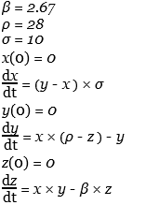
Complexity & partial rejection of mathematics
Lorenz argued that real dynamics of weather were driven by same factor Hayek identified in economics: that system’s behaviour depends
  “not only on the properties of the individual elements of which they are composed…
  but also on the manner in which the individual elements are connected with each other…”
Built very simple model with just 3 variables (x, y & z) and 3 constants (σ, β, ρ)
Unexpectedly, simple model displayed complicated dynamics out of equilibrium
Contradicted Hayek’s expectation that to get complicated behaviour, you would need a complicated model:
  “social sciences … have to deal with structures of essential complexity, i.e., with structures whose characteristic properties can be exhibited only by models made up of relatively large numbers of variables…”

Slide 18
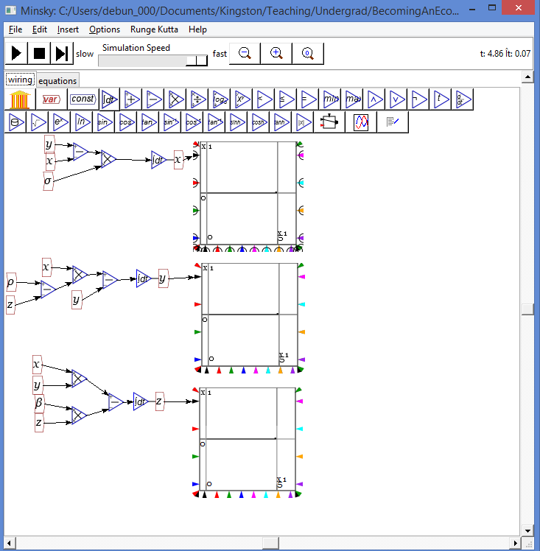
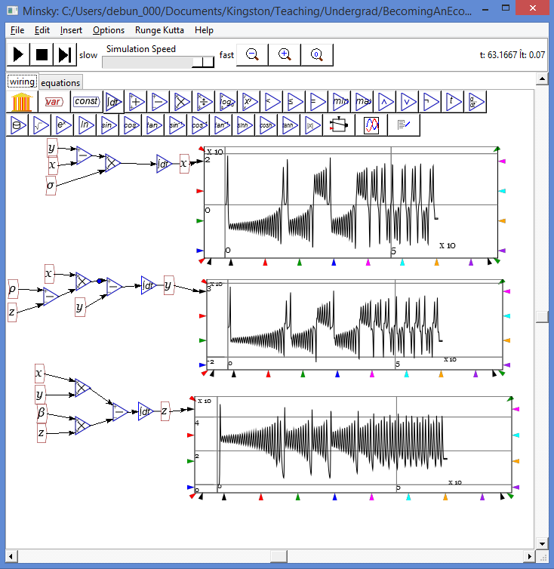
Complexity & partial rejection of mathematics
The Lorenz model in equilibrium is boring…
Out of equilibrium… complex behaviour from a simple model…
So complexity arises from interactions—as Hayek argued
But doesn’t require complicated model—as he thought it would

Slide 19
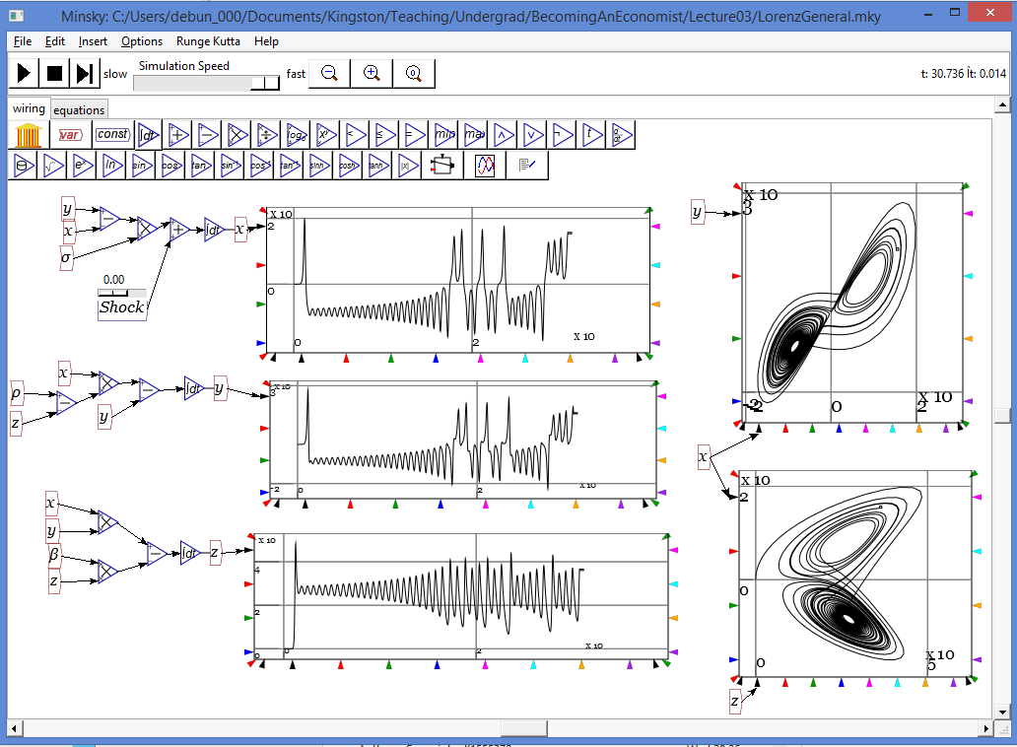
Complexity & partial rejection of mathematics
Simple model, complex behaviour…
Hayek’s followers continue to reject mathematical models
Maybe Hayek would have embraced them had he known about complex system dynamics…

Slide 20
Disequilibrium & the Entrepreneur
Hayek & Austrians in general believed that in the absence of innovation
  That the market would tend to equilibrium
  And that equilibrium would be stable
    Both of which we know are false
However they believed equilibrium would be disturbed by innovation
And this was the major strength of capitalism over other social systems
Best exponent of this was not Hayek but Joseph Schumpeter
  Also Austrian by birth
  Father of “Evolutionary Economics”
  Many similarities with his analysis & Hayek’s
  But rejected as by many Austrian Economists because
    Not as anti-government as they are
    Not as pro-capitalist as they are
    Wrote book arguing Capitalism would give way to Socialism
  Ideology aside, his methodology fits with Hayek on disequilibrium & the role of the entrepreneur…

Slide 21
Disequilibrium & the Entrepreneur
Schumpeter accepted neoclassical “general equilibrium” as accurate model of unchanging economy
  Defines profit as surplus of receipts over cost
  In equilibrium, receipts exactly equal cost in all industries
    All products sold at marginal cost (assuming rising MC)
    Wages equal marginal product of labour
    Return to capital equals marginal product of capital
      But “capital” (machinery) itself an assembly of products
        All paid for at marginal cost
  Hence profit zero:
    “To this extent, therefore, production must flow on essentially profitless.” (31)
    But profit the driving motive of production in capitalist economy!
      Yes, but not in equilibrium (argues Schumpeter)

Slide 22
Disequilibrium & the Entrepreneur
In Schumpeter’s vision, profit arises out of change
Conventional (neoclassical) economic model describes system in static equilibrium
  Describes state of rest given one set of data
  Ignores process of change to new state of rest after change
  Schumpeter argues profit arises in the process of change from one state of rest to another
  Hence conventional economics unable to understand profit
    Also unable to understand pricing or strategy
  Need model of discontinuous change that disturbs equilibrium
As he put it…

Slide 23
Disequilibrium & the Entrepreneur
Neoclassical economics “ describes economic life from the standpoint of the economic system's tendency towards an equilibrium position,
which tendency gives us the means of determining prices and quantities of goods, and may be described as an adaptation to data existing at any time…
These tools only fail … where economic life itself changes its own data by fits and starts.
“Static" analysis is not only unable to predict the consequences of discontinuous changes in the traditional way of doing things;
it can neither explain the occurrence of such productive revolutions nor the phenomena which accompany them.
It can only investigate the new equilibrium position after the changes have occurred.” (62-63)

Slide 24
Disequilibrium & the Entrepreneur
Schumpeter builds model of economic development that
  Uses neoclassical model as a description of equilibrium
  Adds process of qualitative change
  Explains profit as outcome of one of 5 types of qualitative change caused by entrepreneurial activity
    “(1) The introduction of a new good …
    (2) The introduction of a new method of production…
    (3) The opening of a new market…
    (4) The conquest of a new source of supply of raw materials or half-manufactured goods…
    (5) The carrying out of the new organisation of any industry” (66)
  Explains introduction (& pricing) of new products
    In doing so, overturns many conventional economic beliefs not as false, but as only applying in equilibrium

Slide 25
Disequilibrium & the Entrepreneur
Simplifying assumptions
  All innovation done by new firms
    “it is not essential to the matter - though it may happen - that the new combinations should be carried out by the same people who control the productive or commercial process which is to be displaced by the new.” (66)
  All resources (land, labour, machinery) currently fully employed
    “we must never assume that the carrying out of new combinations takes place by employing means of production which happen to be unused.
    In practical life, this is very often the case... This certainly is … a favorable condition ...
    [But] as a rule the new combinations must draw the necessary means of production from some old combinations …
    we shall assume that they always do so.” (67-68)

Slide 26
Disequilibrium & the Entrepreneur
First stage:
  To innovate, need concept and resources to put it into effect
  But new firm has no retained earnings from which to buy them
  Hence new firm needs credit…
Second Stage:
  “To provide this credit is clearly the function of that category of individuals which we call "capitalists".” (69)
    We would call these “venture capitalists” today
  OR “the creation of purchasing power by banks …
  It is always a question, not of transforming purchasing power which already exists in someone's possession, but of the creation of new purchasing power out of nothing … which is added to the existing circulation.
  And this is the source from which new combinations are often financed…” (73)
    ‘The banker… has himself become the capitalist par excellence…’ (1936: 74)

Slide 27
Disequilibrium & the Entrepreneur
Net creation of new money thus essential step:
  “The banker, therefore, is not so much primarily a middleman in the commodity "purchasing power" as a producer of this commodity.” (74)
    Overturns conventional economic argument about “money illusion”.
    Money plays essential role in profit process (according to Schumpeter)
      Economists instead suffer from “barter illusion” that only applies to existing products
Third stage:
  With credit & purchased resources, innovator combines them to revolutionise production in some way
  Process fundamentally different to “management”…

Slide 28
Disequilibrium & the Entrepreneur
“The carrying out of new combinations we call "enterprise"; the individuals whose function it is to carry them out we call "entrepreneurs."” (74)
  Not the same as managers of firms in static theory:
    “The tendency is for the entrepreneur to make neither profit nor loss in the circular flow
      that is he has no function of a special kind there, he simply does not exist;
    but in his stead, there are heads of firms or business managers of a different type which we had better not designate by the same term…
    the Marshallian definition of the entrepreneur, which simply treats the entrepreneurial function as "management" in the widest meaning, will naturally appeal to most of us.
    We do not accept it, simply because it does not bring out what we consider to be the salient point and the only one which specifically distinguishes entrepreneurial from other activities.” (76-77)
    Entrepreneurial decision-making fundamentally different to neoclassical vision of profit-maximising decision-making…

Slide 29
Disequilibrium & the Entrepreneur
Conventional economic “profit maximisation” emphasises rational calculation
  Thomas & Maurice 2003, Managerial Economics, p. 450 “a manager must answer two questions …
  Produce as long as the market price is greater than … minimum average variable cost …
  Produce the output at which market price (which is marginal revenue) equals marginal cost”
Not possible for entrepreneurial decisions:
  “What has been done already has the sharp-edged reality of all the things which we have seen and experienced; the new is only the figment of our imagination.
  Carrying out a new plan and acting according to a customary one are things as different as making a road and walking along it.” (p.85)

Slide 30
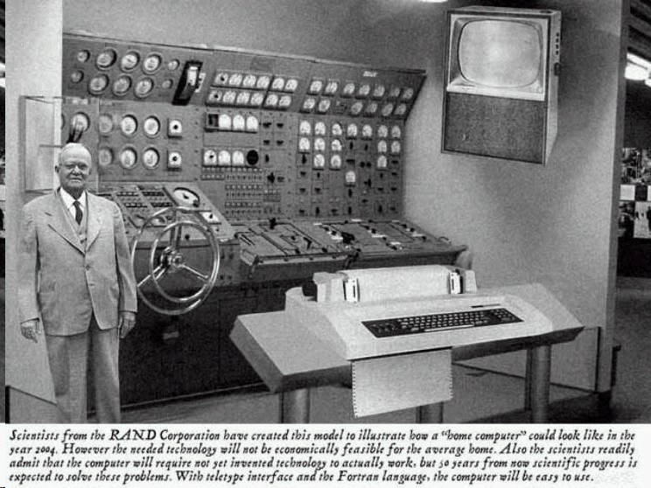
Disequilibrium & the Entrepreneur
Innovations revolutionise production in ways even innovators can’t foresee…
  1954 expert vision of 2004 “home computer”

Slide 31
Disequilibrium & the Entrepreneur
Future impact of new product fundamentally uncertain
“Rational calculation” (e.g., assessing NPV) hardly possible & maybe counterproductive
  “Of course he must still foresee and estimate on the basis of his experience.
  But many things must remain uncertain, still others are only ascertainable within wide limits, some can perhaps only be "guessed." …
  Thorough preparatory work, and special knowledge, breadth of intellectual understanding, talent for logical analysis, may under certain circumstances be sources of failure.” (85)
    Very similar to Keynes’s “animal spirits”
Given 1st 3 stages fulfilled: (1) concept backed by (2) credit, (3) carried to fruition by entrepreneur; we get a cyclical economic process…

Slide 32
Disequilibrium & the Entrepreneur
Cycles considered later in this lecture
Here the pricing/strategy issue
  How can entrepreneur borrow money, produce new commodity/new production method etc., and still make a profit?
Essential “systemic” reason: creation of new credit by loan from bank/[venture] capitalist affects economic system.
Injection of new spending power will, amongst other things, “affect the price level” (74)
Technological innovation gives innovator cost advantage over incumbents…

Slide 33
Disequilibrium & the Entrepreneur
“Entrepreneurial profit is a surplus over costs. From the standpoint of the entrepreneur, it is the difference between receipts and outlay in a business.” (128)
  Schumpeter argues this does not exist in equilibrium in the “circular flow”:
  “in the circular flow the total receipts of a business—abstracting from monopoly—are just big enough to cover outlays.
  In it there are only producers who neither make profits nor suffer losses and whose income is sufficiently characterised by the phrase "wages of management."” (129)
But entrepreneur (if successful!) uses technologies etc. that are superior to those in “circular flow”; “since the new combinations … are necessarily more advantageous than the old, total receipts must in this case be greater than total costs.” (129)

Slide 34
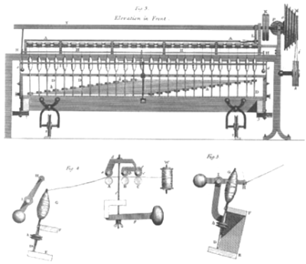
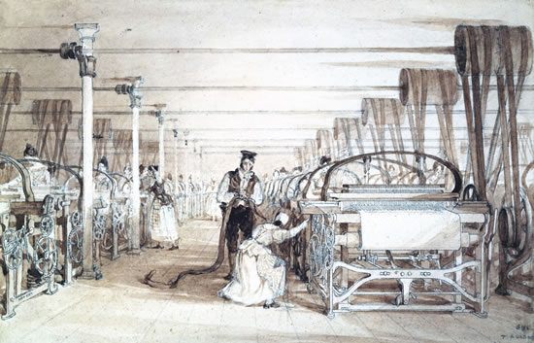
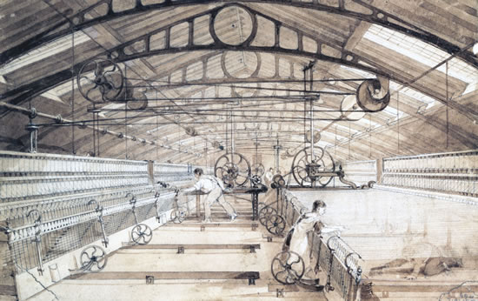
Disequilibrium & the Entrepreneur
Schumpeter’s example: the powerloom
  1st major step in automation of industry: replacing hand weaving with mechanised production of cloth
  Has taken many forms over the years…
    From the original design
And the original sweatshops…

Slide 35
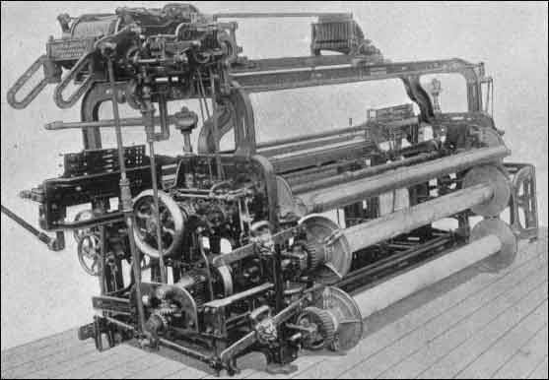
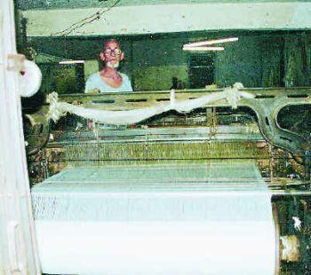
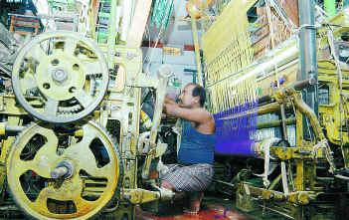
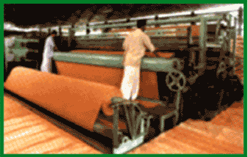
Disequilibrium & the Entrepreneur
To the more advanced
And its sweatshop…
To today’s “high tech”
And …
And what tomorrow: bioengineering? nanotech?

Slide 36
Disequilibrium & the Entrepreneur
“If anyone in … the textile industry … with hand labor
sees the possibility of … powerlooms,...
borrows … from a bank and creates his business...
If a worker … is now in a position to produce six times as much as a hand-worker in a day, … given three conditions the business must yield a surplus over costs
  First, the price of the product must not fall when the new supply appears, or else not fall to such an extent that the greater product per worker brings no greater receipts now …
  Secondly, the costs of the powerloom per day must … remain below the daily wages of the five workers dispensed with …
  The third condition ... If his demand is [not] relatively small … then the prices of … labor and land rise because of the new demand. ... therefore the businessman, … must add an appropriate amount, so that yet a third item must be deducted.
Only if the receipts exceed outlays after allowing for all three sets of changes is there a surplus over costs.” (129-130)

Slide 37

Disequilibrium & the Entrepreneur
Process: Current production requires 6 workers costing $100 per day + machine depreciation $100 per day
$100 p.d.
depreciation
$100
$100
$101
$100
$200 p.d.
depreciation
New machine reduces labour need to one
  But bids wages up $1/day
  $100 rise in depreciation
$100
$100
$100
Extra supplier drives price down (say $1/days output)
Surplus ($398) minus interest payments is entrepreneur’s profit
  Profit falls as more producers adopt new technology…

Slide 38
Disequilibrium & the Entrepreneur
Evolutionary basis to thinking: Economic evolution & hence development is
  “spontaneous and discontinuous change in the channels of the flow, disturbance of equilibrium, which forever alters and displaces the equilibrium state previously existing.” (1936: 64)
Entrepreneur as agent of evolutionary change:
  ‘The carrying out of new combinations we call “enterprise”; the individuals whose function it is to carry them out we call “entrepreneurs”.’ (1936: 74)
Net profit emanates from development
  “he has, if everything has gone according to expectations, enriched the social stream with goods whose total price is greater than the credit received and than the total price of the goods directly and indirectly used up by him...
  Furthermore, the entrepreneur can now repay his debt (amount credited plus interest) at his bank, and normally still retain a credit balance (=entrepreneurial profit) that is withdrawn from the purchasing power of the circular flow.” (110-111)

Slide 39
Disequilibrium & the Entrepreneur
Net credit (credit in excess of asset backing) arises from development:
  “money, and … other means of payment … perform an essential function, …
  processes in terms of means of payment are not merely reflexes of processes in terms of goods… (95)…
  in real life total credit must be greater than it could be if there were only fully covered credit…” (101)
    Contra standard neoclassical “money as veil over barter” conclusion solely because dynamic, disequilibrium analysis vs conventional static equilibrium thinking
Disruption to equilibrium, net entrepreneurial profit, net credit, leading ultimately to a new equilibrium:

Slide 40
Disequilibrium & the Entrepreneur
“But now comes the second part of the drama. The spell is broken and new businesses are continually arising under the impulse of the alluring profit.
A complete reorganisation of the industry occurs, with its increases in production, its competitive struggle, its supercession of obsolete businesses, its possible dismissal of workers, and so forth… the final result must be a new equilibrium position…
Consequently, the surplus of the entrepreneur in question and his immediate followers disappears …
Nevertheless, the surplus is realised … And their profit, the surplus, to which no liability corresponds, is an entrepreneurial profit.” (131-132)
This process occurs in cycles: the Austrian theory of the business cycle
  Back to Hayek…

Slide 41
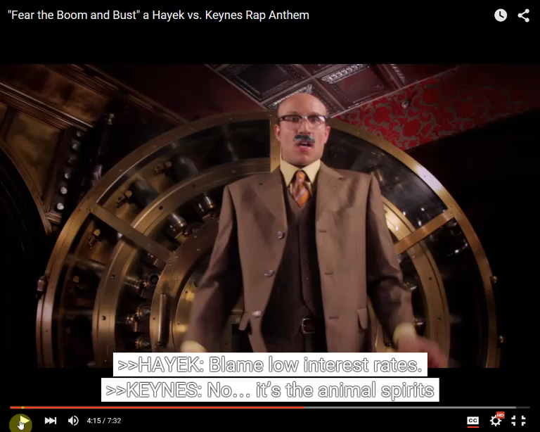
Austrian model of the trade cycle
Keynes-Hayek rap gets it mostly right…

Slide 42
Austrian model of the trade cycle
Neoclassical economics focuses on equilibrium, & treats cycles as due to “exogenous shocks”…and there must have been a lot of them!
Austrians (and most other schools of thought) see cycles as intrinsic to capitalism, & try to explain how they come about…

Slide 43
Austrian model of the trade cycle
To Neoclassicals, trade cycle is simply result of a stable equilibrium system being hit by random external shocks
Model is like “a rocking horse being hit by a club”: (Frisch 1933)
  “Knut Wicksell seems to be the first who has been definitely aware of the two types of problems in economic cycle analysis
    the propagation problem and the impulse problem
  and also the first who has formulated explicitly the theory that the source of energy which maintains the economic cycles are erratic shocks.
  He conceived more or less definitely of the economic system as being pushed along irregularly, jerkingly.
  New innovations and exploitations do not come regularly he says. But, on the other hand, these irregular jerks may cause more or less regular cyclical movements.
  He illustrates it by one of those perfectly simple and yet profound illustrations: "If you hit a wooden rocking-horse with a club, the movement of the horse will be very different to that of the club."”

Slide 44
Austrian model of the trade cycle
To Austrians: cycles are endogenous & generated by monetary system
  “the automatic adjustment of supply and demand can only be disturbed when money is introduced into the economic system.”
  “Money being a commodity that, unlike all others, is incapable of finally satisfying demand, its introduction does away with the rigid interdependence and self-sufficiency of the “closed” system of equilibrium, and makes possible movements that would be excluded from the latter.”
  “So long as we make use of bank credit as a means of furthering economic development we shall have to put up with the resulting trade cycles.” (Hayek 1933)
Basic logic:
  Accept (wrongly—see last week) prices converge to equilibrium
  “Price” for money is the interest rate
  Its capacity to equilibrate supply and demand for money is disturbed by capacity of banks to create credit…

Slide 45
Austrian model of the trade cycle
Since Austrians believe that in general, prices tend to bring demand & supply into equilibrium, they have to explain why this doesn’t happen in general, so that a “business cycle” develops:
  “To show how the interplay of these prices keeps supply and demand, production and consumption, in equilibrium, is the main object of pure economics…
    It is, however, the task of trade cycle theory to show under what conditions a break may occur in that tendency toward equilibrium which is described in pure analysis
      i.e., why prices, in contradiction to the conclusions of static theory, do not bring about such changes in the quantities produced as would correspond to an equilibrium situation.” (Hayek 1933, p. 30)

Slide 46
Austrian model of the trade cycle
Since they nominate money as the (unavoidable) reason for this failure, they have to have a model of why the price mechanism fails in the “market for money”…
  “Assuming that the rate of interest always determines the point to which the available volume of savings enables productive plant to be extended
    and it is only by this assumption that we can explain what determines the rate of interest at all
  any allegations of a discrepancy between savings and investments must be backed up by a demonstration why, in the given case, interest does not fulfill this function.”

Slide 47
Austrian model of the trade cycle
Argue that in a barter world, savings (supply of “money”) and investment (demand for “money”) would be brought into equilibrium by the interest rate (price of “money”)
Therefore there must be something different about the supply of money that breaks this mechanism:
  “If it is admitted that, in the absence of money, interest would effectively prevent any excessive extension of the production of production goods,
  by keeping it within the limits of the available supply of savings,
  and that an extension of the stock of capital goods that is based on a voluntary postponement of consumers’ demand into the future can never lead to disproportionate extensions,
  then it must also necessarily be admitted that disproportional developments in the production of capital goods
  can arise only through the independence of the supply of free money capital from the accumulation of savings,
  which in turn arises from the elasticity of the volume of money.”

Slide 48
Austrian model of the trade cycle
Hayek sees this “elasticity of the volume of money” coming from normal operation of banking system:
  “the theory of monetary economy should, therefore, be able to explain the occurrence of phenomena that would be inconceivable in the barter economy, and notably the disproportional developments that give rise to crises.
  A starting point for such explanations should be found in the possibility of alterations in the quantity of money occurring automatically and in the normal course of events, under the present organization of money and credit, without the need for violent or artificial action by any external agency.”
So while modern Austrians criticise Central Banks for causing crises by
  Creating too much “Base Money”; and
  Keeping interest rate below the “natural rate”
Hayek says fundamental cause of cycles is the normal operation of a banking system
Followers blame The Fed only; Hayek more “endogenous” than that…

Slide 49
Austrian model of the trade cycle
“Altogether, there are three elements that regulate the volume of circulating media within a country
  changes in the volume of cash, caused by inflows and outflows of gold;
  changes in the note circulation of the central banks: and last, and in many ways most important,
  the often-disputed “creation” of deposits by other banks…”
Uses “money multiplier” model to explain credit creation:
  “At this bank a certain amount of cash is newly deposited…
  If the policy of the bank was to keep a reserve of 10 percent against deposits, that ratio has now been increased … and the bank is therefore in a position … to grant new credit…
  As every bank re-lends 90 percent of the amount paid into it and thus causes an equivalent increase in deposits for some other bank, the original deposit will give rise to credit representing 0.9+0.92+0.93+0.94... times the original amount…”

Slide 50
Austrian model of the trade cycle
This additional credit expands demand in the economy in general faster than it could be expanded by an increase in savings:
  “By creating additional credit in response to an increased demand, and thus opening up new possibilities of improving and extending production,
  the banks ensure that impulses toward expansion of the productive apparatus shall not be so immediately and insuperably balked by a rise of interest rates as they would be if progress were limited by the slow increase in the flow of savings.
  But this same policy stultifies the automatic mechanism of adjustment that keeps the various parts of the system in equilibrium and makes possible disproportionate developments that must, sooner or later, bring about a reaction.”
But this results in above-equilibrium output in general in the economy, which must later lead to below-equilibrium output…

Slide 51
Austrian model of the trade cycle
“The immediate consequence of an adjustment of the volume of money to the “requirements” of industry is the failure of the “interest brake” to operate as promptly as it would in an economy operating without credit.
This means, however, that new adjustments are undertaken on a larger scale than can be completed; a boom is thus made possible, with the inevitably recurring “crisis.”
The determining cause of the cyclical fluctuation is, therefore, the fact that on account of the elasticity of the volume of currency media the rate of interest demanded by the banks is not necessarily always equal to the equilibrium rate, but is, in the short run, determined by considerations of banking liquidity.”
Curious omission by Hayek worth noting here:
  Sees banks as main creators of money
  But never considers that money creation by banks creates private debt, and what consequences of that might be…
Schumpeter does better job of explaining why business cycles occur…

Slide 52
Austrian model of the trade cycle
“I explain the phenomenon of business fluctuations … solely by an objective chain of causation which runs its course automatically, that is by the effect of the appearance of new enterprises upon the conditions of the existing ones.” (Schumpeter 213)
Necessarily non-equilibrium because discontinuous:
  “It is a fact that the economic system does not move along continually and smoothly. Counter-movements, setbacks, incidents of the most various kinds, occur which obstruct the path of development; there are breakdowns in the economic value system which interrupt it.” (216)
Breakdowns could be randomly distributed through time
  There would then be no “trade cycle”, only “deviations from trend”
But “new combinations are not, as one would expect according to general principles of probability, evenly distributed through time—in such a way that equal intervals of time could be chosen, in each of which the carrying out of one new combination would fall—but appear, if at all, discontinuously in groups or swarms.” (223)

Slide 53
Austrian model of the trade cycle
This discontinuous appearance is necessary for a true cycle to emerge, since…
“If the new enterprises in our sense were to appear independently of one another, there would be no boom and no depression as special, distinguishable, striking, regularly recurring phenomena. For their appearance would then be, in general, continuous.” (224)
Three reasons for the “clumped” nature of new innovations & associated booms:
  Frequently, “new combinations will not grow out of the old firms or immediately take their place, but appear side by side, and compete, with them.” (226)
  Credit extended to new entrepreneurs causes “a very substantial increase in purchasing power all over the business sphere. This starts a secondary boom, which spreads over the whole economic system and is the vehicle of the phenomenon of general prosperity…”

Slide 54
Austrian model of the trade cycle
The combination of these factors
  notable innovations in production
  new credit-financed demand as they are brought into existence
  general prosperity from the extended credit
Means that other entrepreneurs (good and bad!) find it easier to also get funding:
  “Why do entrepreneurs appear, not continuously, that is singly in every appropriately chosen interval, but in clusters?
  Exclusively because the appearance of one or a few entrepreneurs facilitates the appearance of others, and these the appearance of more, in ever-increasing numbers.” (228)
    With danger that success of good entrepreneurs helps bad ones to get funding…

Slide 55
Austrian model of the trade cycle
So a boom is a positive feedback process:
  Financing of one invention makes it easier for other inventions to be financed
  One success in one industry sector makes it easier for others in the same sector to succeed
  Spillover of finance into rest of economy makes new businesses and old ones profitable
Conventional economics dominated by presumption of negative feedback:
  Increase in price reduces demand
  Rise of profits encourages new entrants who reduce profits…, etc.
In fact many real-world processes involve positive feedback, with one other essential real-world feature:

Slide 56
Austrian model of the trade cycle
“the new entrepreneur's demand for means of production, which is based upon new purchasing power—the well known "race for means of production" in a period of prosperity—drives up the prices of these.” (232)
“the new products come on the market after a few years or sooner and compete with the old…
  “At the beginning of the boom costs rise in the old businesses;
  later their receipts are reduced, first in those businesses with which the innovation competes, but then in all old businesses, in so far as consumers' demand changes in favor of the innovation…”

Slide 57
Austrian model of the trade cycle
“The average time which must elapse before the new products appear—though of course actually dependent upon many other elements—fundamentally explains the length of the boom.
This appearance of the new products causes the fall in prices, which on its part terminates the boom, may lead to a crisis, must lead to a depression, and starts all the rest…” (233)
“the appearance of the results of the new enterprises leads to a credit deflation, because entrepreneurs are now in the position—and have every incentive—to pay off their debts;
and since no other borrowers step into their place this leads to a disappearance of the recently created purchasing power just when its complement in goods emerges…” (233)

Slide 58
Austrian model of the trade cycle
Cycle seen as necessary aspect of capitalism, rather than something to be eradicated;
But does have negative aspects as well as positive
“the boom … creates out of itself an objective situation, which … makes an end of the boom, leads easily to a crisis, necessarily to a depression, and hence to a temporary position of relative steadiness and absence of development.
  The depression as such we may call the "normal" process of resorption and liquidation; the course of events characterised by the outbreak of a crisis—panic, breakdown of the credit system, epidemics of bankruptcies, and its further consequences—we may call the "abnormal process of liquidation."” (236)

Slide 59
Austrian model of the trade cycle
A recession/depression a necessary outcome of a boom:
  “With the fall in the demand for means of production, the rate of interest—if the coefficient of risk is removed—and the volume of employment also fall.
  With the fall in money incomes, which is causally traceable to the deflation, even though it is increased by bankruptcies and so forth, the demand for all other commodities finally falls, and the process has then penetrated the whole economic system.
  The picture of the depression is complete.” (237)
“the depression leads … to a new equilibrium position.” (242)
  In fact, downturn involves over-compensation: system goes “below” equilibrium whereas was above it during boom
  “Equilibrium” itself shifts: path-dependent change
    Try to imagine today’s capitalism without the Internet…
    Modern Schumpeterians (e.g., Ed Nell) refer to process of growth as “Transformational change”

Slide 60
Austrians on economic policy—not!
Austrians partly blame Federal Reserve for causing crises by setting interest rates too low
  Hayek more nuanced than this
    interest rate doesn’t bring supply of savings & demand for investment into equilibrium because of elastic nature of private bank lending
What about what to do when a crisis occurs?
Hayek wrote “Monetary Theory and the Trade Cycle” in 1932, right at the peak of the Great Depression
  Greatest downturn in history of capitalism
  At a time when Government was relatively small…

Slide 61
Austrians on economic policy—not!
The ultimate boom and bust:

Slide 62
Austrians on economic policy—not!
Hayek’s policy advice? Do nothing: let market sort itself out:
  “It is a curious fact that the general disinclination to explain the past boom by monetary factors has been quickly replaced by an even greater readiness to hold the present working of our monetary organization exclusively responsible for our present plight.
  And the same stabilizers who believed that nothing was wrong with the boom and that it might last indefinitely because prices did not rise,
  now believe that everything could be set right again if only we would use the weapons of monetary policy to prevent prices from falling.
  The same superficial view which sees no other harmful effect of a credit expansion but the rise of the price level, now believes that our only difficulty is a fall in the price level, caused by credit contraction.”

Slide 63
Austrians on economic policy—not!
Both nominal output & inflation fell during the crisis—twice

Slide 64
Austrians on economic policy—not!
Hayek agreed first bout of deflation could be damaging if continued:
  “There can, of course, be little doubt that, at the present time, a deflationary process is going on and that an indefinite continuation of that deflation would do inestimable harm.”
But argued deflation a secondary effect, not primary cause of crisis:
  “But this does not, by any means, necessarily mean that the deflation is the original cause of our difficulties or that we could overcome these difficulties by compensating for the deflationary tendencies, at present operative in our economic system, by forcing more money into circulation.
Not caused by policy but due to uneven disequilibrium effects of 1920s boom:
  "There is no reason to assume that the crisis was started by a deliberate deflationary action on the part of the monetary authorities, or that the deflation itself is anything but a secondary phenomenon, a process induced by the maladjustments of industry left over from the boom.”

Slide 65
Austrians on economic policy—not!
Saw necessary slump after the boom as primary cause of decline in profits & consequent Depression:
  “If, however, the deflation is not a cause but an effect of the unprofitableness of industry, then it is surely vain to hope that, by reversing the deflationary process, we can regain lasting prosperity.
Alleged government tried to restart private credit growth without success:
  “Far from following a deflationary policy, Central Banks, particularly in the United States, have been making earlier and more far-reaching efforts than have ever been undertaken before to combat the depression by a policy of credit expansion — with the result that the depression has lasted longer and has become more severe than any preceding one.”

Slide 66
Austrians on economic policy—not!
Slump would end when disequilibrium in different sectors overcome by necessary liquidations:
  “What we need is a readjustment of those elements in the structure of production and of prices which existed before the deflation began and which then made it unprofitable for industry to borrow.
  But, instead of furthering the inevitable liquidation of the maladjustments brought about by the boom during the last three years, all conceivable means have been used to prevent that readjustment from taking place;
  and one of these means, which has been repeatedly tried though without success, from the earliest to the most recent stages of depression, has been this deliberate policy of credit expansion.”
Hayek’s anti-policy stance lost out to his arch-rival Keynes’s call for expansionary policy
But government policy before the Great Depression was to run a sustained surplus…

Slide 67
Austrians on economic policy—not!
And “New Deal” deficits were not a “big deal” compared to modern Government—maximum deficit 5% of GDP:
Attempt to return government budget to surplus in 1936 coincided with return to Depression conditions
Unemployment rose from 11%-20%, after having fallen from 25% peak in 1932…

Slide 68
Austrians on economic policy—not!
Arguably despair over 2nd great downturn led to willingness of economists in general to embrace Keynes…

Slide 69
Next week
But did economists understand Keynes?
  Next week’s School—the Post Keynesians—argue Keynes massively distorted by mainstream followers Hicks and Samuelson…

