Slide 1

Why Economists Disagree: The Mainstream
Professor Steve Keen
Head of Economics, History & Politics
Kingston University London
IDEAeconomics
Minsky Open Source System Dynamics
www.debtdeflation.com/blogs

Slide 2
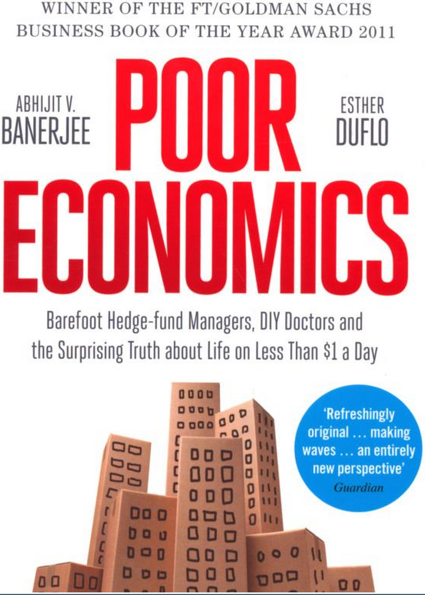
Subject Details: Assessment
Four forms of assessment
  First essay on the methodology of economics
  Second essay on a macroeconomic topic
  Group assignment
  Book Report on “Poor Economics: Barefoot Hedge-fund Managers, DIY Doctors and the Surprising Truth about Life on less than $1 a Day” by Banerjee & Duflo…
  Website: http://www.pooreconomics.com/
  Buy it from Amazon at:
  http://www.amazon.co.uk/Poor-Economics-Barefoot-Hedge-fund-Surprising/dp/0718193660

Slide 3
Recap/Coming Up
Recap
  Last week: introduction to schools of thought in economics via an analogy to astronomy
Coming Up
  More detail on 3 major schools of thought
    The Mainstream (“Neoclassical”)
    Austrian or Libertarian
    Post Keynesian
  Their position in relation to economics in general
  Their evolution (very quick overview)
  How they reacted—before and after—to the crisis of 2008
  This week: The Mainstream

Slide 4

The Mainstream or “Neoclassical” Economics
To the mainstream, there is no such thing as “mainstream” or “Neoclassical” economics
  There is simply “economics”, which is what they do.
  This guy is representative: a Dutch professor debating critical students live on Dutch TV: https://youtu.be/x7uITEBqQvM?t=134

Slide 5
The Mainstream or “Neoclassical” Economics
So to mainstream economists, non-mainstream economists are like believers in “Intelligent Design” (i.e., evolution deniers) in biology:
  “Unscientific”: they don’t get published in leading economic journals because they don’t deserve publication
Neoclassicals are generally unaware of own history too…
  See themselves as descendants of Adam Smith & David Ricardo…
  For example, Mankiw’s textbook:
    “In his 1776 book An Inquiry into the Nature and Causes of the Wealth of Nations, economist Adam Smith made the most famous observation in all of economics:
      Households and firms interacting in markets act as if they are guided by an “invisible hand” that leads them to desirable market outcomes.
      One of our aims in this book is to understand how this invisible hand works its magic.”

Slide 6
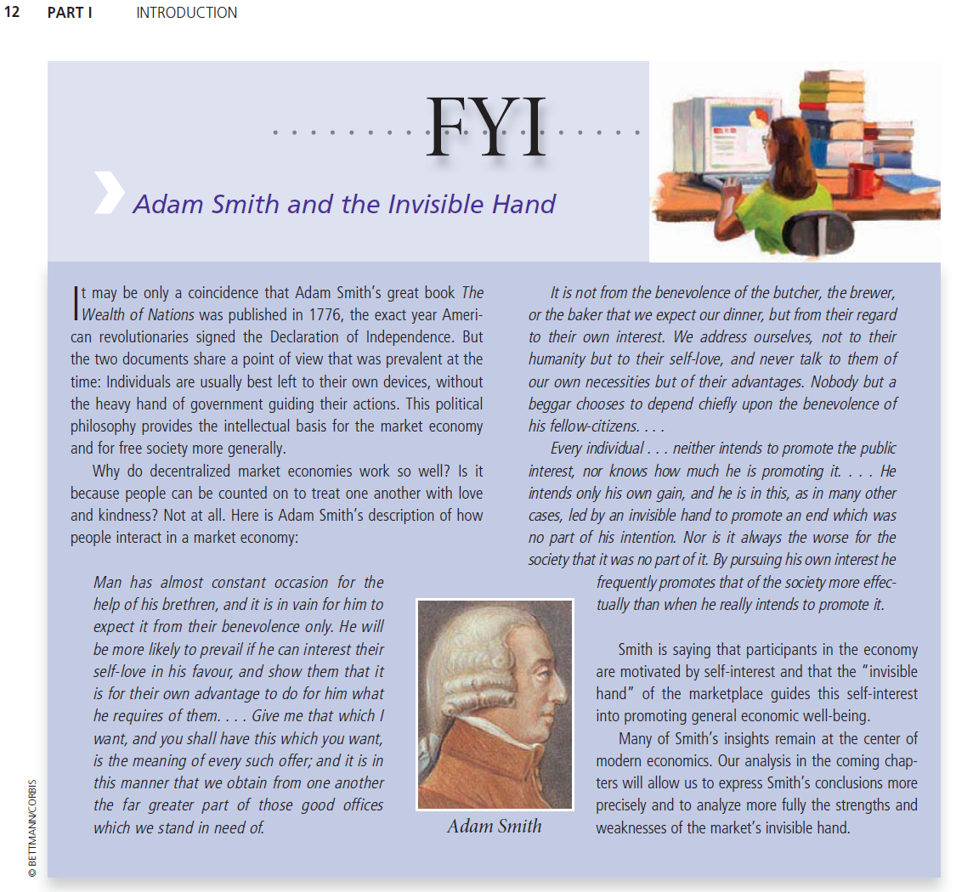
The Mainstream or “Neoclassical” Economics
“Many of Smith’s insights remain at the center of modern economics.
Our analysis in the coming chapters will allow us to express Smith’s conclusions more precisely and to analyze more fully the strengths and weaknesses of the market’s invisible hand.” (Mankiw)
Mankiw on “Smith & The Invisible Hand”…

Slide 7
The Mainstream or “Neoclassical” Economics
In fact, Smith’s “invisible hand” metaphor explained why English capitalists would prefer to produce at home rather than overseas—and therefore that tariffs were unnecessary:
  “By preferring the support of domestic to that of foreign industry, he intends only his own security;
  and by directing that industry in such a manner as its produce may be of the greatest value, he intends only his own gain,
  and he is in this, as in many other eases, led by an invisible hand to promote an end which was no part of his intention.”
More crucially, Smith & Ricardo had a “theory of value” which was the opposite of today’s Neoclassicals…

Slide 8
The Mainstream or “Neoclassical” Economics
Neoclassical: value involves utility; utility & cost set price
Smith: value involves effort; effort alone sets price
  “The word VALUE, it is to be observed, has two different meanings, and sometimes expresses the utility of some particular object, and sometimes the power of purchasing other goods which the possession of that object conveys.
  The real price of every thing …is the toil and trouble of acquiring it.
  What is bought with money or with goods is purchased by labour.”
Neoclassical
  Demand & cost of production together determine price
Smith
  Cost of production alone determines price
  Demand determines quantity produced
Real antecedents of Neoclassicals are not the “Classical” economists Smith & Ricardo, but then “underground” figures Jeremy Bentham, Jean-Baptiste Say, & Antoine Cournot…

Slide 9
The Mainstream or “Neoclassical” Economics
Bentham, Say & Cournot all saw value as originating in utility
  “there is no actual production of wealth, without a creation or augmentation of utility. Let us see in what manner this utility is to be produced…” (Say, Treatise on Political Economy)
This was the minority position when they wrote
Majority was Smith/Ricardo/Marx position that utility played no role in setting prices
  “Utility then is not the measure of exchangeable value, although it is absolutely essential to it.” (Ricardo 1817)
“Utility as the essence of value” became the majority position after Marx turned the Classical theory of economics against capitalism
Neoclassical Utility-theory-of-value economics originated with Stanley Jevons, Leon Walras & Carl Menger in the 1870s
Jevons & Walras both tried to build a mathematical economics
Walras’s approach came to dominate over time…

Slide 10
The Mainstream or “Neoclassical” Economics
Walras’s key question: “Can a system of free markets reach a set of prices that ensures that supply equals demand in all markets?”
Based on actual mechanics of French single commodity/asset markets
  “Open outcry” markets—traders declare prices & quantities
  Market maker sums supply & demand offers at declared prices
  Published price for that day is one where demand = supply
Walras generalized this to all markets
Imagined single place where all traders in all commodities meet
Random initial set of relative (not money) prices declared
Supply & demand summed in all markets
Price increased for those where demand exceeds supply
Price reduced for those where supply exceeds demand
Only once all markets are in equilibrium does trade occur…

Slide 11
The Mainstream or “Neoclassical” Economics
“First, let us imagine a market in which only consumer goods and services are bought and sold…
Once the prices or the ratios of exchange of all these goods and services have been cried at random in terms of one of them selected as numeraire,
each party to the exchange will offer at these prices those goods or services of which he thinks he has relatively too much, and he will demand those articles of which he thinks he has relatively too little…
the prices of those things for which the demand exceeds the offer will rise, and the prices of those things of which the offer exceeds the demand will fall.
New prices now having been cried, each party to the exchange will offer and demand new quantities. And again prices will rise or fall until the demand and the offer of each good and each service are equal.
Then the prices will be current equilibrium prices and exchange will effectively take place.” (Walras 1874)

Slide 12
The Mainstream or “Neoclassical” Economics
Walras believed—but could not prove—that this process of “tatonnement” (trial and error) would converge to equilibrium:
  “This will appear probable if we remember that the change from p’b to p’’b, which reduced the above inequality to an equality,
  exerted a direct influence that was invariably in the direction of equality at least so far as the demand for (B) was concerned;
  while the [consequent] changes from p’c to p’’c, p’d to p’’d, which moved the foregoing inequality farther away from equality,
  exerted indirect influences, some in the direction of equality and some in the opposite direction, at least so far as the demand for (B) was concerned,
  so that up to a certain point they cancelled each other out.
  Hence, the new system of prices (p’’b, p’’c, p’’d,) is closer to equilibrium than the old system of prices (p’b, p’c, p’d,); and it is only necessary to continue this process along the same lines for the system to move closer and closer to equilibrium.” (Walras 1874)

Slide 13
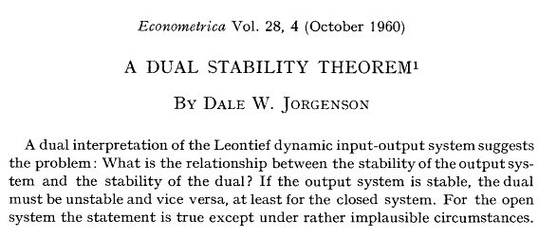
The Mainstream or “Neoclassical” Economics
In the 1900s, mathematicians proved this process wouldn’t converge
  Didn’t deliberately attack economics
    Just a theorem on properties of arrays of positive numbers
  But when applied to Walras’s algorithm for a growing economy, result was that either prices or quantities would be unstable
    If initial price & quantity amounts weren’t in equilibrium,
    then next iteration would move either prices or quantities further away from equilibrium

Slide 14
The Mainstream or “Neoclassical” Economics
The mathematical logic is complicated! But in a nutshell:
  2 conditions apply for a growing economy to be in equilibrium:
    Output of every good must be growing at the same rate
    Relative prices must be constant
  First condition is
Using symbols instead—Y for “Output” & g for “growth rate”:
Output is a list of goods—bread, iPads, buses (called a “vector”)
  So every element of this list has to be growing at the same rate
Simplest way to describe production is like a cooking recipe:
  “Ingredients 1 omelette: 3 eggs, 1 onion, 1 tomato, 1 gram salt”
  “Ingredients 1 cake: 0.3 kg flour, 2 eggs, 0.1 kg chocolate”…
Recipes for all products form an array of numbers (called a “matrix”). Let’s call this R for “recipe”. Then this equation is also true:

Slide 15
The Mainstream or “Neoclassical” Economics
This means output in 2016 is R times output in 2015
Outputs in 2016
(bread, iPads, buses)
Outputs in 2015 are
inputs for 2016
“Production recipes”
Stability means “if growth rates of bread, iPads, buses aren’t the same in 2015 (some are above g, some below), will they get closer to g in 2016?”
This depends on a property of R called its “characteristic values”
  If the biggest of these is less than 1, then output is stable.
Condition 2 for prices is that prices must enable producers to purchase their inputs and make a profit that is the same in all industries
  Otherwise there would be an incentive to change outputs
Uniform rate of profit
What you sell the cake for
What you pay for cake ingredients

Slide 16
The Mainstream or “Neoclassical” Economics
Using symbols instead—P for Prices & π_{r} for profit rate
Stability depends on “characteristic value” of the inverse of R or R⁻¹
  This is the inverse of the characteristic value of R:
    For example, if the characteristic value of R is 0.05 (or 1/20) then the characteristic value of R⁻¹ is 20 (or 1/0.05)
So the stability of output depends on the characteristic value of R
While stability of prices depends on the characteristic value of R⁻¹
Both have to be less than 1 for stability
How is that possible? Any ideas?
  The biggest characteristic value of R has to be negative
    For example, if the biggest characteristic value of R is minus 0.05 (or -1/20), then the characteristic value of R⁻¹ is -20 (or 1/-0.05)
    Then both are below zero and both output and price dynamics are stable…

Slide 17
The Mainstream or “Neoclassical” Economics
R is an array of either positive numbers or zero
  All recipes involve non-negative amounts of ingredients
    You can’t use minus half an egg to make an omelette
Unfortunately (for Walras), mathematicians Perron & Frobenius proved the biggest characteristic value of an array of non-negative numbers is greater than zero. Hence the “dual (in)stability problem”:
  If the biggest characteristic value of R is less than 1
    So that production is stable
  Then the characteristic value of R⁻¹ will be greater than 1
    So prices will be unstable
So Walras’s process won’t work: If the initial list of prices “cried at random” isn’t the equilibrium list, then “tatonnement” won’t get there
Rather than converging to equilibrium as Walras thought it would, either prices or quantities would diverge
So the answer to Walras’s key question “Can the economy reach equilibrium with demand equal to supply in every market?” is “No”
  How do you think mainstream economists reacted to this?...

Slide 18
The Mainstream or “Neoclassical” Economics
Belief that initial question was correct dominated result that it wasn’t
Denial: “It’s because you used rigid recipes rather than flexible ones”
  True! But near equilibrium, a rigid ( “linear”) recipe dominates
    Flexible (or “nonlinear”) factors dominate far from equilibrium
    So equilibrium remains unstable even with flexible recipes
Evasion: “Let’s add assumptions to make it stable then”
  “To avoid dual instability, a number of re-interpretations of the basic model have been proposed… In this paper, a third re-interpretation … is suggested…” (Jorgenson 1961 , p. 106)
  “For any economic agent a complete action plan (made now for the whole future)…” (Debreu 1959, p. 32)
Ignorance: “Let’s ignore stability & just assume equilibrium”
  Equilibrium taken for granted; stability normally not analysed
Redefinition: “Let’s redefine equilibrium so it is stable”
  Equilibrium now is “inter-temporal” rather than “input-output”
  From “Computable General Equilibrium” (CGE) to “Dynamic Stochastic General Equilibrium” (DSGE)…

Slide 19
The Mainstream or “Neoclassical” Economics
Modern mainstream macroeconomics is “applied microeconomics”:
  Robert Lucas and “The Microfoundations Revolution”
    “I think Patinkin was absolutely right to try and use general equilibrium theory to think about macroeconomic problems…
    the theory ought to be microeconomically founded, unified with price theory.
    Nobody was satisfied with IS-LM as the end of macroeconomic theorizing.
    The idea was we were going to tie it together with microeconomics and that was the job of our generation.” (Lucas 2004, pp. 16, 20)
Microeconomic model:
  Consumers maximizing utility (subject to constraints)
  Firms maximizing profits (subject to competition)
  Perfect competition & equilibrium in all markets
Neoclassical macro models derived from these “microeconomic foundations”

Slide 20
The Mainstream or “Neoclassical” Economics
Consumer supposed to decide what to buy based on:
  Preferences—represented by “Indifference Curves”; and
  Income—represented by “Budget Line”
    Individual demand curve derived from these two
Firms supposed to decide what to produce based on
  Cost of production—fixed and variable costs
  Demand curve
    “Marginal cost curve” is the individual firm’s supply curve under “perfect competition”
Aggregate demand curve & aggregate supply curve determined output and price in a single commodity market (under equilibrium assumption)
Neoclassical macroeconomic models apply this to whole economy…

Slide 21
The Mainstream or “Neoclassical” Economics
Micro: behaviour of consumer & producer & market today
Macro: behaviour of consumers & producers & markets over time
Micro consumer: maximize utility subject to budget constraint
  Utility: subjective satisfaction from consumption rises as consumption rises, but at diminishing rate: “Diminishing marginal utility”…
Rising Utility
Diminishing marginal utility

Slide 22
The Mainstream or “Neoclassical” Economics
When consuming two goods, more utility from both…
“Indifference curve” shows combinations of 2 goods that yields same utility
A “contour map” of “Utility Hill”

Slide 23
The Mainstream or “Neoclassical” Economics
Consumer maximises utility by consuming where budget line tangential to indifference curve
  Budget line shows amount of both good consumer will purchase with given income & given prices
Demand curve for individual consumer derived by
Holding income constant
Holding price of vertical axis good constant
Varying price of horizontal axis good…

Slide 24
The Mainstream or “Neoclassical” Economics
Mainstream microeconomics
Derive a single consumer’s demand curve for coffee at a point in time…
Hold income & Price of Biscuits constant
Start with low price for Coffee…
Then a slightly higher price…
Join up the points
Individual demand curve for coffee now
Modern mainstream macroeconomics:
  Apply same process to choice between working (for an income) versus not working (and enjoying leisure) over all time…
Price of Coffee
P₄
P₃
P₂
P₁
Q₄
Q₃
Q₂
Q₁
Cups of Coffee

Slide 25
The Mainstream or “Neoclassical” Economics
Trade-off now between leisure (maximum 24 hours a day) & income
“Representative Consumer” maximises discounted lifetime utility by choosing optimal consumption-work trade-off based on “rational expectations” of future wages & prices…
Time path of consumption/leisure→
“Representative Firm” does likewise:
  Produces to maximise lifetime discounted profits
Market determines equilibrium time-path of output & employment
Where do cycles come from in this “Real Business Cycle (RBC) approach?...

Slide 26
The Mainstream or “Neoclassical” Economics
Variations in equilibrium output & employment time-path due to “exogenous shocks” to tastes (consumers) & technology (firms)
  Consumers are on equilibrium welfare-maximising consumption-work time-path given current expectations of future wages & prices
  An “exogenous shock” changes optimal time path
  “Representative Consumer” adjusts current work-leisure trade-off
  Current employment & output changes as a result
In original “Real Business Cycle” form, this meant all unemployment was voluntary: workers choose to work less because current wage is less than the marginal disutility of work:
  “Since accepting work at a lower wage may involve, say, an investment in search or in moving to another community, the decision on current labor supply will differ depending on the wage he anticipates in the near future.
  If the current fall in wages is regarded as temporary, he may accept leisure now (be unemployed). If it is regarded as permanent, he may accept work elsewhere. ” (Lucas & Rapping 1969)

Slide 27
The Mainstream or “Neoclassical” Economics
Original developers even explained The Great Depression this way:
“business cycles are responses to persistent changes, or shocks, that shift the constant growth path of the economy up or down.
This constant growth path is the path to which the economy would converge if there were no subsequent shocks.
If a shock shifts the constant growth path down, the economy responds as follows.
  Market hours [i.e., employment] fall, reducing output; a bigger share of output is allocated to consumption and a smaller share to investment; and more time is allocated to leisure…
The fundamental difference between the Great Depression and business cycles is that market hours did not return to normal during the Great Depression.
Rather, market hours fell and stayed low.
In the 1930s, labor market institutions and industrial policy actions changed normal market hours. I think these institutions and actions are what caused the Great Depression…

Slide 28
The Mainstream or “Neoclassical” Economics
“the Great Depression is a great decline in steady-state market hours.
I think this great decline was the unintended consequence of labor market institutions and industrial policies designed to improve the performance of the economy.
Exactly what changes in market institutions and industrial policies gave rise to the large decline in normal market hours is not clear…
The capitalistic economy is stable, and absent some change in technology or the rules of the economic game, the economy converges to a constant growth path with the standard of living doubling every 40 years.
In the 1930s, there was an important change in the rules of the economic game. This change lowered the steady-state market hours.
The Keynesians had it all wrong. In the Great Depression, employment was not low because investment was low.
Employment and investment were low because labor market institutions and industrial policies changed in a way that lowered normal employment.” (Kydland 1999)

Slide 29
The Mainstream or “Neoclassical” Economics
This “all unemployment is voluntary” vision was too much for some mainstream economists
  RBC models assumed all markets were “perfect” & in equilibrium
  Drop in demand for labor—or decrease in supply at existing wage—meant equilibrium employment level changed, but market was still in equilibrium
Breakaway “New Keynesian” group tried to explain involuntary unemployment while still being consistent with microeconomics
  Agreed that with perfect markets, there would be no unemployment
Argued that all markets are not perfect, so there is price and wage “stickiness”.
This explains persistent involuntary unemployment:
  “a large number of authors… have produced an outpouring of research within the Keynesian tradition that attempts to build the microeconomic foundations of wage and price stickiness.
  The adjective new-Keynesian nicely juxtaposes this body of research with its arch-opposite, the new-classical approach.” (Gordon 1990)

Slide 30
The Mainstream or “Neoclassical” Economics
Temporary disequilbrium due to “price stickiness” and “frictions” explains macroeconomic phenomena like recessions & involuntary unemployment:
“The essential feature of Keynesian macroeconomics is the absence of continuous market clearing.
Thus a Keynesian model is by definition a non-market-clearing model, one in which prices fail to adjust rapidly enough to clear markets within some relatively short period of time.
Common to almost all Keynesian models is the prediction that in response to a decline in nominal demand, the aggregate price level will decline less than proportionately over a substantial time period,
during which the actual price level is above the equilibrium price level consistent with the maintenance of the initial equilibrium level of real output.
  The fact that the price level is too high means that the subequilibrium level of output actually produced is not chosen voluntarily by firms and workers, but rather is imposed on them as a constraint.” (Gordon 1990)

Slide 31
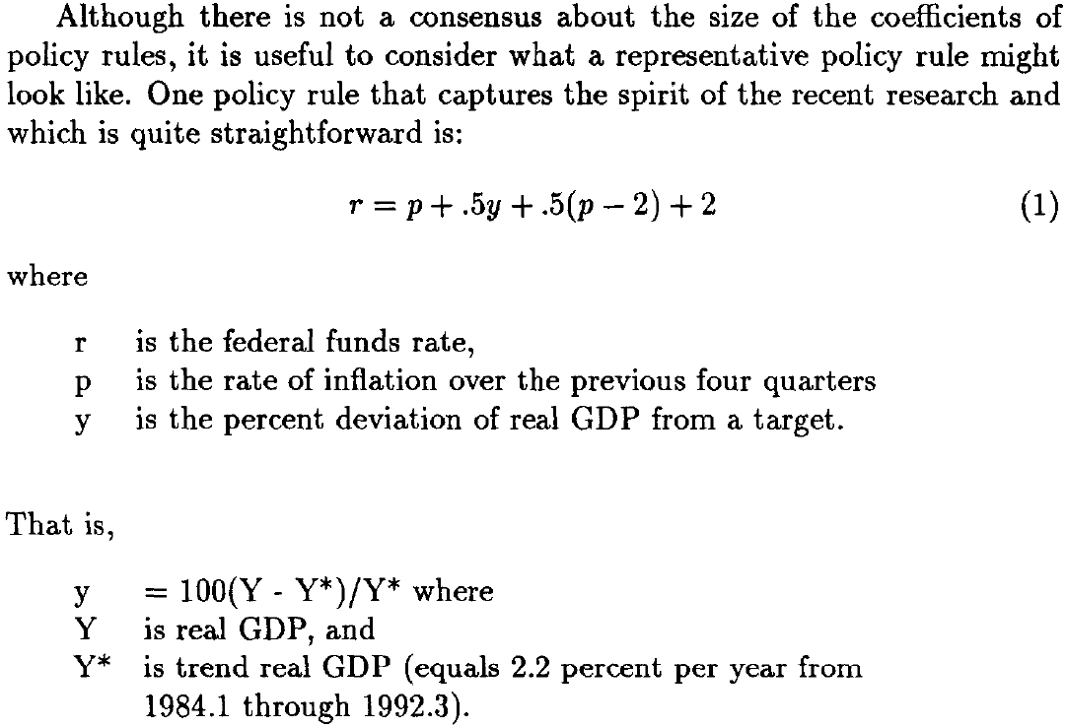
The Mainstream or “Neoclassical” Economics
Policy implications of New Keynesian Economics
  Fiscal policy ineffectiveness
  Inflation targeting via “the Taylor Rule” for Federal Reserve rate
    Taylor 1993 “Discretion versus policy rules in practice”

Slide 32
The Mainstream or “Neoclassical” Economics
Theoretical implications: microeconomic-based models with “market imperfections”: “Dynamic Stochastic General Equilibrium” (DSGE)
  Derived from utility maximizing household & profit-maximising firm
  By early 1990s, dominated mainstream macroeconomics
But still criticised by some Neoclassical economists—such as 1997 Nobel Prize winner Robert Solow (for “Neoclassical Growth Theory”):
  “imagine that the economy is populated by a single immortal consumer … [who solves] an infinite-time utility-maximization problem. That strikes me as far-fetched…
  The end result is a construction in which the whole economy is assumed to be solving a Ramsey optimal-growth problem through time, disturbed only by stationary stochastic shocks to tastes and technology. To these the economy adapts optimally.
  Inseparable from this habit of thought is the automatic presumption that observed paths are equilibrium paths.
  So we are asked to regard the construction I have just described as a model of the actual capitalist world…” (Solow 1987)

Slide 33
The Mainstream or “Neoclassical” Economics
Solow became more critical over time…
“The preferred model has a single representative consumer optimizing over infinite time with perfect foresight or rational expectations, in an environment that realizes the resulting plans more or less flawlessly through perfectly competitive forward-looking markets for goods and labor, and perfectly flexible prices and wages.
How could anyone expect a sensible short-to-medium-run macroeconomics to come out of that set-up?...
I start from the presumption that we want macroeconomics to account for the occasional aggregative pathologies that beset modern capitalist economies, like recessions, intervals of stagnation, inflation, "stagflation," not to mention negative pathologies like unusually good times.
A model that rules out pathologies by definition is unlikely to help.
  Solow 2003: “Dumb And Dumber In Macroeconomics”
Criticisms here apply to pure RBC or “Freshwater” macroeconomics…

Slide 34
The Mainstream or “Neoclassical” Economics
But Solow also rejected “Saltwater” DSGE models:
  “The simpler sort of RBC model that I have been using for expository purposes has had little or no empirical success, even with a very undemanding notion of 'empirical success'.
  As a result, some of the freer spirits in the RBC school have begun to loosen up the basic framework by allowing for 'imperfections' in the labor market, and even in the capital market…
  The model then sounds better and fits the data better.
  This is not surprising: these imperfections were chosen by intelligent economists to make the models work better...” (Solow 2001, p. 26; emphasis added)
Despite protests from within Neoclassical school, “saltwater” DSGE models became dominant
Their rise coincided with “The Great Moderation”
  Declining volatility in unemployment & inflation from 1990-2007
Just before the crisis, they were triumphant (last week’s lecture)
Even after it had been going for a year, they were still confident…

Slide 35
The Mainstream or “Neoclassical” Economics
Crisis began in August 2007 when BNP shut down 3 US Subprime funds
Immediate reaction of mainstream was relaxed:
  Federal Reserve Open Market Committee minutes December 2007:
    “Overall, our forecast could admittedly be read as still painting a pretty benign picture:
    Despite all the financial turmoil, the economy avoids recession and … we achieve some modest edging-off of inflation.
    So I tried not to take it personally when I received a notice the other day that the Board had approved more frequent drug-testing for certain members of the senior staff… [Laughter]
    the staff is not going to fall back on the increasingly popular celebrity excuse that we were under the influence of mind altering chemicals and thus should not be held responsible for this forecast.
    No, we came up with this projection unimpaired and on nothing stronger than many late nights of diet Pepsi and vending-machine Twinkies.” (Federal Reserve Chief Economist Stockton)

Slide 36
The Mainstream or “Neoclassical” Economics
In August 2008, the Editor of the AEA Macro journal said:
“Over time however, largely because facts have a way of not going away, a largely shared vision both of fluctuations and of methodology has emerged.
Not everything is fine. Like all revolutions, this one has come with the destruction of some knowledge, and suffers from extremism, herding, and fashion. But none of this is deadly.
The state of macro is good…
Facts have a way of eventually forcing irrelevant theory out (one wishes it happened faster). And good theory also has a way of eventually forcing bad theory out.
The new tools developed by the new-classicals came to dominate. The facts emphasized by the new-Keynesians forced imperfections back in the benchmark model. A largely common vision has emerged…” (Blanchard 2008 “The State of Macro”)

Slide 37
The Mainstream or “Neoclassical” Economics
So even 1 year after crisis began, mainstream didn’t expect it to be severe
But it proved to be the deepest and longest recession in Post-WWII economic history…

Slide 38
The Mainstream or “Neoclassical” Economics
After the crisis, some soul-searching…
  “the Great Recession’s extreme severity makes it tempting to argue that new theories are required to fully explain it. (Ireland 2011, p. 31)
  But … “Attempts to explain movements in one set of endogenous variables … by direct appeal to movements in another … sometimes make for decent journalism but rarely produce satisfactory economic insights.” (p. 32)
  And finally… “the Great Recession began …with a series of adverse preference and technology shocks in roughly the same mix and of roughly the same magnitude as those that hit the United States at the onset of the previous two recessions…
  these shocks grew larger in magnitude, adding substantially not just to the length but also to the severity of the great recession…
  these results … speak to the continued relevance of the New Keynesian model, perhaps not as providing the very last word on but certainly for offering up useful insights into, both macroeconomic analysis and monetary policy evaluation. (Ireland 2011, p. 33)

Slide 39
The Mainstream or “Neoclassical” Economics
So the Neoclassical Mainstream:
  Adheres to equilibrium approach despite
    Theoretical problems
      Walrasian General equilibrium unstable
      Many other problems
    Empirical failure to anticipate crisis of 2008
Still chastened by the experience:
  “Until the 2008 global financial crisis, mainstream U.S. macroeconomics had taken an increasingly benign view of economic fluctuations in output and employment. The crisis has made it clear that this view was wrong and that there is a need for a deep reassessment…” (Blanchard 2014: “Where Danger Lurks”)
Somewhat more open to alternatives:
  “Turning from policy to research, the message should be to let a hundred flowers bloom. Now that we are more aware of nonlinearities and the dangers they pose, we should explore them further theoretically and empirically—and in all sorts of models.”

Slide 40
The Mainstream or “Neoclassical” Economics
Money, banks, debt & finance played no role in canonical DSGE models
After the crisis, being added to the base model as “financial frictions”:
Macroeconomics with Financial Frictions: A Survey (Brunnermeier 2012)
  “The ongoing great recession is a stark reminder that financial frictions are a key driver of business cycle fluctuations.
  Imbalances can build up during seemingly tranquil times until a trigger leads to large and persistent wealth destructions potentially spilling over to the real economy.
  While in normal times the financial sector can mitigate financial frictions, in crisis times the financial sector’s fragility adds to instability. Adverse feedback loops and liquidity spirals lead to non-linear effects with the potential of causing a credit crunch…”

Slide 41
The Mainstream or “Neoclassical” Economics
But still wedded to its equilibrium approach:
  “How should we modify our benchmark models—the so-called dynamic stochastic general equilibrium (DSGE) models that we use, for example, at the IMF to think about alternative scenarios and to quantify the effects of policy decisions?
  The easy and uncontroversial part of the answer is that the DSGE models should be expanded to better recognize the role of the financial system—and this is happening. But should these models be able to describe how the economy behaves in the dark corners?
  Let me offer a pragmatic answer. If macroeconomic policy and financial regulation are set in such a way as to maintain a healthy distance from dark corners, then our models that portray normal times may still be largely appropriate…
  Trying to create a model that integrates normal times and systemic risks may be beyond the profession’s conceptual and technical reach at this stage.” (Blanchard 2014: “Where Danger Lurks”)

Slide 42
The Mainstream or “Neoclassical” Economics
Impact on what they thought was good macroeconomic policy too:
  Rethinking Macroeconomic Policy (Blanchard 2010)
  “WHAT WE THOUGHT WE KNEW
  To caricature (we shall give amore nuanced picture below): we thought of monetary policy as having one target, inflation, and one instrument, the policy rate.
  So long as inflation was stable, the output gap was likely to be small and stable and monetary policy did its job.
  We thought of fiscal policy as playing a secondary cyclical role, with political constraints sharply limiting its de facto usefulness.
  And we thought of financial regulation as mostly outside the macroeconomic policy framework.
  Admittedly, these views were more closely held in academia: policymakers were often more pragmatic.
  Nevertheless, the prevailing consensus played an important role in shaping policies and the design of institutions.”

Slide 43
The Mainstream or “Neoclassical” Economics
But here also, resistance to change despite the crisis:
  “It is important to start by stating the obvious, namely, that the baby should not be thrown out with the bathwater.
  Most of the elements of the precrisis consensus, including the major conclusions from macroeconomic theory, still hold.
  Among them, the ultimate targets remain output and inflation stability.
  The natural rate hypothesis holds, at least to a good enough approximation, and
  policymakers should not design policy on the assumption that there is a long-term trade-off between inflation and unemployment.
  Stable inflation must remain one of the major goals of monetary policy.
  Fiscal sustainability is of the essence, not only for the long term but also in affecting expectations in the short term.”

Slide 44
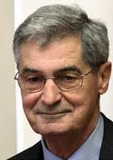
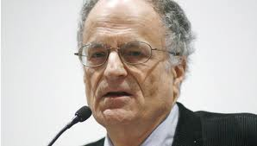
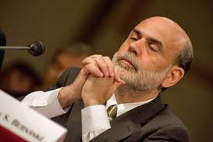

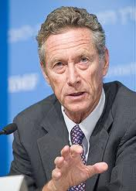
The Mainstream or “Neoclassical” Economics
Some prominent modern Neoclassicals
  “Freshwater” “Real Business Cycle” “New Classicals”:
Robert Lucas
Thomas Sargent
  “Saltwater” “DSGE Models” “New Keynesians”:
Ben Bernanke
Paul Krugman
Olivier Blanchard

Slide 45
The Mainstream or “Neoclassical” Economics
Conclusion:
  Mainstream behaving like Ptolemaic astronomers after discovery of craters on the Moon & Moons around Jupiter
    “Yes there are problems, but how else can we model?”
Next week, a closely related group—the Austrians—some of whom did anticipate the crisis
  How their paradigm differs to the Mainstream
  Their attitude to modelling in general
  Reactions to the crisis (which they did have a [non-mathematical] model for) and its aftermath (which they didn’t expect)

