Slide 1

Becoming an Economist: Why Economists Disagree
Professor Steve Keen
Head of Economics, History & Politics
Kingston University London
IDEAeconomics
Minsky Open Source System Dynamics
www.debtdeflation.com/blogs

Slide 2

Economists Disagree with each other…
Like these two guys: John Maynard Keynes & Friedrich Hayek…
https://www.youtube.com/watch?v=d0nERTFo-Sk

Slide 3
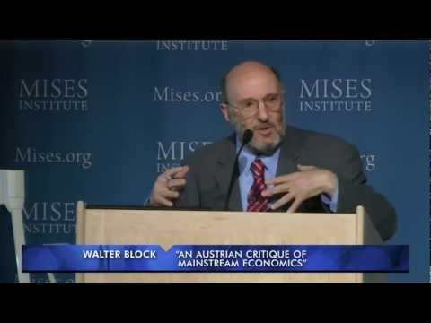

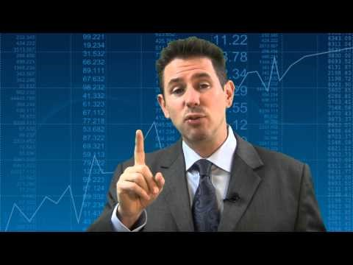

Economists Disagree with each other…
And it’s not just in fiction…
https://youtu.be/TI5fjTz1Rbw 1:34
https://youtu.be/Xr3LPFh8CsM 0:11
https://youtu.be/V1-1tqgUoeo 0:13
https://youtu.be/iWEq27Ai6ZU 2:00

Slide 4
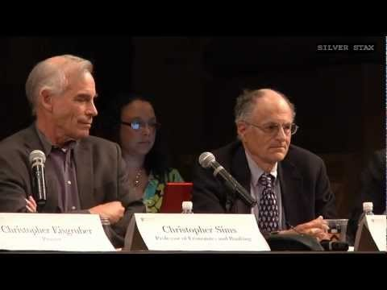
Economists Disagree with each other…
Sometimes, Nobel Prize winners can’t answer economic questions…
https://youtu.be/AI_uAdvMwVc

Slide 5
Economists Disagree with each other…
Why do they disagree? Any suggestions?
We can’t observe the economy from outside it
So we invent a framework to interpret what we do see
In other words, we create a model (or “paradigm”)…
  That lets us explain at least some of what we have seen
  That lets us make predictions about the future
Once they have a model, economists then describe how the model behaves—not how reality behaves because can’t observe it directly
If the real world does something the model doesn’t predict, how do they respond?
  Do they chuck out the model and start all over again?
    Or modify it a bit so that it can handle this unexpected event?
How is a model invented in the first place?
How astronomy developed gives us a guide
Like economists who can’t see economy from the outside, early astronomers could only see Universe from Earth with the naked eye
  How did they interpret what they saw?

Slide 6
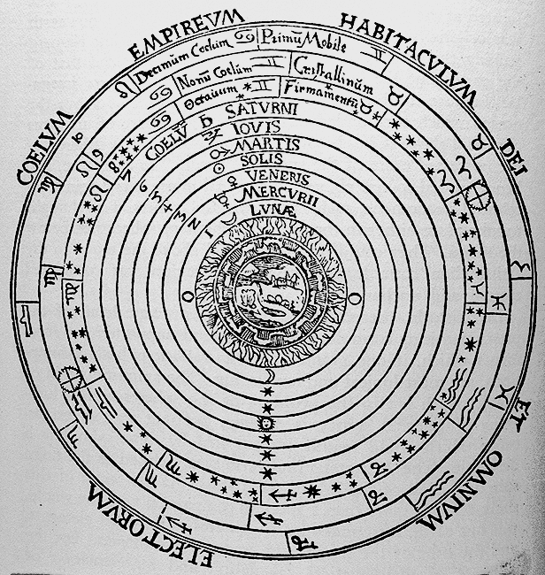

Economists Disagree with each other…
They saw:
  Sun & Moon rising & falling
  Stars rotating
  Planets “wandering”
About 2400 years ago Aristotle proposed that:
  The Earth was stationary at the centre of the Universe
  The Stars, Sun, Moon and Planets rotated around it on perfect crystalline spheres
  Heavens were perfect
    never changing
  Earth was imperfect
    change and decay
How to explain comets then?
  They were “atmospheric phenomena”—Heavens had to be perfect

Slide 7
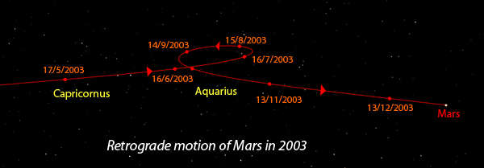
Economists Disagree with each other…
Aristotle’s model worked for the Stars, the Sun and the Moon
  But Planets (“Wanderers” in ancient Greek) didn’t “play ball”…
    They moved sometimes left in the sky, sometimes right…
    Got bigger and brighter, then smaller and dimmer…
    Sped up and then slowed down…
This was the apparent motion of Mars from May to December 2003:
How does Mar’s motion look when mapped against Signs of the Zodiac?

Slide 8
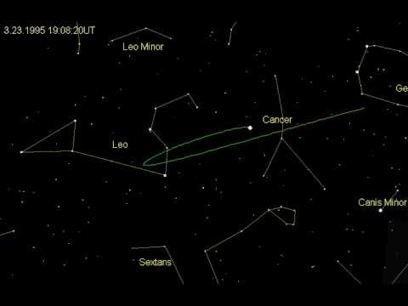
https://youtu.be/1SBn3ZEoA7w

Slide 9
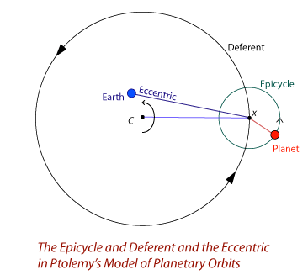
Economists Disagree with each other…
  About 1900 years ago, Ptolemy suggested a modification for the planets which fitted what they appeared to do almost perfectly
Earth was stationary near (but not quite at) the centre of the Universe
Heavenly bodies rotated the actual centre on circles called “Deferents”
Planets rotated on their Deferents on smaller circles called “Epicycles”
Model was complicated
  About 70 circles used to describe Sun, Moon, planets and major Stars
And completely wrong about structure of the Universe
But enabled accurate prediction of where the planets would be
Looks strange today, but it was brilliant for its time…

Slide 10
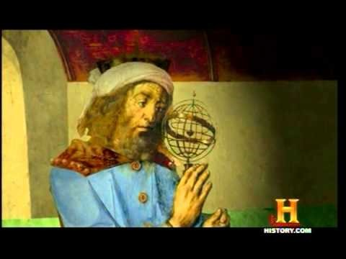
https://youtu.be/GevV1yvMJbc

Slide 11
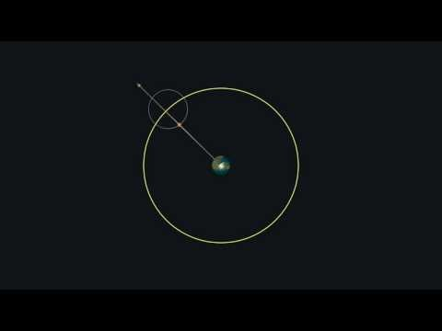
Economists Disagree with each other…
A model of circles (epicycles) on circles (deferents)…
https://youtu.be/KT3PmGVf6DU

Slide 12
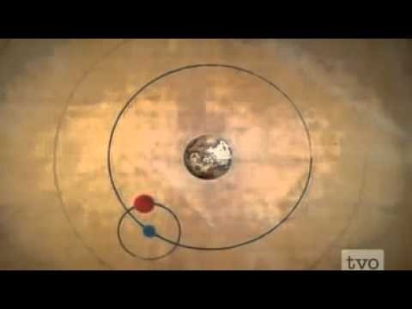
Economists Disagree with each other…
Earth (almost) at the centre of the Universe
  Highly mathematical model (for its day)
  Accurately predicted location of planets for centuries in advance
https://youtu.be/Az-0x06epg0

Slide 13

Economists Disagree with each other…
Wildly inaccurate model can fit any observed planetary data
  Even a planet whose apparent movement traces out Homer Simson’s face in the sky!...
https://youtu.be/QVuU2YCwHjw?list=PLxzqV9hdJinBxIb-YBr9VlVNkVSz4I6tT

Slide 14
Economists Disagree with each other…
Ptolemy’s system accurately predicted motions of planets, Moon & Sun
But modern day astronomers said about Ptolemy’s system that:
  “It worked beautifully, but it was just wrong”; and
  “The idea that you can predict something doesn’t mean that you understand the fundamental principles behind it”
  So accurate prediction isn’t enough;
    Prediction doesn’t mean understanding
    You have to get the actual structure right too
So what’s this got to do with economics?
The economy today is as poorly observed as the Universe once was
Economists use different models to try to understand it
  One model dominates
  But there are many others
Same phenomenon explained in different ways by different models
Disputes over economic policy are often disputes about models

Slide 15
Economists Disagree with each other…
Different approaches to economics start from different questions
Same thing applied in astronomy:
  Ptolemy: “Can I explain the motions of the planets, using perfect circular motion, assuming that Earth is the centre of the universe?”
    Yes: Everything in the heavens rotates on perfect crystalline spheres called “Deferents” (centered slightly away from Earth)
    Planets rotate on their Deferents on spheres called “Epicycles”
      Model fitted observed motions of planets almost perfectly
  Copernicus: “Can I explain the motions of the planets, using perfect circular motion, assuming the Sun is the centre of the universe?”
    Yes: everything orbits the Sun on circular orbits, including Earth
    Model—or “paradigm”—didn’t fit data quite as well as Ptolemy
      Planets move in ellipses, not circles
      Didn’t have offsetting Epicycles or Equant to compensate
      Motion later explained by Kepler (elliptical orbits) and Newton (force of gravity)

Slide 16
Economists Disagree with each other…
Similar “first questions” shape approaches to economics
  “Can the economy equate demand and supply in every market?”
  “How does innovation & change occur in capitalism?”
  “How did capitalism evolve, and will it turn into something else?”
  “What caused the Great Depression, and can it happen again?”
  “How does the economy produce more outputs than inputs, and what are the impacts of this on the environment?”
  “How do real people behave in economic situations?”
  “How do relations between the sexes affect economics?”
  “Can we understand the economy using tools from physics?”
Each core question is a valid one to ask
The questions & answers to it define the way you see the economy
  The answers may accurately describe the economy (like Copernicus on astronomy) or they may not (like Ptolemy)
  But economists will be more committed to their core question & their answers to it than to what the economy actually does
So how do we get to a better, more realistic model of the economy?...

Slide 17
Economists Disagree with each other…
Astronomy provides a guide…
Astronomers went from Ptolemy’s model: Predictively accurate
  Could match any observed planetary motion
  But structurally completely wrong
To Copernicus’s model: Predictively slightly less accurate
    Couldn’t fudge orbits as Ptolemy could with epicycles, equants
  But structurally almost correct
    Initially assumed circular orbits, when they’re actually elliptical
Because of flaws (“anomalies”) in the model revealed by telescopes
  Moons orbiting Saturn & Jupiter
    In Ptolemy’s model, everything orbited the Earth
  Craters on the moon
    Heavenly bodies were supposed to be “perfect”
  Easier to calculate Copernicus’s system than Ptolemy’s
  Unlike Ptolemy, Copernicus could work out distances to planets
  Kepler’s Laws used ellipses, and made Copernicus more accurate
  Newton’s gravitational theory explained Earth & Heaven in one go

Slide 18
Economists Disagree with each other…
But enormous conflict and delays in the transition
  Copernicus’s book published as he died in 1543
  Criticised by Catholic theologians
  Understood & followed by very few astronomers for next century
  Galileo discovered moons of Jupiter in 1610
    Put through Inquisition by Catholic Church
    Forced to recant “heliocentric” model in favour of “geocentric”
    Wrote satire comparing two models in 1632
    2nd Inquisition in 1633
  Heliocentric model finally widely accepted by late 1600s
  Newton’s treatise published 1687
    A mathematical model to explain
      Orbits of planets in the Heavens; and
      How things move on the Earth
So a wrong but predictively accurate model dominated for 1400 years
150 years of conflict before a more realistic model won out…

Slide 19
Economists Disagree with each other…
Ptolemy’s model accurately predicted the movement of planets
So there was no predictive need to change the model
A serious “Crisis” or “Anomaly” was needed before it could change
Permanent problem. Difficulties with the calendar:
  A year is 365.25 days minus 11 minutes & 14 seconds long
  Calendar with 365 days meant key dates like Easter kept moving
  Even 365/366 calendar system didn’t work perfectly
Observational problem. Galileo’s telescope showed:
  Imperfections in the Heavens: craters on the Moon
  Satellites orbiting other planets: moons of Jupiter & Saturn
Complicatedness. Ptolemy’s accurately fitted movement of planets:
  But incredibly complicated mathematics
    Off-centre point of rotation
    Rotation of main “deferent” circles
    Secondary rotation of “epicycle” circles
Ultimate Copernicus-Kelper-Newton system much simpler
  Even though it involved new concepts: elliptical movement, gravity

Slide 20
Economists Disagree with each other…
Economics appeared settled before the 2008 crisis
Mainstream “New Classicals” said there could never be another crisis
  Robert Lucas, 1995 Nobel Prize winner, speaking as President of American Economic Association in 2003:
    “Macroeconomics was born as a distinct field in the 1940's, as a part of the intellectual response to the Great Depression.
    The term then referred to the body of knowledge and expertise that we hoped would prevent the recurrence of that economic disaster.
    My thesis in this lecture is that macroeconomics in this original sense has succeeded:
    Its central problem of depression prevention has been solved, for all practical purposes, and has in fact been solved for many decades.” (Lucas 2003 “Macroeconomic Priorities”)

Slide 21
Economists Disagree with each other…
Mainstream “New Keynesians” believed they had tamed the business cycle. Ben Bernanke in 2004:
  “the low-inflation era of the past two decades has seen not only significant improvements in economic growth and productivity but also a marked reduction in economic volatility, both in the United States and abroad,
  a phenomenon that has been dubbed “the Great Moderation”.
  Recessions have become less frequent and milder, and quarter-to-quarter volatility in output and employment has declined significantly as well.
  The sources of the Great Moderation remain somewhat controversial,
  but as I have argued elsewhere, there is evidence for the view that
  improved control of inflation has contributed in important measure to this welcome change in the economy.”

Slide 22
Economists Disagree with each other…
Official bodies like the OECD, using mainstream economic models, predicted that 2008 was going to be a wonderful year:
  “In its Economic Outlook last Autumn, the OECD took the view that the US slowdown was not heralding a period of worldwide economic weakness, unlike, for instance, in 2001…
  Recent developments have broadly confirmed this prognosis.
  Indeed, the current economic situation is in many ways better than what we have experienced in years. Against that background, we have stuck to the rebalancing scenario.
  Our central forecast remains indeed quite benign: a soft landing in the United States, a strong and sustained recovery in Europe, a solid trajectory in Japan and buoyant activity in China and India.
  In line with recent trends, sustained growth in OECD economies would be underpinned by strong job creation and falling unemployment.” (OECD Economic Outlook: Editorial June 2007 p. 8)

Slide 23
Economists Disagree with each other…
And then this happened…
“Great Moderation”: Falling unemployment & inflation
Crisis
Crisis

Slide 24
Economists Disagree with each other…
How did economists react? Did the mainstream question its model?
No—they defended the model despite its failure to warn of the crisis:
Bernanke 2010 “Implications of the Financial Crisis for Economics”
  “Standard macroeconomic models, such as the workhorse new-Keynesian model, did not predict the crisis, nor did they incorporate very easily the effects of financial instability.
  Do these failures of standard macroeconomic models mean that they are irrelevant or at least significantly flawed?
  I think the answer is a qualified no. Economic models are useful only in the context for which they are designed.
  Most of the time, including during recessions, serious financial instability is not an issue.
  The standard models were designed for these non-crisis periods, and they have proven quite useful in that context.
  Notably, they were part of the intellectual framework that helped deliver low inflation and macroeconomic stability in most industrial countries during the two decades that began in the mid-1980s.”

Slide 25
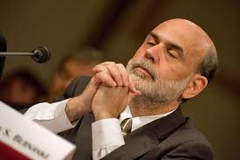

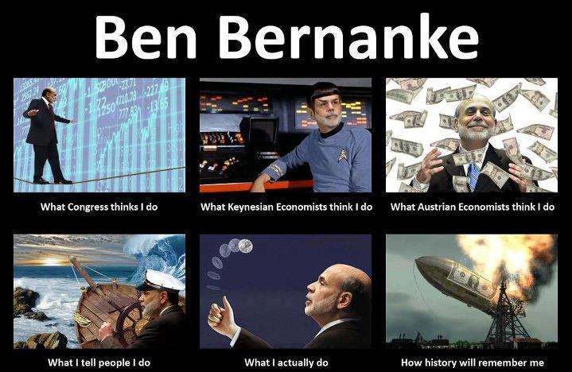
Economists Disagree with each other…
Putting Bernanke another way…
  “Our models could draw Homer Simpson in the sky, so they must be OK…”
Serious anomaly—crisis where none was thought possible—didn’t shake faith of mainstream economists in their paradigm
Same as reaction of Ptolemaic astronomers to Jupiter’s moons…

Slide 26
Economists Disagree with each other…
Economics is currently like astronomy at the time of Copernicus
  One dominant model or “paradigm” (“Neoclassical”)
    Very elaborate core model (with two main variants)
    Many “tweaks” in sub-models so they fit the data very well
      Except for the 2008 financial crisis (& the Great Depression)
Many competing paradigms that are not as elaborate, but explain things that are “anomalies” for the Neoclassical model
  Crises like 2008 & the Great Depression
    Post Keynesian economics: Fisher, Minsky
  Innovation & growth
    Austrian economics: Hayek, Schumpeter
  Pollution and ecological crises
    Ecological economics: Daly, Meadows
  Gender and ethnic inequality
    Feminist economics: Waring, Nelson
  Actual behaviour of people versus economic models
    Behavioural economics: Simon, Kahneman…

Slide 27
Economists Disagree with each other…
So economists disagree, and arguments between economists are like arguments between Ptolemaic and Copernican astronomers
Ptolemaic astronomer Earth-centric model; Copernican Sun-centric
  Ptolemaic disputes “obvious” flaws in Copernican view
    “If the Earth is moving, why don’t we fall off it?”
    “If Earth is not the centre of the Universe, why does a stone fall down when you throw it into the air?”
  Copernican points out obvious flaws with Ptolemaic view
    “If everything revolves around the Earth, why does Jupiter have moons?”
    If the Heavens are perfect, why are there craters on the Moon?”
Economists similar
  Disputes about applying dominant model (about 80% of the time)
    “Ptolemaic to Ptolemaic”: agree on model but differ on details
  Clashes between different models (about 20% of the time)
    “Ptolemaic to Copernican”: don’t understand each other & clash on world views…

Slide 28
Economists Disagree with each other…
There are at least 8 different “schools of thought” in economics:
  Neoclassical or “Mainstream”, with 2 Sub-groups
    “Freshwater”; and
    “Saltwater”
  Austrian or Libertarian
  Post-Keynesian
  Marxian
  Ecological or Evolutionary
  Behavioural
  Feminist
  “Econo-physicists”
Helps to understand economic & political debate if you know which “School” someone belongs to or listens to.

Slide 29
Neoclassical or “Mainstream”
Majority of academic economists (70-85%)
Dominates policy advice to and policy making by most governments
Key question: “Can the economy reach equilibrium with demand equal to supply in every market?”
First asked by French economist Leon Walras in the 1870s
Models based on operation of French markets (“Bourse”) at the time
  Traders in a market (for example, “wheat”) “cry out” the quantity they wish to sell or buy at a given price
  Market manager adds up demand and supply at that price
  If supply and demand differ, trade does not occur
  Market manager allowed trade when demand equalled supply—when equilibrium was achieved.
Walras generalised this to imagine it happening in all markets at once
  Made many “simplifying assumptions” to try to model this mathematically…

Slide 30
  Austrian or “Libertarian”
Minority of academic economists (maybe 5%)
Popular with some politicians (Maggie Thatcher, etc) & journalists
Key question: “How does innovation & change occur in capitalism?”
First asked by Friedrich Hayek (other guy with Keynes in the Rap)
Shares most of the core ideas of Neoclassical economics
  Individuals motivated by desire to maximise utility
  Firms motivated by desire to maximise profits
  Markets as equilibrium-seeking systems
But says actual markets are never in equilibrium
Instead, disequilibrium (supply not equal to demand) is the rule
Difference enables entrepreneur to see a way to make a profit
Disequilibrium & entrepreneurial innovation mean economy progresses
Attempts by government to control economy set off booms & busts
Best policy is to minimise (or even eliminate) the government
Let the market work things out on its own
Reject use of mathematics in economics as “Physics envy”
  Says you can’t model “human action”, free will, etc.…

Slide 31
  Post-Keynesian
Minority of academic economists (maybe 5-10%)
Some prominent bloggers but much less influence on politicians etc.
  Key question: “What caused the Great Depression, and can it happen again?”
Derived from non-textbook reading of Keynes
Rejects microeconomics accepted by Neoclassicals & Austrians
  Not “Individuals maximising utility” but “individuals coping with fundamental uncertainty about the future”
  Not “profit maximising firms” but firms investing under “animal spirits”
  Less emphasis on equilibrium, more on dynamics, change and possible crises
Focus on macroeconomics rather than micro
See money and banking as essential
Emphasise realism instead of “simplifying assumptions”
Use mathematical models, but don’t impose equilibrium solutions

Slide 32
Behavioural
Minority of academic economists (maybe 1-2%)
Prominent in media, blogs
  Key question: “How do real people behave in economic situations?”
  Origins in rejection of Neoclassical “simplifying assumption” of rational behaviour
  Experiments on what actual people do given economic choices
    Don’t “maximise utility”
    Often make choices Neoclassical theory calls “irrational”
      “Loss aversion”
      Holding onto shares rather than selling
    Focus on micro rather than macro
      But what people really do, rather than hypothetical behaviour

Slide 33
Marxian
Tiny minority of academic economists (maybe 1%)
Popular in left-wing political groups
  Key question: “How did capitalism evolve, and will it turn into something else?”
  See capitalism as based on exploitation of labour
  Used to assert that it will be superseded by socialism
  Still assert that capitalism is prone to crises and stagnation
  Based on economic & political works of Karl Marx
  Rejects “subjective” theory of value of Neoclassical School
    “Value” is not satisfaction of consumer, but effort of producer
  Focus on struggle between social classes (workers, capitalists, bankers) rather than classless individual of Neoclassical school
  Sometimes use mathematical models
    Impose assumption that all profit (“surplus”) comes from labour
  Expect crises like 2008 on basis of “tendency for rate of profit to fall”

Slide 34
Ecological/Evolutionary Economics
Tiny minority of academic economists (Maybe 1%)
Very prominent in progressive politics
  Key question: “How does the economy produce more outputs than inputs, and what are the impacts of this on the environment?”
Rejects “supply & demand” Neoclassical method
Core concept: sees economy as an evolving system over time
  Change & adaptation rather than equilibrium
  Focuses on dynamics and evolution of economy over time
Necessary link between consumption of energy & generation of waste
  No output possible without exploiting “free energy”
  Production necessarily causes waste because of “Laws of Thermodynamics”
    Described like a game of cards:
      “(1) You can’t win” (Energy can’t be made)
      “(2) You can’t break even” (Work necessarily creates waste unless there’s somewhere at Absolute Zero to dump heat)
      “(3) You can’t leave the game” (Absolute Zero doesn’t exist)

Slide 35
Feminist
Tiny minority of academic economists (less than 1%)
  Prominent in social media
  Key question: “How do relations between the sexes affect economics?”
  Emphasises aspects of society undervalued by market system
    Unpaid work of women in general (especially 3rd world economies)
    “Glass ceiling” in firms
    Unequal treatment of equal work given gender bias
    Neglected social dimensions of economic exchange
  Rejects Neoclassical tendency to treat everything as a commodity
  Focuses on value of non-market activities

Slide 36
“Econo-physicists”
Tiny minority of academic economists (less than 1%)
Influential in finance markets—“rocket scientists” in hedge funds
  Key question: “Can we understand the economy using tools from physics?”
Substantial group in physics departments
  Academics with PhDs in physics applying physics techniques to economic data
  Developed “because we’ve solved all the big problems in physics”
  Physics has sophisticated methods to analyse
    Huge amounts of data (collisions of protons in accelerators, etc.)
    Highly unstable systems powered by enormous energy
  See analogy with finance markets—many traders, huge volatility
  Apply techniques for analysing explosions, collisions, etc. to finance
Reject “Efficient Markets Hypothesis” in Neoclassical economics
Reject use of “equilibrium” as part of economic models
Far more advanced mathematics than used by Neoclassical economists

Slide 37
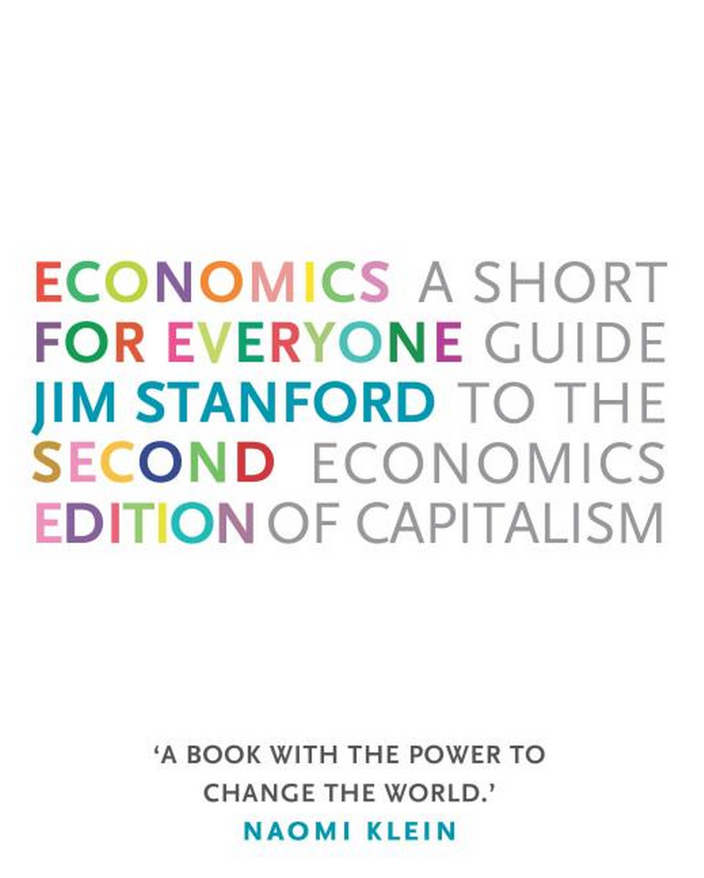
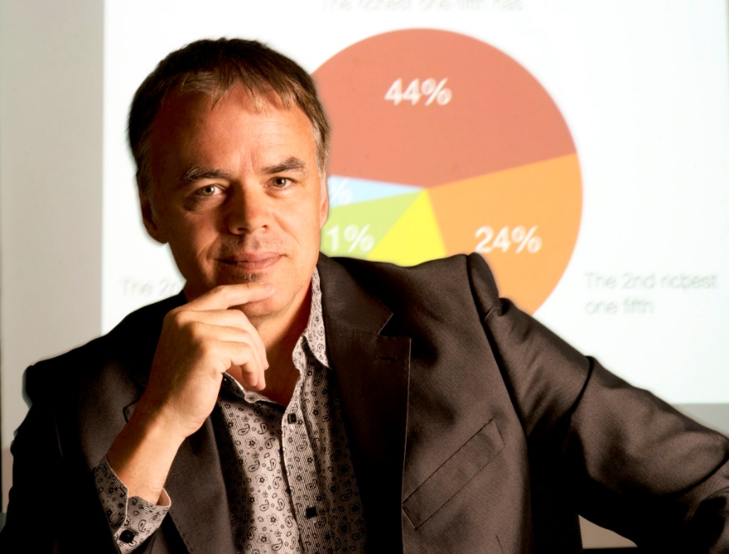
Subject Details: The textbook
Not your usual economics textbook…
Jim Stanford’s Economics for Everyone:
“Jimbo” is chief economist for the Canadian trade union Unifor, and a human rights activist as well as an economist
Buy it from Amazon here
Supporting website: http://economicsforeveryone.ca/
  Includes talks by Jimbo as well as student resources

Slide 38
Subject Details: Tutorials & Workshops
Three main purposes
  To improve your skills in data analysis & presentation
    Lab sessions on Excel, Word, Powerpoint
  To guide you in completing assessments
  To complement the lectures
Tutorial guide and resources still being developed
  Major changes have been made to this subject since last year
  Bear with us as we bring the online materials etc. up to speed…
Next week, we start looking at
  Core ideas in Mainstream, Libertarian & Post Keynesian economics
  How each group reacted to the crisis of 2008…

Slide 39
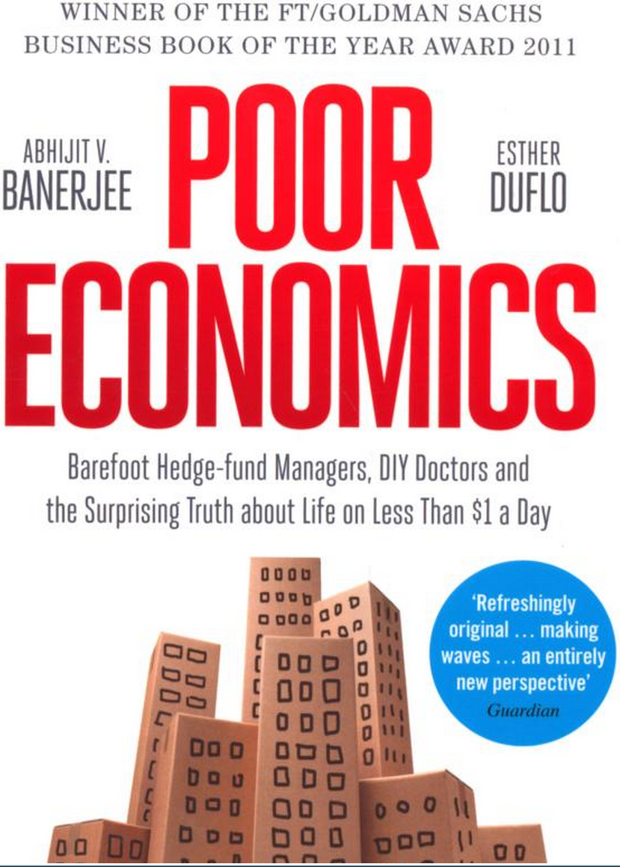
Subject Details: Assessment
Four forms of assessment
  First essay on the methodology of economics
  Second essay on a macroeconomic topic
  Group assignment
  Book Report on “Poor Economics: Barefoot Hedge-fund Managers, DIY Doctors and the Surprising Truth about Life on less than $1 a Day” by Banerjee & Duflo…
  Website: http://www.pooreconomics.com/
  Buy it from Amazon at:
  http://www.amazon.co.uk/Poor-Economics-Barefoot-Hedge-fund-Surprising/dp/0718193660

