Slide 1



Inequality, Debt and Credit Stagnation
Steve Keen
Kingston University London
IDEAeconomics
Minsky Open Source System Dynamics
www.debtdeflation.com/blogs

Slide 2
Secular Stagnation Mark I
Hansen 1939
  “Not until the problem of full employment … from the long-run, secular standpoint was upon us, were we compelled to give serious consideration to those factors … which tend to make business recoveries weak .. and which tend to prolong and deepen the course of depressions.
  This is the essence of secular stagnation—sick recoveries which die in their infancy and depressions which feed on themselves and leave a hard and seemingly immovable core of unemployment.” (Hansen, 1939, p. 4)
Hansen blamed “external factors”
  Technological change & population growth:
    “Fundamental to an understanding of this problem are the changes in the "external" forces, if I may so describe them, which underlie economic progress—changes in the character of technological innovations, in the availability of new territory, and in the growth of population.” (Hansen, 1939, p. 4)

Slide 3
Secular Stagnation Mark I
His timing was a bit off…
Hansen’s expectation
What actually happened

Slide 4
Secular Stagnation Mark II
80 years later, along comes Larry:
  “a decline in the full-employment real interest rate (FERIR) coupled with low inflation could indefinitely prevent the attainment of full employment…”
This is after the financial crisis, which, of course, is no longer an issue:
  “If a financial crisis represents a kind of power failure, one would expect growth to accelerate after its resolution as those who could not express demand because of a lack of credit were enabled to do so…
  How might one understand why growth would remain anaemic in the absence of major financial concerns? Suppose that a substantial shock took place … and that this tended to raise private saving propensities and reduce investment propensities…
  one would expect interest rates to fall … until the saving and investment rate were equated at the full-employment level of output…
  But this presupposes full flexibility of interest rates…”

Slide 5
Secular Stagnation Mark II
Finance clearly irrelevant when Hansen & Summers extemporised…

Slide 6
Secular Stagnation Mark II
Back to Larry’s FERIR brainwave:
“A variety of structural changes … suggest that FERIR levels may have declined substantially. These include:
  Slower population and possibly technological growth means a reduction in the demand for new capital goods to equip new or more productive workers…”
And the cure for a FERIR is?
  “some major exogenous event will occur that raises spending or lowers saving…”; or
  “In the long run, as the economy’s supply potential declines, the FERIR rises, restoring equilibrium – albeit not a very good one.”
So a FERIR is really, really important!
Um, but what is it though?…

Slide 7
Secular Stagnation Mark II
The FERIR was recently discovered by MIT’s fabled CERN* laboratory
  CERN stands for “Crazy Economic Rationalisations of aNomalies”
A “FERIR” (“Full-Employment Real Interest Rate”) is an antiparticle to a “NAIRU” (“Non-Accelerating Inflation Rate of Unemployment”)
FERIR created when a NAIRU interacts with a GFC (“Global Financial Crisis”) in CERN’s economic particle equilibrator (the “DSGEin”)
  DSGEin crashed—since it assumed that GFC’s don’t exist
  GFC came from orthogonal universe called TRW (“The Real World”)
Equilibration with a GFC caused the NAIRU to decay…
  And to emit a ZLB (“Zero Lower Bound”) and a FERIR
The long-lived ZLB particle inverts all other standard particles, so that
  HMDs (“Helicopter Money Drops”) which were mad, are now sane
  Growth, which was high, is now low
  CBs (“Central Banks”) which prevent inflation, now try to cause it; &
  Inflation, which was bad & everywhere, is now good & nowhere
Footnote *: CERN has been reported to COCOA (the “Campaign to Outlaw Contrived and Outrageous Acronyms”)

Slide 8
Secular Stagnation Mark II
Of course, there was no empirical data that might have alerted CERN to the possible importance of the CREDIT particle…

Slide 9
Secular Stagnation Mark I
Just like there was nothing to alert Hansen in 1934

Slide 10
Secular Stagnation Mark II
This correlation is zero in the TSM, & therefore can be ignored:

Slide 11
Let’s leave MIT, CERN and TSM for TRW…
Credit doesn’t exist in Neoclassical macro because of “Loanable Funds”
  “Think of it this way: when debt is rising, it’s not the economy as a whole borrowing more money.
  It is, rather, a case of less patient people—people who for whatever reason want to spend sooner rather than later—borrowing from more patient people.” (Krugman 2012, pp. 146-47)
ole for credit still not accepted in Post Keynesian macro either…
  “In this primer we will examine the macroeconomic theory that is the basis for analysing the economy as it actually exists. We begin with simple macro accounting, starting from the recognition that at the aggregate level spending equals income.” (Wray 2011)
  “Unless Keen (2014a) can explain how a purchase of a good or service does not provide income for the seller, then he should rethink his claim that debt extensions can force an inequality between expenditure and income at the aggregate level…
  a sector can spend more than its current income, but the sum of sectors cannot.” (Fiebiger 2014, p. 296)

Slide 12
Integrating Credit into Income ≡ Expenditure
An expenditure table view:
  Divide economy into 3 non-bank sectors plus banking sector
  Aggregate Expenditure negative sum of diagonal
  Aggregate Income positive sum of off-diagonal elements
  All flows (in $/Year at a point in time) shown in lowercase
  All stocks (in $ at a point in time) shown in UPPERCASE
  Greek ρ used for interest rate
  First case: lending/borrowing does not occur:
 | Assets |  | Liabilities |  |  | Equity
 | Loans |  | S₁ | S₂ | S₃ | B_{E}
 | Level ($) | Flows ($/Year)
S₁ |  |  | -(a+b) | a | b
S₂ |  |  | c | -(c+d) | d
S₃ |  |  | e | f | -(e+f)
B_{E}

Slide 13
Credit and Income ≡ Expenditure
Loanable Funds and (almost) no role for credit
  Sector 1 borrows l ($/Year) from Sector 2
  Pays interest of ρ.L ($/Year) to Sector 2
 | Assets |  | Liabilities |  |  | Equity
 | Loans |  | S₁ | S₂ | S₃ | B_{E}
 | Level ($) | Flows ($/Year)
S₁ |  |  | -(a+b+l+ρ.L) | a+ρ.L | b+l
S₂ |  |  | c | -(c+(d-l)) | d-l
S₃ |  |  | e | f | -(e+f)
B_{E}

Slide 14
Credit and Income ≡ Expenditure
Endogenous Money and an essential role for credit
  Sector 1 borrows l ($/Year) from banking sector
  Pays interest of ρ.L ($/Year) to banking sector…
 | Assets |  | Liabilities |  |  | Equity
 | Loans |  | S₁ | S₂ | S₃ | B_{E}
 | Level ($) | Flows ($/Year)
S₁ | L | l | -(a+b+l+ρ.L) | a | b+l | ρ.L
S₂ |  |  | c | -(c+d) | d
S₃ |  |  | e | f | -(e+f)
B_{E} |  |  | g | h | i | -(g+h+i)
Change in debt (≡credit) plays an essential role in aggregate expenditure & aggregate income with endogenous money
Expenditure is fundamentally monetary
2 sources of expenditure: turnover of existing money
New expenditure financed 1:1 by new debt

Slide 15

Credit and Income ≡ Expenditure
How to measure?
  GDP a (poor) approximate measure of flow of expenditure financed by existing money in $/Year
  Change in debt a (better) measure of flow of credit created by new debt in $/Year
  Dimensionally accurate & empirically OK to add together to measure aggregate expenditure at a point in time
  Analogy
    Flow in river
    with a pump
    injecting or removing
    water:
GDP ($/Year)
Credit ($/Year)

Slide 16
The “Smoking Gun of Credit” & Walking Dead of Debt
Add GDP to change in debt (credit) to measure aggregate expenditure
Peak GDP+Credit identifies every economic crisis since Japan…
Average credit 5 years before Crisis 18% GDP
Average after: minus 1.8% GDP

Slide 17
The “Smoking Gun of Credit” & Walking Dead of Debt
USA
Average credit 5 years before Crisis 11% GDP
Average after: 3.7% GDP

Slide 18
The “Walking Dead” of Private Debt
Countries now in post-debt crisis with low credit-based demand
Country | Crisis Date | Peak debt | Now
USA | 2006.4 | 169 | 150
UK | 2008.3 | 197 | 160
Japan | 1990.25 | 221 | 167
Spain | 2006 | 217 | 172
Ireland | 2006.5 | 330 | 257
Netherlands | 2015.25 | 247 | 238
Denmark | 2006 | 268 | 230

Slide 19
The “Walking Dead” of Private Debt
Flat to negative credit-based demand
Country | 10 years Pre | Post % GDP
USA | 10 | 4.4
UK | 13.75 | 2.5
Japan | 15.8 | 0.2
Spain | 17 | 1.8
Ireland | 21.6 | 13
Netherlands | 6.9 | 12
Denmark | 12.7 | 8.7
“Schrodinger’s Zombie”

Slide 20
The “Smoking Gun of Credit” & Future Debt Zombies
Future Debt-Zombies:
  Countries with >150% GDP private debt to GDP
  Where debt is growing quickly (above 10% of GDP per year)
  Can’t predict timing
    Can be delayed by government enticement into private debt
      Australia 2008 “First Home Vendors Boost”
      UK “Help to Sell”
  But inevitable since at high levels even stabilisation of debt/GDP ratio causes fall in aggregate demand & income

Slide 21
The “Smoking Gun of Credit” & Future Debt Zombies
Low debt ratio
GDP Growth Rate | 10%
Debt Growth Rate | 20%
Final Debt Growth | 10%
Initial Debt Ratio | 50%
Years | 0 | 1 | 2 | 3 | 4 | 5 | 6
GDP | 1000 | $1,100 | $1,210 | $1,331 | $1,464 | $1,611 | $1,772
Debt | $500 | $600 | $720 | $864 | $1,037 | $1,244 | $1,369
Debt to GDP Ratio | 50% | 55% | 60% | 65% | 71% | 77% | 77%
Credit |  | $100 | $120 | $144 | $173 | $207 | $124
Total Demand |  | $1,200 | $1,330 | $1,475 | $1,637 | $1,818 | $1,896
Demand Growth Rate |  |  | 10.8% | 10.9% | 11.0% | 11.1% | 4.3%

Slide 22
The “Smoking Gun of Credit” & Future Debt Zombies
Medium debt ratio
GDP Growth Rate | 10%
Debt Growth Rate | 20%
Final Debt Growth | 10%
Initial Debt Ratio | 100%
Years | 0 | 1 | 2 | 3 | 4 | 5 | 6
GDP | $1,000 | $1,100 | $1,210 | $1,331 | $1,464 | $1,611 | $1,772
Debt | $1,000 | $1,200 | $1,440 | $1,728 | $2,074 | $2,488 | $2,737
Debt to GDP Ratio | 100% | 109% | 119% | 130% | 142% | 155% | 155%
Credit |  | $200 | $240 | $288 | $346 | $415 | $249
Total Demand |  | $1,300 | $1,450 | $1,619 | $1,810 | $2,025 | $2,020
Demand Growth Rate |  |  | 11.5% | 11.7% | 11.8% | 11.9% | -0.2%

Slide 23
The “Smoking Gun of Credit” & Future Debt Zombies
High Debt Ratio
GDP Growth Rate | 10%
Debt Growth Rate | 20%
Final Debt Growth | 10%
Initial Debt Ratio | 125%
Years | 0 | 1 | 2 | 3 | 4 | 5 | 6
GDP | $1,000 | $1,100 | $1,210 | $1,331 | $1,464 | $1,611 | $1,772
Debt | $1,250 | $1,500 | $1,800 | $2,160 | $2,592 | $3,110 | $3,421
Debt to GDP Ratio | 125% | 136% | 149% | 162% | 177% | 193% | 193%
Credit |  | $250 | $300 | $360 | $432 | $518 | $311
Total Demand |  | $1,350 | $1,510 | $1,691 | $1,896 | $2,129 | $2,083
Demand Growth Rate |  |  | 11.9% | 12.0% | 12.1% | 12.3% | -2.2%
Future Debt Zombies include…

Slide 24
Some Future Debt Zombies
A sample of 18 vulnerable countries…
Country | Debt Ratio % | Credit % GDP
China | 210 | 29
Sweden | 237 | 15
Canada | 210 | 13
Korea | 194 | 13
Australia | 207 | 11
Norway | 234 | 6
France | 181 | 5

Slide 25
The “Smoking Gun of Credit” & Future Debt Zombies
Canada: Debt crisis almost certain during life of Trudeau Government

Slide 26
The “Smoking Gun of Credit” & Future Debt Zombies
Australia : Debt crisis almost certain during life of ??? Government

Slide 27
The “Smoking Gun of Credit” & Future Debt Zombies
China: debt crisis inevitable, but form it will take???

Slide 28
Modeling credit in capitalism
A “Lucas-critique-immune” modelling paradigm
  Derive macro models from strictly true identities
My Minsky model can be derived by putting these 3 definitions in dynamic form:
  Employment rate L/N=λ;
  Wages share of GDP W/Y=ω;
  Private debt to GDP ratio d=D/Y
Differentiate with respect to time and you get:
“Employment will rise if economic growth exceeds the sum of population & labor productivity growth”
“Wages share of output will rise if wage rise exceeds growth in labor productivity”
“Debt ratio will rise if rate of growth of debt exceeds rate of growth of GDP”

Slide 29

Modeling credit in capitalism
Operationalise with simplest possible linear expressions
We get this system with intrinsic nonlinearities:

Slide 30
Two feasible outcomes
(1) Convergence to “good” equilibrium

Slide 31
Two feasible outcomes
(2) Convergence to “bad” equilibrium after apparent “moderation”

Slide 32
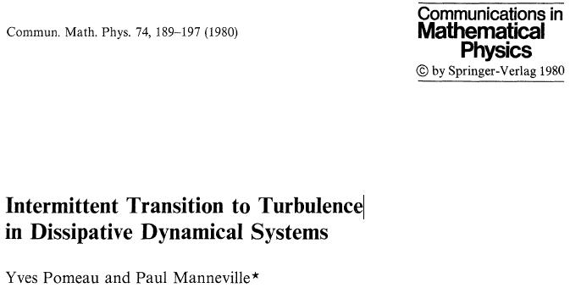
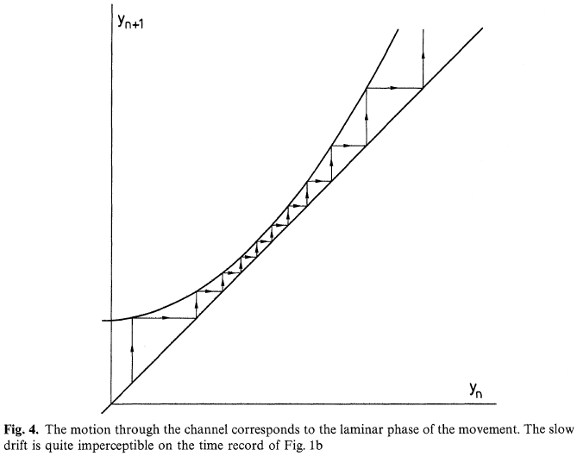
We’ve seen this before—in complex systems
Property of Lorenz “chaotic” model of fluid flow
This behaviour cannot be generated by standard equilibrium-oriented “linear” model
Inherent nonlinearity & non-equilibrium dynamics are essential
Decreasing followed by increasing turbulence
Convergence to laminar flow…

Slide 33
Modeling credit in capitalism
    Solving for π_{Eq}, ω_{Eq} and d_{Eq} yields:
Wages share is a residual:
Inequality stabilises if debt ratio converges to stable equilibrium
Inequality rises if debt ratio continues to rise
Rising inequality as a sign of systemic breakdown
Paradoxes as well: higher investment propensity→lower growth

Slide 34
Modeling credit in capitalism
Higher propensity to invest—higher debt level—lower growth
Strong sensitivity of debt to slope of investment function
Bankers benefit at expense of capitalists, workers
Higher desire to invest, lower growth rate

Slide 35
Simple complex systems model…
With price dynamics & variable interest rate
Inflation-adjusted nominal interest rate
1st order time lag determines inflation
Inflation affects wages share
Inflation affects debt growth
Lagged interest rate reaction to inflation

Slide 36
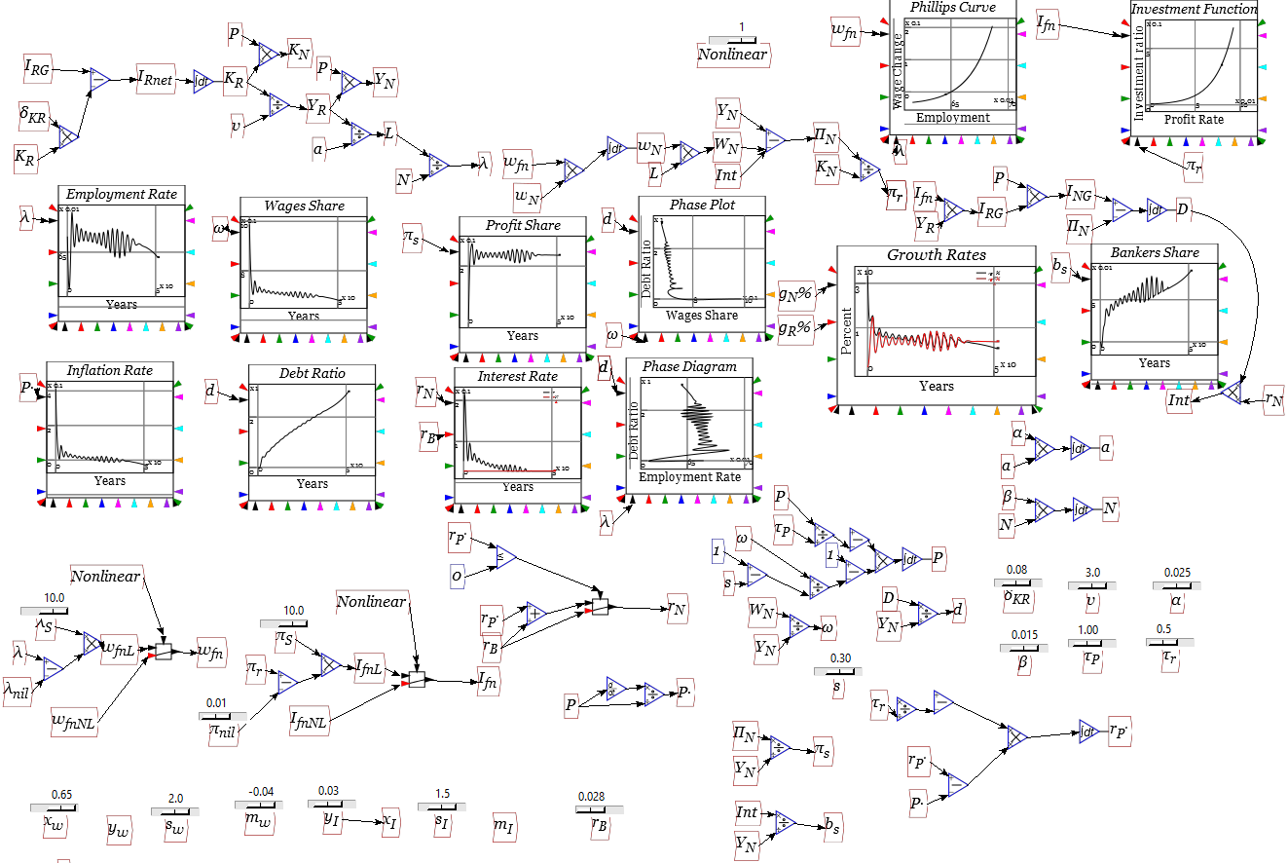
Simple complex systems model…
The same model in Open Source system dynamics program Minsky:

Slide 37
Conclusion
We’re suffering from credit stagnation, not “secular stagnation”
Summers is as wrong now as Hansen was then…

Slide 38
Debt to GDP Ratios in France
France

Slide 39
Credit & Unemployment in France
Credit and Unemployment France…

