Slide 1

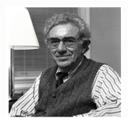

Transcending Lucas Critique & Modelling in Minsky
Steve Keen
Kingston University London
IDEAeconomics
Minsky Open Source System Dynamics
www.debtdeflation.com/blogs

Slide 2
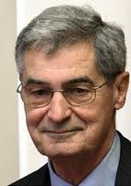
How to answer economic questions with models?
How should one do economics?
Work from microfoundations?
According to Lucas, yes:
Lucas 1976: “This essay has been devoted to an exposition and elaboration of a single syllogism: given that the structure of an econometric model consists of optimal decision rules of economic agents…”
Lucas 2003: “I also held on to Patinkin’s ambition somehow, that the theory ought to be microeconomically founded, unified with price theory. I think this was a very common view.
Nobody was satisfied with IS-LM as the end of macroeconomic theorizing. The idea was we were going to tie it together with microeconomics and that was the job of our generation.”

Slide 3
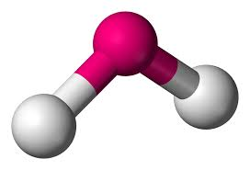






How to answer economic questions with models?
So macroeconomics must be derived from microeconomics?
Sure! Just like fluid scientists derive the properties of water (macro) from micro (single molecule of H₂0)…
A water molecule
A steam molecule
An ice molecule
A snowflake molecule
Properties of water are emergent
Can’t understand without considering relationship between entities even when they are identical
Ditto economics: “microfoundations” a non-sequitur

Slide 4
How to answer economic questions with models?
Realised by physicists half a century ago:
  “The behavior of large and complex aggregates of elementary particles, it turns out, is not to be understood in terms of a simple extrapolation of the properties of a few particles.
  Instead, at each level of complexity entirely new properties appear, and the understanding of the new behaviors requires research which I think is as fundamental in its nature as any other.
  One may array the sciences roughly linearly in a hierarchy, according to the idea:
    The elementary entities of science X obey the laws of science Y
  But this hierarchy does not imply that science X is “just applied Y”. At each stage entirely new laws, concepts, and generalizations are necessary, requiring inspiration and creativity to just as great a degree as in the previous one.
  Psychology is not applied biology, nor is biology applied chemistry.” (Anderson 1972 , p. 393)

Slide 5
How to answer economic questions with models?
Anderson explicitly rejected “constructionism”:
  “The main fallacy in this kind of thinking is that the reductionist hypothesis does not by any means imply a “constructionist” one:
    The ability to reduce everything to simple fundamental laws does not imply the ability to start from those laws and reconstruct the universe.”
Result discovered in economics by Sonnenschein-Mantel-Debreu:
  “market demand functions need not satisfy in any way the classical restrictions which characterize consumer demand functions…
  Only in special cases can an economy be expected to act as an ‘idealized consumer’. The utility hypothesis tells us nothing about market demand unless it is augmented by additional requirements.” (Shafer & Sonnenschein 1993, p. 671)
But ignored (and misunderstood) by Neoclassicals
So we can’t “do” macro by extrapolating from micro
How to do instead?...

Slide 6
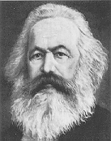
How to answer economic questions with models?
Classical tradition that structure of capitalism is the main explicant of its behaviour
Work from structure of capitalism:
  “Men make their own history,
  but they do not make it as they please;
  they do not make it under self-selected circumstances,
  but under circumstances existing already, given and transmitted from the past.” (Marx 1852)
Consistent with Post Keynesian practice:
  Derive dynamics of capitalism from its social & physical structure
Use this to pose the ultimate question about capitalism:
  “Is capitalism stable or unstable?”

Slide 7
Is Capitalism Stable or Unstable?
The (Ultra)-Orthodox Perspective
  Edward Prescott (Nobel Prize 2004 for Real Business Cycle Theory)
    “Some Observations on the Great Depression” (1999)
      “The Marxian view is that capitalistic economies are inherently unstable
      and that excessive accumulation of capital will lead to increasingly severe economic crises.
      Growth theory, which has proved to be empirically successful, says this is not true.
      The capitalistic economy is stable, and absent some change in technology or the rules of the economic game,
      the economy converges to a constant growth path
      with the standard of living doubling every 40 years.”

Slide 8
Is Capitalism Stable or Unstable?
The heterodox “Minskian” Alternative: Hyman Minsky (1969)
  “In this "Chicago" view there exists a financial system, different from that which ruled at the time of crisis but nonetheless consistent with capitalism, which would make serious financial disturbances impossible
  The alternative polar view, which I call unreconstructed Keynes­ian,
  is that capitalism is inherently flawed, being prone to booms, crises and depressions.
  This instability, in my view, is due to characteristics the financial system must possess if it is to be consistent with full-blown capitalism.
  Such a financial system will be capable of both generating signals that induce an accelerating desire to invest and of financing that accelerating investment.” (Minsky 1969 [1982, p. 224])

Slide 9
Different ideology, or better logic?
A logically incontestable starting point: working from identities
Can’t be disputed—just definitions
Put them in dynamic form and you get…
The employment rate will rise if real economic growth exceeds the sum of population growth and growth in labor productivity;
The wages share of output will rise if money wage demands exceed the sum of inflation and growth in labor productivity; and
The private debt to GDP ratio will rise if the rate of growth of private debt exceeds the sum of inflation plus the rate of economic growth.

Slide 10
Deriving the model from strict identities
Deriving Goodwin model from strict identities:
  Employment rate ≡ Employment/Population
“Employment will rise if economic growth exceeds the sum of population & labor productivity growth”

Slide 11
Deriving the model from strict identities
  Wages share of GDP ≡ Wages/GDP
“Wages share of output will rise if wage rise exceeds growth in labor productivity”

Slide 12
Deriving the model from strict identities
  Extending Goodwin to include (Hyman) Minsky
    Private Debt Ratio ≡ Debt/GDP
“The private debt ratio will rise if private debt grows faster than GDP”

Slide 13


Turning identities into a simple model
Simplest possible model of this:
  Output Y_{R} a linear function of capital K_{R}
  Investment I_{R} a linear function of profit rate π_{r} (& depreciation)
  Employment a linear function of output
  Wage change a linear function of employment rate
  Change in debt equal to investment minus profits
Some fundamental nonlinearities apply…

Slide 14
A Classical theory of economic cycles
Replicating this in Minsky (starting from basic Goodwin model)
Simplest form of this model: linear relationships between variables
    So “Capital K determines Output Y” becomes
    Output determines Employment L becomes
    Employment rate λ determines rate of change of wages w_{r}…
Rate of change of wages
A function of the rate of employment
Simplest “Phillips Curve” function linear
    Though Phillips insisted on nonlinear 3 factor function—introduced in later lectures
Rate at which wage change is zero
How much wages change for a given gap between actual employment λ and zero change rate λ₀

Slide 15
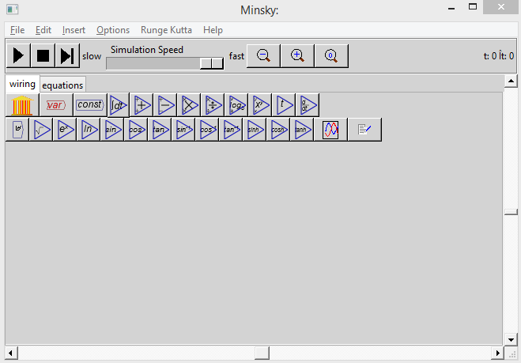
A Classical theory of economic cycles
Minsky Interface:
You develop a model by
Putting variables and mathematical operators on the canvas
Joining them using “wires”
For example, 2nd equation in Goodwin model is
Simulation controls
Toolkit of functions
“Canvas” where model is drawn
In Minsky this looks like…
Start entering this equation in Minsky by either
  Choosing “var” (“Variable”) from menu and naming it Y;
  Or simply type Y on canvas and press Enter key…

Slide 16
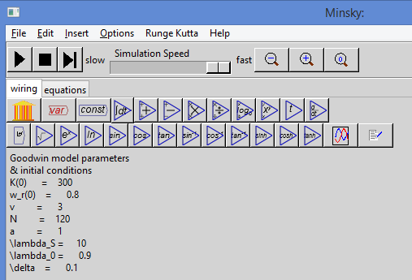
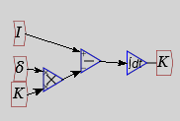
A Classical theory of economic cycles
Key block in any system dynamics program is “Integral” block
Used to relate flow (Investment) to a stock (Capital)
Take equation like
Integrate both sides
In Minsky this looks like…
Integration used rather than differentiation because it’s more stable
Now let’s build whole model starting from definition of K…

Slide 17
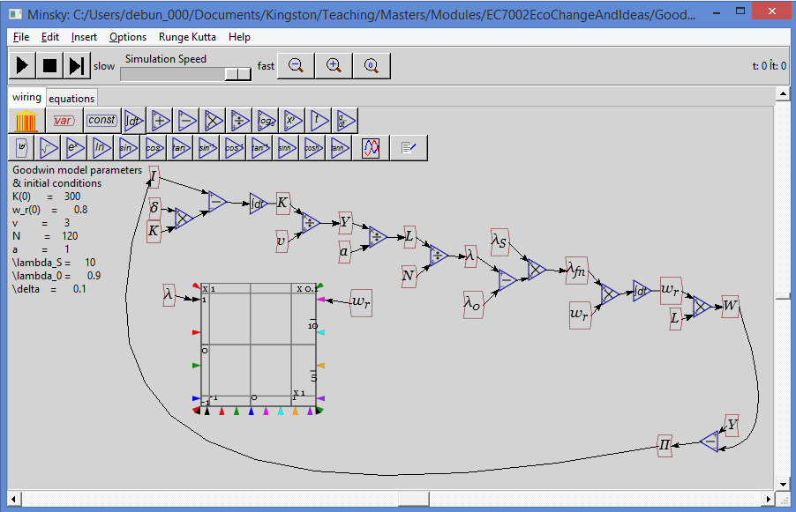
A Classical theory of economic cycles
Building model in Minsky
Using parameter values:
  v = 3
  a = 1
  λ_{s} = 10
  λ_{Z} = 0.9
  δ = 0.1
  N = 120
Initial conditions
  K(0) = 300
  w_{r}(0)=0.8
Equations…
Enter these on the canvas like this:
You should get something like the above…
Now press Run…
What you should see is sustained cycles in employment rate λ and wage rate w_{r}—not “equilibrium”…

Slide 18
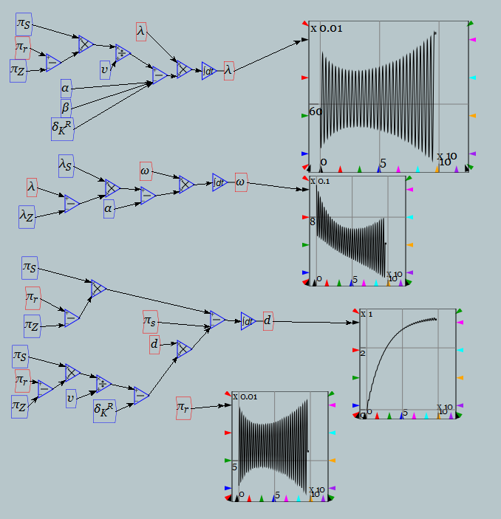
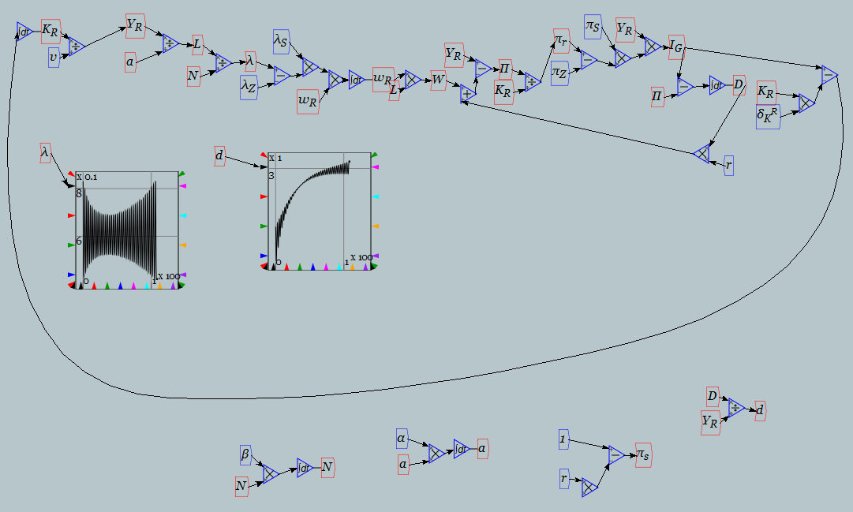
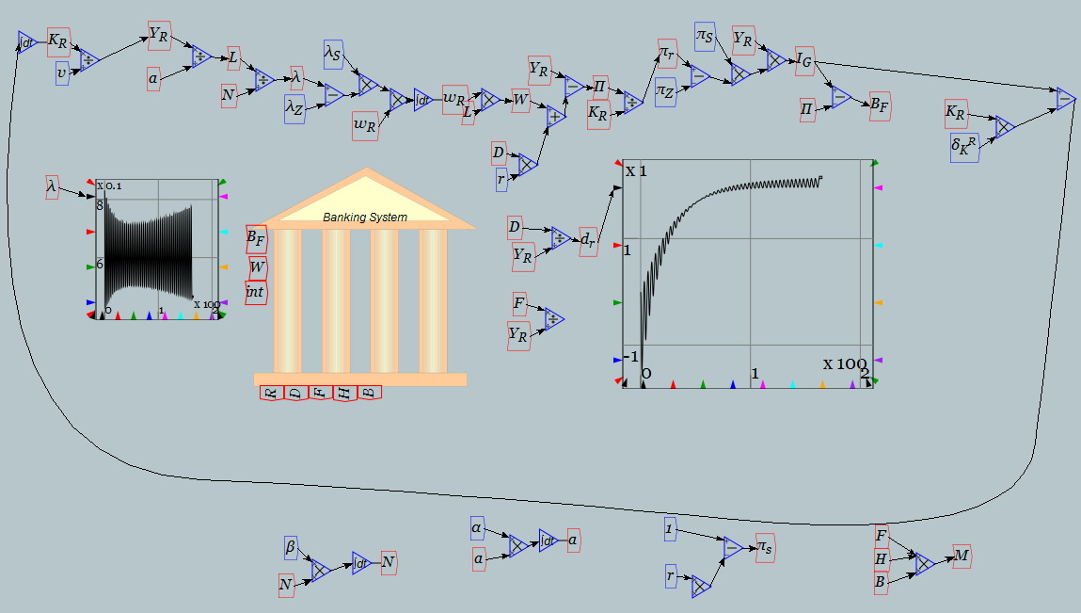
A Classical theory of economic cycles
Two basic ways to render model—closed form or full structure:

Slide 19
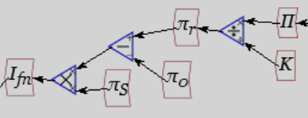
A Classical theory of economic cycles
For now let’s add next level of realism: an investment function…
Simple Goodwin model has capitalists investing all profits
  But they don’t
    Instead invest more during a boom, less during a slump
    Ignoring source of finance for this for now, add a linear investment function to this model
      Linear only for simplicity—replaced later with more realistic nonlinear function
Have capitalists
  Invest on basis of investment function (I_{fn}) where they:
    Invest all of profits when profit rate = 3%
    Have reaction coefficient as big as that used in Phillips curve = 10
      π_{Z} = 0.03
      π_{S} = 10
    In Minsky this will look like:

Slide 20
A Classical theory of economic cycles
A model of capitalism without “bankers behaving badly”:
  Pure free-market system: No government, Ponzi Finance, bankruptcy
  Nothing to “reform away” if there are problems
Model has two main equilibria:
  “Good” equilibrium: Positive employment rate & wages share of output; Finite debt ratio
  “Bad” equilibrium: Zero employment rate & wages share of output; Infinite debt ratio
Only the beginning of modelling cyclical dynamics of capitalism
  Multiple other sources of cyclicality (& possible systemic crises)
    Innovation cycles (Schumputer); inventory cycles (Meztler, Kitchin); multi-sectoral cycles (Goodwin, dynamic versions of Sraffa); ecological feedback (Limits to Growth, thermodynamics)
Actual production & behaviour nonlinear
  But linear approximation (truncated Taylor series) dominates behaviour in vicinity of equilibrium
  Model tells you deep characteristics of capitalism

Slide 21
Two possible outcomes
(1) Convergence to “good” equilibrium

Slide 22
Two possible outcomes
(2) Convergence to “bad” equilibrium after apparent “moderation”

Slide 23
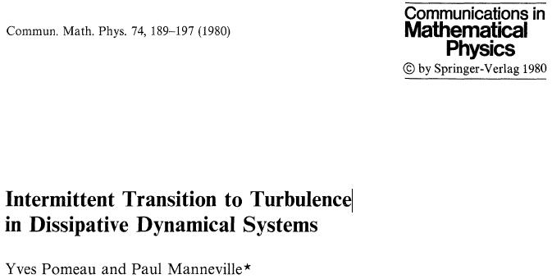
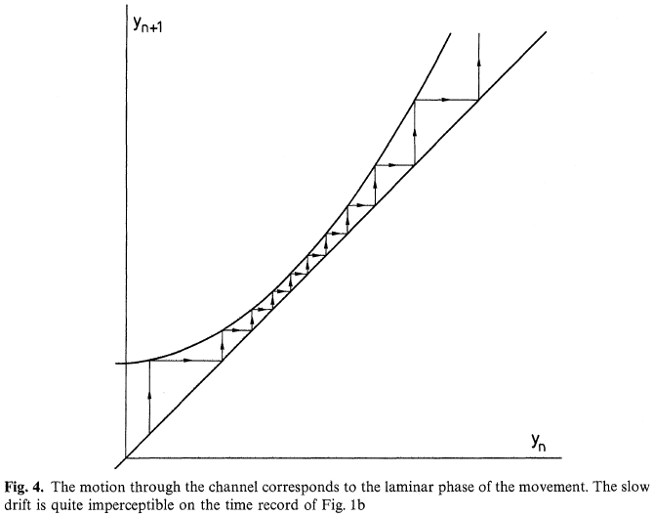
We’ve seen this before—in complex systems
Property of Lorenz “chaotic” model of fluid flow
This behaviour cannot be generated by standard equilibrium-oriented “linear” model
Inherent nonlinearity & non-equilibrium dynamics are essential
Decreasing followed by increasing turbulence
Convergence to laminar flow…

Slide 24
Emergent Phenomena 1: Diminishing cycles then crisis
Both had declining volatility before the crisis

Slide 25
Emergent Phenomena 1: Diminishing cycles then crisis
Both also had rising private debt, followed by deleveraging

Slide 26
Simple complex systems model…
Slightly more complicated but still simple model (in equations)
Inflation-adjusted nominal interest rate
1st order time lag determines inflation
Inflation affects wages share
Inflation affects debt growth
Lagged interest rate reaction to inflation

Slide 27
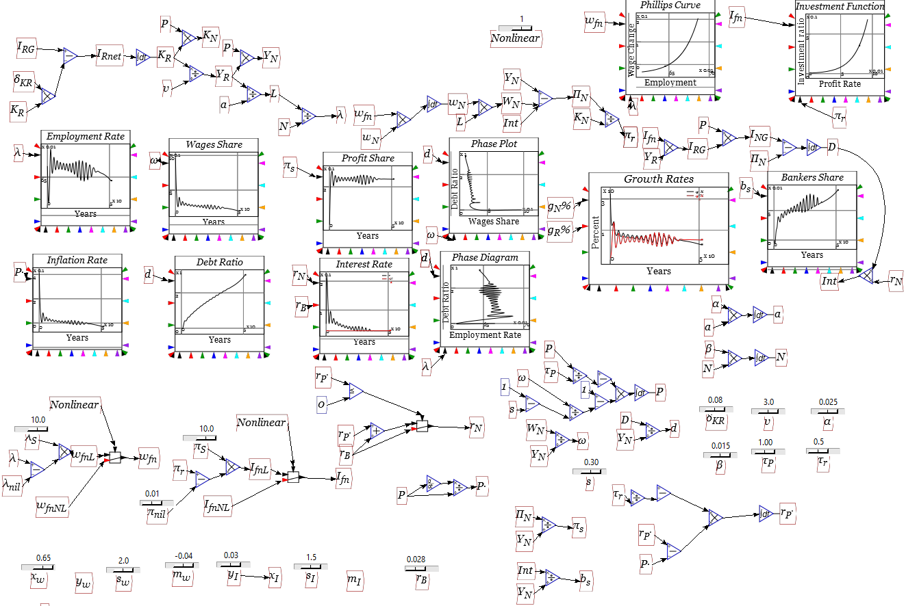
Simple complex systems model…
The same model in Open Source system dynamics program Minsky:

Slide 28
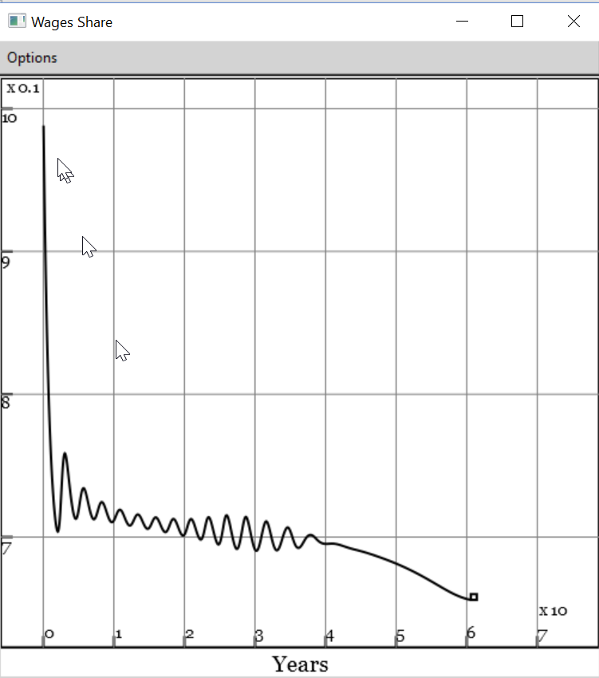
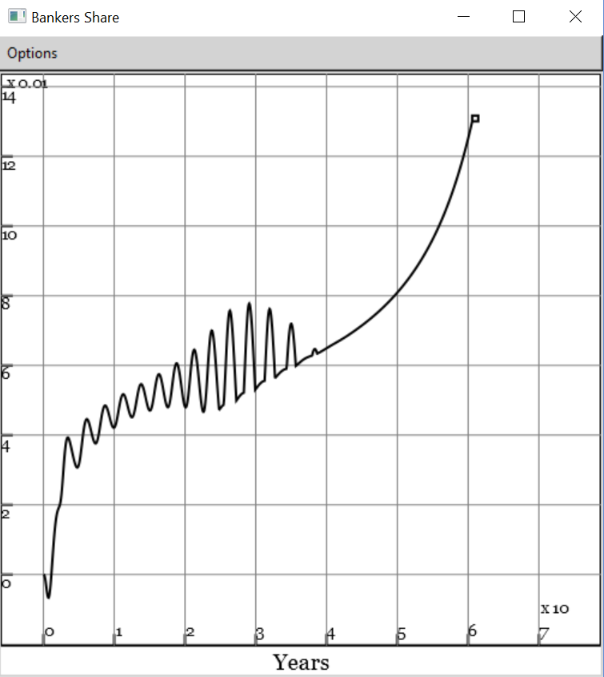
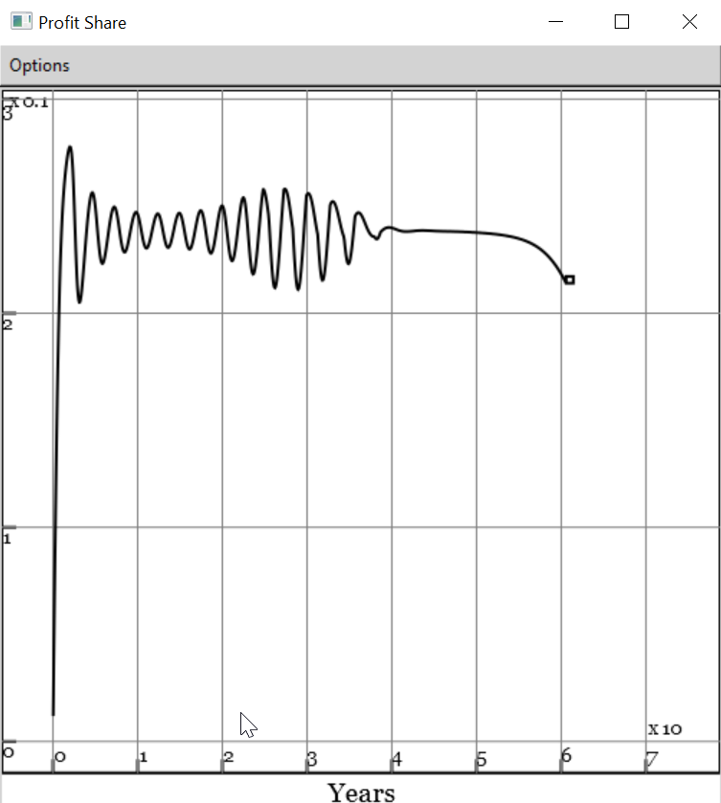
Rising inequality & crisis (full nonlinear price model)
Falling workers’ share…
Offsets rising bankers’ share…
Capitalist are the last ones to know that capitalism is coming to an end…

Slide 29
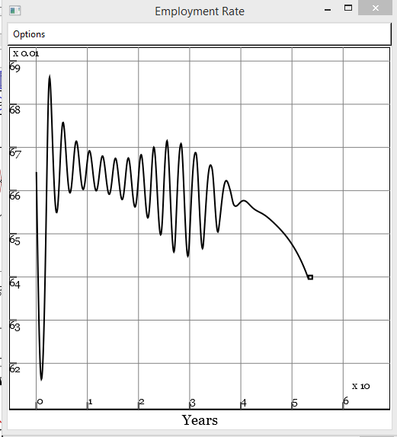
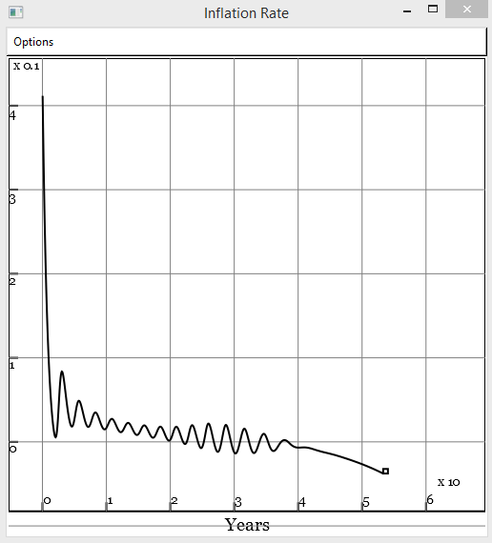
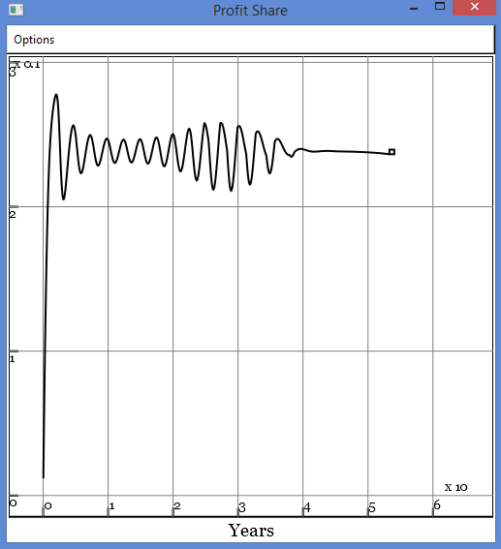
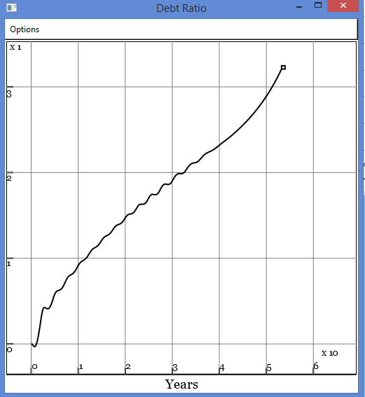
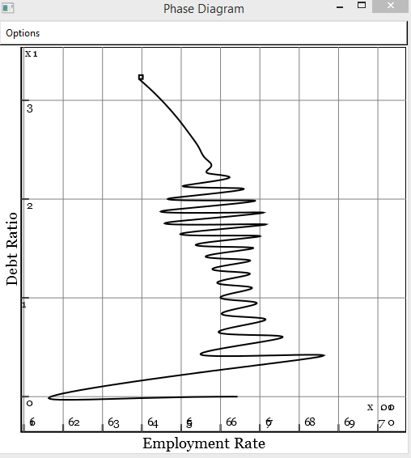
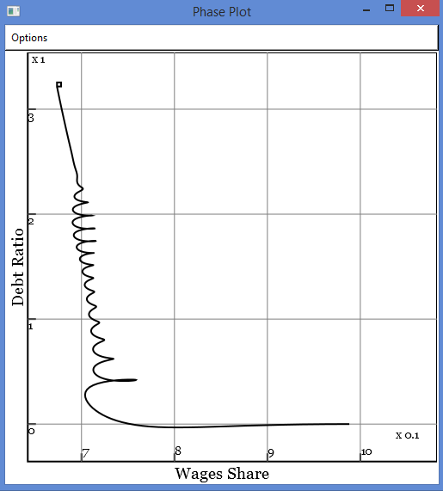
Crisis because the mainstream ignores private debt
Employment, inflation & profit give no warning of crisis:
Private debt ratio is the key indicator of impending crisis

Slide 30
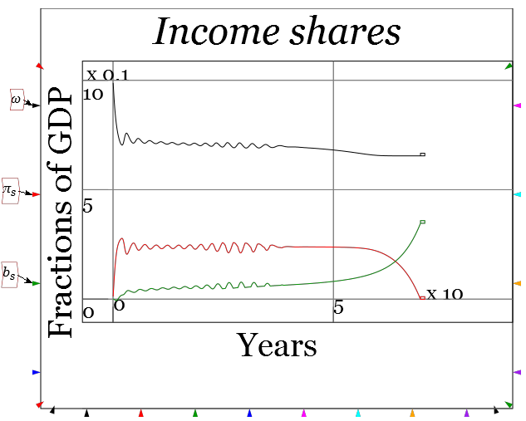
Crisis because The Left ignores private debt too
There is no “tendency for the rate of profit to fall”
There is a “tendency for private debt to grow exponentially”

Slide 31
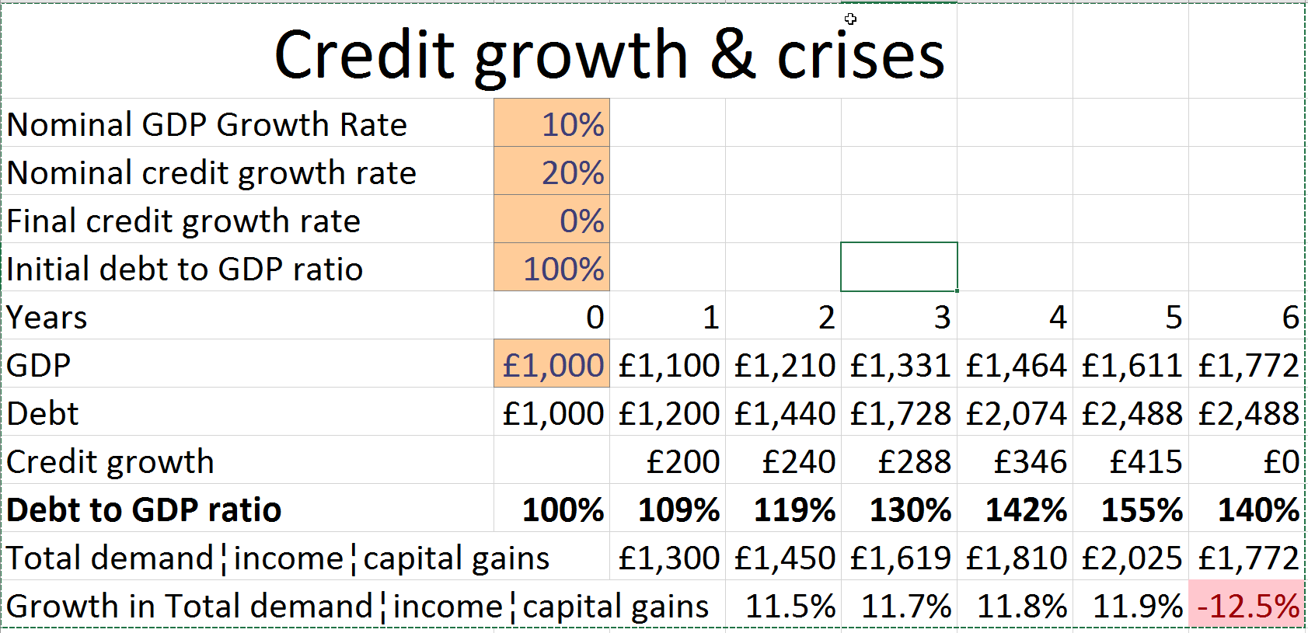
Simple reason why credit slowdown causes crises
Slowdown in credit growth causes crisis if Debt/GDP already high…

Slide 32
Where the next crisis will come from
Candidates (1) : private debt > 175% of GDP (in rank order)

Slide 33
Where the next crisis will come from
Candidates (2) : Debt growth > 8% GDP per year since 2010 (rank order)

Slide 34
Implications for economic pedagogy
A Rethinking and Re-Learning of Economics is needed
Learn Neoclassical economics well
  Warts and all (not the airbrushed textbook version)
    As a (hopefully passing) phase in the history of economic thought
Learn other existing schools well too: none have complete alternative
  Austrian, Marxian, Post Keynesian, Evolutionary, Ecological, Feminist
Learn complex systems approaches & thermodynamics
But you won’t find that curriculum at Oxford or Cambridge!
S0…
Kingston
University
London
For a pluralist education in economics
Come to Kingston
School of Economics, History & Politics

