Slide 1

EC7005: Financialisation
Steve Keen
Kingston University London
IDEAeconomics
Minsky Open Source System Dynamics
www.debtdeflation.com/blogs

Slide 2
Recap
Last week:
  The brilliance (& the bad maths) of Graziani
  Coherence of Circuitist vision once stock-flow errors overcome
  Using double-entry bookkeeping to point out lunacy of “Money Multiplier” model: violates Fundamental Law of Accounting
This week
  Lunatic idea #2: Neoclassical “Loanable Funds” model of banking
  The role of credit in aggregate demand and income

Slide 3
Lunatic idea #2: Neoclassical “Loanable Funds” model
Mainstream see banks as “intermediaries”, not “originators” of loans
  “Fisher's idea was less influential in academic circles, though, because of the counterargument that debt-deflation represented no more than a redistribution from one group (debtors) to another (creditors).
  Absent implausibly large differences in marginal spending propensities among the groups, it was suggested, pure redistributions should have no significant macro-economic effects. (Bernanke, 2000, p. 24)
  “Think of it this way: when debt is rising, it’s not the economy as a whole borrowing more money.
  It is, rather, a case of less patient people—people who for whatever reason want to spend sooner rather than later—borrowing from more patient people.” (Krugman 2012, pp. 146-47)

Slide 4
Lunatic idea #2: Neoclassical “Loanable Funds” model
The Bank of England knows better:
  “Whenever a bank makes a loan, it simultaneously creates a matching deposit in the borrower’s bank account, thereby creating new money.” (Bank of England 2014, p. 14)
Mainstream can’t see why this matters:
  “OK, color me puzzled. I’ve seen a number of people touting this Bank of England paper … as offering some kind of radical new way of looking at the economy…while banks are indeed more complicated … this doesn’t mean … that they are somehow outside the usual rules of economics. Don’t let monetary realism slide into monetary mysticism!” (Krugman 2014)
Let’s see who’s being the mystic:
  Consider “Loanable Funds” & “Endogenous Money” from double entry perspective…

Slide 5
Lunatic idea #2: Neoclassical “Loanable Funds” model
Lending as a “pure redistribution”; bank as intermediary
 | Assets | Liabilities |  | Equity
 | Reserves | Saver | Investor | Bank
Lending |  | From | To
Paying interest |  | To | From
Repaying |  | To | From
Bank Fee for arranging loan |  | From |  | To
Nothing on Asset Side
Shuffling $ on Liability Side
Lending as money creation; bank as originator of loans
Assets & Liabilities Rise
 | Assets |  | Liabilities |  | Equity
 | Reserves | Loans | Saver | Investor | Bank
Lending |  | From |  | To
Paying interest |  |  |  | From | To
Repaying |  | To |  | From
Assets & Liabilities Fall
Is there no essential difference, as Krugman claims?...

Slide 6
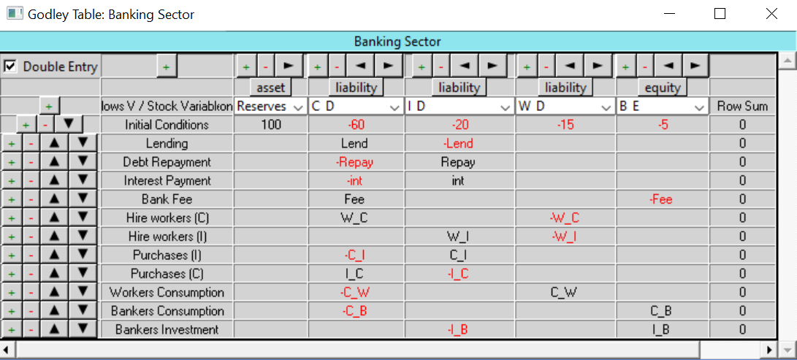
Lunatic idea #2: Neoclassical “Loanable Funds” model
Modelling this in Minsky:
  Two firm sectors: Consumption & Investment
  Consumption is the “Saver”; Investment the “Borrower”
  Set up basic operations in Godley Table for Bank…
Notice Debt doesn’t appear at all: that’s because it’s an Asset of the Consumer sector & Liability of the Investment Sector…

Slide 7
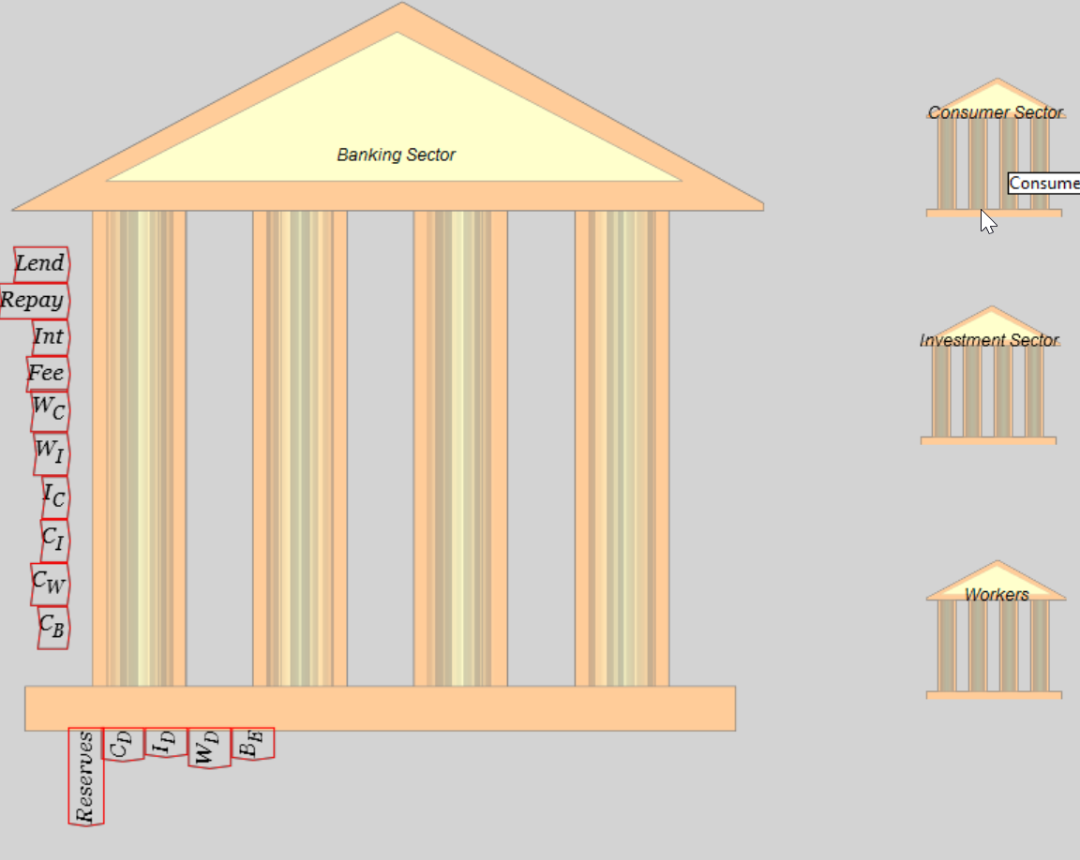
Lunatic idea #2: Neoclassical “Loanable Funds” model
Create 3 more Godley Tables: Consumer Sector, Investment, Workers

Slide 8
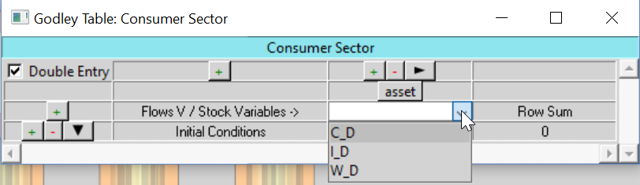
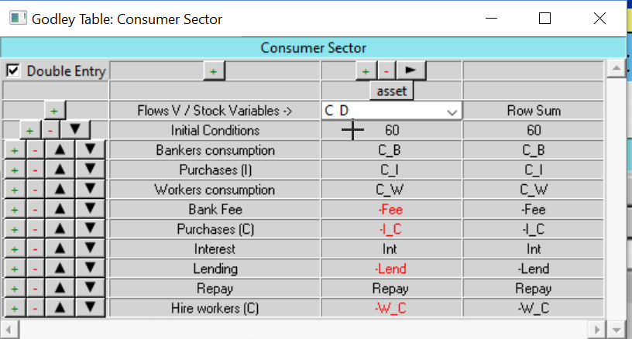
Lunatic idea #2: Neoclassical “Loanable Funds” model
Choose an existing liability as an asset for each table:
Minsky populates column with all existing operations on it:

Slide 9
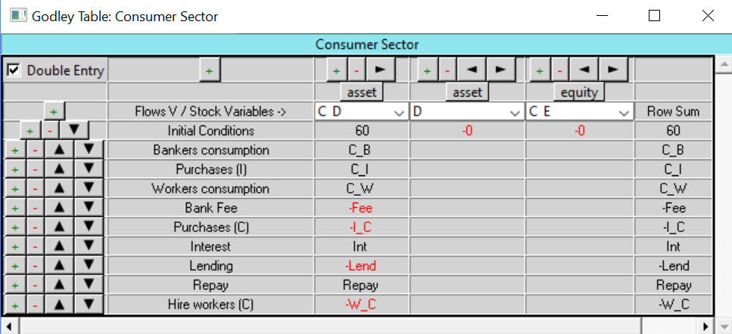
Lunatic idea #2: Neoclassical “Loanable Funds” model
Insert “D” for Debt as an asset of the consumer sector; and
C_E for Equity of the consumer sector
Enter matching double-entry operation for each row…

Slide 10
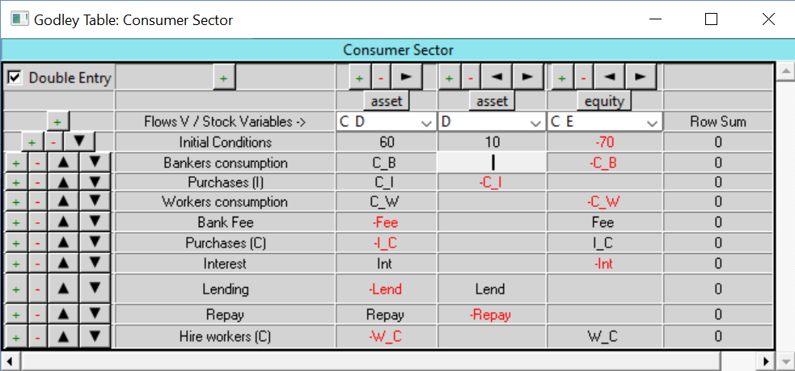
Lunatic idea #2: Neoclassical “Loanable Funds” model
Final state of Consumer Sector’s Godley Table:
Do the same for Investment Sector & Workers…

Slide 11
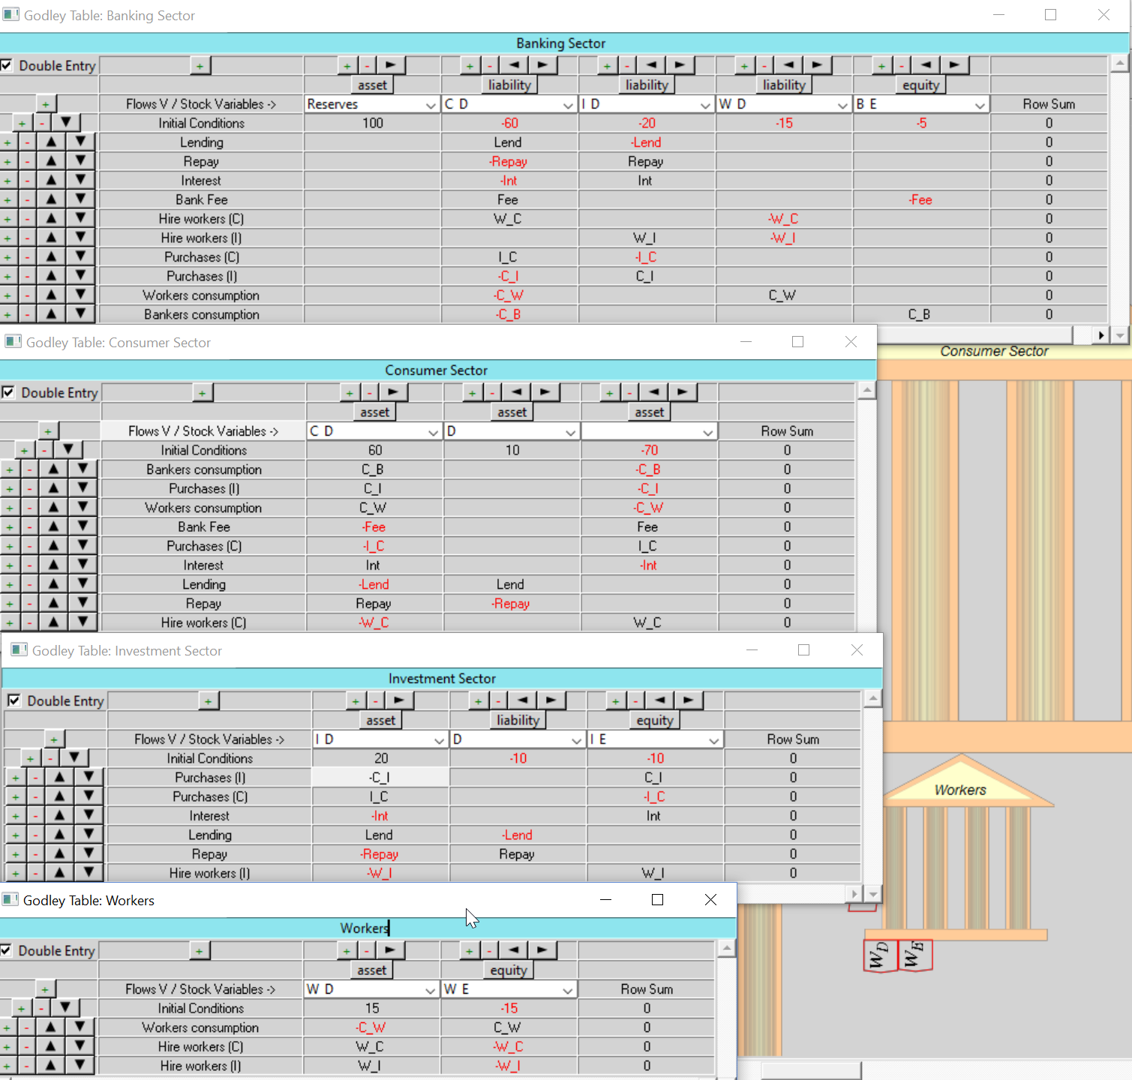
Lunatic idea #2: Neoclassical “Loanable Funds” model
Final set of Godley Tables:

Slide 12
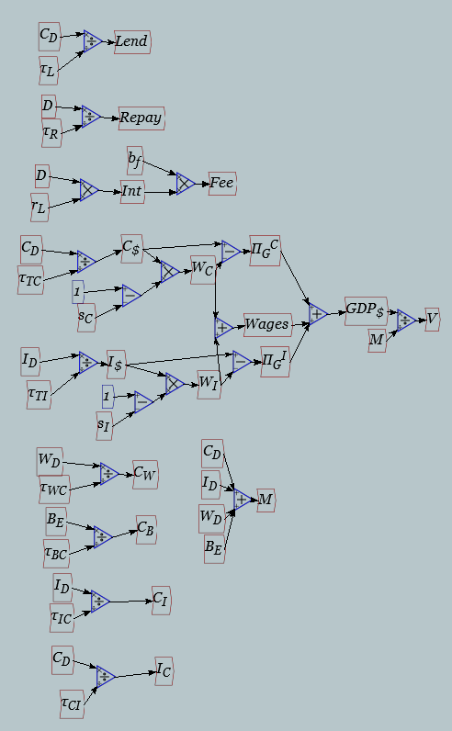
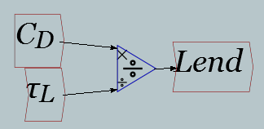
Lunatic idea #2: Neoclassical “Loanable Funds” model
Add definitions for flow variables using stocks & time constants:
Money in C sector account ($)
Flow of lending ($/Year)
Time constant of lending (Years)
Similar definitions for other flows
Except interest payments (Debt times interest rate)
Bank Fee (Fraction of interest payments)
Share of surplus going to capitalists (fraction of annual turnover)
Can define incomes/year as well…

Slide 13
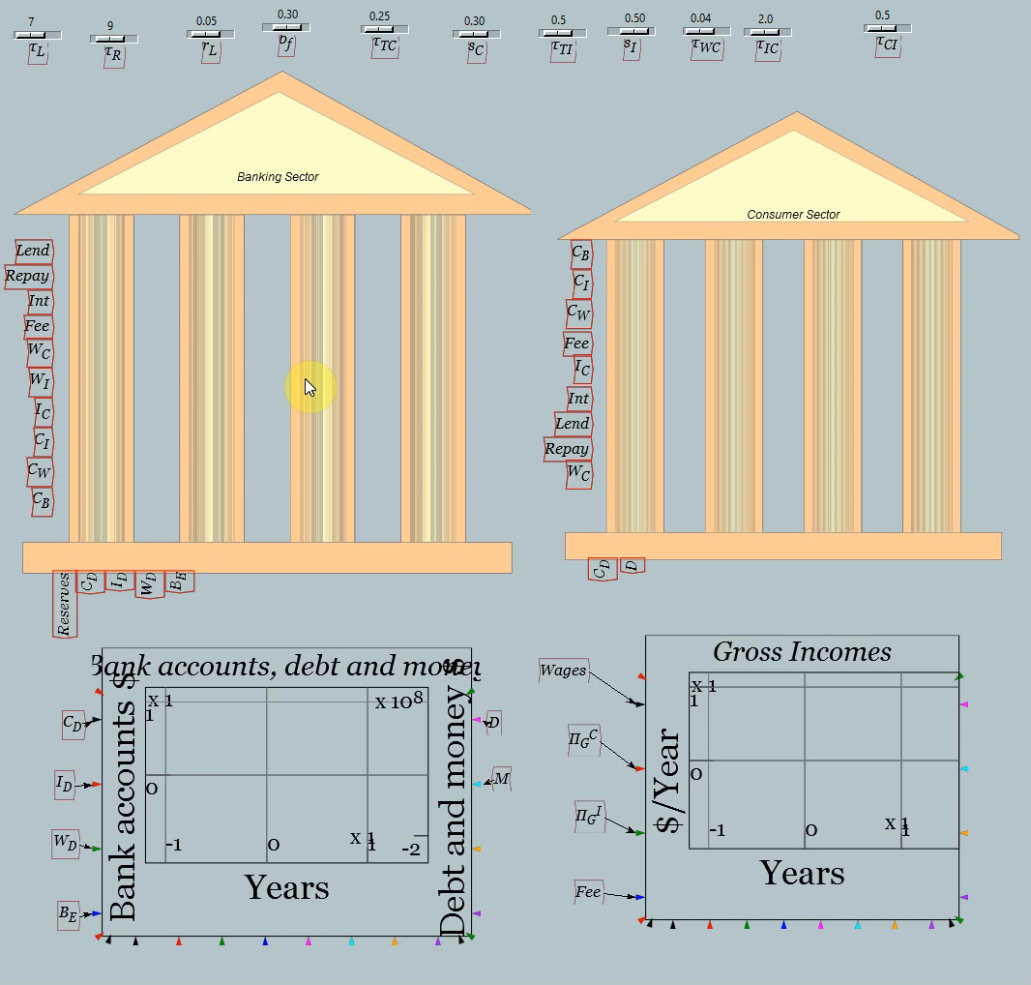
Lunatic idea #2: Neoclassical “Loanable Funds” model
Shrink the Godley Tables to make room for some graphs:
Sliders to change parameters during simulation
Now let’s test the model out…

Slide 14
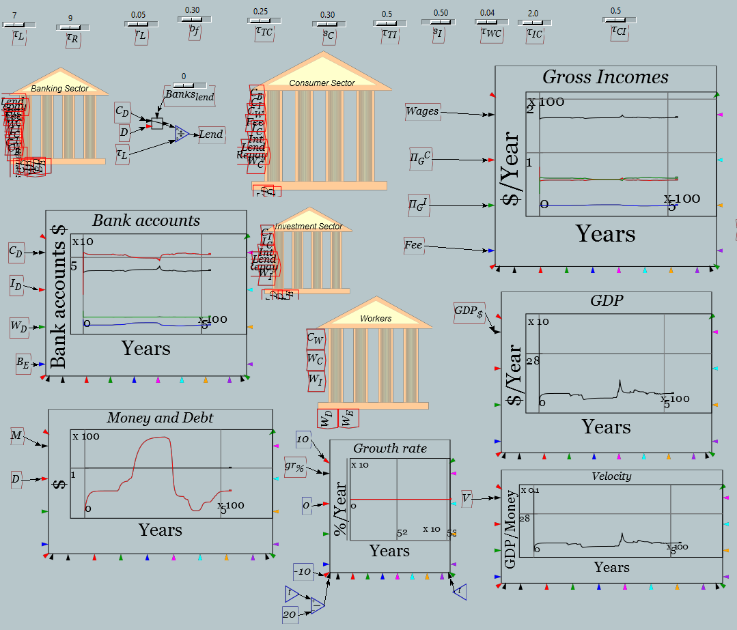
Lunatic idea #2: Neoclassical “Loanable Funds” model
Bernanke & Krugman are right! Debt doesn’t matter…
IF banks are just “intermediaries”
But what if they—shudder—lend money?
What if they originate rather than merely intermediate?

Slide 15
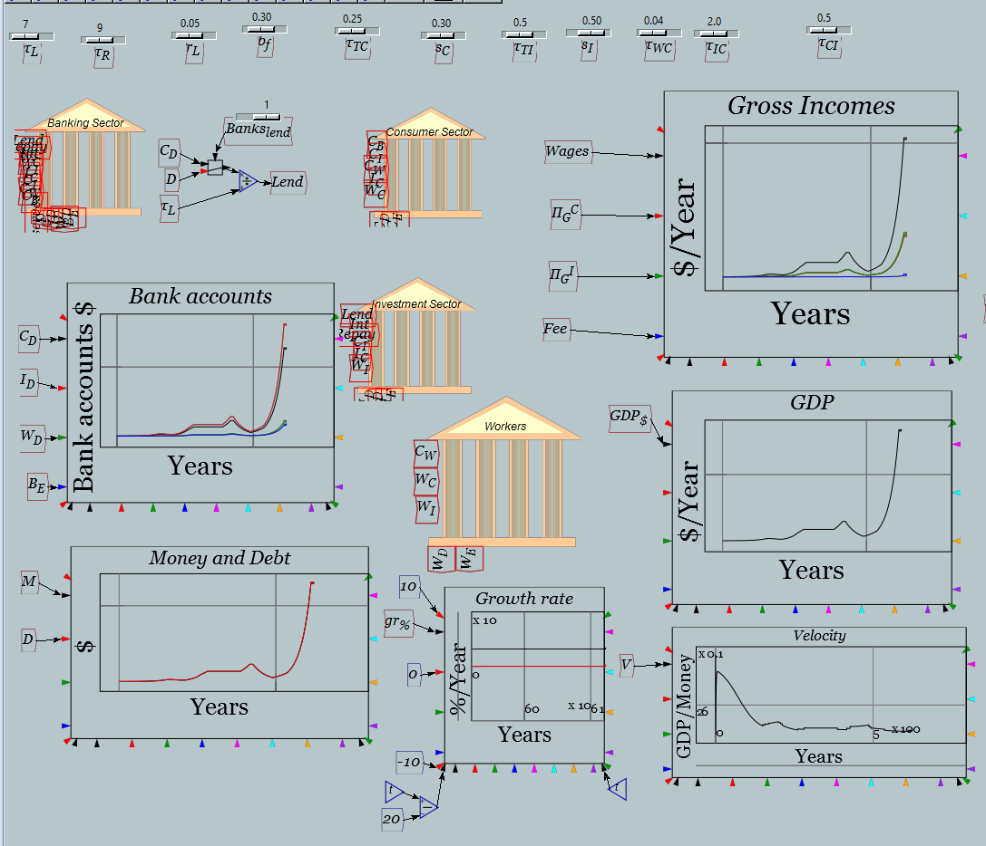
Lunatic idea #2: Neoclassical “Loanable Funds” model
The result is slightly different…
Lending creates money
And Demand
And Income

Slide 16
Loanable Funds vs Endogenous Money
Why is it so different?
  Loanable Funds:
    Banks intermediate between savers & investors
    No creation of money by lending
    No creation of additional demand either
  Endogenous money:
    Banks originate loans to investors (& speculators)
    Money created by lending
    Additional demand created
    Change in Debt thus adds to demand
      But how to reconcile this with “Expenditure≡Income” identity?...

Slide 17
Loanable Funds, aggregate demand & income
Consider 3 sector model with sectors S₁, S₂, S₃
Expenditure not debt-financed shown by CAPITAL LETTERS
Debt financed expenditure shown by lowercase letters
3 situations considered
  Borrowing not possible
  Borrowing from other sectors possible (“Loanable Funds”)
  Borrowing from banks possible (“Endogenous Money”)
First case “Say’s Law” (actually “demand creates its own supply”)
Activity |  | Net Income
 | Sector | Sector 1 | Sector 2 | Sector 3
Expenditure | Sector 1 | -(A + B) | A | B
 | Sector 2 | C | -(C+D) | D
 | Sector 3 | E | F | -(E+F)
Negative sum of diagonal elements is aggregate demand
Sum of off-diagonal elements is aggregate income

Slide 18
Loanable Funds, aggregate demand & income
Clearly Expenditure ≡ Income:
Loanable Funds: Sector 1 borrows b from Sector 2 to spend on Sector 3
  Sector 1’s funds for spending increase by b
  Sector 2’s funds fall by b
Activity |  | Net Income
 | Sector | Sector 1 | Sector 2 | Sector 3
Expenditure | Sector 1 | -(A + B+b) | A | B+b
 | Sector 2 | C | -(C+D-b) | D-b
 | Sector 3 | E | F | -(E+F)
Aggregate outcome clearly the same as without borrowing
Sound logical basis of Bernanke’s “Absent implau­sibly large differences in marginal spending propensities among the groups, it was suggested, pure redistributions should have no significant macro­economic effects.”

Slide 19
Endogenous money, aggregate demand & income
But what if a bank lends to Sector 1?
  Assets & liabilities of banking sector rise equally; and…
  Increased spending power for Sector 1 not offset by fall in Sector 2
Causes a rise in Sector 1’s spending, and incomes of Sectors 2 & 3
Bank Assets | Activity |  | Net Income
Loans |  | Sector | S1 | S2 | S3
b | Expenditure | S1 | -(A+B+b) | A | B+b
0 |  | S2 | C | -(C+D) | D
0 |  | S3 | E | F | -(E+F)
Aggregate outcome greater (if b>0) than without borrowing
Increase in debt causes equivalent increase in expenditure and income

Slide 20
Endogenous money, aggregate demand & income
More precisely:
  Most loans are effectively “spent into existence”
  Loan is approved (e.g., mortgage) as an allowed ceiling
  No liability incurred until borrowed money transferred to seller
  Loan and expenditure appear simultaneously
  Expenditure of loan becomes income (or source of potential capital gain) for the seller…

Slide 21
Endogenous money, aggregate demand & income
Bank-eye-view of Loanable Funds:
Action | Assets | Liabilities: Deposit Accounts |  |  | Net Positions
 |  | Saver | Borrower | Recipient | Assets | Liabilities
Create |  | -Lend | +Lend |  | 0 | 0
Spend |  |  | -Lend | +Lend | 0 | 0
Net | 0 | -Lend | 0 | +Lend | 0 | 0
Bank-eye-view of Endogenous Money:
Action | Assets | Liabilities: Deposit Accounts |  |  | Net Positions
 | Loans | Saver | Borrower | Recipient | Assets | Liabilities
Create | +Lend |  | +Lend |  | +Lend | +Lend
Spend |  |  | -Lend | +Lend | 0 | 0
Net | +Lend |  | 0 | +Lend | +Lend | +Lend

Slide 22
Endogenous money, aggregate demand & income
More formally, using “time constants” introduced earlier
Each sector S_{x} has bank deposit of S_{x} $
Each spends at the rate τ_{xy} on the other sectors
First situation: no borrowing possible…
Same situation as before—now expressed using time constants:
Now “Loanable Funds”: non-bank lender devotes splits flow of expenditure into part expenditure, part lending…

Slide 23
Endogenous money, aggregate demand & income
Banks intermediate loans…
Part of flow S₂ would have spent on S3 is lent to S1 instead
Change in debt turns up as part of aggregate demand & income
  If “marginal propensities to spend” differ
Logical basis for Bernanke’s “Absent implausibly large differences in marginal spending propensities among the groups, it was suggested, pure redistributions should have no significant macro-economic effects.”

Slide 24
Endogenous money, aggregate demand & income
Banks originate loans…
Money “borrowed”
By S1 spent on S2
Creating income for S2
Change in debt turns up 1:1 as part of aggregate demand & income

Slide 25
Endogenous money, aggregate demand & income
Reconciliation with Expenditure≡Income identity
  Expenditure is the sum of
    Expenditure financed by turnover of existing money
      Measured—however poorly—as GDP (Expenditure method)
      Dimensioned in $/Year
    Plus expenditure financed by new debt
      Measured—more accurately—as Change in Debt
      Dimensioned in $/Year
    Plus gross financial transactions (debt & deposit interest)
    Total expenditure is therefore
Income side of identity needs amendment too:
  Vast majority of debt today finances asset purchases
  Modern monetary theory must integrate macroeconomics & finance
  Income side is therefore Income plus realized capital gains

Slide 26
Endogenous money, aggregate demand & income
GDP & capital gains are both affected by change in debt
GDP growth and realized capital gains affected by debt acceleration
Change in debt by far most the volatile element on expenditure side
  Logical basis for extraordinary empirical correlations between
    Change in debt & economic activity (employment rate, etc.)
    Acceleration in debt and change in economic activity
    Acceleration in debt and change in asset market prices
Empirical findings contradict mainstream macro & finance theory
  Rather than changes in debt being “pure redistributions” with “no significant macro-economic effects”, changes in debt are the main determinants of macroeconomic outcomes
  Rather than leverage not affecting asset prices (Modigliani-Miller theorem), leverage is the main determinant of asset prices…

Slide 27
The historical record from a credit perspective
We are living during the biggest private debt bubble in history:

Slide 28
The historical record from a credit perspective
The very long view: every serious crisis caused by deleveraging

Slide 29
The historical record from a credit perspective
The developed world is on the downside of “Peak Debt”
Next economic crisis will come from developing world…

