Slide 1

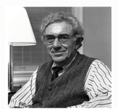

Is Capitalism Doomed to have Crises?
Steve Keen
Kingston University London
IDEAeconomics
Minsky Open Source System Dynamics
www.debtdeflation.com/blogs

Slide 2
Is Capitalism Stable or Unstable?
The (Ultra)-Orthodox Perspective
  Edward Prescott (Nobel Prize 2004 for Real Business Cycle Theory)
    “Some Observations on the Great Depression” (1999)
      “The Marxian view is that capitalistic economies are inherently unstable
      and that excessive accumulation of capital will lead to increasingly severe economic crises.
      Growth theory, which has proved to be empirically successful, says this is not true.
      The capitalistic economy is stable, and absent some change in technology or the rules of the economic game,
      the economy converges to a constant growth path
      with the standard of living doubling every 40 years.”

Slide 3
Is Capitalism Stable or Unstable?
The heterodox “Minskian” Alternative: Hyman Minsky (1969)
  “In this "Chicago" view there exists a financial system, different from that which ruled at the time of crisis but nonetheless consistent with capitalism, which would make serious financial disturbances impossible
  The alternative polar view, which I call unreconstructed Keynes­ian,
  is that capitalism is inherently flawed, being prone to booms, crises and depressions.
  This instability, in my view, is due to characteristics the financial system must possess if it is to be consistent with full-blown capitalism.
  Such a financial system will be capable of both generating signals that induce an accelerating desire to invest and of financing that accelerating investment.” (Minsky 1969 [1982, p. 224])

Slide 4
A contest of ideologies, or logic?
A logically incontestable starting point: working from identities
Can’t be disputed—just definitions
Can only dispute relevance
Neoclassicals dispute relevance of 3rd definition
?
“Fisher's idea was less influential … because of the counterargument that debt-deflation represented no more than a redistribution from one group (debtors) to another (creditors).
Absent implausibly large differences in marginal spending propensities among the groups, it was suggested, pure redistributions should have no significant macro-economic effects…”)
But is this valid?

Slide 5

A contest of ideologies or logic?
Minsky asserts a key role for private debt:
  “The natural starting place for analyzing the relation between debt and income is to take an economy with a cyclical past that is now doing well…”
Let’s consider. Putting those 3 identities into dynamic form yields:
  The employment rate will rise if economic growth exceeds the sum of growth in labor productivity and population growth;
  The wages share of output will rise if wage demands exceed the growth in labor productivity; and
  The private debt to GDP ratio will rise if private debt growth exceeds the rate of economic growth
In equations…

Slide 6

A contest of ideologies or logic?
Simplest possible model of this:
  Output Y_{R} a linear function of capital K_{R}
  Investment I_{R} a linear function of profit rate π_{r} (& depreciation)
  Employment a linear function of output
  Wage change a linear function of employment rate
  Change in debt equal to investment minus profits
Some fundamental nonlinearities apply…

Slide 7
A contest of ideologies or logic?
A model of capitalism without “bankers behaving badly”:
  Pure free-market system
  No government sector, no Ponzi Finance, no bankruptcy
  Nothing to “reform away” if there are problems
Model has two main equilibria:
  “Good” equilibrium:
    Positive employment rate & wages share of output
    Finite debt ratio
  “Bad” equilibrium:
    Zero employment rate & wages share of output
    Infinite debt ratio

Slide 8
Two possible outcomes
(1) Convergence to “good” equilibrium

Slide 9
Two possible outcomes
(2) Convergence to “bad” equilibrium after apparent “moderation”

Slide 10
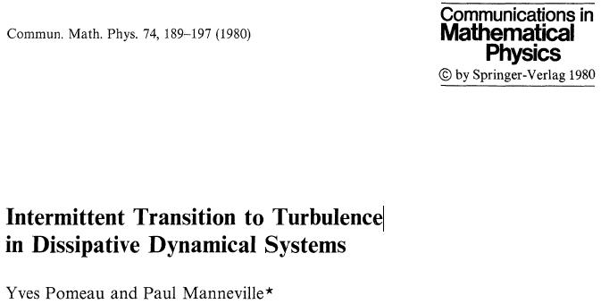
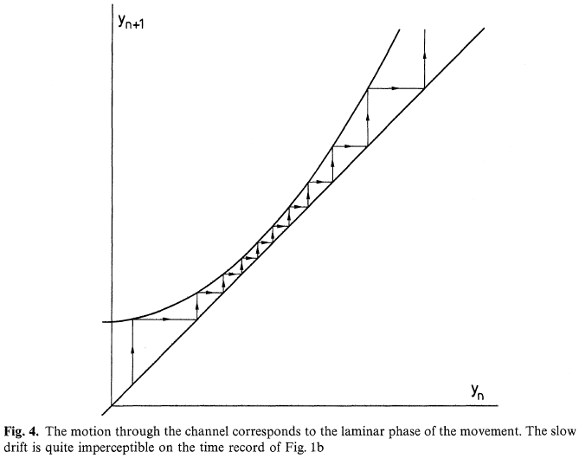
We’ve seen this before—in complex systems
Property of Lorenz “chaotic” model of fluid flow
This behaviour cannot be generated by standard equilibrium-oriented “linear” model
Inherent nonlinearity & non-equilibrium dynamics are essential
Decreasing followed by increasing turbulence
Convergence to laminar flow…

Slide 11
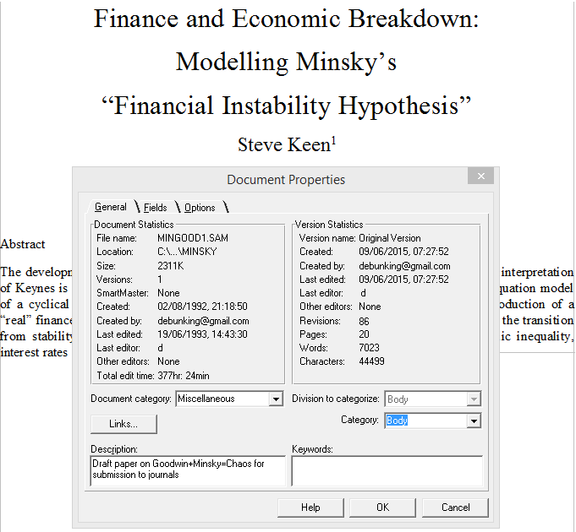
Genesis of the Keen/Minsky/Goodwin model
Objective of my 1995 JPKE paper was to model Minsky’s “Financial Instability Hypothesis”
Original paper written in August 1992
Well before Neoclassicals discovered (and misinterpreted) the “Great Moderation”…

Slide 12
Emergent Phenomena: Diminishing cycles then crisis
Model had completely unexpected dynamics
  Debt crisis, as expected
  But apparent tranquillity beforehand
  Pure free-market capitalism trapped in a vortex of rising debt?…
Inspired what I thought at the time was a nice rhetorical flourish
“The chaotic dynamics explored in this paper should warn us against accepting a period of relative tranquility in a capitalist economy as anything other than a lull before the storm.” (Keen 1995)

Slide 13
Economic implications of model
Real-world implications of the model:
  If there was decreasing volatility in inflation & employment
  And the private debt to GDP ratio was stabilizing
    Then Prescott was right
      Economy is bound for equilibrium & stable growth
  If there was decreasing volatility in inflation & employment
  And the private debt to GDP ratio was increasing
    Then Minsky was right
      Economy is bound for systemic breakdown; and…
      Crisis will be preceded by period of apparent stability in employment & inflation
What does the data show?
There were two boom-bust crises in capitalism in last century
  1920-40, 1980-Now…

Slide 14
Emergent Phenomena 1: Diminishing cycles then crisis
Both had declining volatility before the crisis

Slide 15
Emergent Phenomena 1: Diminishing cycles then crisis
Both also had rising private debt, followed by deleveraging

Slide 16
Emergent Phenomena 1: Diminishing cycles then crisis
Linear, equilibrium framework of mainstream economists led them to
  (1) Dismiss “Great Depression” as due to policy mistakes
    “Let me end my talk by abusing slightly my status as an official representative of the Federal Reserve.
    I would like to say to Milton and Anna:
      Regarding the Great Depression.
      You're right, we did it.
      We're very sorry.
      But thanks to you, we won't do it again.” (Bernanke 2002)
  (2) Interpret “Great Moderation” as due to their good management
    “The sources of the Great Moderation remain somewhat controversial, but as I have argued elsewhere,
    there is evidence for the view that improved control of inflation has contributed in important measure to this welcome change in the economy.” (Bernanke 2004)
From Keen-Minsky model perspective, “The Great Moderation” & “The Great Recession” were simply phases in same dynamic process…

Slide 17
Emergent Phenomena 2: Rising inequality
Other emergent aspects of model
Model’s “system states” are
  Employment rate (λ)
  Debt ratio (d)
  Wages share of output (ω)
Model’s equilibria are
  Employment rate (λ)
  Debt ratio (d)
  Profit share of output (π)
Wages share directly negatively related to debt ratio
Relationship persists in model dynamics
  If model converges to good equilibrium, then inequality stabilizes
  If model diverges to bad equilibrium, then inequality rises
    Falling workers’ share offsets rising bankers’ share
    Profit share cycles around equilibrium (before final crisis)
Rising inequality is a prelude to crisis…

Slide 18
Simple rules, complex behaviour
Best seen in full price model with nonlinear behavioural functions
Generated by generalizing earlier identities to include inflation:
  The employment rate will rise if real economic growth exceeds the sum of population growth and growth in labor productivity;
  The wages share of output will rise if money wage demands exceed the sum of inflation and growth in labor productivity; and
  The private debt to GDP ratio will rise if the rate of growth of private debt exceeds the sum of inflation plus the rate of economic growth.
Additional equations needed for
  Rate of inflation
    Lagged convergence to equilibrium prices in monetary economy
  Variable nominal interest rate
    Lagged inflation premium to base interest rate if inflation > 0

Slide 19
Simple complex systems model…
Slightly more complicated but still simple model (in equations)
Inflation-adjusted nominal interest rate
1st order time lag determines inflation
Inflation affects wages share
Inflation affects debt growth
Lagged interest rate reaction to inflation

Slide 20
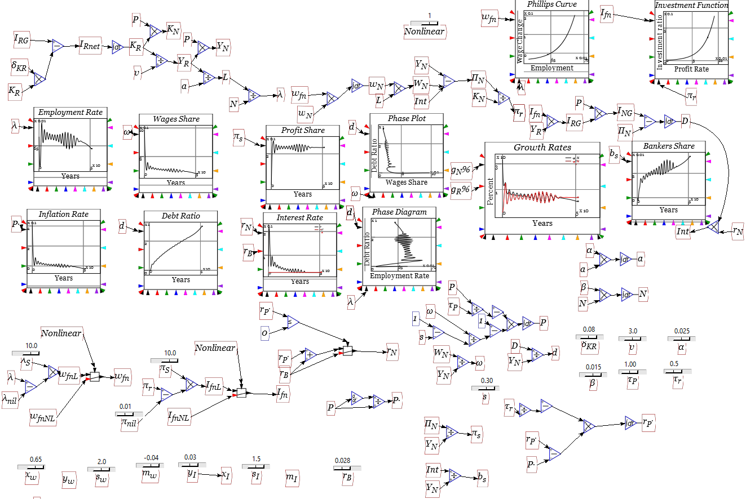
Simple complex systems model…
The same model in Open Source system dynamics program Minsky:

Slide 21
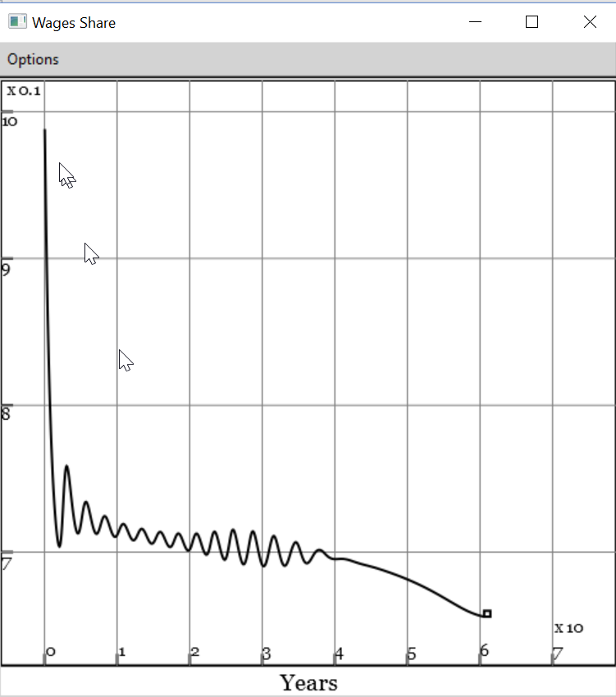
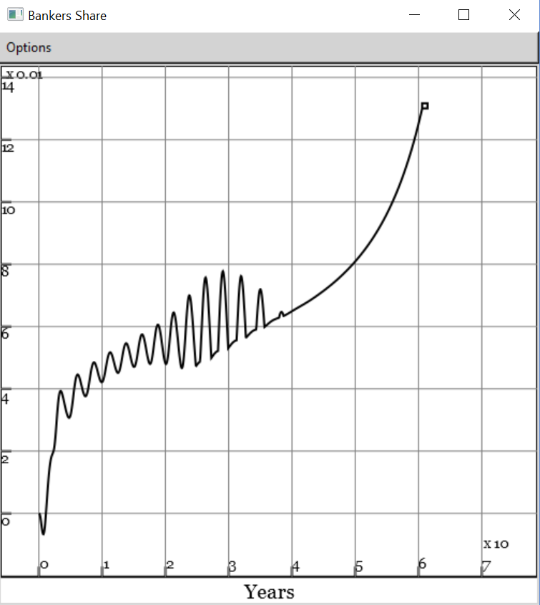
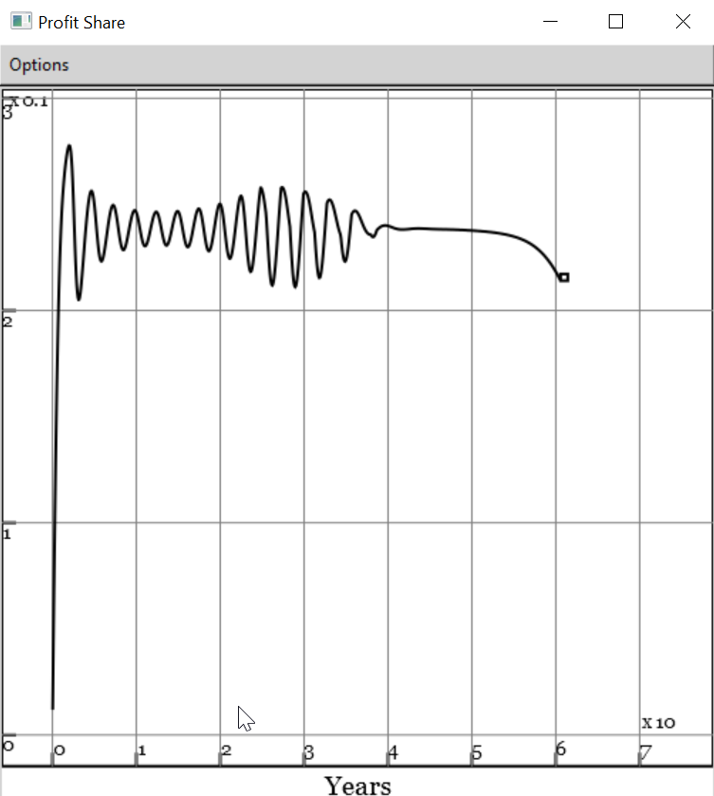
Rising inequality & crisis (full nonlinear price model)
Falling workers’ share…
Offsets rising bankers’ share…
Capitalist are the last ones to know that capitalism is coming to an end…

Slide 22
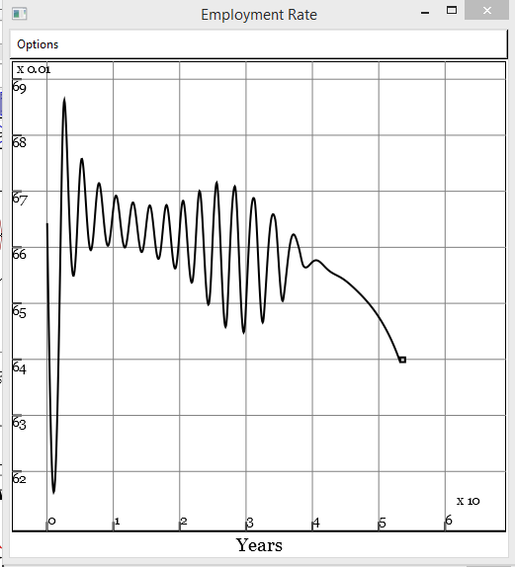
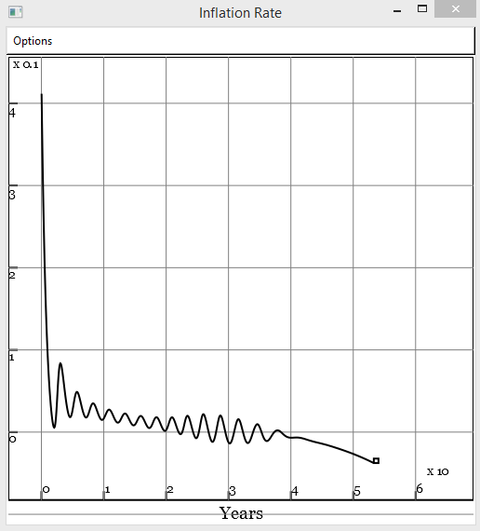
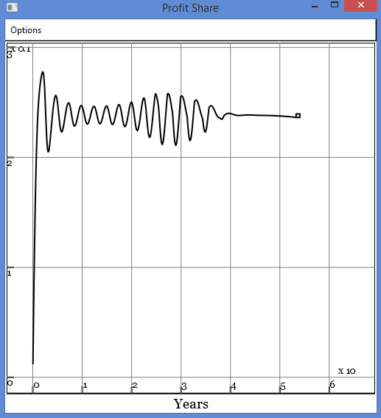
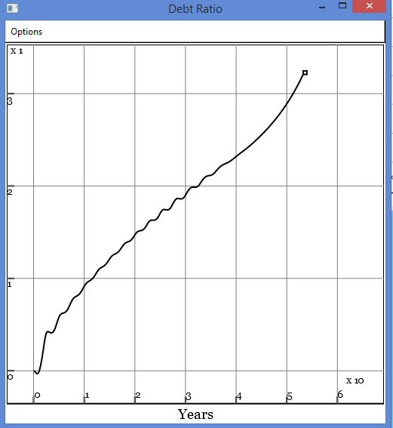
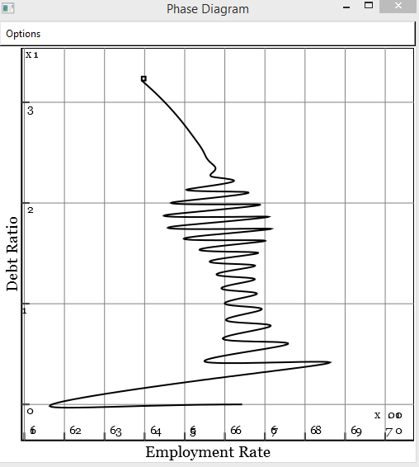
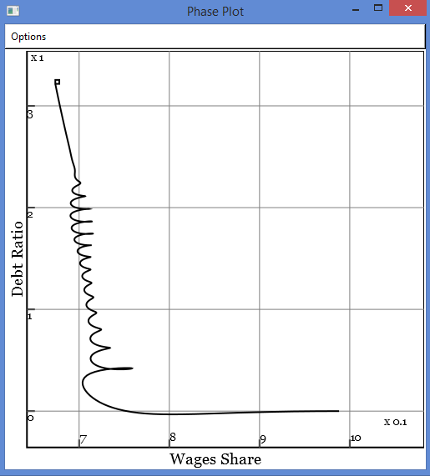
Crisis because the mainstream ignores private debt
Employment, inflation & profit give no warning of crisis:
Private debt ratio is the key indicator of impending crisis

Slide 23
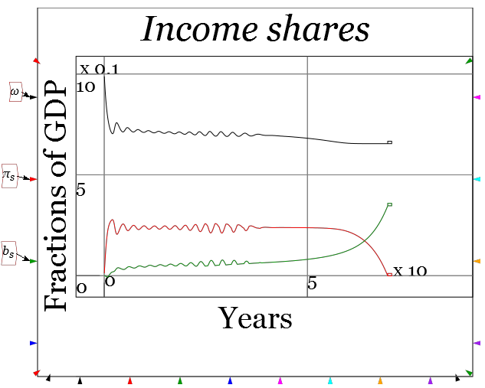
Crisis because The Left ignores private debt too
There is no “tendency for the rate of profit to fall”
There is a “tendency for private debt to grow exponentially”

Slide 24
Crisis because the mainstream ignores private debt
Key implication of model
  Level of private debt a key factor in macroeconomics
  Too high a level of debt will cause a crisis
  Private debt ratio should be a key macroeconomic target
But economic mainstream rejects importance of debt:
  “The idea of debt-deflation goes back to Irving Fisher (1933)…
  His diagnosis led him to urge President Roosevelt to subordinate exchange-rate considerations to the need for reflation…
  Fisher's idea was less influential in academic circles, though, because of the counterargument that debt-deflation represented no more than a re­distribution from one group (debtors) to another (creditors).
  Absent implau­sibly large differences in marginal spending propensities among the groups, it was suggested, pure redistributions should have no significant macro­economic effects.” (Bernanke 2000, p. 24)

Slide 25
Crisis because the mainstream ignores private debt
Mainstream persists in ignoring private debt—even after 2008 crisis:
  Krugman rejects Koo’s “balance sheet recession” argument:
    “Maybe part of the problem is that Koo envisages an economy in which everyone is balance-sheet constrained, as opposed to one in which lots of people are balance-sheet constrained.
    I’d say that his vision makes no sense: where there are debtors, there must also be creditors, so there have to be at least some people who can respond to lower real interest rates even in a balance-sheet recession.” (Krugman 2013)
  Stiglitz lambasts banks for not facilitating lending:
    “While our banks are back to a reasonable state of health, they have demonstrated that they are not fit to fulfill their purpose...
    Between long-term savers and long-term investment in infrastructure stands our short-sighted and dysfunctional financial sector.” (Stiglitz 2016)
Can’t understand why banks aren’t lending much now?…

Slide 26
Crisis because the mainstream ignores private debt
Check the level of private debt…

Slide 27
Crisis because the mainstream ignores private debt
Rate of growth of credit is low to negative because level is so high…

Slide 28
Crisis because the mainstream ignores private debt
Mainstream see banks as “intermediaries”, not “originators” of loans
  “Think of it this way: when debt is rising, it’s not the economy as a whole borrowing more money.
  It is, rather, a case of less patient people—people who for whatever reason want to spend sooner rather than later—borrowing from more patient people.” (Krugman 2012, pp. 146-47)
The Bank of England knows better:
  “Whenever a bank makes a loan, it simultaneously creates a matching deposit in the borrower’s bank account, thereby creating new money.” (Bank of England 2014, p. 14)
Mainstream can’t see why this matters:
  “OK, color me puzzled. I’ve seen a number of people touting this Bank of England paper … as offering some kind of radical new way of looking at the economy…while banks are indeed more complicated … this doesn’t mean … that they are somehow outside the usual rules of economics. Don’t let monetary realism slide into monetary mysticism!” (Krugman 2014)

Slide 29
Crisis because the mainstream ignores private debt
Lending as a “pure redistribution”; bank as intermediary
 | Assets | Liabilities |  | Equity
 | Reserves | Saver | Investor | Bank
Lending |  | From | To
Paying interest |  | To | From
Repaying |  | To | From
Bank Fee for arranging loan |  | From |  | To
Nothing on Asset Side
Shuffling $ on Liability Side
Lending as money creation; bank as originator of loans
Assets & Liabilities Rise
 | Assets |  | Liabilities |  | Equity
 | Reserves | Loans | Saver | Investor | Bank
Lending |  | From |  | To
Paying interest |  |  |  | From | To
Repaying |  | To |  | From
Assets & Liabilities Fall
Is there no essential difference, as Krugman claims?...

Slide 30
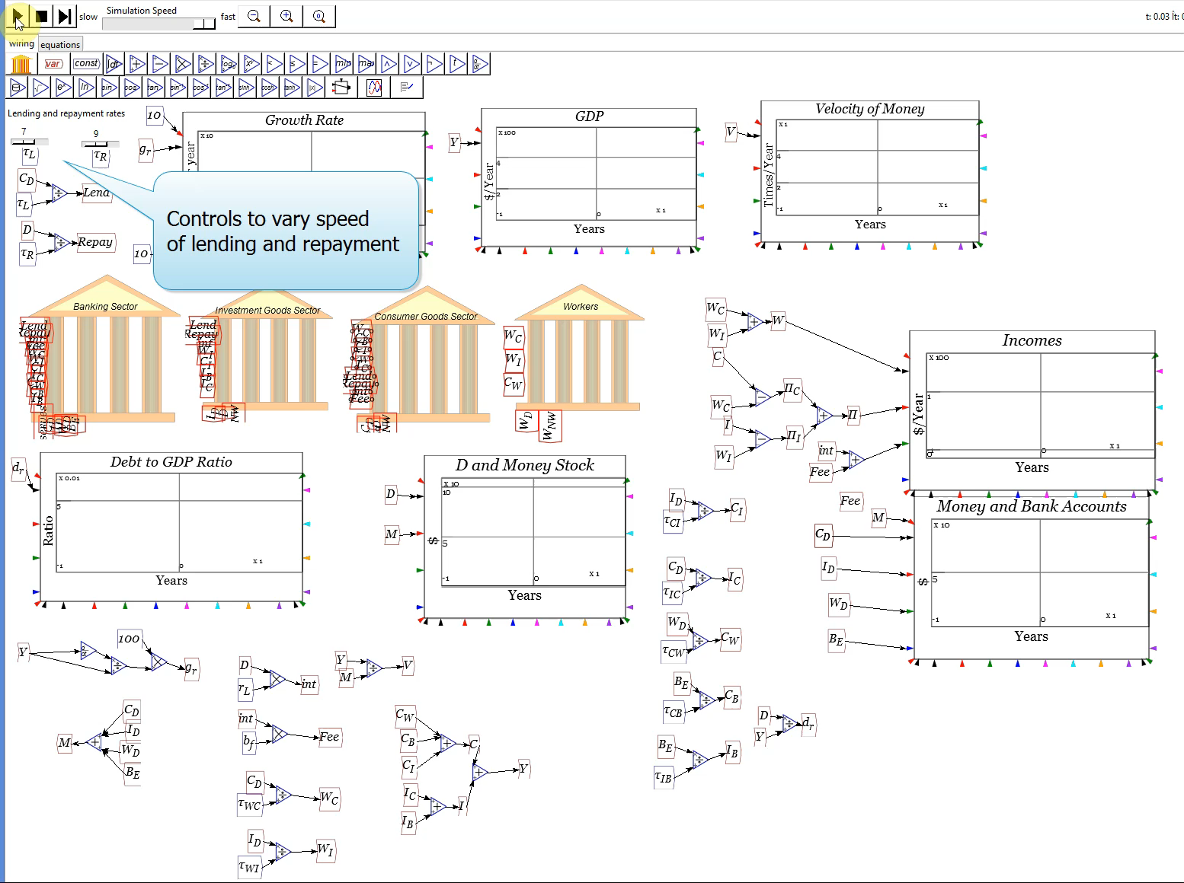
Loanable Funds vs Endogenous Money
Modelling this in Minsky:

Slide 31

Loanable Funds vs Endogenous Money
Change banks from “Intermediators” to “Originators”

Slide 32
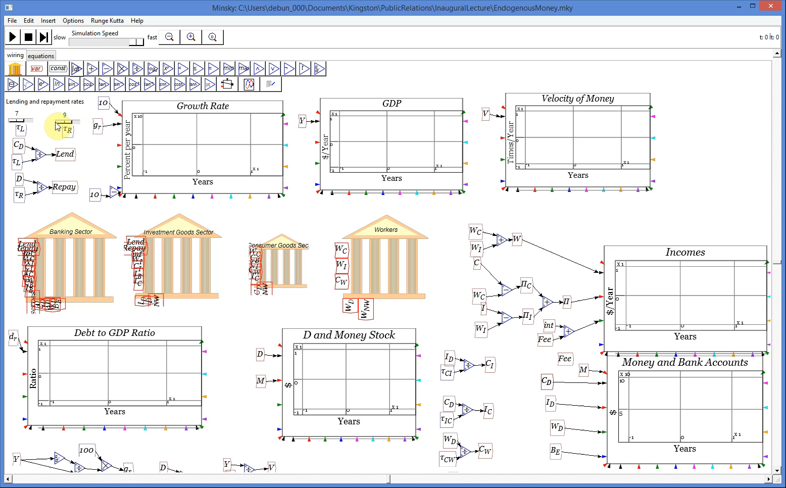
Loanable Funds vs Endogenous Money
Is it any different?

Slide 33
Loanable Funds vs Endogenous Money
Why is it so different?
  Loanable Funds:
    Banks intermediate between savers & investors
    No creation of money by lending
    No creation of additional demand either
  Endogenous money:
    Banks originate loans to investors (& speculators)
    Money created by lending
    Additional demand created
    Change in Debt thus adds to demand
      But how to reconcile this with “Expenditure≡Income” identity?...

Slide 34
Loanable Funds, aggregate demand & income
Consider 3 sector model with sectors S₁, S₂, S₃
Expenditure not debt-financed shown by CAPITAL LETTERS
Debt financed expenditure shown by lowercase letters
3 situations considered
  Borrowing not possible
  Borrowing from other sectors possible (“Loanable Funds”)
  Borrowing from banks possible (“Endogenous Money”)
First case “Say’s Law” (actually “demand creates its own supply”)
Activity |  | Net Income
 | Sector | Sector 1 | Sector 2 | Sector 3
Expenditure (Exp.) | Sector 1 | -(A + B) | A | B
 | Sector 2 | C | -(C+D) | D
 | Sector 3 | E | F | -(E+F)
Negative sum of diagonal elements is aggregate demand
Sum of off-diagonal elements is aggregate income

Slide 35
Loanable Funds, aggregate demand & income
Clearly Expenditure ≡ Income:
Loanable Funds: Sector 1 borrows b from Sector 2 to spend on Sector 3
  Sector 1’s funds for spending increase by b
  Sector 2’s funds fall by b (split 50:50 between S1 & S3 for simplicity)
Activity |  | Net Income
 | Sector | Sector 1 | Sector 2 | Sector 3
Expenditure (Exp.) | Sector 1 | -(A + B+b) | A | B+b
 | Sector 2 | C-b/2 | -(C+D-b) | D-b/2
 | Sector 3 | E | F | -(E+F)
Aggregate outcome clearly the same as without borrowing
Sound logical basis of Bernanke’s “Absent implau­sibly large differences in marginal spending propensities among the groups, it was suggested, pure redistributions should have no significant macro­economic effects.”

Slide 36
Endogenous money, aggregate demand & income
But what if a bank lends to Sector 1?
  Assets & liabilities of banking sector rise equally; and…
  Increased spending power for Sector 1 not offset by fall in Sector 2
Causes a rise in Sector 1’s spending, and incomes of Sectors 2 & 3
Bank Assets | Activity |  | Net Income
Loans |  | Sector | S1 | S2 | S3
b | Expenditure (Exp.) | S1 | -(A+B+b) | A | B+b
0 |  | S2 | C | -(C+D) | D
0 |  | S3 | E | F | -(E+F)
Aggregate outcome greater (if b>0) than without borrowing
Increase in debt causes equivalent increase in expenditure and income

Slide 37
Endogenous money, aggregate demand & income
Reconciliation with Expenditure≡Income identity
  Expenditure is the sum of
    Expenditure financed by turnover of existing money
      Measured—however poorly—as GDP (Expenditure method)
      Dimensioned in $/Year
    Plus expenditure financed by new debt
      Measured—more accurately—as Change in Debt
      Dimensioned in $/Year
    Plus gross financial transactions (debt & deposit interest)
    Total expenditure is therefore
Income side of identity needs amendment too:
  Vast majority of debt today finances asset purchases
  Modern monetary theory must integrate macroeconomics & finance
  Income side is therefore Income plus capital gains

Slide 38
Endogenous money, aggregate demand & income
GDP & capital gains are both affected by change in debt
GDP growth and change in capital gains affected by debt acceleration
Change in debt by far most the volatile element on expenditure side
  Logical basis for extraordinary empirical correlations between
    Change in debt & economic activity (employment rate, etc.)
    Acceleration in debt and change in economic activity
    Acceleration in debt and change in asset market prices
Empirical findings contradict mainstream macro & finance theory
  Rather than changes in debt being “pure redistributions” with “no significant macro-economic effects”, changes in debt are the main determinants of macroeconomic outcomes
  Rather than leverage not affecting asset prices (Modigliani-Miller theorem), leverage is the main determinant of asset prices…

Slide 39
Change in Debt & Economic Performance
Change in debt & unemployment 1980-Now

Slide 40
Change in Debt & Economic Performance
Acceleration in debt & change in unemployment 1980-Now

Slide 41
Change in Debt & Asset Market Performance
Acceleration in mortgage debt & house price change 1980-Now

Slide 42
Change in Debt & Asset Market Performance
Acceleration in margin debt & SP500 change 1980-Now

Slide 43
Change in Debt & Asset Market Performance
From one of the oldest capitalist markets to one of the newest…

Slide 44
Change in Debt & Asset Market Performance
This crash is margin-debt-driven, unlike previous one in 2008
Minskian analysis explains what mainstream cannot comprehend
Built using an approach the mainstream explicitly rejects…

Slide 45
Implications for economic theory
Minskian economics violates all mainstream methodological rules:
 | Mainstream “New Keynesian” | Heterodox/Minsky/Keen
Derivation | Methodological Individualism | Structural “Top-Down” Identities
 | “Economics is about what individuals do: not classes, not “correlations of forces”, but individual actors. This is not to deny the relevance of higher levels of analysis, but they must be grounded in individual behavior. Methodological individualism is of the essence.” (Krugman) | “Men make their own history, but they do not make it as they please; they do not make it under self-selected circumstances, but under circumstances existing already, given and transmitted from the past.” (Marx)
Process | Methodological Equilibration | Complex systems dynamics
 | “I am basically a maximization-and-equilibrium kind of guy.” (Krugman) | “Any system transforms itself simply by its mere working and if history teaches us nothing else it teaches that.” (Schumpeter)
Money | No essential role for banks, debt, money | Fundamentally monetary
Results | Did not expect or foresee crisis | Expected & foresaw crisis
Monetary complex systems theory as the basis for a new economics…

Slide 46
Implications for economic policy
In general: “Pure free market capitalism” is inherently unstable
  Capitalism needs fiat as well as credit money to avoid debt crises
In particular: Not “secular stagnation” but “stagnant credit”
  Private debt must be reduced without reducing aggregate demand
Could be done by “People’s QE”
  Existing QE buys assets from pension funds, insurance funds
  Creates money for entities that primarily buy assets
    Inflates asset prices—which excess leverage has already inflated
    Small spillover effect into non-FIRE sectors of economy
People’s QE could
  Use Bank of England capacity to create money to inject funds into individual bank accounts pro-rata (as done in Australia in 2008)
    With condition that debtors must pay-off debt
    While savers get a cash injection
    Reduce debt and asset prices without reducing demand
    Motivate banks to lend again via fall in income earning assets
  Can be done on trial basis to assess inflation, CAD effects

Slide 47

Implications for economic policy
Ultimate objectives
  Reduce private debt to “safe” zone—well below 100% of GDP
  Redesign banking to reduce “Ponzi” lending in mortgages & shares
      “The PILL”: Property Income Limited Leverage
      Ban Margin Lending (“no credit cards in the casino”)
    Encourage “Schumpeterian” lending
      “EELs”: Entrepreneurial Equity Loans
Current political likelihood of above reforms?...

Slide 48
Implications for economic policy
And if we don’t reduce private debt?
Then we will “turn Japanese”—minus its trade surplus & fiscal policy:

Slide 49
Implications for economic policy
Not “secular stagnation” but “credit stagnation”—for 2 decades:

Slide 50
Implications for the immediate economic future
Crash in China inevitable: Debt growth 3 times US rate, level close to Japan peak…

Slide 51
Implications for the immediate economic future
End of China bubble will remove aggregate demand equivalent to ¼ China GDP from global economy…

Slide 52
Implications for economic pedagogy
A Rethinking and Re-Learning of Economics is needed
Learn Neoclassical economics well
  Warts and all (not the airbrushed textbook version)
    As a (hopefully passing) phase in the history of economic thought
Learn other existing schools well too: none have complete alternative
  Austrian, Marxian, Post Keynesian, Evolutionary, Ecological, Feminist
Learn complex systems approaches & thermodynamics
But you won’t find that curriculum at Oxford or Cambridge!
S0…
Kingston
University
London
For a pluralist education in economics
Come to Kingston
School of Economics, History & Politics

