Slide 1

Will we crash again?
Steve Keen
Kingston University London
IDEAeconomics
Minsky Open Source System Dynamics
www.debtdeflation.com/blogs

Slide 2
The last crash wasn’t anticipated by the mainstream…
Bernanke 2004: “What Have We Learned Since October 1979?”
  “the past two decades has seen not only significant improvements in economic growth and productivity but also a marked reduction in economic volatility… dubbed ‘the Great Moderation’…
  The sources of the Great Moderation remain somewhat controversial, but as I have argued elsewhere, there is evidence for the view that improved control of inflation has contributed in important measure to this welcome change in the economy.”
OECD Economic Outlook, June 2007
  “the current economic situation is in many ways better than what we have experienced in years…
  Our central forecast remains indeed quite benign: a soft landing in the United States, a strong and sustained recovery in Europe…
  sustained growth in OECD economies would be underpinned by strong job creation and falling unemployment.”

Slide 3
The last crash wasn’t anticipated by the mainstream…
And then all hell broke loose…
Inflation & Unemployment Falling
Unemployment
Deflation
After the event, mainstream described Great Moderation & the crisis as two separate events…

Slide 4
The last crash wasn’t anticipated by the mainstream…
Bernanke 2010 “Implications of the Financial Crisis for Economics”
  “Standard macroeconomic models, such as the workhorse new-Keynesian model, did not predict the crisis, nor did they incorporate very easily the effects of financial instability.
  Do these failures of standard macroeconomic models mean that they are irrelevant or at least significantly flawed?
  I think the answer is a qualified no. Economic models are useful only in the context for which they are designed. Most of the time, including during recessions, serious financial instability is not an issue.
  The standard models were designed for these non-crisis periods, and they have proven quite useful in that context.
  Notably, they were part of the intellectual framework that helped deliver low inflation and macroeconomic stability in most industrial countries during the two decades that began in the mid-1980s.”
What utter self-serving bollocks!
  Look again at the 1980-2010 inflation & unemployment data…

Slide 5
The factor the mainstream ignores…
This time, including rising private debt…

Slide 6
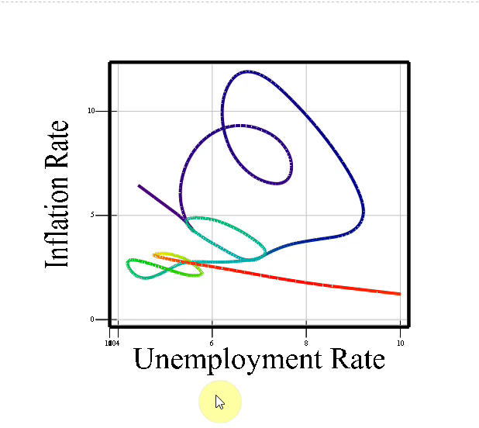
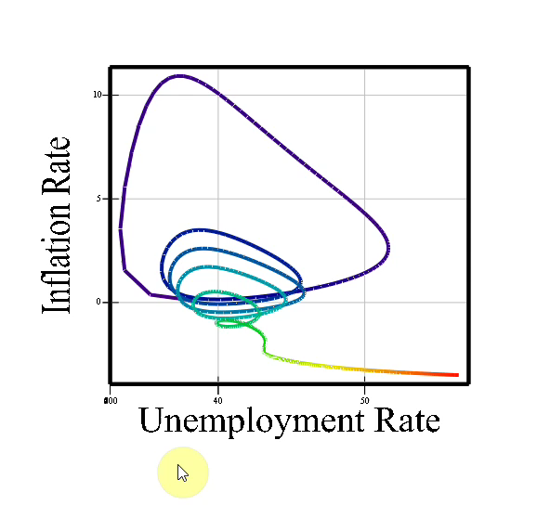
The factor the mainstream ignores…
Graphing inflation against unemployment, an inexplicable shift:
Heading towards equilibrium
Then sudden collapse!
Making sense of this with non-mainstream macroeconomics
Minsky’s Financial Instability Hypothesis
Plus “Complex Systems Macro”

Slide 7
Why does the mainstream ignore private debt?
Because of a fantasy model of lending that ignores banks!
  “The idea of debt-deflation goes back to Irving Fisher (1933)…
  Fisher's idea was less influential in academic circles, though, because of the counterargument that debt-deflation represented no more than a redistribution from one group (debtors) to another (creditors).
    Absent implausibly large differences in marginal spending propensities among the groups, it was suggested, pure redistributions should have no significant macro-economic effects…” (Bernanke 2000, Essays on the Great Depression)
Essence of opposition is “Loanable Funds” model of debt:
  “Think of it this way: when debt is rising, it’s not the economy as a whole borrowing more money.
  It is, rather, a case of less patient people—people who for whatever reason want to spend sooner rather than later—borrowing from more patient people.” (Krugman 2012, End this Depression Now!)

Slide 8
Why does the mainstream ignore private debt?
Mainstream completely wrong—as Bank of England confirmed in 2014
  Banks are not intermediaries but initiate loans
  Loans create money and new demand
  Logic simple
    Mainstream model: lender offsets borrower’s higher spending
Impatient spends more
Activity |  | Net Income
 |  | “Impatient” | “Patient” | Shop
Expenditure | Impatient | -(A + B+b) | A | B+b
 | Patient | C-b/2 | -(C+D-b) | D-b/2
 | Shop | E | F | -(E+F)
Demand
Loan
Demand
Patient spends less
Demand
    Real world: bank lending adds spending power “endogenously”
Impatient spends more
Activity |  | Net Income
 |  | “Impatient” | “Patient” | Shop
Expenditure | Impatient | -(A + B+b) | A | B+b
 | Patient | C | -(C+D) | D
 | Shop | E | F | -(E+F)
No offsetting fall: demand & income rise

Slide 9
The bottom line
Demand and income are
  Demand & income from turnover of existing money;
  Plus demand and income from new debt
  Rising debt thus increases demand & income & asset prices
  Falling debt reduces them…
Change (& acceleration) in debt explain what the mainstream can’t
  The boom before the crash
  The crash itself
  The ups & downs of asset markets
  And the certainty that the world is “Turning Japanese”…
    The reason? We’ve followed Japan into biggest private debt bubble in the history of capitalism…

Slide 10
Turning Japanese
Japan’s private debt crisis began 18 years before the USA’s…

Slide 11
Turning Japanese
Anaemic change in private debt has kept Japanese unemployment high for 25 years…

Slide 12
Turning Japanese
USA fell into the same trap in 2008…

Slide 13
Turning Japanese
Japan’s past 18 years gives us best case scenario projection for OECD…

Slide 14
US Aggregate debt levels
The long view: this is the biggest debt bubble in history of capitalism
Level when I began to warn of crisis (2006)
Level when Godley began to warn of crisis (1998)

Slide 15
Debt acceleration & asset markets
Acceleration of margin debt drives the stockmarket
Correlation 0.53

Slide 16
Debt acceleration & asset markets
Acceleration of mortgage debt drives the housing mark
Correlation 0.77

Slide 17
Financial Instability Hypothesis
Minsky on capitalism:
  “capitalism is inherently flawed, being prone to booms, crises and depressions.
  This instability, in my view, is due to characteristics the financial system must possess if it is to be consistent with full-blown capitalism.
  Such a financial system will be capable of both generating signals that induce an accelerating desire to invest and of financing that accelerating investment.” (Minsky 1969b: 224)
Christens his model the “Financial Instability Hypothesis”
Cycles, debt & non-equilibrium behaviour at the centre of his model…

Slide 18
Financial Instability Hypothesis
“The natural starting place for analyzing the relation between debt and income is to take an economy with a cyclical past that is now doing well.
The inherited debt reflects the history of the economy, which includes a period in the not too distant past in which the economy did not do well.
Acceptable liability structures are based upon some margin of safety so that expected cash flows, even in periods when the economy is not doing well, will cover contractual debt payments.
As the period over which the economy does well lengthens, two things become evident in board rooms. Existing debts are easily validated and units that were heavily in debt prospered; it paid to lever.” (65)
“After the event it becomes apparent that the margins of safety built into debt structures were too great.
As a result, over a period in which the economy does well, views about acceptable debt structure change. In the deal­making that goes on between banks, investment bankers, and businessmen,
  the acceptable amount of debt to use in financing various types of activity and positions increases.

Slide 19
Financial Instability Hypothesis
This increase in the weight of debt financing raises the market price of capital assets and increases investment. As this continues the economy is transformed into a boom economy…” (65)
This transforms a period of tranquil growth into a period of speculative excess
“Stable growth is inconsistent with the manner in which investment is determined in an economy in which debt-financed ownership of capital assets exists, and the extent to which such debt financing can be carried is market determined.
It follows that the fundamental instability of a capitalist economy is upward.
The tendency to transform doing well into a speculative investment boom is the basic instability in a capitalist economy.” (65)
This process is fundamentally non-equilibrium in nature
  Spelling out Minsky’s verbal model step by step…

Slide 20
Financial Instability Hypothesis
Economy in historical time
Debt-induced recession in recent past
Firms and banks conservative re debt/equity ratios, asset valuation
Only conservative projects are funded
Recovery means conservative projects succeed
Firms and banks revise risk premiums
  Accepted debt/equity ratio rises
  Assets revalued upwards
Self-fulfilling expectations
  Decline in risk aversion causes increase in investment
    Investment expansion causes economy to grow faster
  Asset prices rise, making speculation on assets profitable
  Increased willingness to lend increases money supply
    Money supply “endogenous”, not controlled by Central Bank
  Riskier investments enabled, asset speculation rises…

Slide 21
The Euphoric Economy
Prevalence of “euphoric expectations” allows emergence of “Ponzi” financiers
  Cash flow from “investments” always less than debt servicing costs
  Profits made by selling assets on a rising market
  Desperate demand for debt since fundamentally insolvent
    Must borrow to service existing debt before asset sales
  Interest-rate insensitive demand for finance
Initial profitability of asset speculation:
  reduces debt and interest rate sensitivity
  drives up supply of and demand for finance
  market interest rates rise
Income distribution changes as economy goes into a boom
  Wages rise
  Cost of raw material inputs (energy inputs, metal ores) rise…

Slide 22
The Assets Boom and Bust
Eventually debt growth breaks for an endogenous reason:
  Changing cost structure undermines profit expectations
  Ponzis necessarily losing money
    Debts accumulate, while shares in Ponzi firms purchased widely
    Can suddenly crash if they fail to roll over debts in time
  Many “euphoric expectations” investments fail
  Rising rates make once conservative projects speculative
    Non-Ponzi investors attempt to sell assets to service debts
    Entry of new sellers floods asset markets
    Rising trend of asset prices falters or reverses
Ponzi financiers quickly go bankrupt:
  can no longer sell assets for a profit
  debt servicing on assets far exceeds cash flows
Asset prices collapse, drastically increasing debt/equity ratios
Endogenous expansion of money supply reverses
Investment evaporates; economic growth slows or reverses
Economy enters a debt-induced recession ...

Slide 23
Crisis and Aftermath
What happens next depends on
  Inflation rate at the time
  Size of the government sector…
High Inflation?
  Debts repaid by rising price level
  Economic growth remains low: Stagflation
  Renewal of cycle once debt levels reduced
Low Inflation?
  Debts cannot be repaid
  Chain of bankruptcy affects even non-speculative businesses
  Economic activity remains suppressed: a Depression
Big Government?
  Anti-cyclical spending and taxation of government enables debts to be repaid
  Renewal of cycle once debt levels reduced

Slide 24
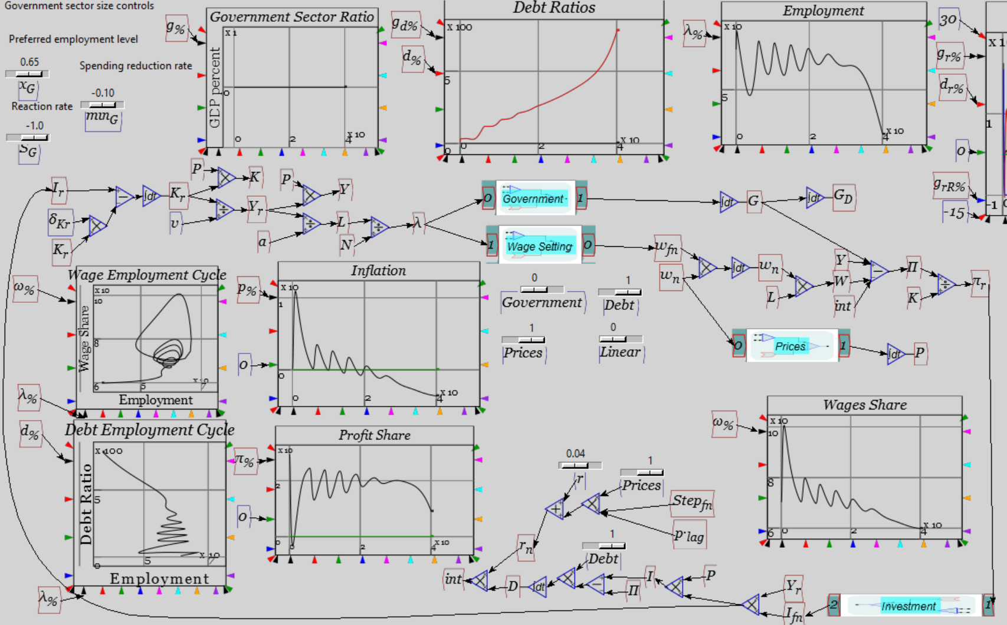
System dynamics…
Modeling Minsky:

Slide 25
System dynamics…
It looks complicated
  It’s actually simple but complex
Boils down to three irrefutable statements:
  The employment rate will rise if economic growth exceeds the sum of population growth and growth in labor productivity;
  The wages share of output will rise if money wage demands exceed the sum of inflation and growth in labor productivity; and
  The private debt to GDP ratio will rise if the rate of growth of private debt exceeds the sum of inflation plus the rate of economic growth.
Statements are simply facts
  Disagreeing with them is like disagreeing with gravity
Complexity arises from how they interact with each other
  Behaviour could never be deduced using verbal logic
    Have to simulate to see the effects
But this phenomenon—rising private debt leading to a crisis—is what Minsky predicted from his observations of capitalism
We are now in an era of permanent debt-deflation, countered only by government deficits…

Slide 26
Dramatic fall in credit growth post-crisis
Except in China, which will be the next bubble to burst

Slide 27
Investment implications
Excessive private debt means credit growth slow/falter from now on
Real cause of overall decline in economic growth rates
  Sustained acceleration in private debt now impossible to achieve
Low & correlated asset returns likely, except
  Where QE drives asset prices
  In “Super Cities” where elite incomes + debt drive house prices
China crash inevitable in next 1-2 years
  Avoided crisis via huge growth in private credit
    Faster rate of growth than Japan during “Bubble Economy” days
  Now well into Richard Vague’s two “danger zone” ranges:
    Private debt more than 1.5 times GDP (well over 1.8 times now)
    Grows by 18% of GDP or more over 5 years (rose by 70% over last 5 years)
      (See The Next Economic Disaster: Why It's Coming and How to Avoid It: http://www.amazon.co.uk/Next-Economic-Disaster-Coming-Avoid/dp/0812247043)
“May you invest in interesting times…”

Slide 28
Educational implications
Crisis in part a product of bad economic theory
Realistic “Minskian” economics warned of dangers of rising private debt
Unrealistic “Neoclassical” economics ignored it
Business needs realism in economics—leave ideology to political scientists
Most Universities only teach mainstream Neoclassical theory
  New “CORE” curriculum just as bad on this front
Support Universities that take a pluralist approach to economics…
Or Greenwich!
Kingston
University
London
For a pluralist education in economics
Come to Kingston
School of Economics, History & Politics

