Slide 1

Putting banks, debt & money into economics
Steve Keen
Kingston University London
IDEAeconomics
Minsky Open Source System Dynamics www.debtdeflation.com/blogs

Slide 2
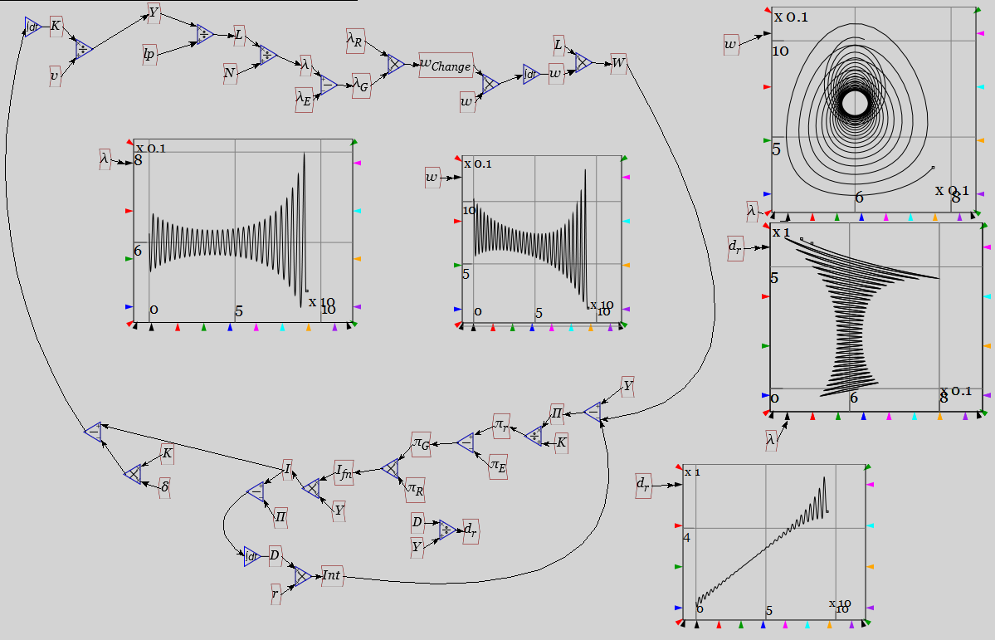
Putting banks, debt & money into economics
Last week we built this model by simply adding debt-financed investment to Goodwin’s nonlinear model of cyclical growth:

Slide 3
Putting banks, debt & money into economics
Model my rendition of Minsky’s “Financial Instability Hypothesis”
Essential part of Minsky’s hypothesis was the role of private debt
“The natural starting place for analyzing the relation between debt and income is to take an economy with a cyclical past that is now doing well…” (Minsky Challenge 1977, p. 24)
Addition of investment-oriented private debt to Goodwin’s cyclical model generated dynamics of apparent tranquillity with rising debt, followed by breakdown
Led to rhetorical flourish at end of my 1995 paper:
“From the perspective of economic theory and policy, this vision of a capitalist economy with finance requires us to go beyond that habit of mind that Keynes described so well, the excessive reliance on the (stable) recent past as a guide to the future.
The chaotic dynamics explored in this paper should warn us against accepting a period of relative tranquility in a capitalist economy as anything other than a lull before the storm.”
Then the economy began to behave like the model…

Slide 4
Putting banks, debt & money into economics
But role of banks, debt & money in macroeconomics remained unexplained
Minsky & I (& others) initially simply assumed it
But rejected by most mainstream economists & some Post Keynesians
Mainstream on basis of “Loanable Funds” model of banking
“Think of it this way: when debt is rising, it’s not the economy as a whole borrowing more money.
It is, rather, a case of less patient people—people who for whatever reason want to spend sooner rather than later—borrowing from more patient people.” (Krugman 2012: 146-47)
Post Keynesians on basis of identity of expenditure & income
“Unless Keen (2014a) can explain how a purchase of a good or service does not provide income for the seller, then he should rethink his claim that debt extensions can force an inequality between expenditure and income at the aggregate level.” (Fiebiger 2014: 296)
Back to basics: what is money?

Slide 5
Putting banks, debt & money into economics
"What, now, does the industrial capitalist pay, and what is, therefore, the price of the loaned capital?…
What the buyer of an ordinary commodity, buys is its use-value; what he pays for is its value.
What the borrower of money buys is likewise its use-value as capital; but what does he pay for?
Surely not its price, or value, as in the case of ordinary commodities." (Marx 1894, p. 352.)
Marx’s dialectical vision of money
M—C—M+ circuit
Foreground:
Commodity (essential to exchange)
Background: Non-commodity (not produced by means of commodities)
Money
Dialectical Tension: exchange-value set by use-value

Slide 6
Putting banks, debt & money into economics
“It must always be borne in mind that here capital as capital is a commodity…
All the relations in evidence here would therefore be irrational from the standpoint of an ordinary commodity…
Similarly,… If we want to call interest the price of money-capital, then it is an irrational form of price quite at variance with the conception of price of commodities.” (Marx 1894: p. 353)
“How, then, can a sum of value have a price besides its own price… Price, after all, is the value of a commodity as distinct from its use-value. A price which differs from value in quality is an absurd contradiction…” (Marx 1894: p. 354)
“The value of money or of commodities employed as capital does not depend on their value as money or as commodities, but on the quantity of surplus-value they produce for their owner.” (Marx 1894, p. 355.)
“What is sold is, in fact, its use-value, whose function in this case is to produce exchange-value, to yield profit, in other words to produce more value than it itself contains.” (Marx 1861 Part III, p. 458)
This perspective informed Minsky’s thinking—but never acknowledged in citations during McCarthyist period in the USA

Slide 7
Putting banks, debt & money into economics
Also background to Circuitist “Monetary Theory of Production”
Graziani posed the question:
“How does a monetary economy differ from barter?”
1st principle: money cannot be a commodity:
“a true monetary economy is inconsistent with the presence of a commodity money.
A commodity money is by definition a kind of money that any producer can produce for himself.
But an economy using as money a commodity coming out of a regular process of production, cannot be distinguished from a barter economy.
A true monetary economy must therefore be using a token money, which is nowadays a paper currency.”
So “gold bugs” aren’t saying “gold is money”
They’re saying “we prefer a barter system to a monetary one”

Slide 8
Putting banks, debt & money into economics
2nd Principle: money isn’t credit
“If in a credit economy at the end of the period some agents still owe money to other ones, a final payment is needed, which means that no money has been used.”
3rd principle: money creator can’t exploit seignorage
“If, on the other hand, final payments were continually postponed and replaced by new promises, buyers would enjoy an unlimited privilege of seignorage.
Money is therefore something different from a regular commodity and something more than a mere promise of payment.”
Graziani’s resolution
“In order for money to exist, three basic conditions must be met:…

Slide 9
Putting banks, debt & money into economics
“a) money has to be a token currency (otherwise it would give rise to barter and not to monetary exchanges);
b) money has to be accepted as a means of final settlement of the transaction (otherwise it would be credit and not money);
c) money must not grant privileges of seignorage to any agent making a payment.
The only way to satisfy those three conditions is to have payments made by means of promises of a third agent, the typical third agent being nowadays a bank.
When an agent makes a payment by means of a cheque, he satisfies his partner by the promise of the bank to pay the amount due. Once the payment is made, no debt and credit relationships are left between the two agents. But one of them is now a creditor of the bank, while the second is a debtor of the same bank.
This insures that, in spite of making final payments by means of paper money, agents are not granted any kind of privilege.”

Slide 10


Putting banks, debt & money into economics
Graziani’s brilliant insight:
“For this to be true, any monetary payment must therefore be a triangular transaction, involving at least three agents, the payer, the payee, and the bank.”
Standard economics vision is 2 person, 2 good barter:
X
A
B
Y

Slide 11
Putting banks, debt & money into economics
Monetary economy: 3 sided, single commodity, financial exchanges:
person A gives person B δ units of commodity X
in return for person B having bank Z transfer ψ currency units from B's account A's account
Capitalism's
eternal triangle
A
δ X
B
Not only are all exchanges 3-sided;
also can’t lump firms & banks together
Fulfil essentially different roles in capitalist system:
A=
+$ψ
B=
-$ψ
Z

Slide 12
Putting banks, debt & money into economics
“[B]anks and firms must be considered as two distinct kinds of agents.
Firms are present in the market as sellers or buyers of commodities and make recourse to banks in order to perform their payments;
banks on the other hand produce means of payment, and act as clearing houses among firms.
In any model of a monetary economy, banks and firms cannot be aggregated into one single sector.” (4)
Graziani’s vision inspired my development of Minsky software
System dynamics aspects of Minsky shown last week not original
Same features already available in Simulink, Vensim, etc.
Unique aspect: monetary equations with double-entry bookkeeping
Consider Graziani’s statement of role of banks above:
“banks … produce means of payment”, and
“act as clearing houses among firms”.
Both roles require double-entry bookkeeping to carry out
Neoclassical economics ignores first role
(2nd role is why banks need reserves)…

Slide 13
Putting banks, debt & money into economics
Banks operating as clearing houses between firms:
Activity/Account | Assets |  | Liabilities = Deposits
 | Reserves | Loans | Firm A (Buyer) | Firm B (Seller)
Buy goods |  |  | +100 | -100
Positive because payment reduces bank’s liability to Firm A
Negative because payment increases bank’s liability to Firm B
Triangular relationship as Graziani argues…
Bank
Buyer
Seller
Reserves are needed with multiple banks…

Slide 14
Putting banks, debt & money into economics
Banks operating as clearing houses between firms:
Bank 1
Activity/Account | Assets |  | Liabilities = Deposits
 | Reserves | Loans | Firm A (Buyer) | Other customers
Buy goods | -100 |  | +100
Bank 2
Activity/Account | Assets |  | Liabilities = Deposits
 | Reserves | Loans | Other customers | Firm B (Seller)
Buy goods | +100 |  |  | -100
Central Bank
Activity/Account | Assets |  | Liabilities = Reserves
 | Central Bank Loans |  | Bank 1 | Bank 2
Buy goods |  |  | +100 | -100

Slide 15
Putting banks, debt & money into economics
Triangular pattern repeated:
Bank 1 & Bank 2 exchange Reserves via Central Bank
Central Bank
Bank 1
Bank 2
Clearing house role explains accounting significance of banks
What about macroeconomic significance?...

Slide 16
Putting banks, debt & money into economics
Graziani’s 1st role— “banks … produce means of payment”—is why banks matter in macroeconomics
Missed by Neoclassical Loanable Funds vision:
“Think of it this way: when debt is rising, it’s not the economy as a whole borrowing more money.
It is, rather, a case of less patient people—people who for whatever reason want to spend sooner rather than later—borrowing from more patient people.”
Activity/Account | Assets |  | Liabilities
 | Reserves | Loans | Patient | Impatient
Lend money |  |  | +100 | -100
Lending simply redistributes bank liabilities
No change in total assets or liabilities
Versus the real world…

Slide 17
Putting banks, debt & money into economics
Bank lending is “producing means of payment”
Bank lending increases bank assets and liabilities equally
Creating a new debt also creates new money…
Activity/Account | Assets |  | Liabilities
 | Reserves | Loans | Patient | Impatient
Lend money |  | +100 |  | -100
New money often also causes contemporaneous new demand
Activity/Account | Assets |  | Liabilities
 | Reserves | Loans | Shop | Consumer
Access credit card |  | +100 |  | -100
Pay for goods |  |  | -100 | +100
Loanable Funds implies change in debt has no macroeconomic impact
Endogenous Money implies huge impact
Comparing Loanable Funds to Endogenous Money using Minsky…

Slide 18
Putting banks, debt & money into economics
“Godley Table” is main innovation in Minsky
Double-entry bookkeeping tables produce equations of financial flows
Consider this simple system
“System States” (in this model, just bank accounts) in CAPS
Flows (in this model, just money) in Lowercase
Constant money stock from constant debt (“LOANS”)
FIRM sector hires workers (“Wages”)
FIRM pays interest (“Interest”)
WORKERS and BANKERS consume (“Cons_{W} & Cons_{B}”)
Just 4 accounts and 4 flows
You could build this the same way you built Goodwin last week
What does that look like?

Slide 19
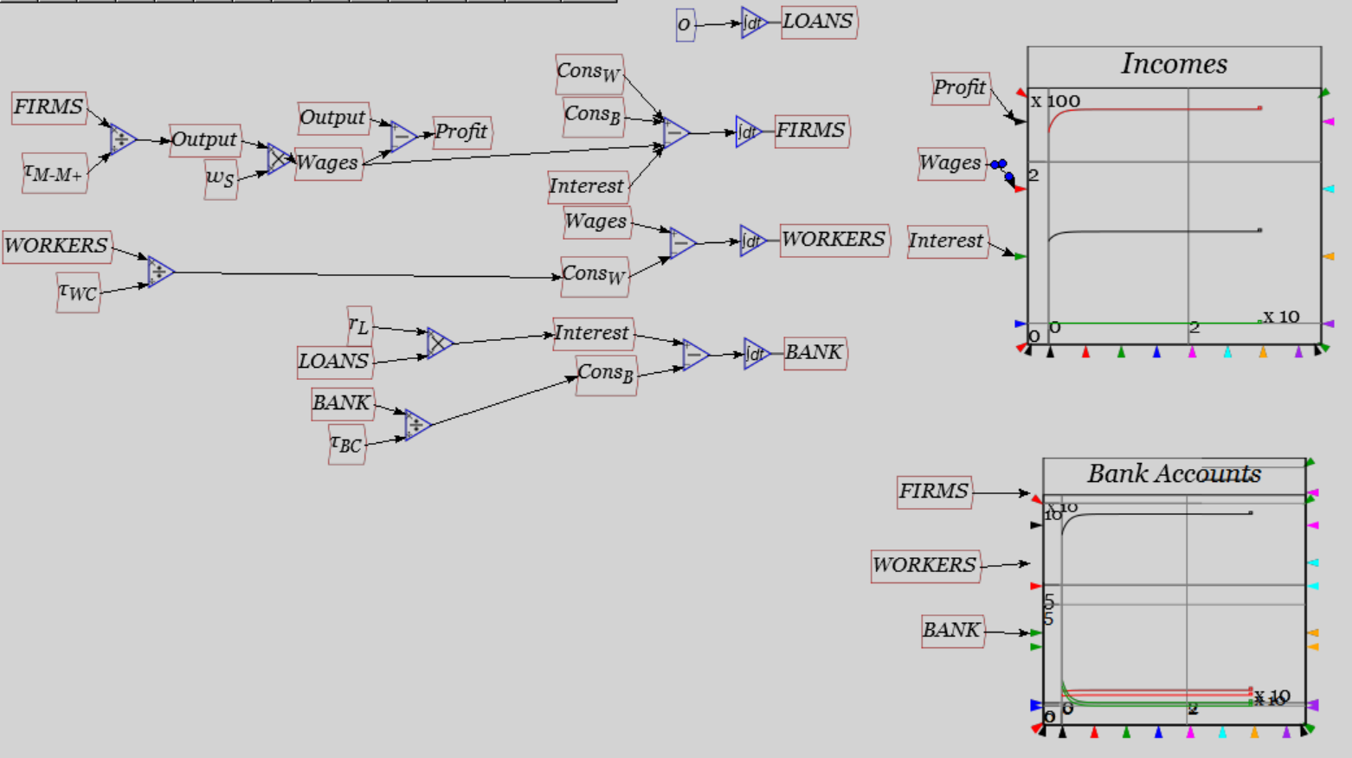
Putting banks, debt & money into economics
It’s a bit hard to follow…
Banking Sector component of model
Easier to understand with double-entry bookkeeping…

Slide 20
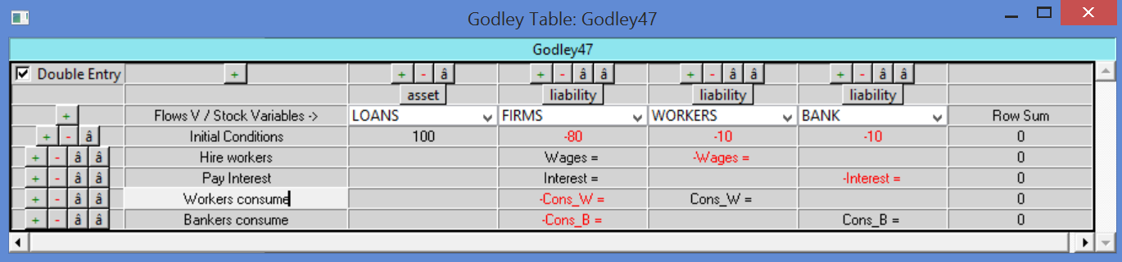
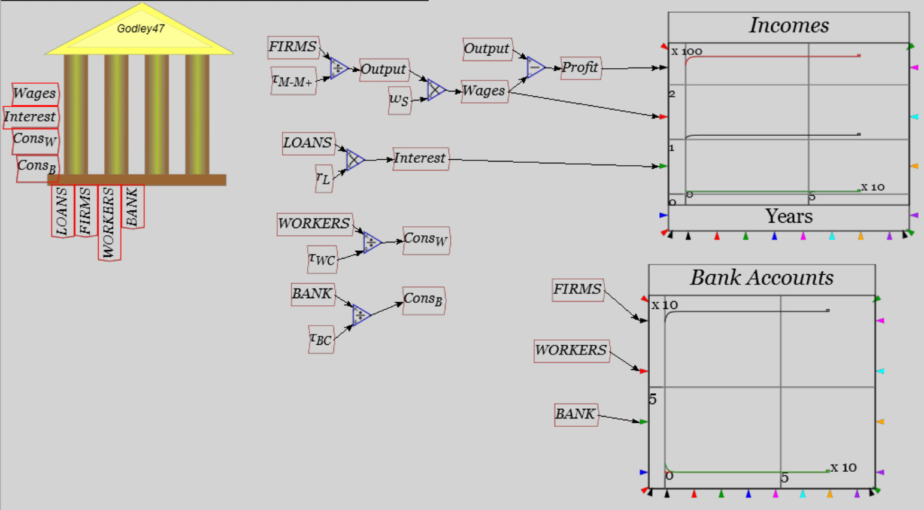
Putting banks, debt & money into economics
Same model with a Godley Table…
Banking Sector component of model
Easier to edit and spot mistakes with double-entry bookkeeping too
For example…

Slide 21
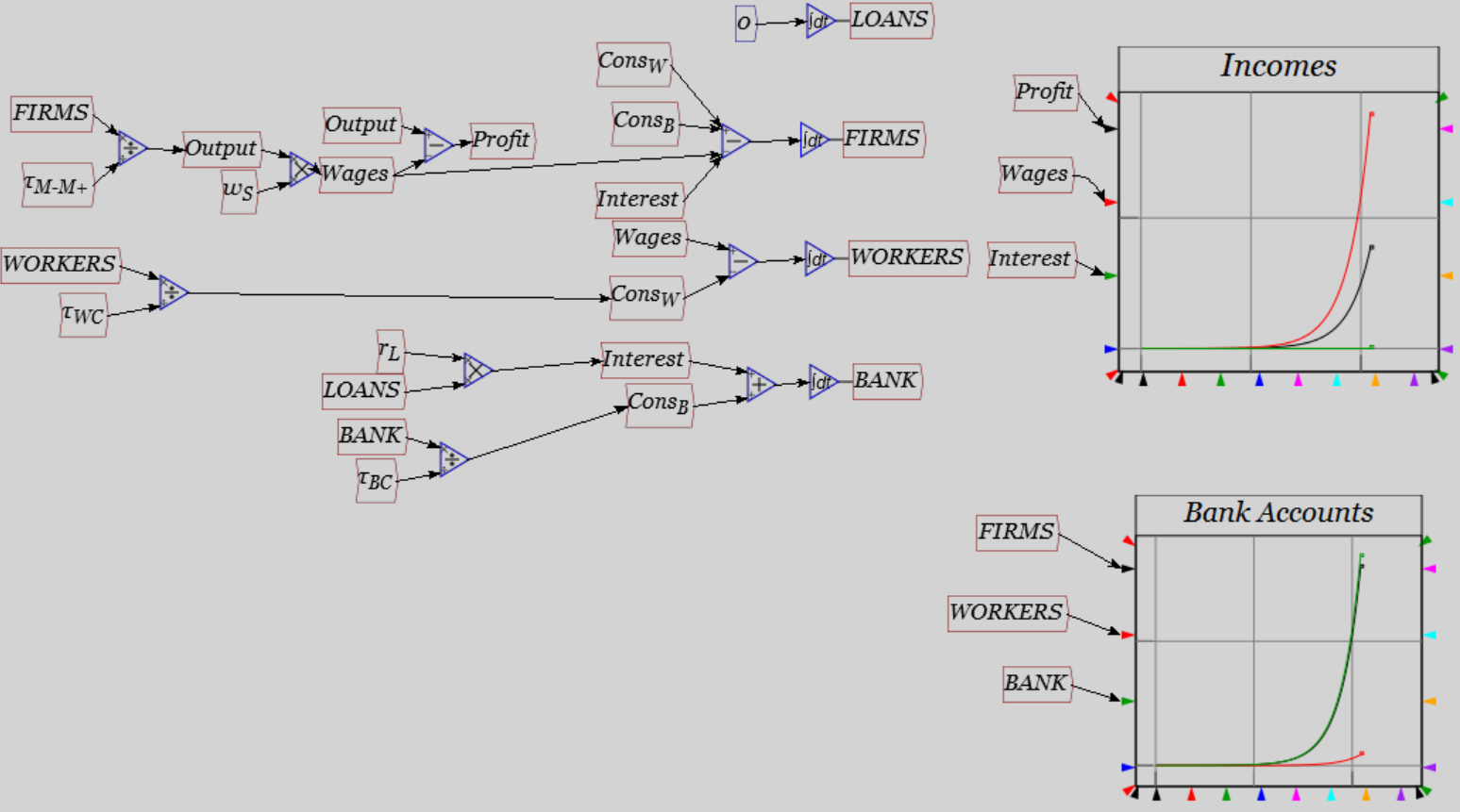
Putting banks, debt & money into economics
There’s an error in this model. Can you spot it?
Plus should be minus
Same error in double-entry bookkeeping…

Slide 22
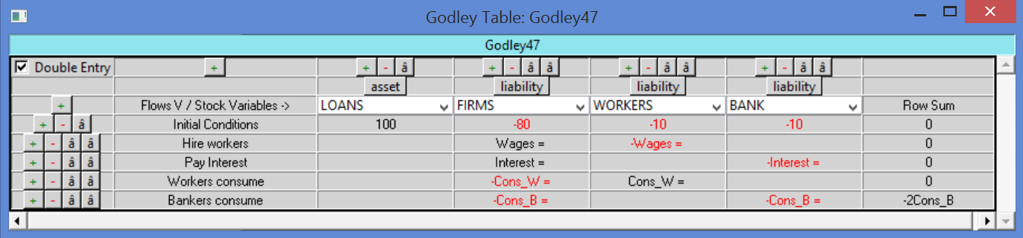
Putting banks, debt & money into economics
Program shows you problem before you simulate:
Must sum to zero
Model structure also much more easily extended
For example, say you wanted to add
Capitalists who receive dividends
A new sector (say MINING) which buys inputs from FIRMS…

Slide 23
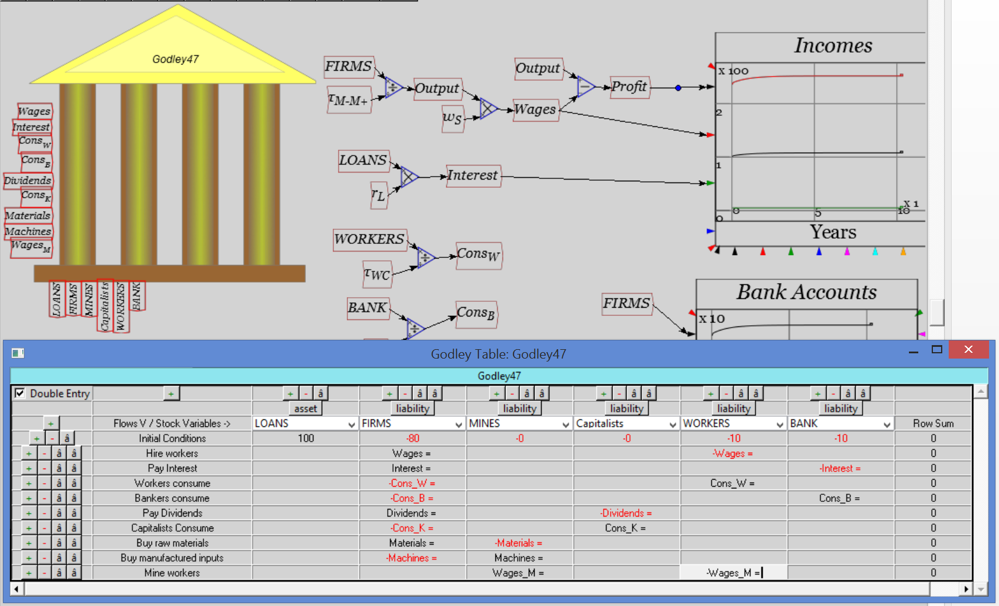
Putting banks, debt & money into economics
Not complete—flow equations needed as well—but easy to do
Minsky also keeps track of multiple tables…

Slide 24
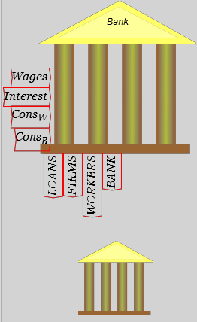
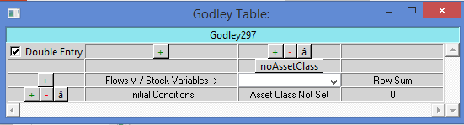
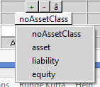
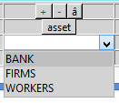
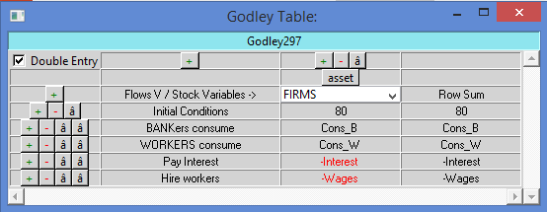
Putting banks, debt & money into economics
Add a Godley Table:
Open it up:
Click on “noAssetClass” & choose “Asset”
Choose “FIRMS”
Minsky will populate column with all current transactions
Repeat with “Liabilities” & choose “LOANS”…

Slide 25
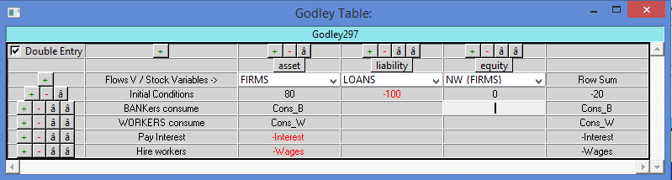
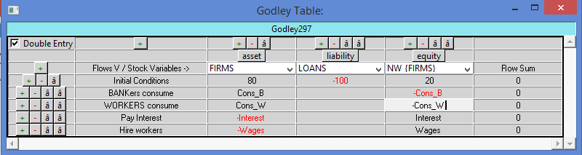
Putting banks, debt & money into economics
Add column and choose “Equity”; call it “NW_{FIRMS}”
Add entries to make all rows sum to zero:
Can add other entities (government treasury, central bank, etc.) for comprehensive monetary model…

Slide 26
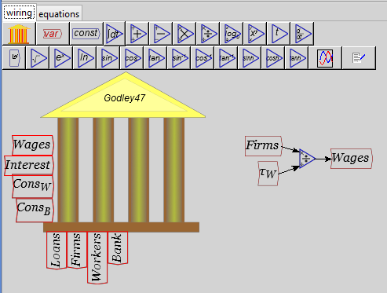
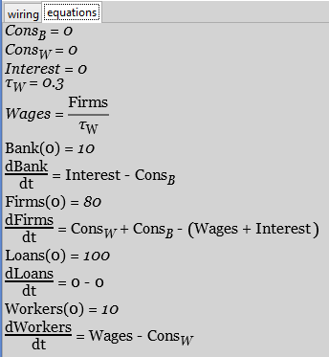
Putting banks, debt & money into economics
Defining flows uses same “flowchart” paradigm as for Goodwin model:
Defines this equation
This flowchart fragment

Slide 27

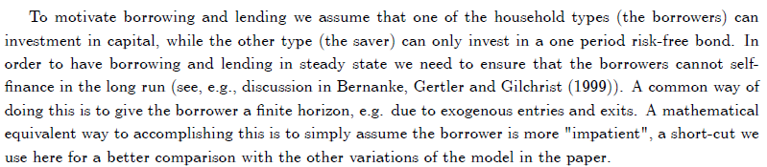
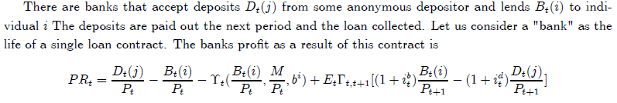
Putting banks, debt & money into economics
First, using Minsky to compare Loanable Funds & Endogenous Money
Eggertsson & Krugman 2012 has “bank” model in Appendix:
Reminds me of Spock quote from Star Trek: “It is not life as we know it”
Basic “Loanable Funds” vision of banks is as intermediaries who arrange loans between non-bank agents:
“If I decide to cut back on my spending
and stash the funds in a bank,
which lends them out to someone else,
this doesn't have to represent a net increase in demand.” (Krugman 2012)
Putting “Bank as Intermediary” in more realistic “Minsky” form
“Patient” Consumer Sector lends to “Impatient” Investment Sector
Investment Sector pays interest on loan
Bank collects fee from Consumer sector for arranging loan…

Slide 28
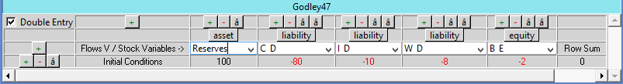
Putting banks, debt & money into economics
Five Bank accounts needed:
Reserves (to store deposits)
C_D: Deposit account for “Patient” consumer goods sector firm
I_D: Deposit account for “Impatient” investment goods sector firm
W_D: Workers Deposit
B_E: Bank Equity account
Operations:
Consumer sector Lends to Investment Sector
Investment sector pays Interest & Repays Consumer Sector
Consumer sector pays intermediation Fee to Bank
Investment & Consumer sector hire workers, buy from each other
Bank & Workers buy from Consumer Sector…

Slide 29
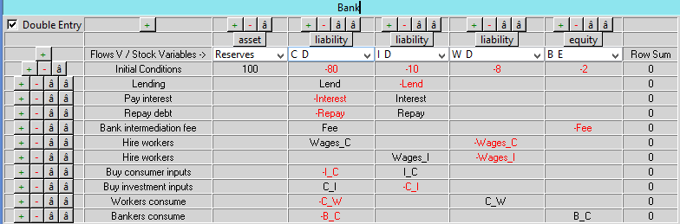
Putting banks, debt & money into economics
Financial flows:
Minsky generates set of ODEs (Ordinary Differential Equations) from these entries…

Slide 30
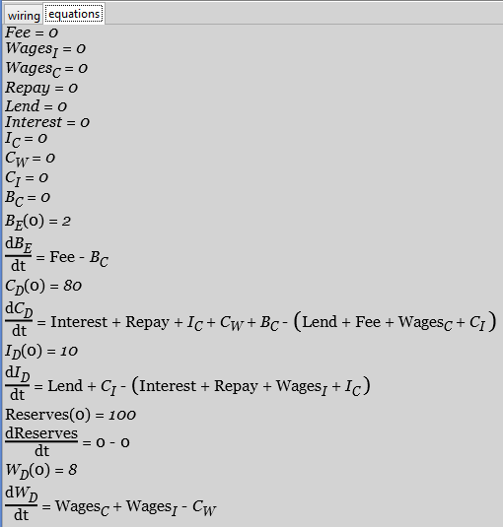
Putting banks, debt & money into economics
System financial dynamics shown on “equations” tab:
Flow terms “Interest”, “Wages_{C}”, just placeholders right now
Need to be defined
Method:
Make copy of entries on Godley icon
Define equations same way as for Goodwin model last week…

Slide 31
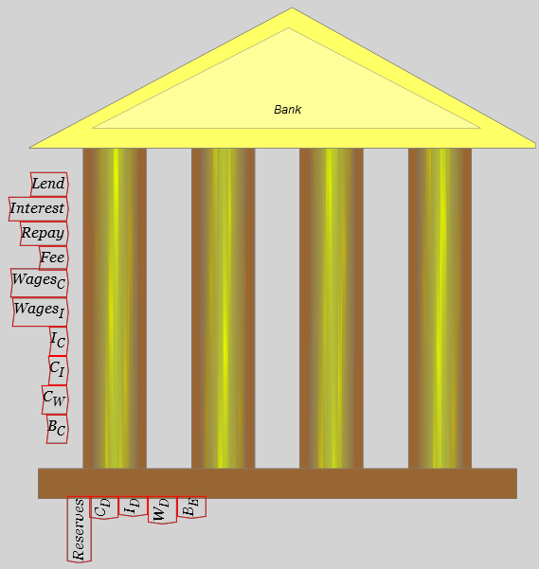
Putting banks, debt & money into economics
Simplest example: Interest will be Debt times Interest Rate…
But where is Debt?...
Debt not shown because it’s neither an Asset nor a Liability of the banking sector under “Loanable Funds”
Instead it’s an
Asset of Consumer sector
Liability of Investment sector
Have to add tables for these two sectors (and might as well add Workers as well)…

Slide 32
Putting banks, debt & money into economics
Insert new Godley Table
Call it “Consumer Sector”
Click on “noAssetClass” & choose Asset
Click on Drop-down menu & select C_D (Consumer Deposit account at bank)
Now add additional column & label it “D” for “Debt”
Give it initial value of 20
Enter matching entries for Lend & Repay
Add another column, choose Equity & call this NW_C (“Net Worth Consumer Sector”)
Add matching entries for all other operations (including net worth)
You should have…

Slide 33
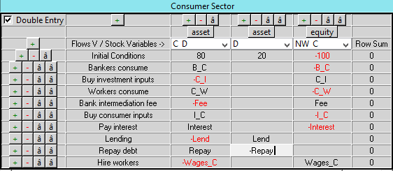
Putting banks, debt & money into economics
Completed Consumer sector Godley Table:
Now add two more Godley Tables
Investment Sector
Workers
Repeat operations with noAssetClass & Drop-Down Menu

Slide 34
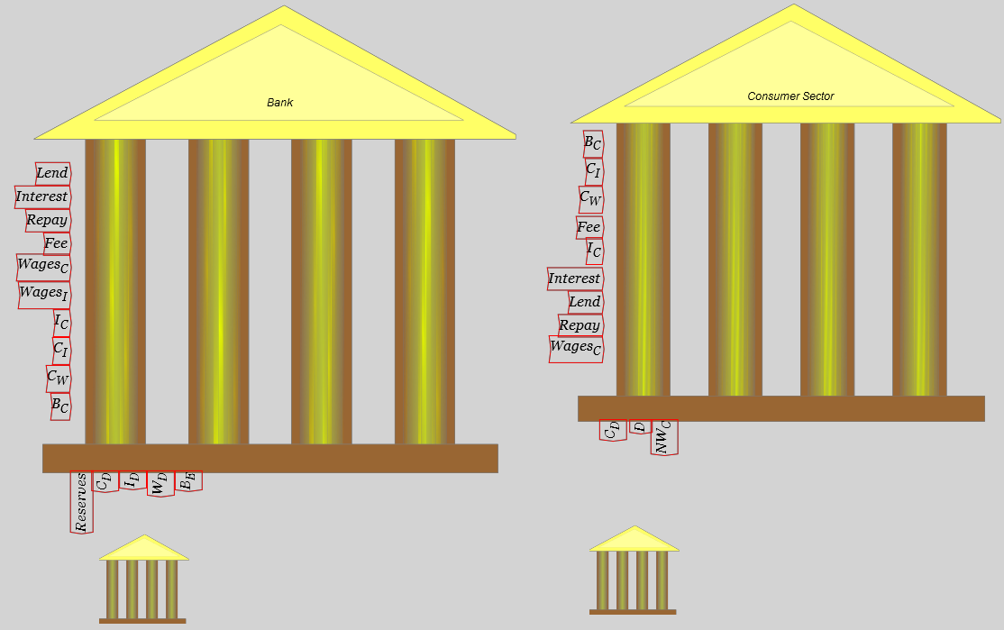
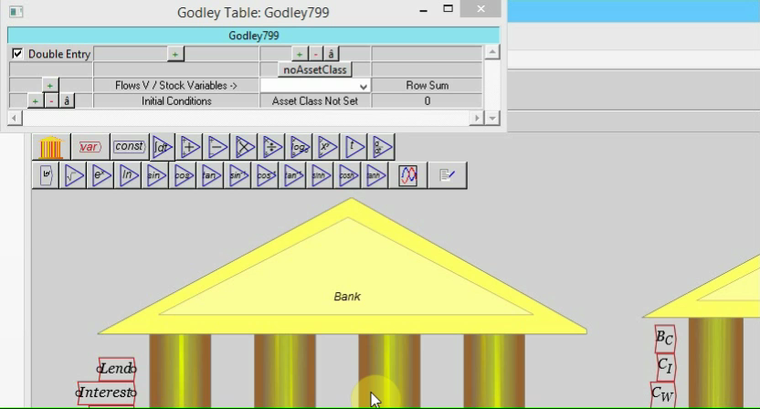
Putting banks, debt & money into economics
First step: insert 2 Tables
Second step: populate Investment table…

Slide 35
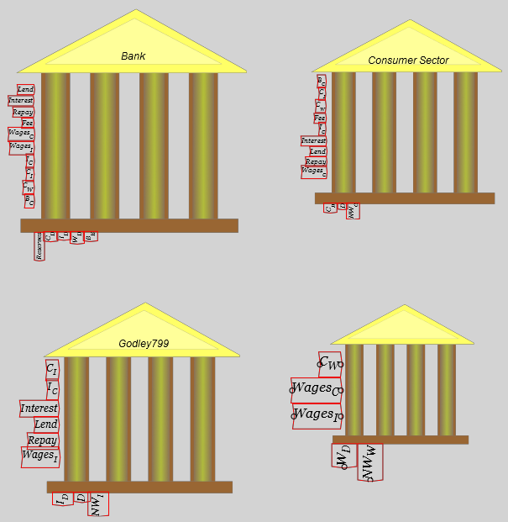
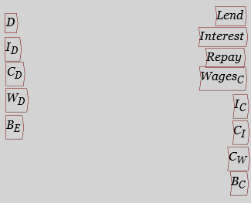
Putting banks, debt & money into economics
Resize Godley Tables to create some space (Right mouse menu)…
Now to define terms…
Right click on each one & choose “Copy”
Place copy on canvas…
Stocks
Flows
Define flows in terms of stocks
More complicated later when include physical factors, but…

Slide 36
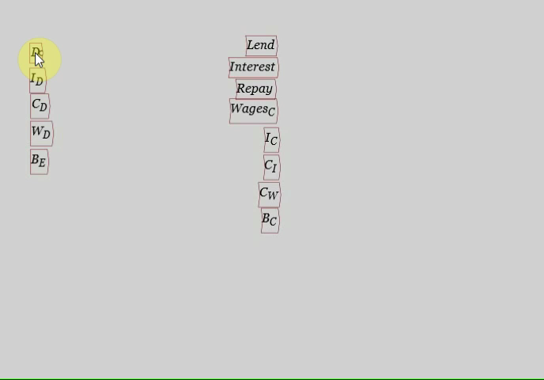
Putting banks, debt & money into economics
Simplest is defining interest payment:
For other flows, best way to relate to stocks is via “time constants”…

Slide 37
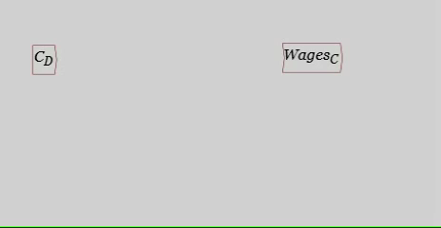

Putting banks, debt & money into economics
Time constants relate a stock
e.g., money in C_D account
To a flow
E.g., flow of production and sale of consumer goods
Say “turnover rate” in production in Marx’s sense
“Time between M and M+”
Was 3 months. That is ¼ of a year:
So the “time constant” in production is ¼
This gives Output (in $/Year) which we can split into Wages & Profits
Fixing some mistakes yields:

Slide 38
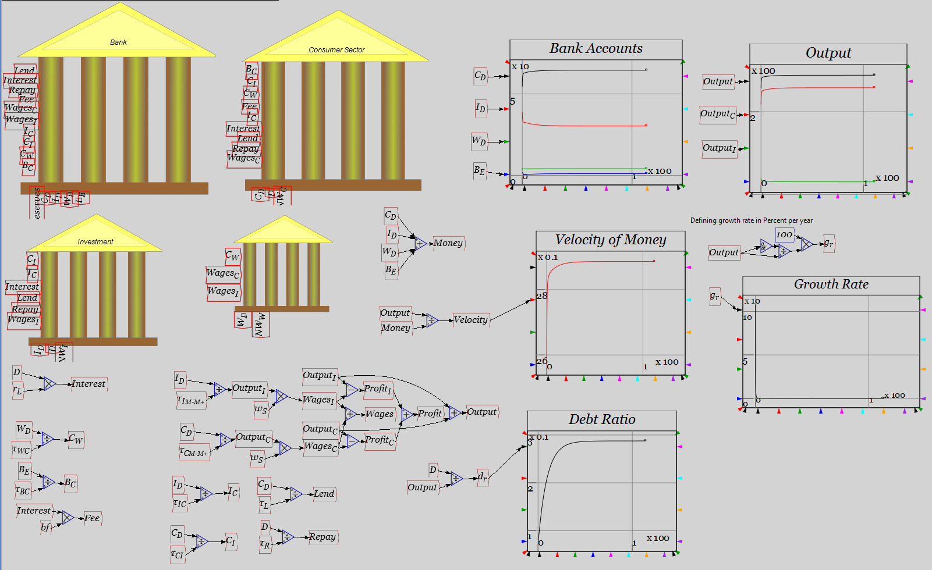
Putting banks, debt & money into economics
Same for other stocks & flows gives us ultimately:
Notice growth rate is zero…

Slide 39
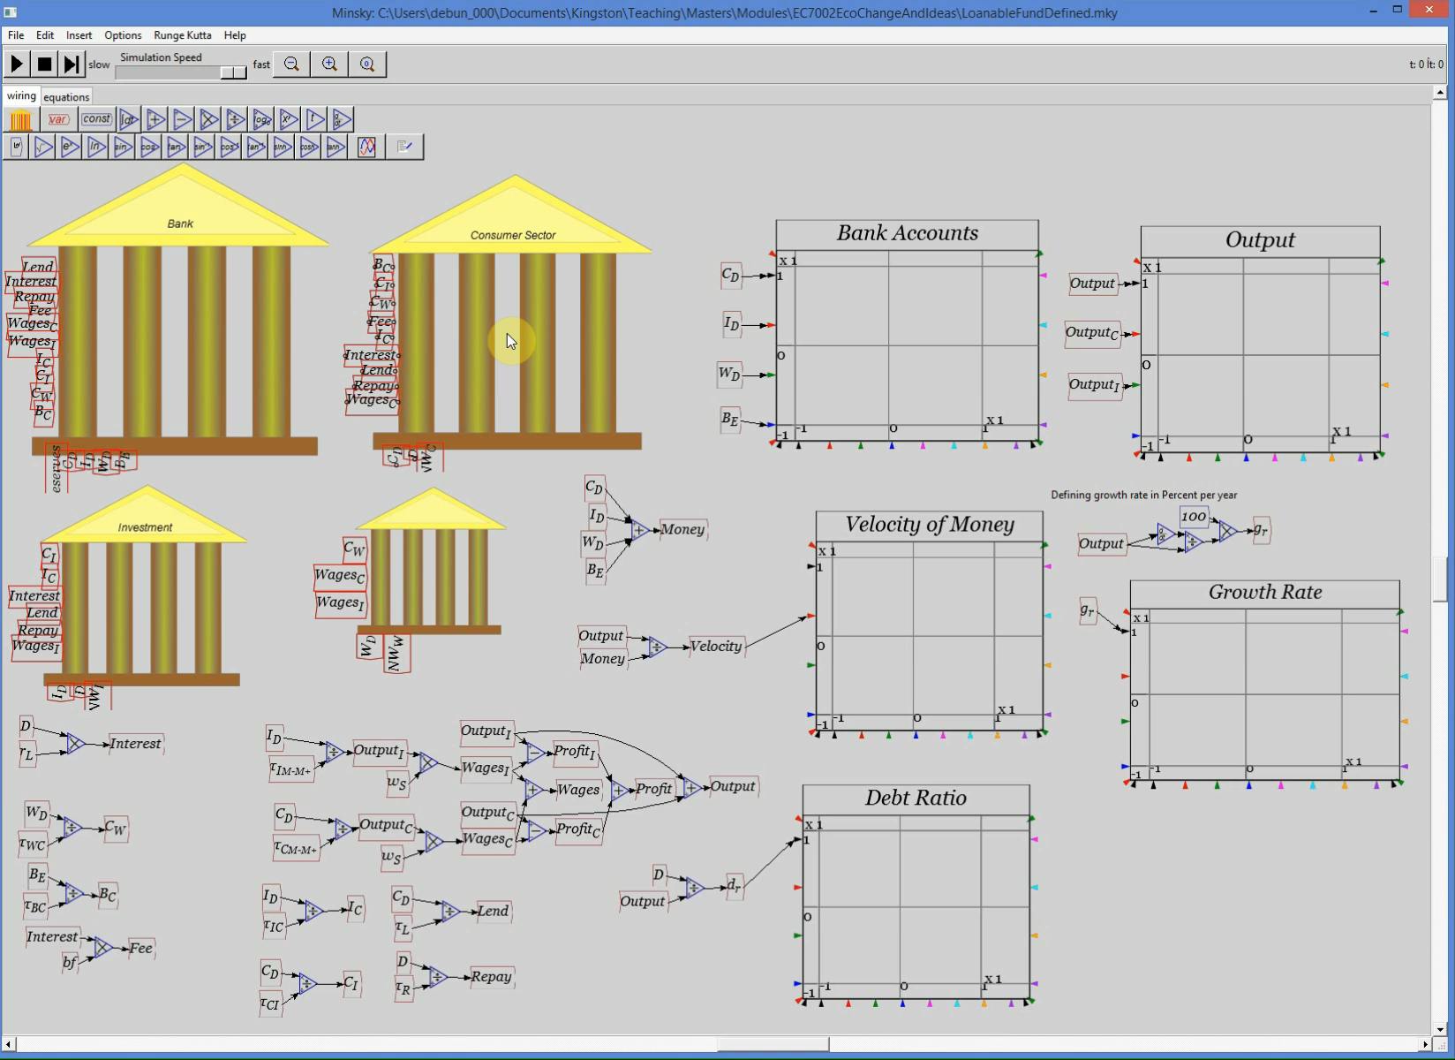
Putting banks, debt & money into economics
Now let’s modify this to be Endogenous Money:
Not “Patient” lends to “Impatient” but “Bank lends to non-bank”

Slide 40
Putting banks, debt & money into economics
But how to reconcile this with “Expenditure≡Income”?…
Consider 3 sector model with sectors S₁, S₂, S₃
Expenditure not debt-financed shown as E_{xy}:
Expenditure by Sector x on output of Sector y
3 situations considered
Borrowing not possible
Borrowing from other sectors possible (“Loanable Funds”)
Borrowing from banks possible (“Endogenous Money”)
First case “Say’s Law” (actually “demand creates its own supply”)
Activity |  | Net Income
 | Sector | Sector 1 | Sector 2 | Sector 3
Expenditure (Exp.) | Sector 1 | -(E_{1,2} + E_{1,3}) | E_{1,2} | E_{1,3}
 | Sector 2 | E_{2,1} | -(E_{2,1} + E_{2,3}) | E_{2,3}
 | Sector 3 | E_{3,1} | E_{3,2} | -(E_{3,1} + E_{3,2})
Negative sum of diagonal elements is aggregate demand
Sum of off-diagonal elements is aggregate income

Slide 41
Putting banks, debt & money into economics
Clearly Expenditure ≡ Income:
Loanable Funds: Sector 1 borrows ΔD from Sector 2
Sector 1’s funds for spending increase by ΔD
Sector 2’s funds fall by ΔD
Sector 1 spends on Sectors 2 & 3 rises at ratios α and 1-α respectively
Sector 2’s spending falls by ratios β and 1-β respectively…
Activity |  | Net Income
 | Sector | Sector 1 | Sector 2 | Sector 3
Exp. | 1 | -(E_{1,2} + E_{1,3}+ΔD) | E_{1,2}+α. ΔD | E_{1,3}+(1−α).ΔD
 | 2 | E_{2,1}-β.ΔD | -(E_{2,1} + E_{2,3}-ΔD) | E_{2,3}-(1−β) .ΔD
 | 3 | E_{3,1} | E_{3,2} | -(E_{3,1} + E_{3,2})
Change in debt plays a transient role…

Slide 42
Putting banks, debt & money into economics
Full expression of aggregate demand and aggregate income:
Terms in ΔD cancel…
Same as for “Say’s Law”
Now Endogenous Money
Borrower’s funds come from a bank
Increase in bank assets ΔD
Identical increase in liabilities
ΔD spent by Sector 1 on outputs of Sectors 2 and 3…

Slide 43
Putting banks, debt & money into economics
Sector 1 borrows ΔD from a bank
No impact on spending by other sectors…
Activity |  | Net Income
 | Sector | Sector 1 | Sector 2 | Sector 3
Exp. | 1 | -(E_{1,2} + E_{1,3}+ΔD) | E_{1,2}+α. ΔD | E_{1,3}+(1−α).ΔD
 | 2 | E_{2,1} | -(E_{2,1} + E_{2,3}) | E_{2,3}
 | 3 | E_{3,1} | E_{3,2} | -(E_{3,1} + E_{3,2})
Full expression of aggregate demand and aggregate income:
Terms in ΔD no longer cancel…

Slide 44
Putting banks, debt & money into economics
Reduced form is…
I.e., Both aggregate expenditure and aggregate income are
Non-debt financed Expenditure (i.e. turnover of existing money)
Plus the change in debt (creation of new money & demand-income)
Generalises to flow of new lending dD/dt
Loanable Funds: flow of lending from Sector 2 to Sector 1 of dD/dt reduces Sector 2’s spending by dD/dt …
Endogenous money: flow of lending from Bank of dD/dt to Sector 1 does not affect spending of other sectors
Sector labels (S₁, S₂, S₃) represent bank balances of each sector
“time constant” τ_{xy} shows rate of flow of money from sector x to y

Slide 45
Role of debt in aggregate demand & income
Loanable funds: flow of lending from Sector 2 to Sector 1
Sector 1 pays interest to Sector 2
Account Balances
Aggregate demand
Interest is part of aggregate demand/income
Aggregate income

Slide 46
Role of debt in aggregate demand & income
Endogenous Money: Bank loans flow to Sector 1
Sector 1 pays interest to Banking sector (shown as B_{E})
Banking sector pays deposit interest to non-bank sectors
Aggregate demand
Aggregate income
Change in debt (+ deposit & loan interest) components of both

Slide 47
Role of debt in aggregate demand & income
Corrected insights on role of debt in aggregate demand & income
Expenditure/Income is
That financed by existing money
Plus that financed by the change in debt
Plus gross financial transactions
Which implies dynamic generalization of “Quantity Theory of Money”

Slide 48
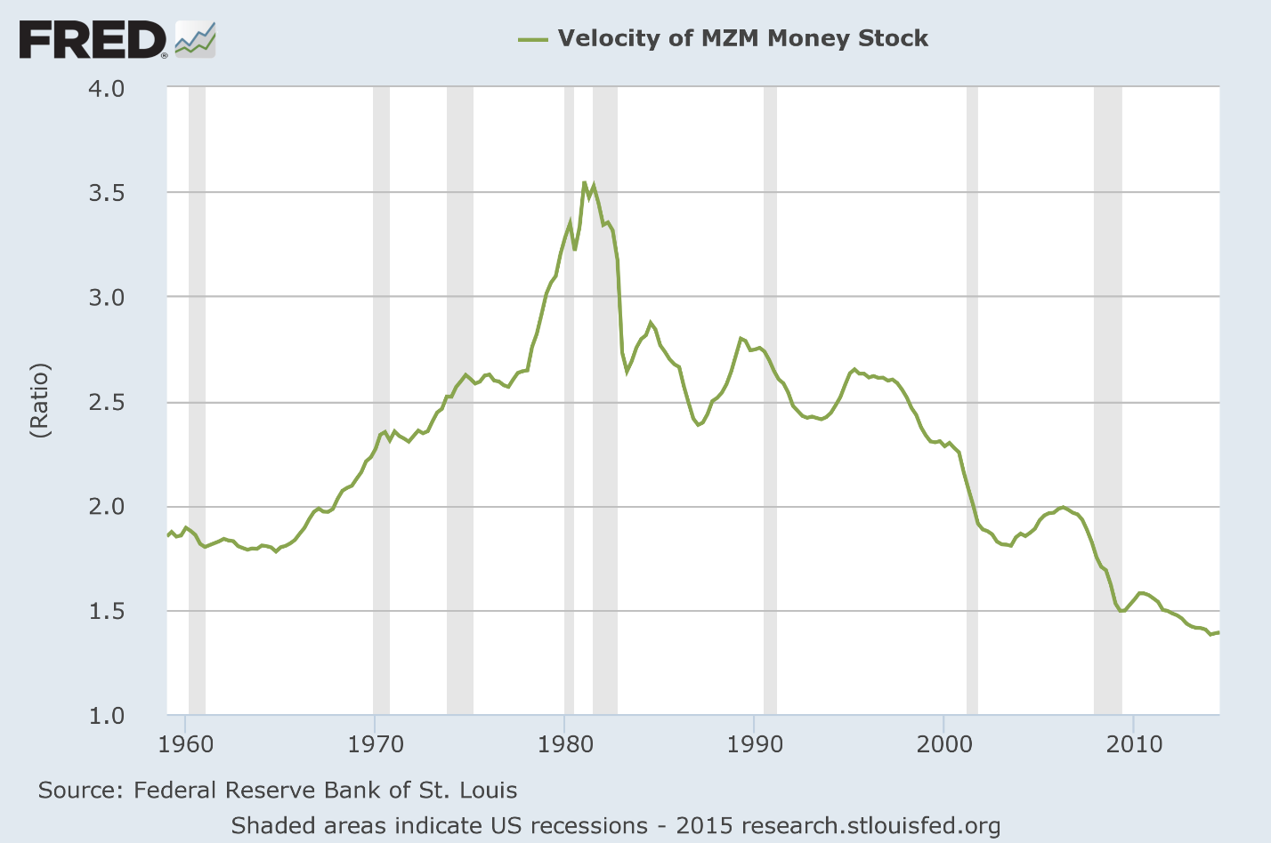
Role of debt in aggregate demand & income
Friedman’s Monetarism used equation
Price level
Output
Money Stock
Velocity of circulation
Friedman asserted
V was constant
Y determined by “real” factors only (general equilibrium, full employment, yada yada yada)
M under government control (“Helicopter money”)
So that “inflation is the government’s fault”
In fact, V is pro-cyclical and highly volatile:

Slide 49
Role of debt in aggregate demand & income
Friedman gave velocity of money bad name amongst Post Keynesians:
“The central assertion of monetarism … is that an excessive increase in the supply of money, caused by the decisions of the note-issuing authority, the central bank, is the main, if not the sole, cause of inflation” (Friedman 1969, p.4)
But velocity of circulation of money a necessary element of monetary approach to economics
When corrected for endogenous creation of money in a pure credit money economy, it becomes:
Demand & Income from turnover of existing money
Demand & Income from newly created money
Since money is used not just to buy newly created goods & services
But also purchases of existing financial claims (ownership of shares & property)
Money demand drives “Net Asset Turnover” as well…

Slide 50
Role of debt in aggregate demand & income
General expression for a modern monetarism:
New Goods
Change Asset Values
Existing money
New money
Gross Financial Transactions
Right hand side is all sources of monetary demand…
Left hand side is all uses of money
Buying new goods
Changing value of existing financial claims
Total value of ownership of existing shares and property
Expanding out NAT:
New Financial Claims
Change Asset Prices

Slide 51
Role of debt in aggregate demand & income
Change in money (primarily change in private debt) & change in asset prices most volatile elements:
Changes rapidly
Changes rapidly
Implies acceleration of debt major contribution to change in GDP
These dynamics missed completely by Loanable Funds model
And explain causal link between change & acceleration of debt & macroeconomic variables…

Slide 52
Role of debt in aggregate demand & income
American Change in debt and unemployment…

Slide 53
Role of debt in aggregate demand & income
US acceleration & change in unemployment (inverted)

Slide 54
Role of debt in aggregate demand & income
Japanese Change in debt and unemployment…

Slide 55
Role of debt in aggregate demand & income
Japanese acceleration & change in unemployment (inverted)

Slide 56
Role of debt in aggregate demand & income
USA Mortgage debt acceleration & house price change

Slide 57
Role of debt in aggregate demand & income
US Margin debt acceleration & share price change

Slide 58
Role of debt in aggregate demand & income
Next week (plus 1): Minsky and the Financial Instability Hypothesis…

