Slide 1

Greek Debt Deflation and Neoclassical Economics
Steve Keen
Kingston University London
IDEAeconomics
Minsky Open Source System Dynamics
www.debtdeflation.com/blogs

Slide 2
What is Heterodox Economics?
According to Diane Coyle, one of the authors of the CORE Curriculum…
  On BBC Radio 4 “Teaching Economics After the Crash”
    “[Post-Crash] has this fixation on Schools of Thought…
    This idea that there is a monolithic Neoclassical School of Thought that’s dominated economics departments and the curriculum for a long period of time, and that it needs to switch to a different School of Thought, ‘Heterodox Economics’, or at least introduce lots of different Schools of Economic Thought.
    I think that’s going backwards. That’s going back to the economics of the 1930s and these almost Medieval Scholastic debates about what your world view was.”
  At Manchester debate with me & George Cooper
    “I find it quite bizarre that there’s a lot of reaching for 70 or 100 year old historical ways of thinking about the economy when the economy has changed so much…” (1:26:00)
So “Post Keynesian Economics” is the “70 or 100 year old” way of thinking back in the 1930s when the economy was “so different”…?

Slide 3
What is Heterodox Economics?
Were the 1930s so different to today?

Slide 4
What is Heterodox Economics?
Why might people have debated economics in the 1930s as well as now?
Breakdown!
“Great Moderation”

Slide 5
What is Heterodox Economics?
Were the causes of the two crises entirely different?

Slide 6
What is Heterodox Economics?
Does mainstream economics have a sound explanation for either crisis?
  “there is now overwhelming evidence that the main factor depressing aggregate demand was a worldwide contraction in world money supplies.”
  “The monetary data for the United States are quite remarkable, and tend to underscore the stinging critique of the Fed’s policy choices by Friedman and Schwartz…”
  “Let me end my talk by abusing slightly my status as an official representative of the Federal Reserve. I would like to say to Milton and Anna:
    Regarding the Great Depression.
    You're right, we did it.
    We're very sorry.
    But thanks to you, we won't do it again.” (Bernanke 2002)
Whoops…

Slide 7
What is Heterodox Economics?
Did mainstream economics dispassionately consider other theories?
  Bernanke before the 2007 crisis:
    “Hyman Minsky (1977) and Charles Kindleberger (1978) have in several places argued for the inherent instability of the financial system
      but in doing so have had to depart from the assumption of rational economic behavior…
    I do not deny the possible importance of irrationality in economic life; however it seems that the best research strategy is to push the rationality postulate as far as it will go.” (Bernanke 2000, Essays on the Great Depression, p. 43)
Ignore alternative views because they don’t fit your paradigm?
  CORE curriculum does the same today after the crisis…
Economics needs to learn some humility:
  “There are more things in heaven and earth, Horatio, Than are dreamt of in your philosophy.” (Hamlet to Horatio in Hamlet)
  You shouldn’t just ignore what you can’t explain

Slide 8
What is Heterodox Economics?
So is Post-Keynesian economics…
  “70 or 100 year old historical ways of thinking about the economy when the economy has changed so much”
  Or…
  A different approach to economics inspired by a similar crisis & similar failure of mainstream economics 80 years ago?
According to mainstream economists: the former
In reality: the latter
  Many other Schools of Thought exist that CORE ignores…
    Post Keynesian (see King 2003, 2012 for detailed history)
    Ecological
    Institutional
    Austrian
    Marxist…
  Economists in these Schools do read Neoclassical economics
  Neoclassical economists don’t read non-Neoclassical economics
    So they barely even know we exist

Slide 9
What is Post Keynesian Economics?
Part critique of Neoclassical Economics
  Dates from well before Keynes—see Veblen 1898 “Why is Economics not an Evolutionary Science?”
    Keynes simply break point at which PK diverged from Hicksian interpretation of Keynes (Hicks 1937 vs Keynes 1937)
Part alternative approach based on realism rather than “simplifying assumption” fantasies
  Uncertainty isn’t risk (Keynes 1937, Kalecki 1937)
    “Rational Prophetic Expectations” is a delusion
  The economy is cyclical & evolutionary (Kalecki 1968, Goodwin 1967)
    Economy is never in equilibrium (Hicks 1981)
    Evolution rather than than price competition (Schumpeter 1934)
  Money, banks and debt matter (Fisher 1933, Minsky 1975)
    Can’t model capitalism without money
  Production is multi-sectoral (Sraffa 1960)
    Input-output dynamics matter
  And many other strands (see King for overview)

Slide 10
Post Keynesian Economics: the alternatives
Many alternatives strands within broad “Post Keynesian” school
  Sraffian economics (derived from Sraffa 1960)
    Input-output focus (Steedman)
  Kaleckian economics
    Cyclical growth focus
  Stock-Flow Consistent Approach (SCFA)
    Strict accounting for monetary stocks & flows (Godley, Lavoie)
  Modern Monetary Theory (MMT)
    Capacity for fiat money creation to overcome recessions
  Minskian economics
    Monetary explanation for dynamic instability & crises
My approach just one of many
  Attempting to blend all above, and to incorporate
    Energy/entropy/ecology analysis (Ayres)
    Evolutionary dynamics (Schumpeter)
Major focus: incorporating banks, debt & money into macroeconomics

Slide 11
Essential issue today: Greece & Austerity
Basis of Austerity is Neoclassical “Ricardian Equivalence”
Robert Barro (1989): “The Ricardian Approach to Budget Deficits”
  “a deficit-financed cut in current taxes leads to higher future taxes.
  a cut in today’s taxes must be matched by a corresponding increase in the present value of future taxes.
  Suppose now that households’ demands for goods depend on the expected present value of taxes.
  Therefore, the substitution of a budget deficit for current taxes has no impact on the aggregate demand for goods.
  A current budget deficit leads to an offsetting increase in desired private saving, and hence to no change in desired national saving…”
  IF! … we assume …
  “a network of intergenerational transfers makes the typical person a part of an extended family that goes on indefinitely.
  In this setting, households capitalize the entire array of expected future taxes, and thereby plan effectively with an infinite horizon.”

Slide 12
Mainstream economics & European economic crisis
So Barro asserts that:
  Families plan for infinite future
  So given increase in government deficit today
  You save more to give bequests to your great great grandchildren
  So they can pay future taxes
Only one thing one can say about this argument:
  What was Barro smoking?
Two elements of delusional reasoning
  Prophetic Agents who plan for “an infinite future”
    What they call “Rational” is really Prophetic (Rome lecture)
  Non-monetary, equilibrium vision of capitalism
    In which the government must run a balanced budget over time
Since these delusional assumptions don’t hold, “expansionary fiscal consolidation” can’t possibly work…
  But Barro’s argument was the basis of European Union belief that reducing the government deficit is the first priority in this crisis

Slide 13

Mainstream economics & European economic crisis
Troika policy is sustained surplus of 4.5% of GDP
  Objective at same time that nominal growth should be 3% p.a.
  Clearly sees government “as a business”
  “Business” should be profitable
  Make receipts (Taxes) exceed expenditure (Government Spending)
  Greek economy will be profitable, economy will boom…
Let’s take a strictly monetary look at this…

Slide 14
A monetary perspective on austerity
Divide society into Government & Private
Surplus means money flow of Government Taxes > Spending
Surplus means net flow of money from Private to Government
  Call this “NetGov”. Then Government surplus means Private deficit
Private:
deficit = NetGov
Government:
surplus = NetGov
So Troika target of sustained (primary) surplus means money flow from Greek Private sector to government must be equivalent to 4.5% of GDP
In general, from where can private sector get this money?…

Slide 15
Should government budget be balanced or in surplus?
One off, not a major problem
  Public just has to reduce its savings or go into debt…
    But this the opposite of what surplus proponents believe!
      Think Government saving will encourage private saving
      But as matter of accounting, only two possibilities
        Either public reduces its bank balances; or
        Public borrows money needed from banks
Banks must “run a deficit”: Loans > Repayments + Interest
  Call this “NetBank”. Then:
Private Banks:
Deficit = NetBank
Government: Surplus = NetGov = NetBank
But this is incompatible with a growing economy
Public money stock remains constant
Only other way for economy to grow is for velocity of money to rise constantly
That’s not what it does…
Private Non-Bank:
Balance = NetGov + NetBank

Slide 16
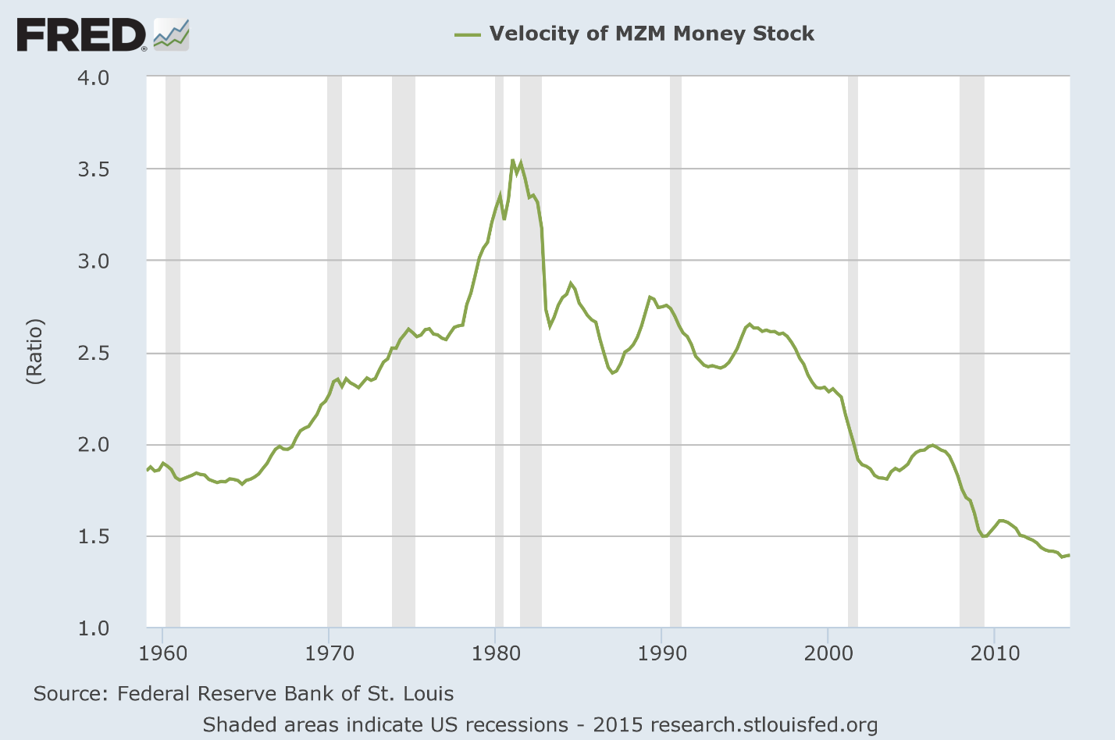
Should government budget be balanced or in surplus?
Velocity trending down for last 3 decades…
So government surplus with NetGov=NetBank means
  At best, no economic growth (maybe even contraction); and
  Rising private debt to GDP (since NetBank > 0 for public)
Only way to get economic growth with a government surplus is…

Slide 17
Should government budget be balanced or in surplus?
If NetBank > NetGov: if public borrows enough to pay government surplus and accumulate more money itself:
But this requires private debt to banks to grow:
  Faster than GDP (given constant or falling velocity of money); and
  Faster than in no-growth case
So medium-term consequence of sustained government surplus is
  Rising private debt to GDP; and…
Private Banks
Deficit = NetBank
Government Surplus = NetGov
Private Non-Bank
Surplus = NetGov + NetBank
Growth
Eventually, an economic crisis when private sector stops borrowing!
This is the opposite of what government surplus fans believe
  If private sector becomes averse to rising debt/income ratio, then
    Private sector will try to reduce debt (delever) …

Slide 18
Should government budget be balanced or in surplus?
Not just hypothetical situation: this is what is happening in Europe…

Slide 19
Should government budget be balanced or in surplus?
Both private banks and government running surplus
Private non-bank sector running a deficit
Economy contracting as money supply and velocity fall
Actual Greek situation under austerity:
External:
Exports to < Imports from
Deficit = NetExt
Private Banks:
Surplus = NetBank
Government: Surplus = NetGov
8% GDP
Private Non-Bank:
Deficit = NetGov + NetBank + NetExt
1% GDP
1.5% GDP
Contraction

Slide 20
Should government budget be balanced or in surplus?
Balanced budget over long term almost as bad
  Private debt growth at least as fast as GDP
Only sustainable situation is government should normally run deficits
External: NetExt= 0
Private Banks:
Deficit = NetBank
Government: Deficit = NetGov
Private Non-Bank:
Surplus = NetGov + NetBank + NetExt
Growth
Barro reached opposite conclusion because Neoclassical mainstream ignores banks, debt and money…

Slide 21
Do banks (and debt and money) matter?
From Loanable Funds to Endogenous Money…

Slide 22
Basic dynamic economic modelling
A foundation for introducing debt & money into macroeconomics…
Goodwin’s simple cyclical growth model
  Capital determines output
  Output determines employment
  Employment rate determines rate of change of wages
  Wages determine Profits
  Profits determine Investment
  Investment is the rate of change of Capital
  Generates cyclical growth…
Building this in Minsky
Using parameter values:
  v = 3
  a = 1
  λ_{s} = 10
  λ₀ = 0.9
  δ = 0.1
  N = 120
Initial conditions
  K(0) = 300
  w_{r}(0)=0.8
Add plots to illustrate…

Slide 23
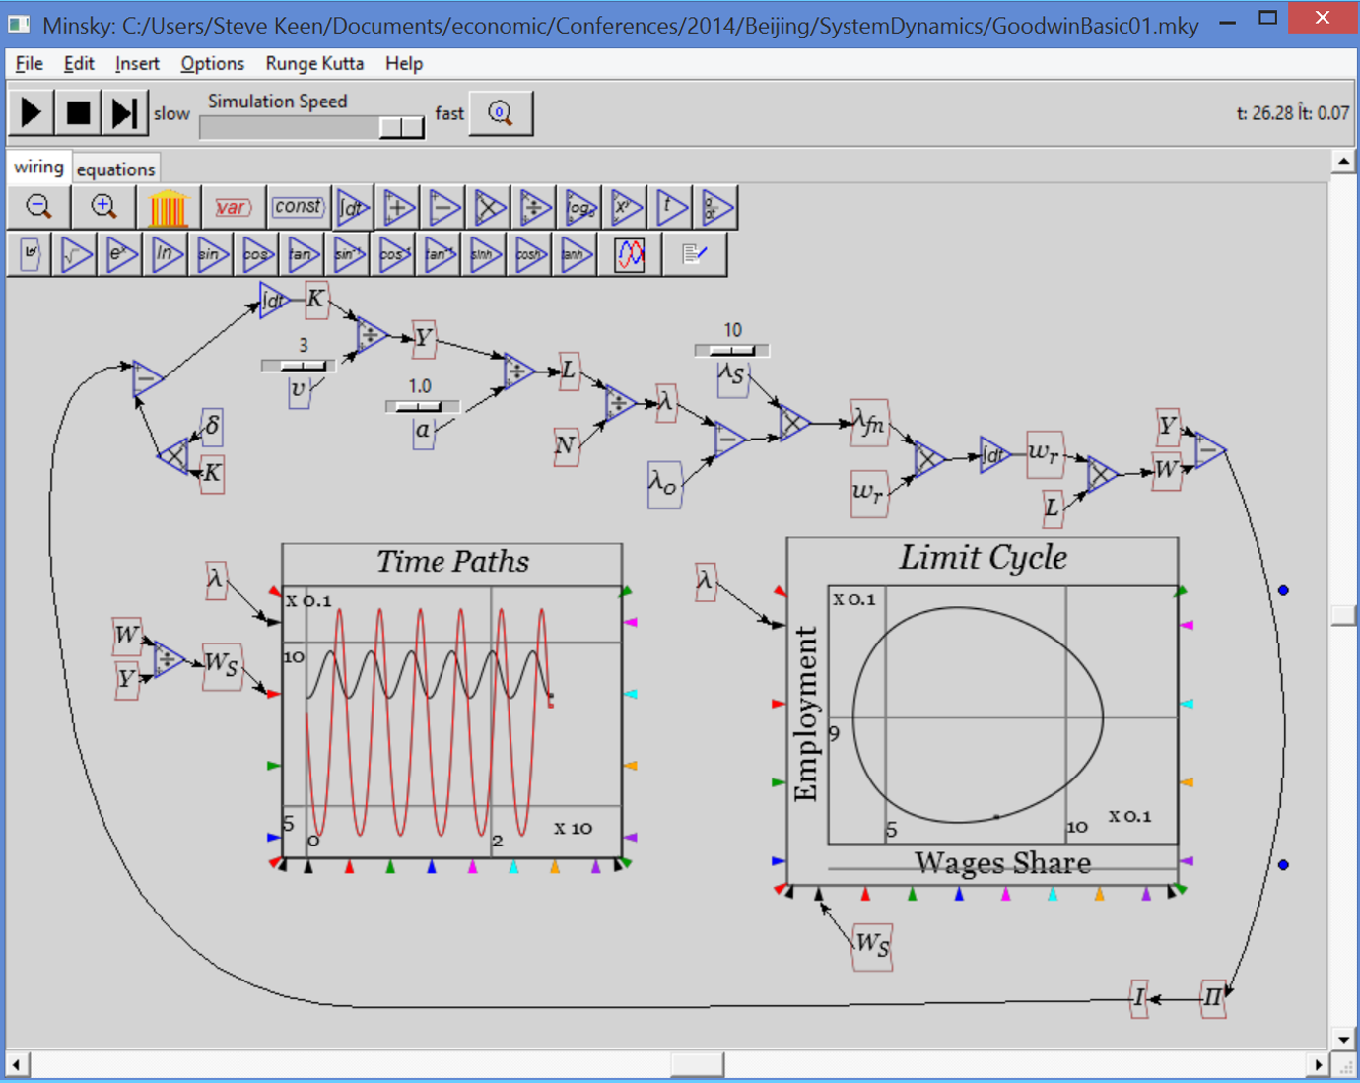
Basic economic modelling: Goodwin’s growth cycle
Generates a cyclical model

Slide 24
Basic economic modelling: Goodwin’s growth cycle
Now add realism
  Capitalists don’t invest all their profits
    More during boom
    Less during slump
  Use linear investment function:
Rate of profit
Investment function
Ignoring (for now)
  where capitalists get funds > profit
  where they store surplus when investment < profit
Using parameter values
  π_{E} = 0.03
  π_{S} = 10

Slide 25
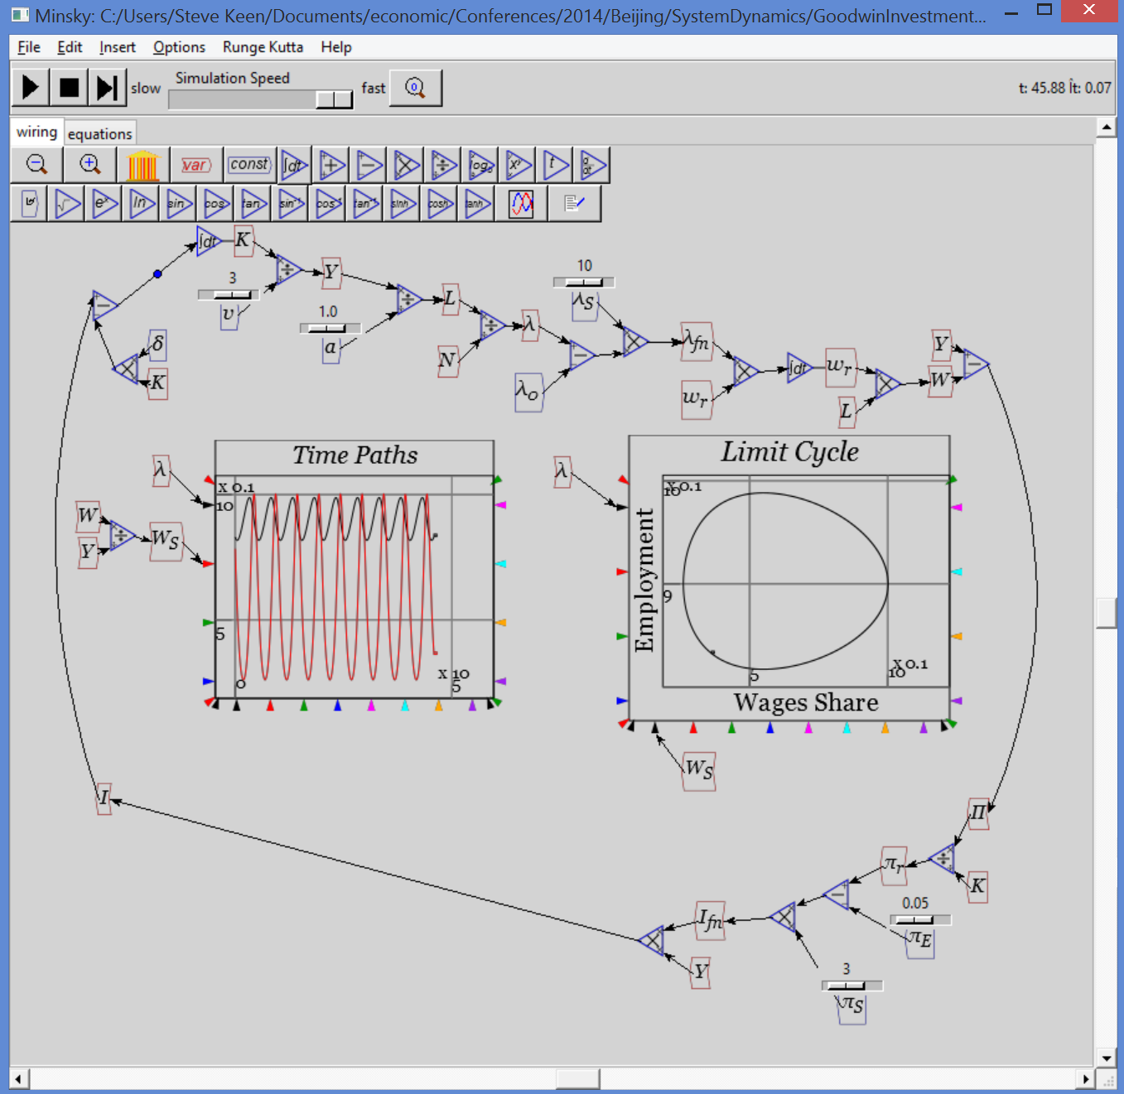
Extending Goodwin: adding debt
Generates same basic outcome: sustained nonlinear cycles
Now more realism:
Capitalists borrow from banks when desired investment exceeds profits
Banks charge interest on outstanding debt
Adds these equations:
Using parameter value
  r_{L} = 0.05
Adding graph for D/Y

Slide 26
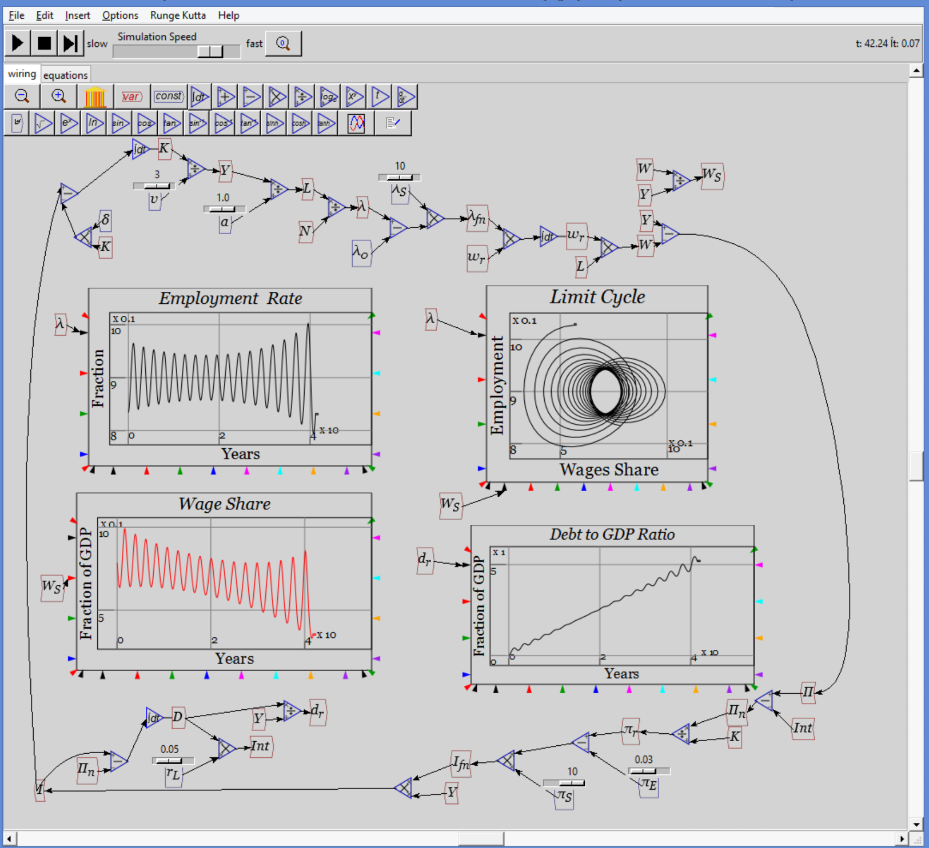
Extending Goodwin: adding debt
Generates complex system
3rd dimension introduces possibility of complex behaviour
Actual dynamics bear qualitative similarity to recent economic history
Period of apparent declining volatility…
Followed by rising volatility and breakdown…
With rising private debt to GDP ratio
And declining workers’ share of output (rising inequality)
All without nonlinear functions or growth…

Slide 27
Extending Goodwin: adding government
Government subsidies to firms (G_{S}) a function of employment rate:
Net profit now includes government subsidy
Replacing unrealistic linear functions with more realistic nonlinear ones
  Generalized exponential function with parameters minimum, x-y coordinate & slope at (x,y) point:

Slide 28
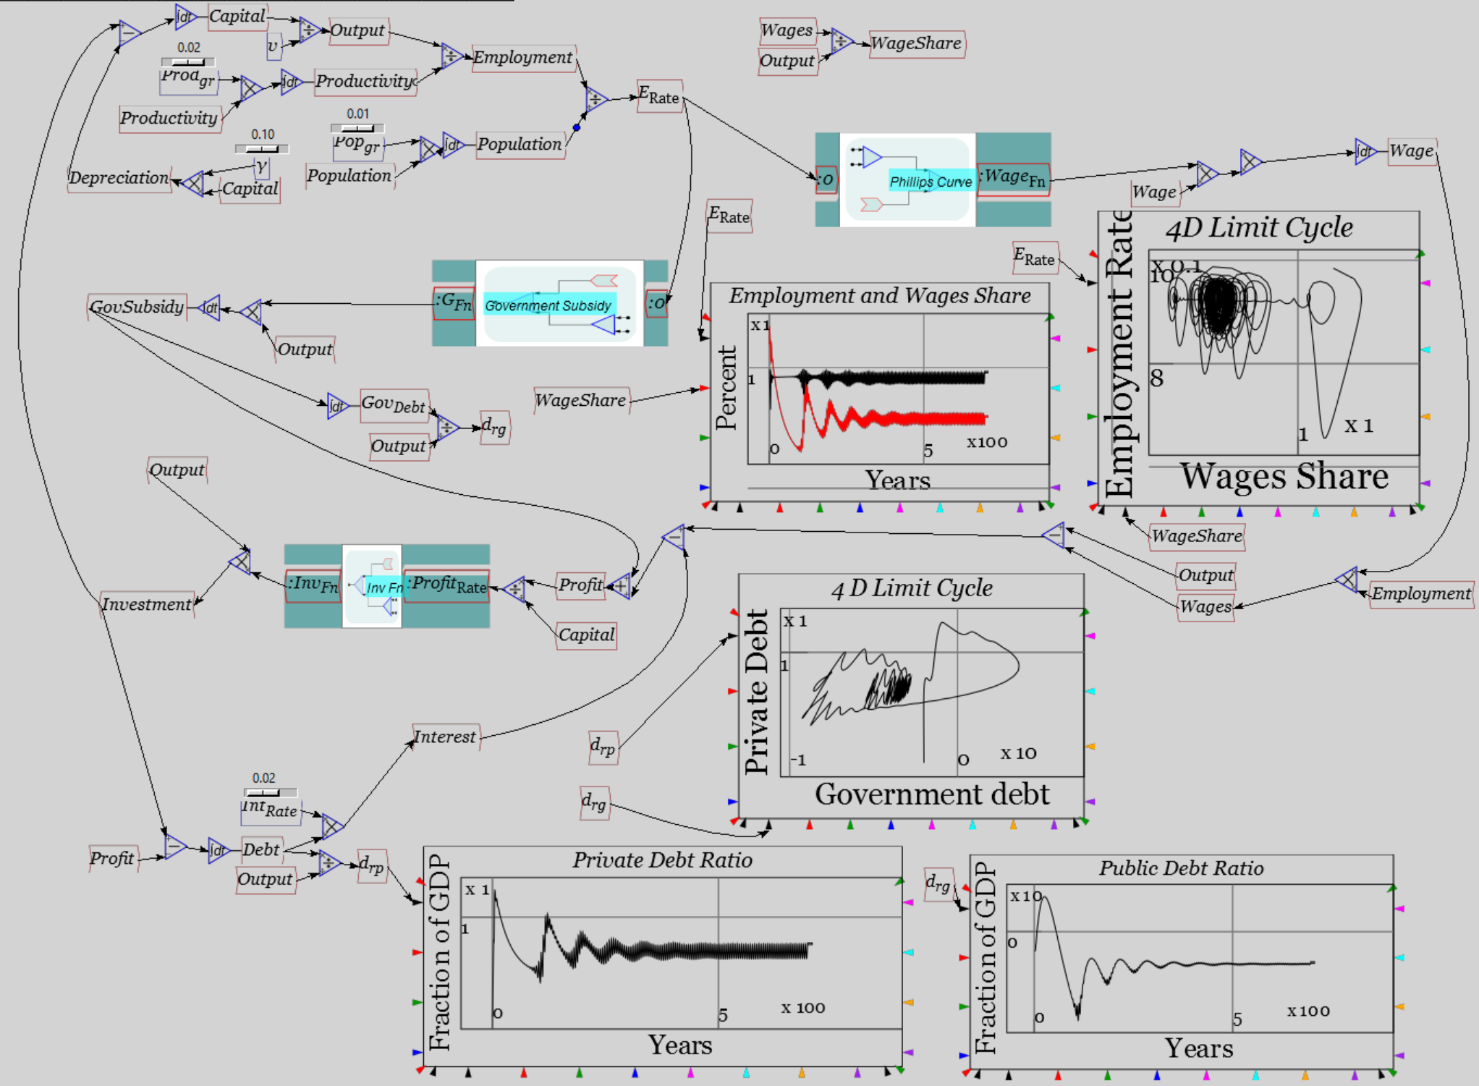
Extending Goodwin: adding government
Resolute counter-cyclical government behaviour prevents breakdown, but cycles remain…
More stable than actual economy
Actual governments have tolerated rising unemployment since 1970s
Private debt continued to rise during “austerity”
Public debt now rising in aftermath…

Slide 29
Why deflation now?
Highest levels of debt in the history of capitalism…

Slide 30
Conclusion
Much more to Post Keynesian economics than I’ve shown here
  Consult King (2012) for a complete survey
Many other Schools of Thought—Austrian, Evolutionary, Ecological, Feminist, Marxist, Institutional, Econophysics
Given failure of Neoclassical paradigm, pluralism should rule
  Teach all current approaches
  Attempt to evolve new realistic paradigm over time
And if your University doesn’t teach alternative approaches, then…
For a pluralist education in economics
Come to Kingston
School of Economics, History & Politics
Kingston
University
London

Slide 31
References: small selection of Post Keynesian papers
Ayres, R. U. (1978). Application of physical principles to economics. Resources, environment, and economics: applications of the materials/energy balance principle. R. U. Ayers: Chapter 3.
Ayres, R. U. (1995). "Thermodynamics and Process Analysis for Future Economic Scenarios." Environmental and Resource Economics 6(3): 207-230.
Ayres, R. U. (1999). "The Second Law, the Fourth Law, Recycling and Limits to Growth." Ecological Economics 29(3): 473-483.
Bernanke, B. S. (2002). Remarks by Governor Ben S. Bernanke At the Conference to Honor Milton Friedman. Conference to Honor Milton Friedman. University of Chicago, Chicago, Illinois.
  NOT a Post-Keynesian!
Blinder, A. S. (1998). Asking about prices: a new approach to understanding price stickiness. New York, Russell Sage Foundation.
  NOT a Post-Keynesian, but his survey work on cost functions contradicted Neoclassical theory
Eiteman, W. J. (1945). "The Equilibrium of the Firm in Multi-Process Industries." THE QUARTERLY JOURNAL OF ECONOMICS 59(2): 280-286.
Eiteman, W. J. (1947). "Factors Determining the Location of the Least Cost Point." The American Economic Review 37(5): 910-918.

Slide 32
References: small selection of Post Keynesian papers
Eiteman, W. J. (1948). "The Least Cost Point, Capacity, and Marginal Analysis: A Rejoinder." The American Economic Review 38(5): 899-904.
Eiteman, W. J. (1953). "The Shape of the Average Cost Curve: Rejoinder." The American Economic Review 43(4): 628-630.
Eiteman, W. J. and G. E. Guthrie (1952). "The Shape of the Average Cost Curve." The American Economic Review 42(5): 832-838.
Fisher, I. (1932). Booms and Depressions: Some First Principles. New York, Adelphi.
Fisher, I. (1933). "The Debt-Deflation Theory of Great Depressions." Econometrica 1(4): 337-357.
Godley, W. (1992). "Maastricht and All That." London Review of Books 14(19): 3-4.
Godley, W. (1999). "Money and Credit in a Keynesian Model of Income Determination." Cambridge Journal of Economics 23(4): 393-411.
Godley, W. (2001). "The Developing Recession in the United States." Banca Nazionale del Lavoro Quarterly Review 54(219): 417-425.
Godley, W. (2004). "Money and Credit in a Keynesian Model of Income Determination: Corrigenda." Cambridge Journal of Economics 28(3): 469-469.
Godley, W. and A. Izurieta (2002). "The Case for a Severe Recession." Challenge 45(2): 27-51.

Slide 33
References: small selection of Post Keynesian papers
Godley, W. and M. Lavoie (2005). "Comprehensive Accounting in Simple Open Economy Macroeconomics with Endogenous Sterilization or Flexible Exchange Rates." Journal of Post Keynesian Economics 28(2): 241-276.
Godley, W. and M. Lavoie (2007). "Fiscal Policy in a Stock-Flow Consistent (SFC) Model." Journal of Post Keynesian Economics 30(1): 79-100.
Godley, W. and M. Lavoie (2007). Monetary Economics: An Integrated Approach to Credit, Money, Income, Production and Wealth. New York, Palgrave Macmillan.
Goodwin, R. (1946). "Innovations and the Irregularity of Economic Cycles." The Review of Economics and Statistics 28(2): 95-104.
Goodwin, R. M. (1967). A growth cycle. Socialism, Capitalism and Economic Growth. C. H. Feinstein. Cambridge, Cambridge University Press: 54-58.
Goodwin, R. M. (1985). "A Personal Perspective on Mathematical Economics." Banca Nazionale del Lavoro Quarterly Review(152): 3-13.
Goodwin, R. M. (1986). "The Economy as an Evolutionary Pulsator." Journal of Economic Behavior and Organization 7(4): 341-349.
Goodwin, R. M. (1986). "Swinging along the Turnpike with von Neumann and Sraffa." Cambridge Journal of Economics 10(3): 203-210.
Goodwin, R. M. (1990). Chaotic economic dynamics. Oxford, Oxford University Press.
Goodwin, R. M. (1990). "The Complex Dynamics of Innovation, Output, and Employment." Structural Change and Economic Dynamics 1(1): 119-131.

Slide 34
References: small selection of Post Keynesian papers
Goodwin, R. M. (1991). "New Results in Non-linear Economic Dynamics." Economic Systems Research 3(4): 426-427.
Goodwin, R. M. (1993). Schumpeter and Keynes. Market and institutions in economic development: Essays in honour of Paolo Sylos Labini. S. Biasco, A. Roncaglia and M. Salvati. New York, St. Martin's Press: 83-85.
Goodwin, R. M. (1996). Structural Change and Macroeconomic Stability in Disaggregated Models. Production and economic dynamics. M. Landesmann and R. Scazzieri. Cambridge, Cambridge University Press: 167-187.
Goodwin, R. M., R. H. Day and P. Chen (1993). A Marx-Keynes-Schumpeter Model of Economic Growth and Fluctuation. Nonlinear dynamics and evolutionary economics. Oxford, Oxford University Press: 45-57.
Goodwin, R. M., G. Gandolfo and F. Marzano (1987). The Nonlinear Theory of the Cycle Revisited. Keynesian theory, planning models and quantitative economics: Essays in memory of Vittorio Marrama. Volume 1, Universita degli Studi di Roma 'La Sapienza' series, no. 44, 1
Goodwin, R. M., G. M. Hodgson and E. Screpanti (1991). Economic Evolution, Chaotic Dynamics and the Marx-Keynes-Schumpeter System. Rethinking economics: Markets, technology and economic evolution, Aldershot, U.K.
Hicks, J. R. (1937). "Mr. Keynes and the "Classics"; A Suggested Interpretation." Econometrica 5(2): 147-159.
  Before he became a Post Keynesian—in the late 1970s

Slide 35
References: small selection of Post Keynesian papers
Hicks, J. (1979). "On Coddington's Interpretation: A Reply." Journal of Economic Literature 17(3): 989-995.
Hicks, J. (1981). "IS-LM: An Explanation." Journal of Post Keynesian Economics 3(2): 139-154.
Hicks, J. (1984). "The 'New Causality': An Explanation." Oxford Economic Papers 36(1): 12-15.
Kalecki, M. (1937). "The Principle of Increasing Risk." Economica 4(16): 440-447.
Kalecki, M. (1937). "A Theory of the Business Cycle." The Review of Economic Studies 4(2): 77-97.
Kalecki, M. (1938). "The Determinants of Distribution of the National Income." Econometrica 6(2): 97-112.
Kalecki, M. (1942). "A Theory of Profits." The Economic Journal 52 (206/207): 258-267.
Kalecki, M. (1946). "A Comment on "Monetary Policy"." The Review of Economics and Statistics 28(2): 81-84.
Kalecki, M. (1949). "A New Approach to the Problem of Business Cycles." The Review of Economic Studies 16(2): 57-64.
Kalecki, M. (1962). "Observations on the Theory of Growth." The Economic Journal 72(285): 134-153.
Kalecki, M. (1968). "Trend and Business Cycles Reconsidered." The Economic Journal 78(310): 263-276.

Slide 36
References: small selection of Post Keynesian papers
Kalecki, M. (1971). "Class Struggle and the Distribution of National Income." Kyklos 24(1): 1-9.
Keynes, J. M. (1937). "The General Theory of Employment." The Quarterly Journal of Economics 51(2): 209-223.
Keen, S. (1995). "Finance and Economic Breakdown: Modeling Minsky's 'Financial Instability Hypothesis.'." Journal of Post Keynesian Economics 17(4): 607-635.
Keen, S. and R. Standish (2010). "Debunking the theory of the firm—a chronology." Real World Economics Review 54(54): 56-94.
Keen, S. (2013). "A monetary Minsky model of the Great Moderation and the Great Recession." Journal of Economic Behavior & Organization 86(0): 221-235.
King, J. E. (2003). A History Of Post Keynesian Economics Since 1936. Aldershot, Edward Elgar.
King, J. E., Ed. (2012). The Elgar Companion To Post Keynesian Economics. Aldershot, Edward Elgar.
Kümmel, R., R. U. Ayres and D. Lindenberger (2010). "Thermodynamic laws, economic methods and the productive power of energy." Journal of Non-Equilibrium Thermodynamics 35: 145-179.
Lavoie, M. (2008). "Financialisation Issues in a Post-Keynesian Stock-Flow Consistent Model." Intervention: European Journal of Economics and Economic Policies 5(2): 331-356.

Slide 37
References: small selection of Post Keynesian papers
Lee, F. S. (1981). "The Oxford Challenge to Marshallian Supply and Demand: The History of the Oxford Economists' Research Group." Oxford Economic Papers 33(3): 339-351.
Lee, F. S. (1998). Post Keynesian price theory. Cambridge, Cambridge University Press.
Lee, F. S. (2011). "Modeling the Economy as a Whole: An Integrative Approach." American Journal of Economics and Sociology 70(5): 1282-1314.
Lee, F. S. and P. Downward (1999). "Retesting Gardiner Means's Evidence on Administered Prices." Journal of Economic Issues 33(4): 861-886.
Lee, F. S. and S. Keen (2004). "The Incoherent Emperor: A Heterodox Critique of Neoclassical Microeconomic Theory." Review of Social Economy 62(2): 169-199.
Means, G. C. (1935). "Price Inflexibility and the Requirements of a Stabilizing Monetary Policy." Journal of the American Statistical Association 30(190): 401-413.
Means, G. C. (1936). "Notes on Inflexible Prices." The American Economic Review 26(1): 23-35.
Means, G. C. (1972). "The Administered-Price Thesis Reconfirmed." The American Economic Review 62(3): 292-306.
Minsky, H. P. (1975). John Maynard Keynes. New York, Columbia University Press.
Schumpeter, J. (1927). "The Explanation of the Business Cycle." Economica(21): 286-311.
Schumpeter, J. (1928). "The Instability of Capitalism." The Economic Journal 38(151): 361-386.

Slide 38
References: small selection of Post Keynesian papers
Schumpeter, J. A. (1934). The theory of economic development : an inquiry into profits, capital, credit, interest and the business cycle. Cambridge, Massachusetts, Harvard University Press.
Schumpeter, J. A. (1935). "The Analysis of Economic Change." The Review of Economics and Statistics 17(4): 2-10.
Sraffa, P. (1960). Production of commodities by means of commodities: prelude to a critique of economic theory. Cambridge, Cambridge University Press.
Steedman, I. (1977). Marx after Sraffa. London, NLB.
Steedman, I. (1992). "Questions for Kaleckians." Review of Political Economy 4(2): 125-151.
Veblen, T. (1898). "Why is Economics not an Evolutionary Science?" THE QUARTERLY JOURNAL OF ECONOMICS 12(4): 373-397.
Wray, L. R. (2003). "The Perfect Fiscal Storm." Challenge 46(1): 55-78.
Wray, L. R. (2007). "A Post Keynesian View of Central Bank Independence, Policy Targets, and the Rules versus Discretion Debate." Journal of Post Keynesian Economics 30(1): 119-141.
Wray, L. R. (2011). "Minsky's Money Manager Capitalism and the Global Financial Crisis." International Journal of Political Economy 40(2): 5-20.

