Slide 1

Post Keynesian Economics & Modeling the Crash
Steve Keen
Kingston University London
IDEAeconomics
Minsky Open Source System Dynamics
www.debtdeflation.com/blogs

Slide 2
What is Post Keynesian Economics?
According to Diane Coyle, one of the authors of the CORE Curriculum…
  On BBC Radio 4 “Teaching Economics After the Crash”
    “[Post-Crash] has this fixation on Schools of Thought…
    This idea that there is a monolithic Neoclassical School of Thought that’s dominated economics departments and the curriculum for a long period of time, and that it needs to switch to a different School of Thought, ‘Heterodox Economics’, or at least introduce lots of different Schools of Economic Thought.
    I think that’s going backwards. That’s going back to the economics of the 1930s and these almost Medieval Scholastic debates about what your world view was.”
  At Manchester debate with me & George Cooper
    “I find it quite bizarre that there’s a lot of reaching for 70 or 100 year old historical ways of thinking about the economy when the economy has changed so much…” (1:26:00)
So “Post Keynesian Economics” is the “70 or 100 year old” way of thinking back in the 1930s when the economy was “so different”…?

Slide 3
What is Post Keynesian Economics?
Were the 1930s so different to today?

Slide 4
What is Post Keynesian Economics?
Why might people have debated economics in the 1930s as well as now?
Breakdown!
“Great Moderation”

Slide 5
What is Post Keynesian Economics?
Were the causes of the two crises entirely different?

Slide 6
What is Post Keynesian Economics?
Does mainstream economics have a sound explanation for either crisis?
  “there is now overwhelming evidence that the main factor depressing aggregate demand was a worldwide contraction in world money supplies.”
  “The monetary data for the United States are quite remarkable, and tend to underscore the stinging critique of the Fed’s policy choices by Friedman and Schwartz…”
  “Let me end my talk by abusing slightly my status as an official representative of the Federal Reserve. I would like to say to Milton and Anna:
    Regarding the Great Depression.
    You're right, we did it.
    We're very sorry.
    But thanks to you, we won't do it again.” (Bernanke 2002)
Whoops…

Slide 7
What is Post Keynesian Economics?
Did mainstream economics dispassionately consider other theories?
  Bernanke before the 2007 crisis:
    “Hyman Minsky (1977) and Charles Kindleberger (1978) have in several places argued for the inherent instability of the financial system
      but in doing so have had to depart from the assumption of rational economic behavior…
    I do not deny the possible importance of irrationality in economic life; however it seems that the best research strategy is to push the rationality postulate as far as it will go.” (Bernanke 2000, Essays on the Great Depression, p. 43)
Ignore alternative views because they don’t fit your paradigm?
  CORE curriculum does the same today after the crisis…
Economics needs to learn some humility:
  “There are more things in heaven and earth, Horatio, Than are dreamt of in your philosophy.” (Hamlet to Horatio in Hamlet)
  You shouldn’t just ignore what you can’t explain

Slide 8
What is Post Keynesian Economics?
So is Post-Keynesian economics…
  “70 or 100 year old historical ways of thinking about the economy when the economy has changed so much”
  Or…
  A different approach to economics inspired by a similar crisis & similar failure of mainstream economics 80 years ago?
According to mainstream economists: the former
In reality: the latter
  Many other Schools of Thought exist that CORE ignores…
    Post Keynesian (see King 2003, 2012 for detailed history)
    Ecological
    Institutional
    Austrian
    Marxist…
  Economists in these Schools do read Neoclassical economics
  Neoclassical economists don’t read non-Neoclassical economics
    So they barely even know we exist

Slide 9
What is Post Keynesian Economics?
Part critique of Neoclassical Economics
  Dates from well before Keynes—see Veblen 1898 “Why is Economics not an Evolutionary Science?”
    Keynes simply break point at which PK diverged from Hicksian interpretation of Keynes (Hicks 1937 vs Keynes 1937)
Part alternative approach based on realism rather than “simplifying assumption” fantasies
  Uncertainty isn’t risk (Keynes 1937, Kalecki 1937)
    “Rational Prophetic Expectations” is a delusion
  The economy is cyclical & evolutionary (Kalecki 1968, Goodwin 1967)
    Economy is never in equilibrium (Hicks 1981)
    Evolution rather than than price competition (Schumpeter 1934)
  Money, banks and debt matter (Fisher 1933, Minsky 1975)
    Can’t model capitalism without money
  Production is multi-sectoral (Sraffa 1960)
    Input-output dynamics matter
  And many other strands (see King for overview)

Slide 10
Post Keynesian Economics: the critiques
One example among many:
  Empirical critique of Neoclassical assumption of “rising marginal cost” (Sraffa 1926, Eiteman, Means, Lee)
Neoclassical theory: rising marginal cost
  Fixed input (capital) in short run
  Vary other input (labor) while fixed input constant
  Marginal cost rises because of diminishing marginal productivity…

Slide 11
Neoclassical theory of production: rising marginal cost
There is some ideal worker:machine ratio (e.g., one worker per jackhammer)
In short run, firm has fixed number of jackhammers
?
If this sounds weird, good! You’re on to something…
To dig holes, firm has to hire workers
1st worker operates all six jackhammers at once: pretty inefficient!
Additional workers might show increasing productivity per worker for a while (two workers operating 3 jackhammers each less messy than one operating 6, ditto three workers operating two each…)

Slide 12
Neoclassical theory of production: rising marginal cost
Eventually ideal ratio reached (6 workers for 6 jackhammers)
Then to dig more holes, have to have more than one worker per jackhammer:
?
?
More holes can be dug with 2 workers per jackhammer than with one…
But productivity of two workers per jackhammer less than one worker per jackhammer…
?
?

Slide 13
Neoclassical theory of production: rising marginal cost
So productivity per worker might rise for a while;
But ultimately falls as more output can only be produced by adding more variable inputs (labour) to fixed input (capital) past ideal labour:capital ratio
  Addition to output from each additional worker falls (but doesn’t become negative)
    “Diminishing marginal productivity” (DMP)
    DMP leads to rising marginal cost
  Aggregate of firm marginal cost curves IS the market supply curve
Preliminary “Post Keynesian” logical critique (Sraffa 1926)…

Slide 14
Sraffa’s critique of “supply curve”
Concept of “diminishing marginal productivity” assumes
  One input to production fixed in short run
  One input variable in short run
Generates “rising supply curve”
Supply curve must be independent of demand curve for “supply & demand analysis”
Sraffa (1926) disputed concept of “fixed factor in short run”
If define “factor” & industry broadly (e.g., “capital” & “agriculture”) then any increase in intensity of usage will drive up price of factor
Change in price will affect distribution of income
This will affect demand—can’t have independent supply & demand curves…

Slide 15
Sraffa’s critique of “supply curve”
If define “factor” & industry narrowly (e.g., “stapling gun” & “cardboard boxes”) then amount in one industry can’t be fixed
Extra staplers can be acquired from other industries with
little impact on price of other industries
trivial impact on demand for cardboard boxes
Factors “stapling guns” and “labour” thus employed at ideal ratio, & productivity constant:
  Not subject to diminishing marginal productivity
  Cardboard box output a linear function of labour input
  “Marginal product” constant so cost constant:

Slide 16
Sraffa’s critique of “supply curve”
It’s either:
  Interdependent supply & demand curves:
  different demand curve for every point on supply curve…
Constant capital-labor ratio out to capacity
Wheat output
Or...
Labour input with
constant labour/land ratio
D_{q2}
Price/ bushel
D_{q3}
Supply
D_{q1}
?
?
Price & Cost
Falling average cost
Price?
?
Constant Marginal Cost
Constant marginal cost so falling average cost
Q₁
Q₂
Q₃
Wheat
Quantity?
“Agriculture”

Slide 17
From Fallacies to Reality
Empirical critique: in numerous surveys
  Andrews, Bishop, Downie, Eiteman, Eiteman and Guthrie, Haines, Hall & Hitch, Lee, Means, Tucker, the ‘Oxford Economic Research Group’,… (see Lee 1998 for full details)
  Even leading Neoclassical Alan Blinder (1998, Chapter 4)…
95% of real firms report
  “marginal revenue/cost” irrelevant, foreign concepts
  Every extra sale adds to profit
    When did a Sales Manager ever say to her sales staff:
      “Stop selling!
      We’ve reached the point where marginal cost equals marginal revenue!”
    No-one ever has given that order, and no-one ever will!
  Average costs fall with output (high fixed costs, constant or falling variable costs)
  Prices set by markup on average costs
  Firms operate well within capacity (not at margin)

Slide 18
Cost functions as seen by managers
Eiteman & Guthrie 1952 showed managers 8 hypothetical average cost curves:
“6… high at minimum output, … decline gradually to a least-cost point near capacity, after which they rise slightly;
7… high at minimum output, … decline gradually to capacity at which point they are lowest.” (Eiteman & Guthrie 1952: 835)
3-5 neoclassical:
“5… high at minimum output, … decline gradually to a least-cost point near capacity, after which they rise sharply.”

Slide 19
Cost functions as seen by managers
Curve Indicated
Number of companies
1
0
2
0
3
1
4
3
5
14
6
113
7
203
8
0
Total
334
Only 18 out of 334 fitted neoclassical vision of diminishing marginal productivity, rising marginal cost
Almost 2/3^{rds} reported they had lowest unit costs at maximum output

Slide 20
Cost functions as seen by managers
Neoclassical cost curves fits just 5% of companies & products
Other 95% experience constant or falling marginal cost
Don’t even get to first base on “MR=MC”
  MC has to rise for MR=MC to be any guide to profit maximisation (even with modified formula)
  Otherwise average costs above marginal cost
What happened to “diminishing marginal productivity”?

Slide 21
Modern industrial production
Modern factories & absence of diminishing returns:
Engineers design factories
  “so as to cause the variable factor to be used most efficiently when the plant is operated close to capacity.
  Under such conditions an average variable cost curve declines steadily until the point of capacity output is reached.
  A marginal cost curve derived from such an average cost curve lies below the average cost curve at all scales of operation short of capacity,
  a fact that makes it physically impossible for an enterprise to determine a scale of operations by equating marginal cost and marginal revenues.” (Eiteman 1947)

Slide 22
Modern industrial production
As some of Eiteman’s survey respondents put it:
  “The amazing thing is that any sane economist could consider No. 3, No. 4 and No. 5 as representing business thinking.
  It looks as if some economists, assuming a premise that business is not progressive, are trying to prove the premise by suggesting curves like Nos. 3, 4 & 5.
  Even with the low efficiency and premium pay of overtime work, our unit costs would still decline with increased production since the absorption of fixed expenses would more than offset the added direct expenses incurred.”
Many more critiques than this
  Indicative of Neoclassical “simplifying assumptions” contradicting reality
  Post Keynesian economists insist on realism rather than fantasy
Makes their modelling harder to do, but more realistic…

Slide 23
Post Keynesian Economics: the alternatives
Many alternatives strands within broad “Post Keynesian” school
  Sraffian economics (derived from Sraffa 1960)
    Input-output focus (Steedman)
  Kaleckian economics
    Cyclical growth focus
  Stock-Flow Consistent Approach (SCFA)
    Strict accounting for monetary stocks & flows (Godley, Lavoie)
  Modern Monetary Theory (MMT)
    Capacity for fiat money creation to overcome recessions
  Minskian economics
    Monetary explanation for dynamic instability & crises
My approach just one of many
  Attempting to blend all above, and to incorporate
    Energy/entropy/ecology analysis (Ayres)
    Evolutionary dynamics (Schumpeter)
Major focus: incorporating banks, debt & money into macroeconomics

Slide 24
Macroeconomics with banks, debt & money
Neoclassical mainstream ignores banks in macroeconomics
  “In particular, he [Keen] asserts that putting banks in the story is essential.
  Now, I'm all for including the banking sector in stories where it's relevant; but why is it so crucial to a story about debt and leverage?
  Keen says that it's because once you include banks, lending increases the money supply. OK, but why does that matter?
  He seems to assume that aggregate demand can't increase unless the money supply rises,
  but that's only true if the velocity of money is fixed;
  so have we suddenly become strict monetarists while I wasn't looking?
  In the kind of model Gauti and I use, lending very much can and does increase aggregate demand, so what is the problem?” (Krugman March 2012)

Slide 25
Macroeconomics with banks, debt & money
Eggertsson-Krugman appendix has model with a bank!
  Almost unheard of in mainstream economics:
Model has lending between “patient” & “impatient” agents
Bank acts as intermediary:
  Facilitates loan, charges intermediation fee
  Replicated in Minsky
  Other “New Keynesian” elements deliberately not modelled
    Hybrid worker-capitalists so wage-profit distribution ignored
    Endowed with Prophetic Expectations…
  instead
    Both “Patient” & “Impatient” are capitalists
    “Patient” produces consumption good (as in E-K model)
    “Impatient” borrows & produces investment good (as in E-K)
    Both hire workers, produce output, sell to each other, workers, and banker…

Slide 26
The conventional “veil over barter” vision of money
Using Minsky to model Krugman’s conventional vision of lending:
  “Patient people” lend to “impatient people”
  Banks just “intermediate” between the two groups
  Therefore lending doesn’t change demand…
“Keen then goes on to assert that lending is, by definition (at least as I understand it), an addition to aggregate demand. I guess I don’t get that at all.
If I decide to cut back on my spending and stash the funds in a bank,
  which lends them out to someone else,
  this doesn't have to represent a net increase in demand.
Yes, in some (many) cases lending is associated with higher demand, because resources are being transferred to people with a higher propensity to spend;
but Keen seems to be saying something else, and I'm not sure what.
I think it has something to do with the notion that creating money = creating demand, but again that isn’t right in any model I understand.”

Slide 27
The conventional “veil over barter” vision of money
Using Minsky to model Krugman’s conventional vision of lending:
  “Patient people” lend to “impatient people”
  Banks just “intermediate” between the two groups
  Therefore lending doesn’t change demand…
“Keen then goes on to assert that lending is, by definition (at least as I understand it), an addition to aggregate demand. I guess I don’t get that at all.
If I decide to cut back on my spending and stash the funds in a bank,
  which lends them out to someone else,
  this doesn't have to represent a net increase in demand.
Yes, in some (many) cases lending is associated with higher demand, because resources are being transferred to people with a higher propensity to spend;
but Keen seems to be saying something else, and I'm not sure what.
I think it has something to do with the notion that creating money = creating demand, but again that isn’t right in any model I understand.”

Slide 28
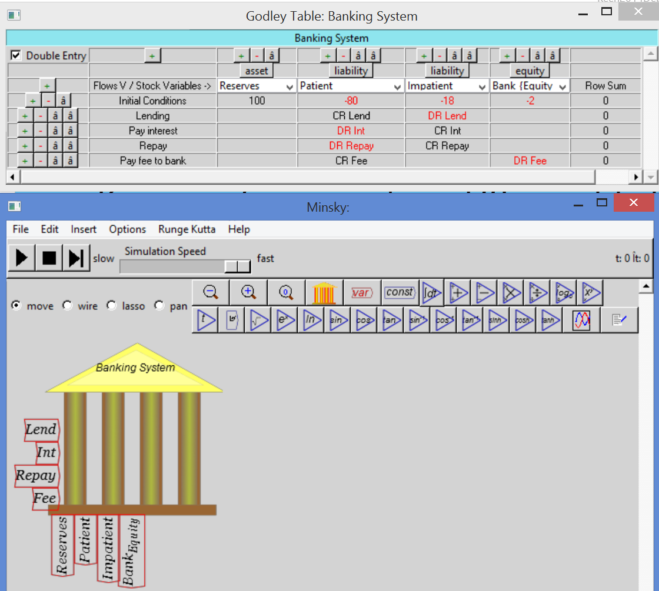
The conventional “veil over barter” vision of money
Modeling “patient lends to impatient” in Minsky
Lending from one deposit account (“Patient”) to another (“Impatient)
Shown as “Crediting” Patient & “Debiting” Impatient because Deposits are liabilities of bank
Can also use + and – (which I prefer)
Click here to download latest version of Minsky

Slide 29
The conventional “veil over barter” vision of money
Full model: Bank arranges loan from Consumer sector (Patient) to investment (Impatient) sector & charges intermediation fee
Workers hired, output produced & sold, investment…
Bank Balance Sheet | Assets | Liabilities |  |  | Equity
Flows\Stocks | Reserves | I_{D} | C_{D} | W_{D} | B_{E}
Initial Conditions | 100 | -20 | -60 | -15 | -5
Lending |  | -Lend | Lend
Debt Repayment |  | Repay | -Repay
Interest Payments |  | int | -int
Bank Fee |  |  | Fee |  | -Fee
Hire Workers (C) |  |  | W_{C} | -W_{C}
Hire Workers (I) |  | W_{I} |  | -W_{I}
Purchases (I) |  | I_{C} | -I_{C}
Purchases (C) |  | -C_{I} | C_{I}
Workers Consumption |  |  | -C_{W} | C_{W}
Bankers Consumption |  |  | -C_{B} |  | C_{B}
Bankers Investment |  | -I_{B} |  |  | I_{B}
Debt doesn’t appear here: Asset of Consumer Sector…

Slide 30
The conventional “veil over barter” vision of money
Consumer Sector “Godley Table”
 | Assets |  | Equity
Flows\Stocks | C_{D} | D | C_{NW}
Initial Conditions | 60 | 10 | -70
Lending | -Lend | Lend
Debt Repayment | Repay | -Repay
Interest Payments | int |  | -int
Bank Fee | -Fee |  | Fee
Hire Workers (C) | -W_{C} |  | W_{C}
Bankers Consumption | C_{B} |  | -C_{B}
Purchases (I) | C_{I} |  | -C_{I}
Workers Consumption | C_{W} |  | -C_{W}
Purchases (C) | -I_{C} |  | I_{C}
Lending reduces Consumer Sector’s Asset of Cash at the Bank
Increases Consumer Sector’s Asset of Loan to Investment Sector
Consumer Sector’s does without Cash for duration of Loan

Slide 31
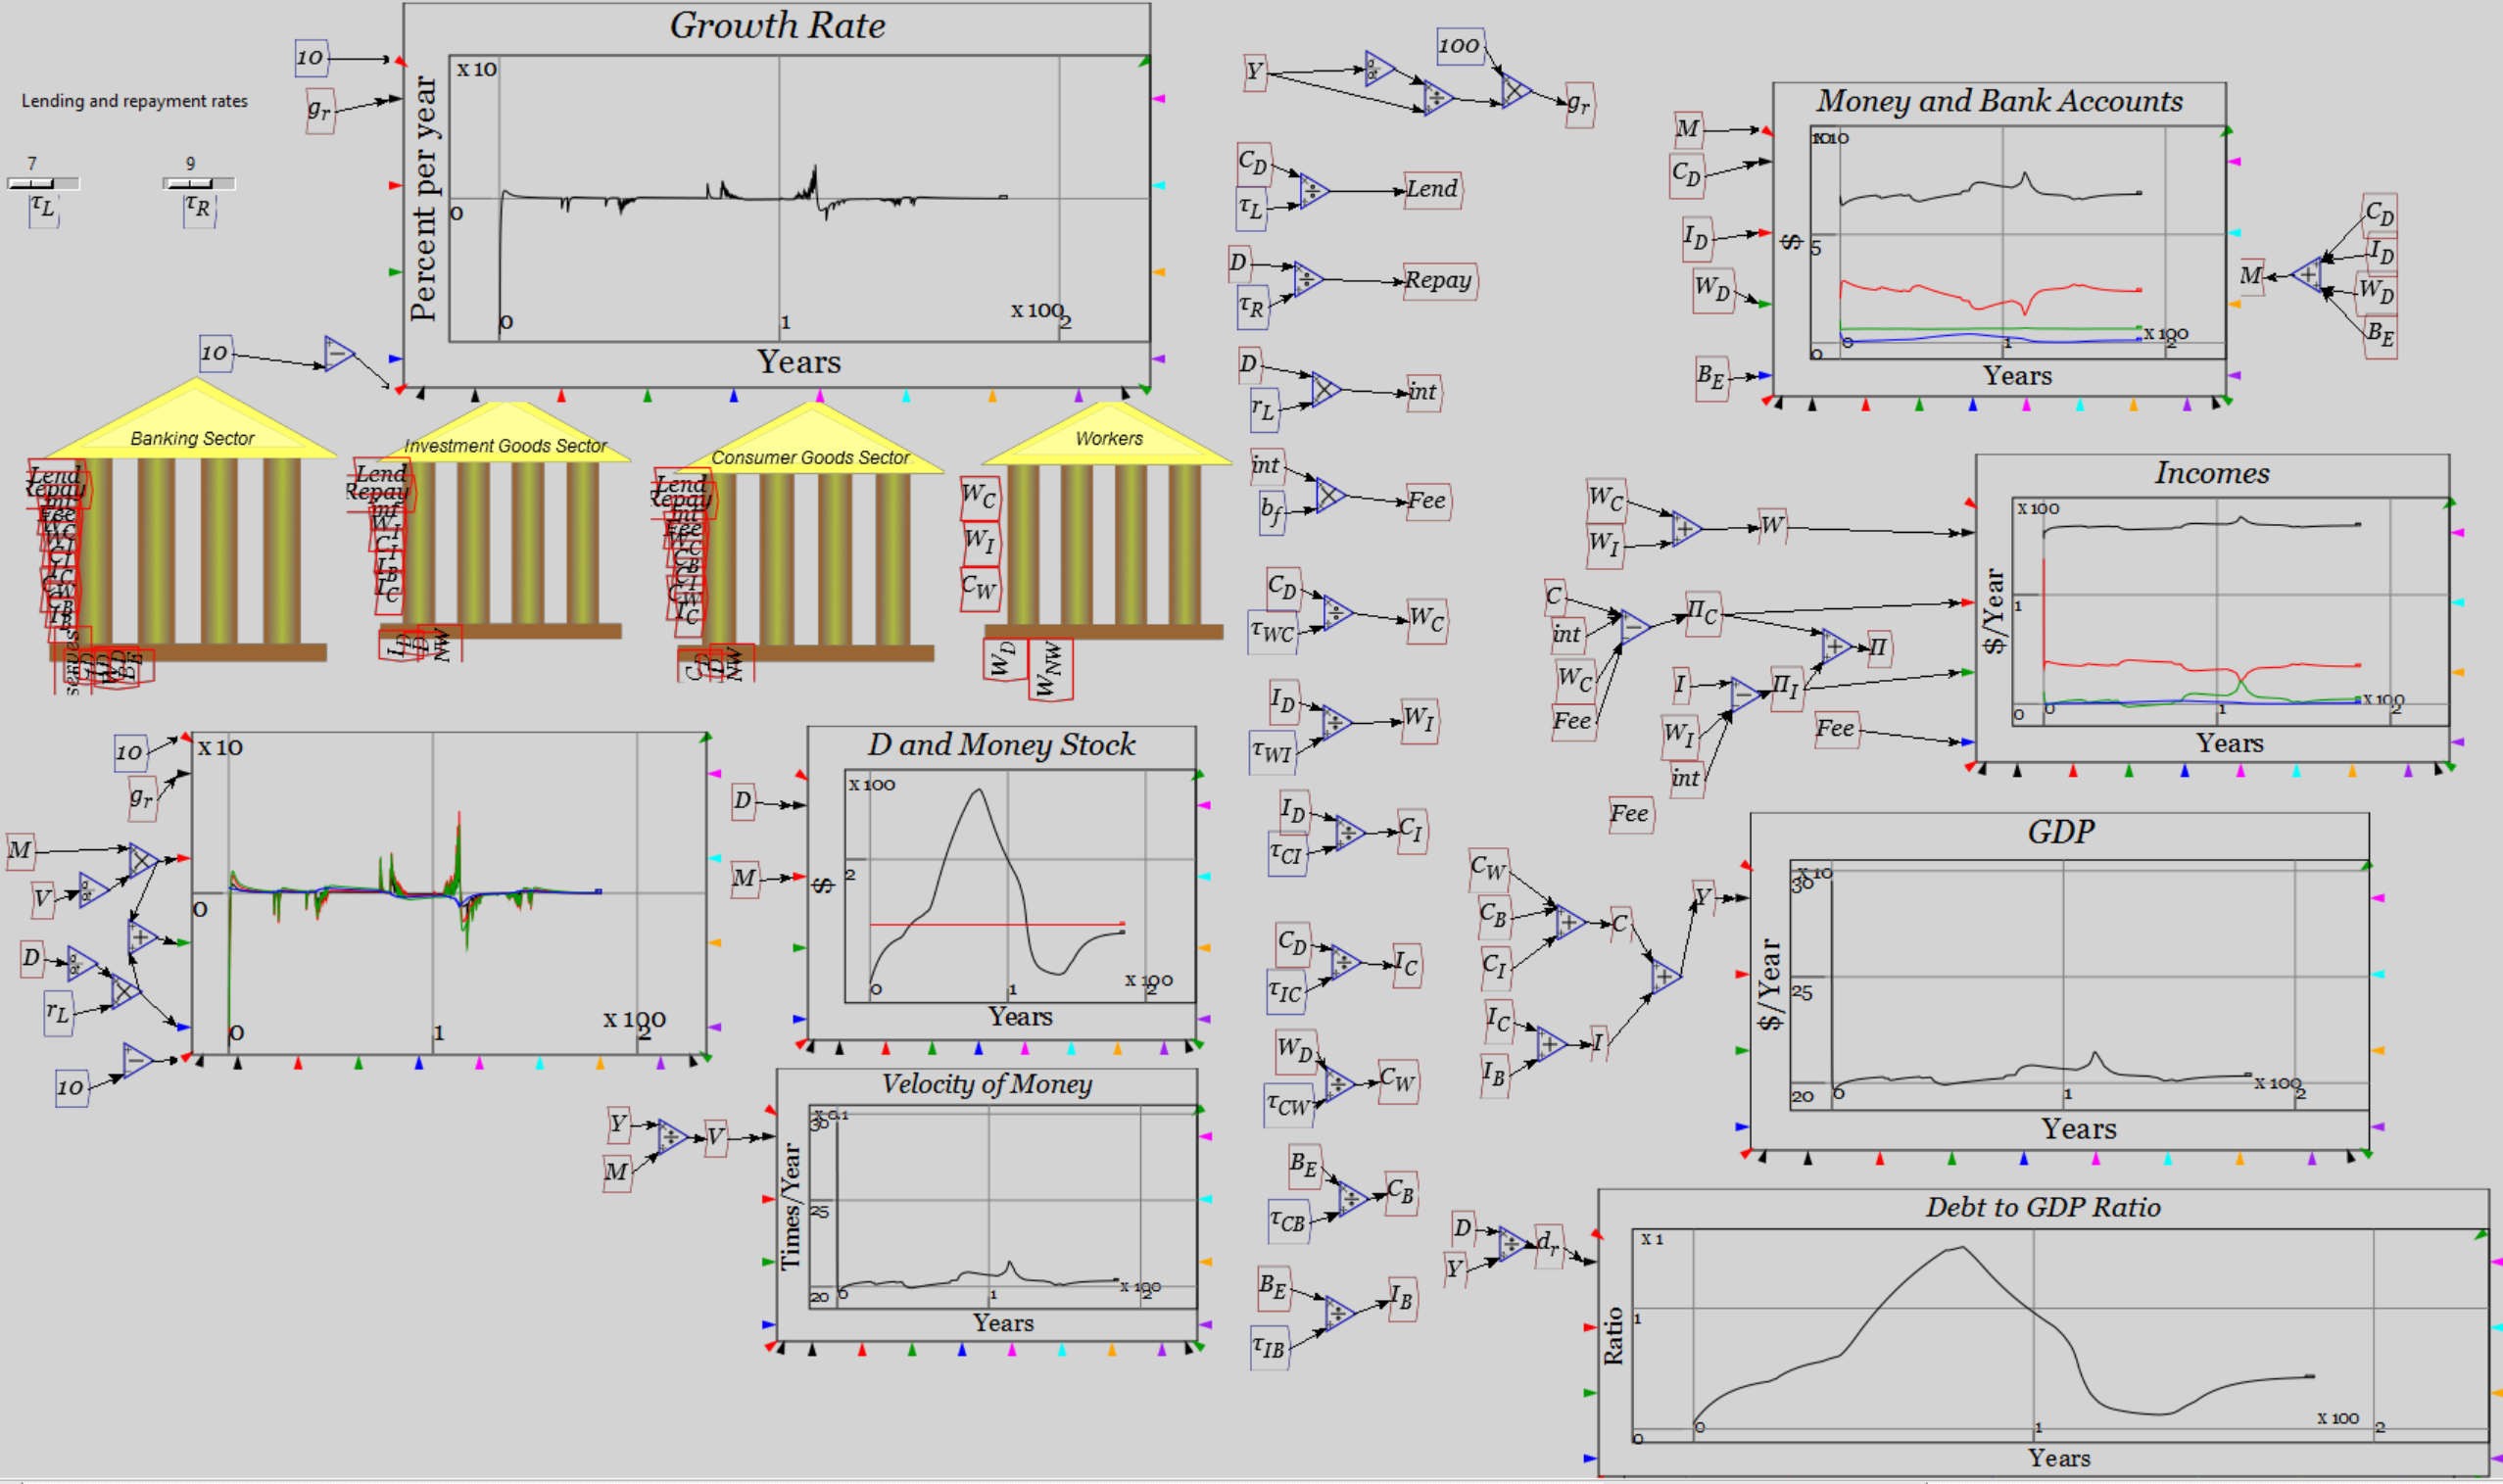
The conventional “Loanable Funds” vision of money
Simulated, Krugman/Bernanke correct: debt doesn’t matter…

Slide 32
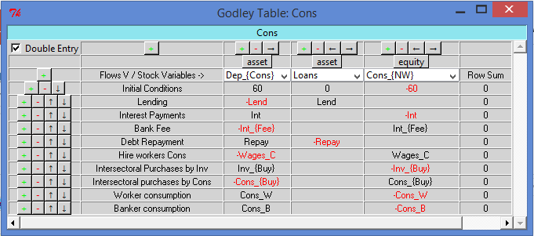
Eggertsson-Krugman bank model in Minsky…
But what if banks lend money, rather than “patient agents”?
Modify Minsky to model bank lending
Model currently shows Loans as asset of “patient” Consumer Agent…
Let’s make it an Asset of the Bank instead…

Slide 33
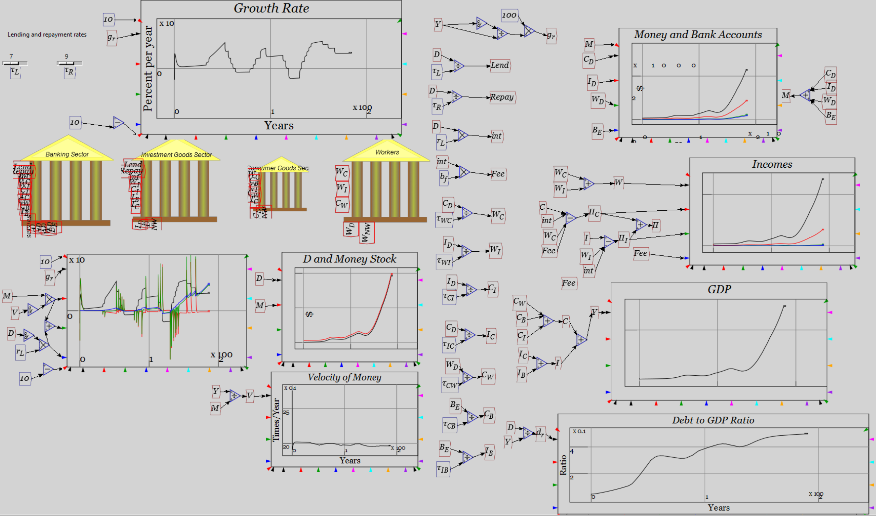
Varying lending & repayment in Endogenous Money
Changing debt matters: change in money supply causes change in GDP

Slide 34
Basic economic modelling: Goodwin’s growth cycle
In 1967, Richard Goodwin put this in mathematical form.
Goodwin’s simple cyclical growth model
  Capital determines output
  Output determines employment
  Employment rate determines rate of change of wages
  Wages determine Profits
  Profits determine Investment
  Investment is the rate of change of Capital
  Generates cyclical growth…
Building this in Minsky
Using parameter values:
  v = 3
  a = 1
  λ_{s} = 10
  λ₀ = 0.9
  δ = 0.1
  N = 120
Initial conditions
  K(0) = 300
  w_{r}(0)=0.8
Add plots to illustrate…

Slide 35
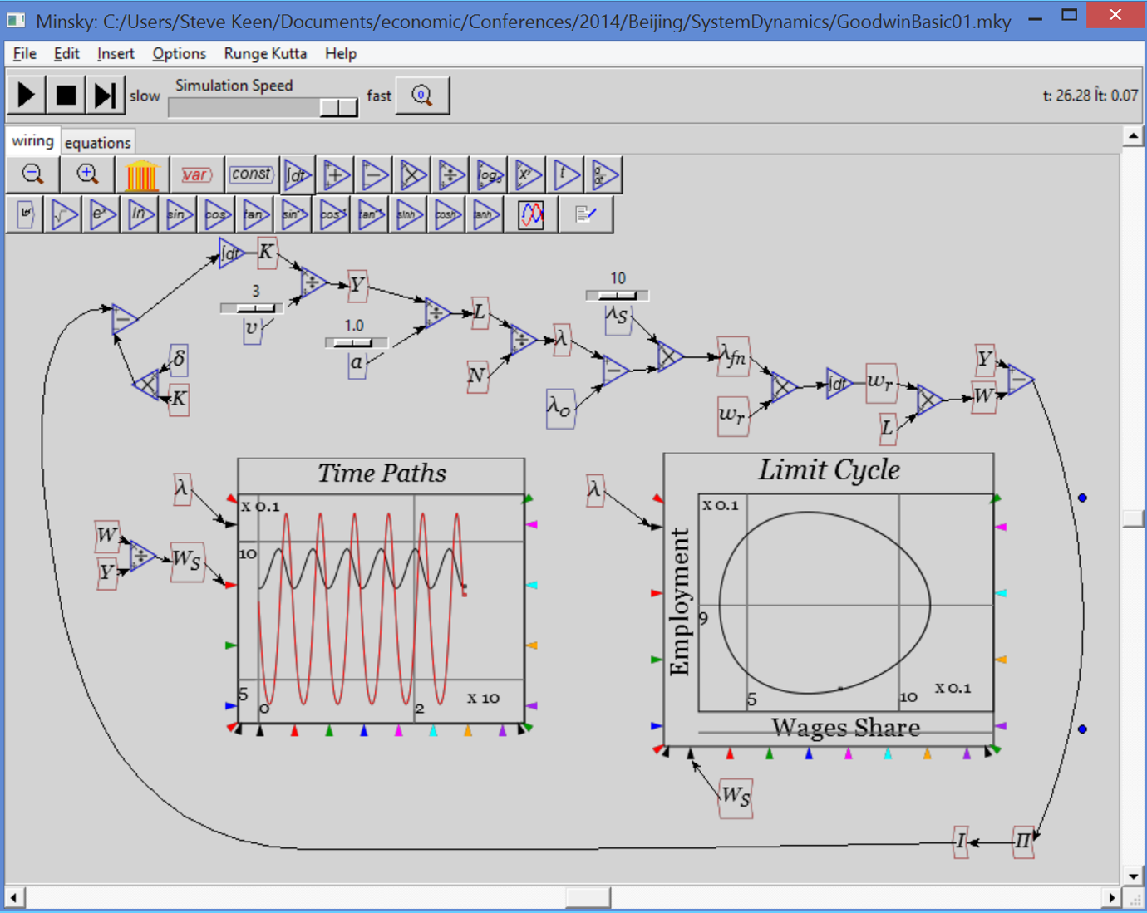
Basic economic modelling: Goodwin’s growth cycle
Generates a cyclical model

Slide 36
Basic economic modelling: Goodwin’s growth cycle
Now add realism
  Capitalists don’t invest all their profits
    More during boom
    Less during slump
  Use linear investment function:
Rate of profit
Investment function
Ignoring (for now)
  where capitalists get funds > profit
  where they store surplus when investment < profit
Using parameter values
  π_{E} = 0.03
  π_{S} = 10

Slide 37
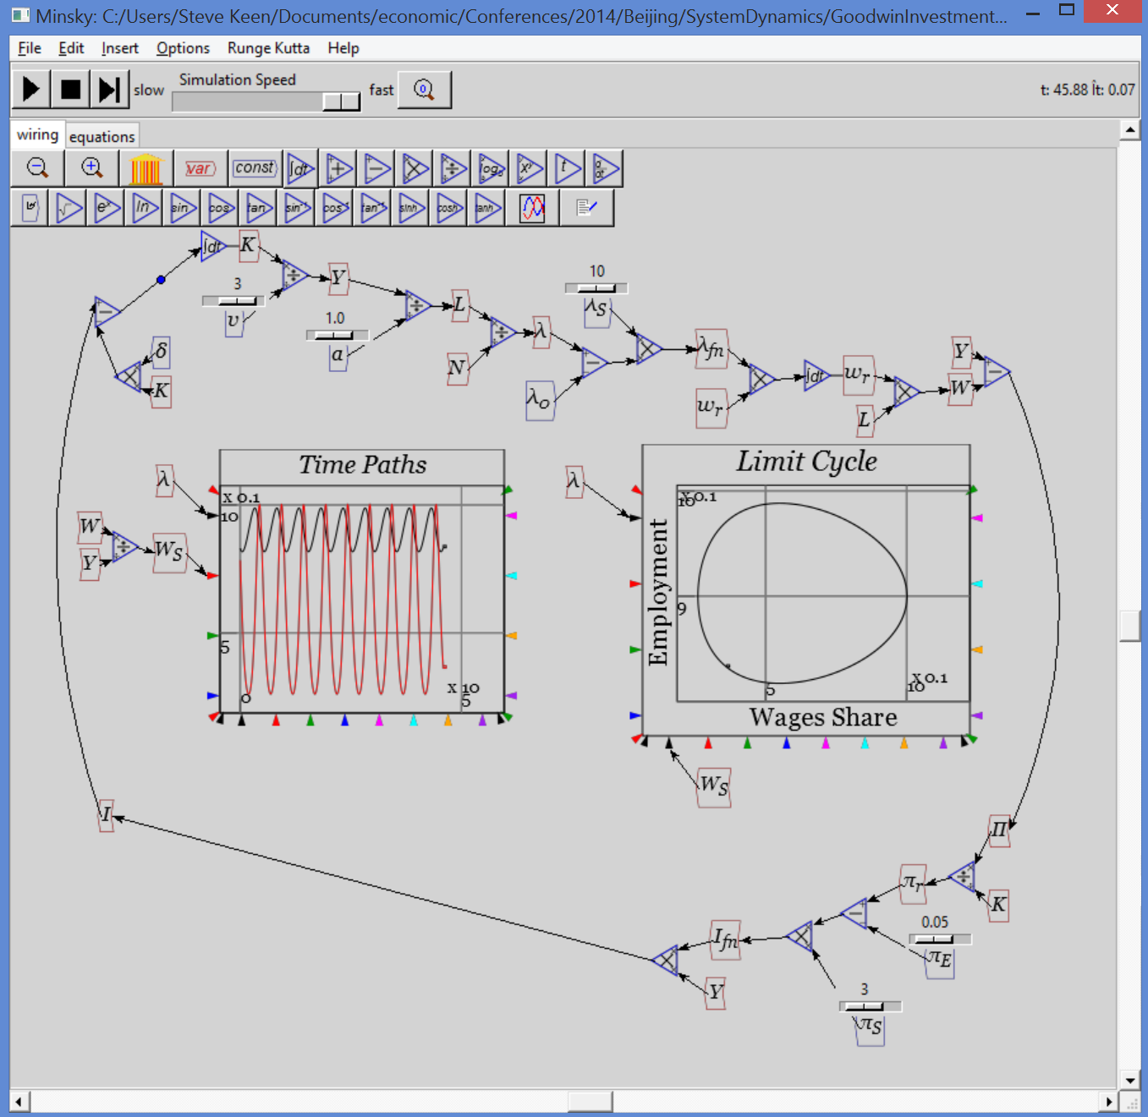
Extending Goodwin: adding debt
Generates same basic outcome: sustained nonlinear cycles
Now more realism:
Capitalists borrow from banks when desired investment exceeds profits
Banks charge interest on outstanding debt
Adds these equations:
Using parameter value
  r_{L} = 0.05
Adding graph for D/Y

Slide 38
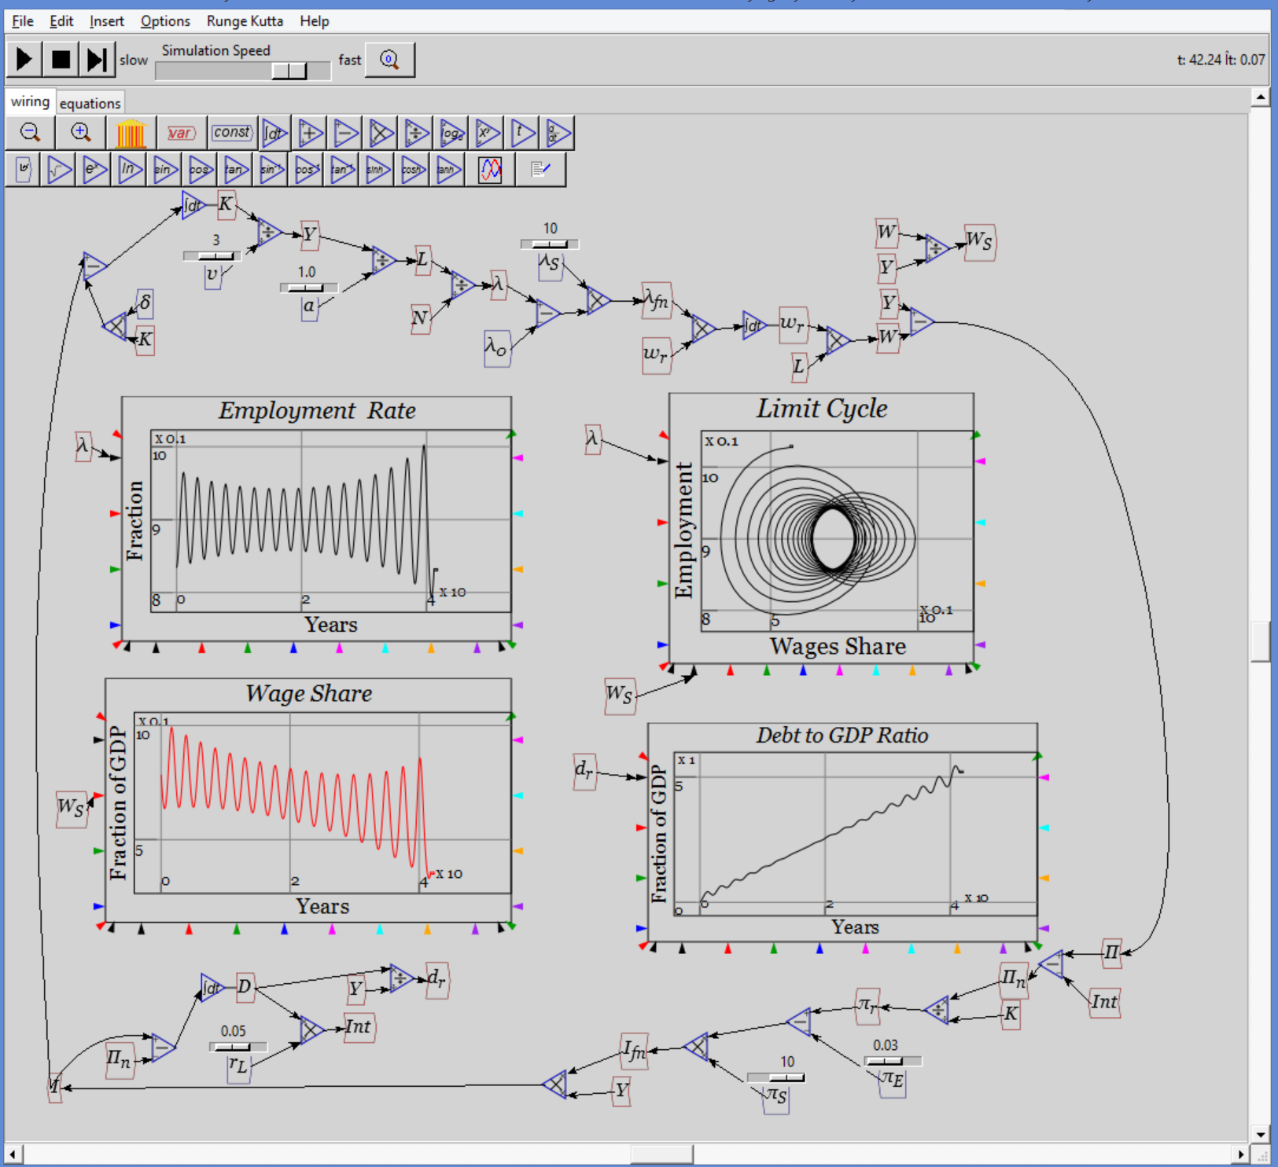
Extending Goodwin: adding debt
Generates complex system
3rd dimension introduces possibility of complex behaviour
Actual dynamics bear qualitative similarity to recent economic history
Period of apparent declining volatility…
Followed by rising volatility and breakdown…
With rising private debt to GDP ratio
And declining workers’ share of output (rising inequality)
All without nonlinear functions or growth…

Slide 39
Extending Goodwin: adding government
Government subsidies to firms (G_{S}) a function of employment rate:
Net profit now includes government subsidy
Replacing unrealistic linear functions with more realistic nonlinear ones
  Generalized exponential function with parameters minimum, x-y coordinate & slope at (x,y) point:

Slide 40
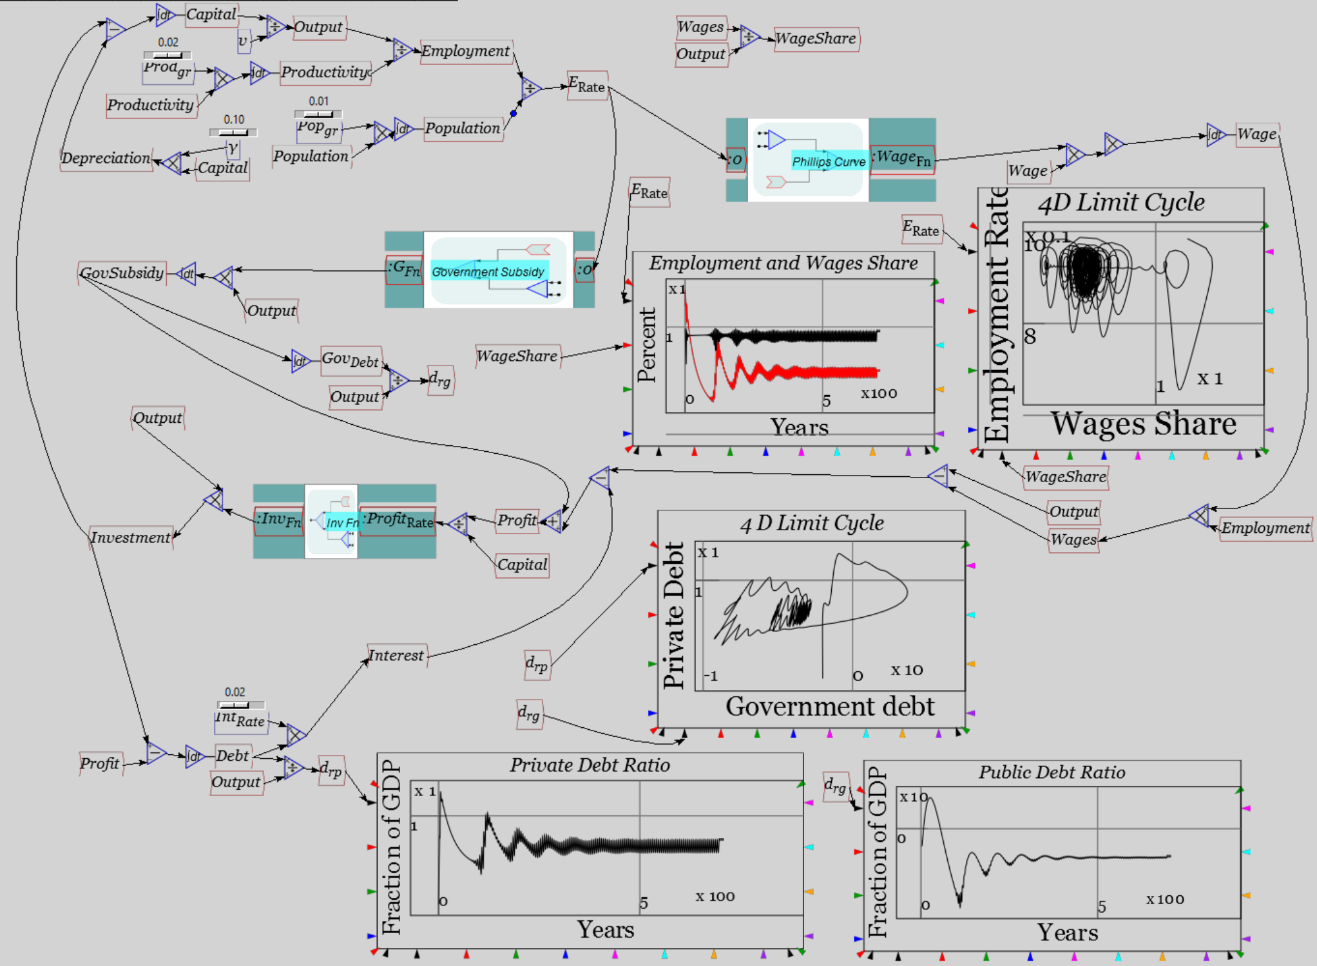
Extending Goodwin: adding government
Resolute counter-cyclical government behaviour prevents breakdown, but cycles remain…
More stable than actual economy because actual governments have tolerated rising unemployment since 1970s

Slide 41
Conclusion
Much more to Post Keynesian economics than I’ve shown here
  Consult King (2012) for a complete survey
Many other Schools of Thought—Austrian, Evolutionary, Ecological, Feminist, Marxist, Institutional, Econophysics
Given failure of Neoclassical paradigm, pluralism should rule
  Teach all current approaches
  Attempt to evolve new realistic paradigm over time
And if your University doesn’t teach alternative approaches, then…
For a pluralist education in economics
Come to Kingston
School of Economics, History & Politics
Kingston
University
London

Slide 42
References: small selection of Post Keynesian papers
Ayres, R. U. (1978). Application of physical principles to economics. Resources, environment, and economics: applications of the materials/energy balance principle. R. U. Ayers: Chapter 3.
Ayres, R. U. (1995). "Thermodynamics and Process Analysis for Future Economic Scenarios." Environmental and Resource Economics 6(3): 207-230.
Ayres, R. U. (1999). "The Second Law, the Fourth Law, Recycling and Limits to Growth." Ecological Economics 29(3): 473-483.
Bernanke, B. S. (2002). Remarks by Governor Ben S. Bernanke At the Conference to Honor Milton Friedman. Conference to Honor Milton Friedman. University of Chicago, Chicago, Illinois.
  NOT a Post-Keynesian!
Blinder, A. S. (1998). Asking about prices: a new approach to understanding price stickiness. New York, Russell Sage Foundation.
  NOT a Post-Keynesian, but his survey work on cost functions contradicted Neoclassical theory
Eiteman, W. J. (1945). "The Equilibrium of the Firm in Multi-Process Industries." THE QUARTERLY JOURNAL OF ECONOMICS 59(2): 280-286.
Eiteman, W. J. (1947). "Factors Determining the Location of the Least Cost Point." The American Economic Review 37(5): 910-918.

Slide 43
References: small selection of Post Keynesian papers
Eiteman, W. J. (1948). "The Least Cost Point, Capacity, and Marginal Analysis: A Rejoinder." The American Economic Review 38(5): 899-904.
Eiteman, W. J. (1953). "The Shape of the Average Cost Curve: Rejoinder." The American Economic Review 43(4): 628-630.
Eiteman, W. J. and G. E. Guthrie (1952). "The Shape of the Average Cost Curve." The American Economic Review 42(5): 832-838.
Fisher, I. (1932). Booms and Depressions: Some First Principles. New York, Adelphi.
Fisher, I. (1933). "The Debt-Deflation Theory of Great Depressions." Econometrica 1(4): 337-357.
Godley, W. (1992). "Maastricht and All That." London Review of Books 14(19): 3-4.
Godley, W. (1999). "Money and Credit in a Keynesian Model of Income Determination." Cambridge Journal of Economics 23(4): 393-411.
Godley, W. (2001). "The Developing Recession in the United States." Banca Nazionale del Lavoro Quarterly Review 54(219): 417-425.
Godley, W. (2004). "Money and Credit in a Keynesian Model of Income Determination: Corrigenda." Cambridge Journal of Economics 28(3): 469-469.
Godley, W. and A. Izurieta (2002). "The Case for a Severe Recession." Challenge 45(2): 27-51.

Slide 44
References: small selection of Post Keynesian papers
Godley, W. and M. Lavoie (2005). "Comprehensive Accounting in Simple Open Economy Macroeconomics with Endogenous Sterilization or Flexible Exchange Rates." Journal of Post Keynesian Economics 28(2): 241-276.
Godley, W. and M. Lavoie (2007). "Fiscal Policy in a Stock-Flow Consistent (SFC) Model." Journal of Post Keynesian Economics 30(1): 79-100.
Godley, W. and M. Lavoie (2007). Monetary Economics: An Integrated Approach to Credit, Money, Income, Production and Wealth. New York, Palgrave Macmillan.
Goodwin, R. (1946). "Innovations and the Irregularity of Economic Cycles." The Review of Economics and Statistics 28(2): 95-104.
Goodwin, R. M. (1967). A growth cycle. Socialism, Capitalism and Economic Growth. C. H. Feinstein. Cambridge, Cambridge University Press: 54-58.
Goodwin, R. M. (1985). "A Personal Perspective on Mathematical Economics." Banca Nazionale del Lavoro Quarterly Review(152): 3-13.
Goodwin, R. M. (1986). "The Economy as an Evolutionary Pulsator." Journal of Economic Behavior and Organization 7(4): 341-349.
Goodwin, R. M. (1986). "Swinging along the Turnpike with von Neumann and Sraffa." Cambridge Journal of Economics 10(3): 203-210.
Goodwin, R. M. (1990). Chaotic economic dynamics. Oxford, Oxford University Press.
Goodwin, R. M. (1990). "The Complex Dynamics of Innovation, Output, and Employment." Structural Change and Economic Dynamics 1(1): 119-131.

Slide 45
References: small selection of Post Keynesian papers
Goodwin, R. M. (1991). "New Results in Non-linear Economic Dynamics." Economic Systems Research 3(4): 426-427.
Goodwin, R. M. (1993). Schumpeter and Keynes. Market and institutions in economic development: Essays in honour of Paolo Sylos Labini. S. Biasco, A. Roncaglia and M. Salvati. New York, St. Martin's Press: 83-85.
Goodwin, R. M. (1996). Structural Change and Macroeconomic Stability in Disaggregated Models. Production and economic dynamics. M. Landesmann and R. Scazzieri. Cambridge, Cambridge University Press: 167-187.
Goodwin, R. M., R. H. Day and P. Chen (1993). A Marx-Keynes-Schumpeter Model of Economic Growth and Fluctuation. Nonlinear dynamics and evolutionary economics. Oxford, Oxford University Press: 45-57.
Goodwin, R. M., G. Gandolfo and F. Marzano (1987). The Nonlinear Theory of the Cycle Revisited. Keynesian theory, planning models and quantitative economics: Essays in memory of Vittorio Marrama. Volume 1, Universita degli Studi di Roma 'La Sapienza' series, no. 44, 1
Goodwin, R. M., G. M. Hodgson and E. Screpanti (1991). Economic Evolution, Chaotic Dynamics and the Marx-Keynes-Schumpeter System. Rethinking economics: Markets, technology and economic evolution, Aldershot, U.K.
Hicks, J. R. (1937). "Mr. Keynes and the "Classics"; A Suggested Interpretation." Econometrica 5(2): 147-159.
  Before he became a Post Keynesian—in the late 1970s

Slide 46
References: small selection of Post Keynesian papers
Hicks, J. (1979). "On Coddington's Interpretation: A Reply." Journal of Economic Literature 17(3): 989-995.
Hicks, J. (1981). "IS-LM: An Explanation." Journal of Post Keynesian Economics 3(2): 139-154.
Hicks, J. (1984). "The 'New Causality': An Explanation." Oxford Economic Papers 36(1): 12-15.
Kalecki, M. (1937). "The Principle of Increasing Risk." Economica 4(16): 440-447.
Kalecki, M. (1937). "A Theory of the Business Cycle." The Review of Economic Studies 4(2): 77-97.
Kalecki, M. (1938). "The Determinants of Distribution of the National Income." Econometrica 6(2): 97-112.
Kalecki, M. (1942). "A Theory of Profits." The Economic Journal 52 (206/207): 258-267.
Kalecki, M. (1946). "A Comment on "Monetary Policy"." The Review of Economics and Statistics 28(2): 81-84.
Kalecki, M. (1949). "A New Approach to the Problem of Business Cycles." The Review of Economic Studies 16(2): 57-64.
Kalecki, M. (1962). "Observations on the Theory of Growth." The Economic Journal 72(285): 134-153.
Kalecki, M. (1968). "Trend and Business Cycles Reconsidered." The Economic Journal 78(310): 263-276.

Slide 47
References: small selection of Post Keynesian papers
Kalecki, M. (1971). "Class Struggle and the Distribution of National Income." Kyklos 24(1): 1-9.
Keynes, J. M. (1937). "The General Theory of Employment." The Quarterly Journal of Economics 51(2): 209-223.
Keen, S. (1995). "Finance and Economic Breakdown: Modeling Minsky's 'Financial Instability Hypothesis.'." Journal of Post Keynesian Economics 17(4): 607-635.
Keen, S. and R. Standish (2010). "Debunking the theory of the firm—a chronology." Real World Economics Review 54(54): 56-94.
Keen, S. (2013). "A monetary Minsky model of the Great Moderation and the Great Recession." Journal of Economic Behavior & Organization 86(0): 221-235.
King, J. E. (2003). A History Of Post Keynesian Economics Since 1936. Aldershot, Edward Elgar.
King, J. E., Ed. (2012). The Elgar Companion To Post Keynesian Economics. Aldershot, Edward Elgar.
Kümmel, R., R. U. Ayres and D. Lindenberger (2010). "Thermodynamic laws, economic methods and the productive power of energy." Journal of Non-Equilibrium Thermodynamics 35: 145-179.
Lavoie, M. (2008). "Financialisation Issues in a Post-Keynesian Stock-Flow Consistent Model." Intervention: European Journal of Economics and Economic Policies 5(2): 331-356.

Slide 48
References: small selection of Post Keynesian papers
Lee, F. S. (1981). "The Oxford Challenge to Marshallian Supply and Demand: The History of the Oxford Economists' Research Group." Oxford Economic Papers 33(3): 339-351.
Lee, F. S. (1998). Post Keynesian price theory. Cambridge, Cambridge University Press.
Lee, F. S. (2011). "Modeling the Economy as a Whole: An Integrative Approach." American Journal of Economics and Sociology 70(5): 1282-1314.
Lee, F. S. and P. Downward (1999). "Retesting Gardiner Means's Evidence on Administered Prices." Journal of Economic Issues 33(4): 861-886.
Lee, F. S. and S. Keen (2004). "The Incoherent Emperor: A Heterodox Critique of Neoclassical Microeconomic Theory." Review of Social Economy 62(2): 169-199.
Means, G. C. (1935). "Price Inflexibility and the Requirements of a Stabilizing Monetary Policy." Journal of the American Statistical Association 30(190): 401-413.
Means, G. C. (1936). "Notes on Inflexible Prices." The American Economic Review 26(1): 23-35.
Means, G. C. (1972). "The Administered-Price Thesis Reconfirmed." The American Economic Review 62(3): 292-306.
Minsky, H. P. (1975). John Maynard Keynes. New York, Columbia University Press.
Schumpeter, J. (1927). "The Explanation of the Business Cycle." Economica(21): 286-311.
Schumpeter, J. (1928). "The Instability of Capitalism." The Economic Journal 38(151): 361-386.

Slide 49
References: small selection of Post Keynesian papers
Schumpeter, J. A. (1934). The theory of economic development : an inquiry into profits, capital, credit, interest and the business cycle. Cambridge, Massachusetts, Harvard University Press.
Schumpeter, J. A. (1935). "The Analysis of Economic Change." The Review of Economics and Statistics 17(4): 2-10.
Sraffa, P. (1960). Production of commodities by means of commodities: prelude to a critique of economic theory. Cambridge, Cambridge University Press.
Steedman, I. (1977). Marx after Sraffa. London, NLB.
Steedman, I. (1992). "Questions for Kaleckians." Review of Political Economy 4(2): 125-151.
Veblen, T. (1898). "Why is Economics not an Evolutionary Science?" THE QUARTERLY JOURNAL OF ECONOMICS 12(4): 373-397.
Wray, L. R. (2003). "The Perfect Fiscal Storm." Challenge 46(1): 55-78.
Wray, L. R. (2007). "A Post Keynesian View of Central Bank Independence, Policy Targets, and the Rules versus Discretion Debate." Journal of Post Keynesian Economics 30(1): 119-141.
Wray, L. R. (2011). "Minsky's Money Manager Capitalism and the Global Financial Crisis." International Journal of Political Economy 40(2): 5-20.

