Slide 1

The overdue Copernican Revolution in Economics
Steve Keen
Kingston University London
IDEAeconomics
Minsky Open Source System Dynamics
www.debtdeflation.com/blogs

Slide 2
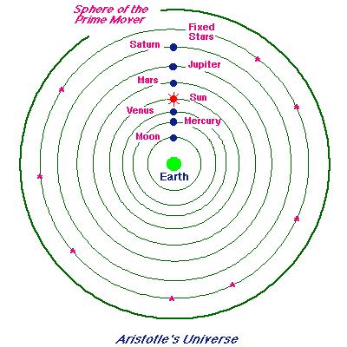
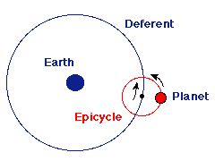
What does Economics have in common with Ptolemy?
(1) The propensity to start from “a priori” beliefs rather than research
(2) A plausible but false model of reality
Ptolemy’s starting point: Aristotle’s vision of the universe…
  “the heavens were literally composed of 55 concentric, crystalline spheres to which the celestial objects were attached and which rotated at different velocities with the Earth at the center”
Ptolemy’s puzzle: how to reconcile this vision with the observable behaviour of the planets (“wanderers” in Greek)?
Answer: epicycles—spheres on spheres
Literally any actual path can be described using epicycle
So the model was plausible—but wrong

Slide 3
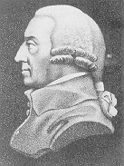
What does Economics have in common with Ptolemy?
Ditto economics on many topics—but especially money
Economics’ starting point: Adam Smith & “The propensity to truck & barter…”
“THIS division of labour, from which so many advantages are derived, is …the necessary …consequence of a certain propensity in human nature …
the propensity to truck, barter, and exchange one thing for another…
It is common to all men, and to be found in no other race of animals, which seem to know neither this nor any other species of contracts…
Nobody ever saw a dog make a fair and deliberate exchange of one bone for another with another dog…”
Origin of Neoclassical vision of money as “veil over barter”
Ensconsed in mainstream macroeconomics
  Banks, debt and money play no essential role…

Slide 4
What does Economics have in common with Ptolemy?
What brought Ptolemaic astronomy to an end?
  More realistic (but incomplete!), simpler observation-based theory
  Anomalies: moons orbiting Jupiter, craters on the Moon
  Accurate predictions of extended Copernicus model
    Elliptic motion replaces circular, epicycles eliminated
    Newton’s theory of gravity
      Accurate prediction of Halley’s comet
What could have brought Neoclassical economics to an end?
  The global financial crisis of 2007
    Not merely failure to predict an event
    But a complete anomaly in their equilibrium, non-monetary vision of the economy
Here economics differs from astronomy
  Laymen thought astronomers were experts on “the heavens”: True
  Laymen think economists are experts on money: False!

Slide 5
The conventional “veil over barter” vision of money
Mainstream economics generally ignores banks, debt & money
  “self-proclaimed true Minskyites view banks as institutions that are somehow outside the rules that apply to the rest of the economy, as having unique powers for good and/or evil.
  I guess I don't see it that way.
  As I (and I think many other economists) see it, …Banks don't create demand out of thin air any more than anyone does by choosing to spend more; and banks are just one channel linking lenders to borrowers.
  I know I'll get the usual barrage of claims that I don't understand banking; actually, I think I do, and it's the mystics who have it wrong.” (Krugman 2012, “Banking Mysticism”)
If Krugman’s model of banking were accurate, debt would have “no significant macroeconomic effects” (except during a liquidity trap)

Slide 6
The conventional “veil over barter” vision of money
“Think of it this way: when debt is rising, it’s not the economy as a whole borrowing more money.
It is, rather, a case of less patient people—people who for whatever reason want to spend sooner rather than later—borrowing from more patient people.” (Krugman 2012, pp. 146-47)
“The idea of debt-deflation goes back to Irving Fisher… Fisher's idea was less influential in academic circles, though, because of the counterargument that debt-deflation represented no more than a re-distribution from one group (debtors) to another (creditors).
Absent implausibly large differences in marginal spending propensities among the groups, it was suggested, pure redistributions should have no significant macroeconomic effects.” (Bernanke 200, p. 24)
Let’s check this out:
Modeling Eggertsson & Krugman’s 2012 model in Minsky…
  a system dynamics program tailored for monetary modeling

Slide 7
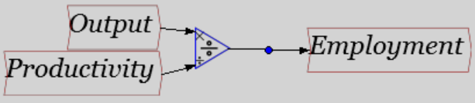
System dynamics
Graphical method of building dynamic models
  Invented in 1950s
  “Bread & butter” in engineering & manufacturing process control
    Matlab’s Simulink (retail price about US$20,000), Vissim…
  Commonplace in sociology
    Vensim, Stella…
Build equations using a flowchart…
Program builds equations in the background…
Overkill for simple equations, essential for complex dynamic systems…

Slide 8
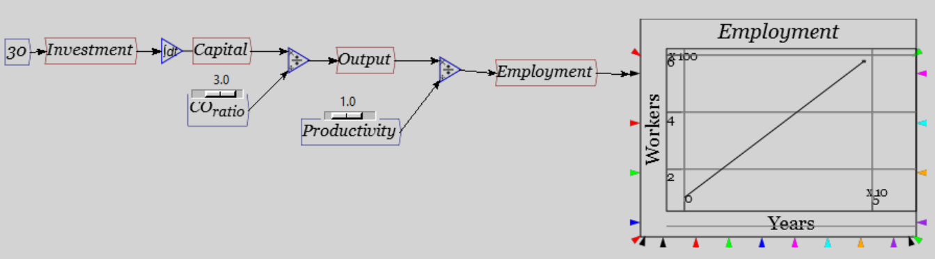
System dynamics
Dynamics—systems with rates of change
Integrals used for technical reasons…
Model now an “Ordinary Differential Equation”
“Ordinary”: involves time but not location
“Differential”: rate of change modelled
  Dynamics & change
  Not “statics” & equilibrium
Models get interesting with more “system states” (variables) & nonlinearity
Minsky adds ability to model money flows using accounting “double entry bookkeeping”…

Slide 9
System dynamics for monetary flows
Flowchart paradigm works really well for physical flows
  Petrol in tank flowing into cylinder…
  One direction only
Difficult to impossible for financial flows
  Every transaction has two “directions”
    Out of one account, into another
    Operation has to have opposite signs
  Easy to forget in flowchart, get signs wrong
Solution: borrow idea from accountants
  Double-entry bookkeeping
  Record every transaction on one row
    Two entities (buyer and seller) recorded on one row
  Every row “sums to zero”
  For example, a simple “Buy and Sell” between two agents…

Slide 10
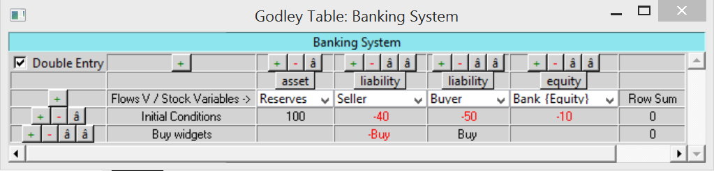
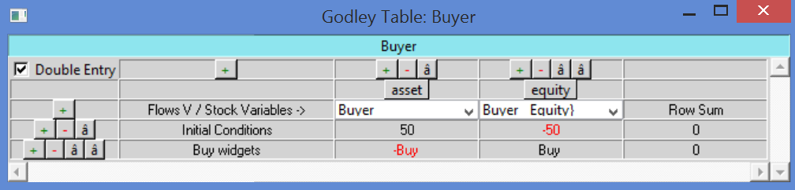
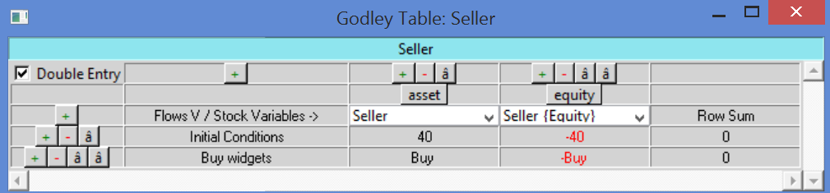
System dynamics for monetary flows
From the banking sector’s point of view…
From the buyer’s point of view…
And the seller’s

Slide 11
The conventional “veil over barter” vision of money
Using Minsky to model Krugman’s conventional vision of lending:
  “Patient people” lend to “impatient people”
  Banks just “intermediate” between the two groups
  Therefore lending doesn’t change demand…
“Keen then goes on to assert that lending is, by definition (at least as I understand it), an addition to aggregate demand. I guess I don’t get that at all.
If I decide to cut back on my spending and stash the funds in a bank,
  which lends them out to someone else,
  this doesn't have to represent a net increase in demand.
Yes, in some (many) cases lending is associated with higher demand, because resources are being transferred to people with a higher propensity to spend;
but Keen seems to be saying something else, and I'm not sure what.
I think it has something to do with the notion that creating money = creating demand, but again that isn’t right in any model I understand.”

Slide 12
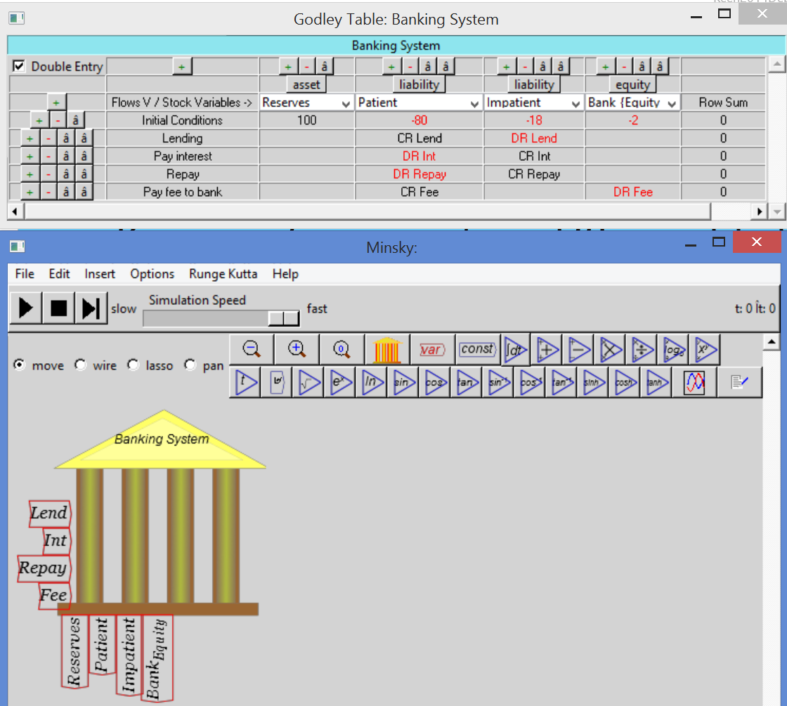
The conventional “veil over barter” vision of money
Modeling “patient lends to impatient” in Minsky
Lending from one deposit account (“Patient”) to another (“Impatient)
Shown as “Crediting” Patient & “Debiting” Impatient because Deposits are liabilities of bank
Can also use + and – (which I prefer)

Slide 13
The conventional “veil over barter” vision of money
Full model: Bank arranges loan from Consumer sector (Patient) to investment (Impatient) sector & charges intermediation fee
Workers hired, output produced & sold, investment…
Bank Balance Sheet | Assets | Liabilities |  |  | Equity
Flows\Stocks | Reserves | I_{D} | C_{D} | W_{D} | B_{E}
Initial Conditions | 100 | -20 | -60 | -15 | -5
Lending |  | -Lend | Lend
Debt Repayment |  | Repay | -Repay
Interest Payments |  | int | -int
Bank Fee |  |  | Fee |  | -Fee
Hire Workers (C) |  |  | W_{C} | -W_{C}
Hire Workers (I) |  | W_{I} |  | -W_{I}
Purchases (I) |  | I_{C} | -I_{C}
Purchases (C) |  | -C_{I} | C_{I}
Workers Consumption |  |  | -C_{W} | C_{W}
Bankers Consumption |  |  | -C_{B} |  | C_{B}
Bankers Investment |  | -I_{B} |  |  | I_{B}
Debt doesn’t appear here: Asset of Consumer Sector…

Slide 14
The conventional “veil over barter” vision of money
Consumer Sector “Godley Table”
 | Assets |  | Equity
Flows\Stocks | C_{D} | D | C_{NW}
Initial Conditions | 60 | 10 | -70
Lending | -Lend | Lend
Debt Repayment | Repay | -Repay
Interest Payments | int |  | -int
Bank Fee | -Fee |  | Fee
Hire Workers (C) | -W_{C} |  | W_{C}
Bankers Consumption | C_{B} |  | -C_{B}
Purchases (I) | C_{I} |  | -C_{I}
Workers Consumption | C_{W} |  | -C_{W}
Purchases (C) | -I_{C} |  | I_{C}
Lending reduces Consumer Sector’s Asset of Cash at the Bank
Increases Consumer Sector’s Asset of Loan to Investment Sector
Consumer Sector’s does without Cash for duration of Loan

Slide 15
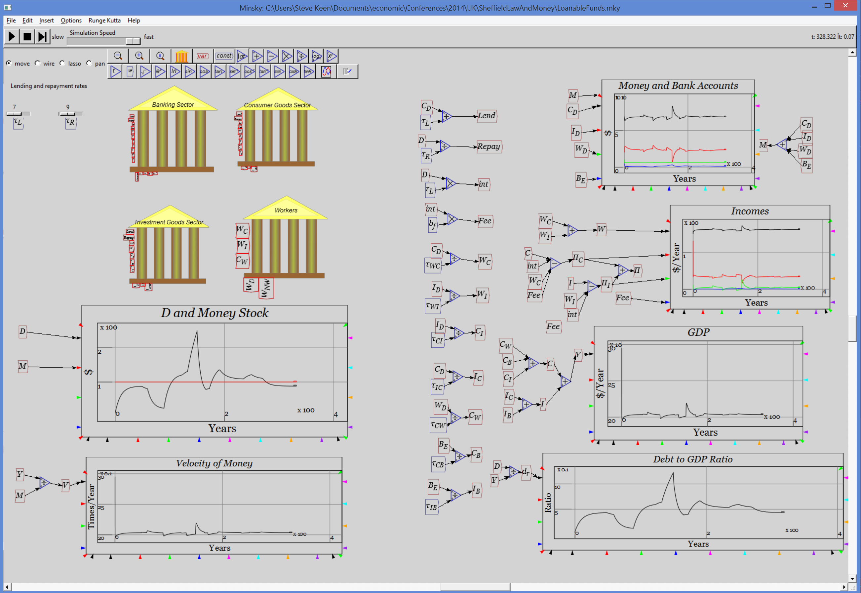
The conventional “commodity” vision of money
Simulated, Krugman/Bernanke correct: debt doesn’t matter…

Slide 16
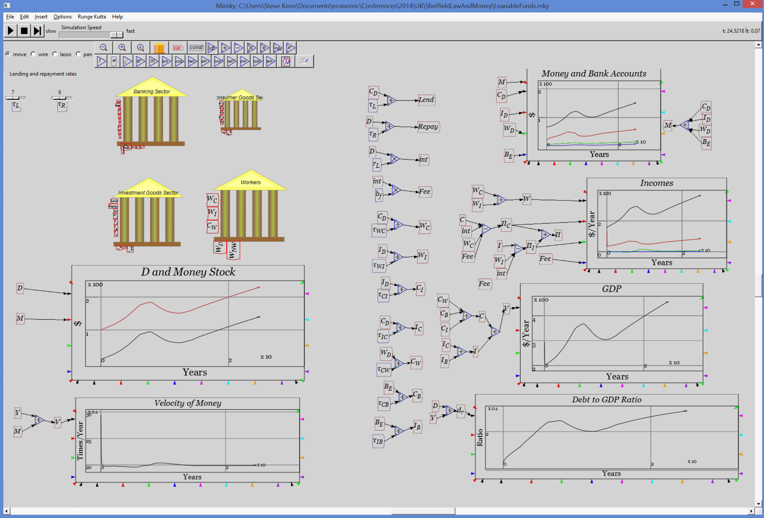
The conventional “commodity” vision of money
But a “Mystical” thought: what if banks are actually the lenders???

Slide 17

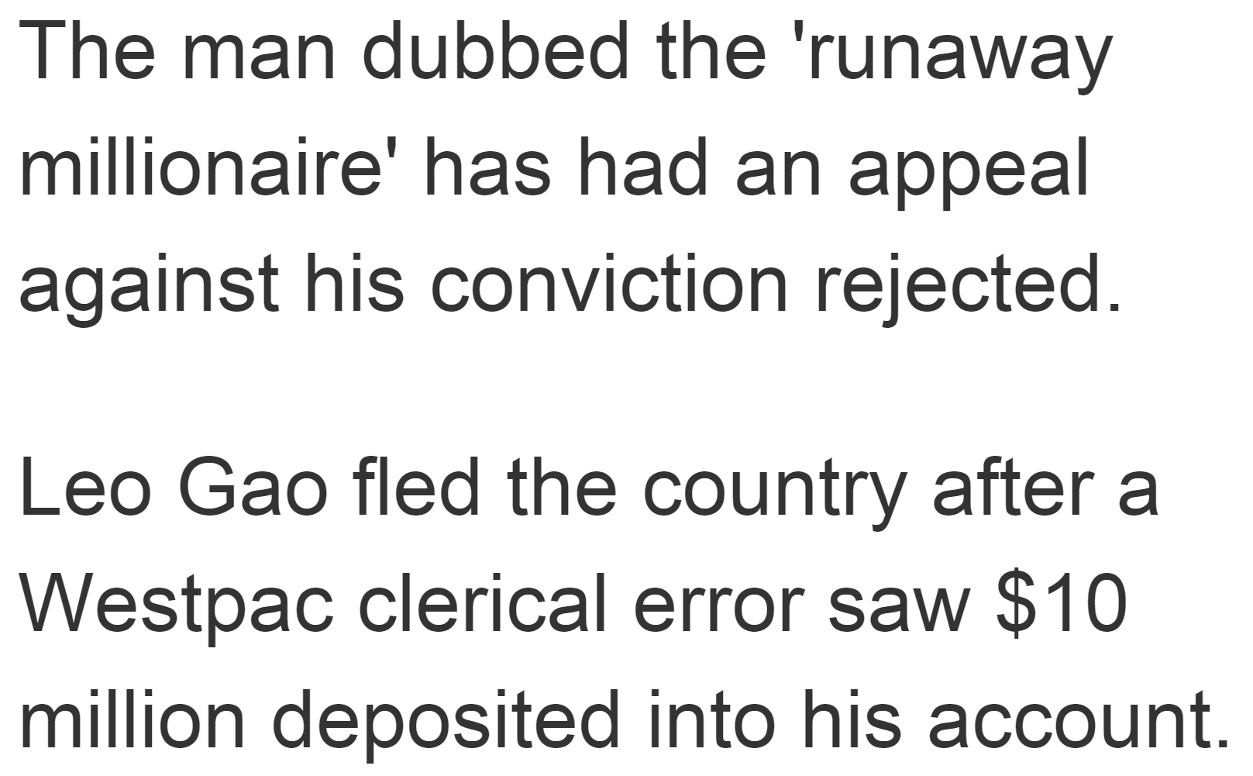
The correct “Endogenous” view of money
Bank lending does matter!
  Money created by it
  Demand created too
Bank doesn’t “sacrifice” to make loan
  Creates money by lending
    Nothing foregone by bank to enable lending
  Benefits from growth in level of debt
Costless production of money gives incentive to over-produce
  New Zealand petrol station owner story…
Asked for $100,000.00 overdraft
Bank clerk didn’t press decimal point
One less keystroke…
100 times as much money created

Slide 18
Endogenous money & systemic crises
Smith’s “Truck & barter” vision of origins of money a myth.
  Money originated in credit (Graeber 2011; Martin 2013)
  Demand-generating effect of bank lending causes booms & busts…
Hyman Minsky on the unstable & monetary nature of capitalism
  “In this "Chicago" view there exists a financial system… which would make serious financial disturbances impossible. It is the task of monetary analysis to design such a financial system, and of monetary policy to execute the design…
  The alternative polar view, which I call unreconstructed Keynesian, is that capitalism is inherently flawed, being prone to booms, crises, and depressions.
  This instability, in my view, is due to characteristics the financial system must possess if it is to be consistent with full-blown capitalism.
  Such a financial system will be capable of both generating signals that induce an accelerating desire to invest and of financing that accelerating investment.” (Minsky 1982, p. 279)

Slide 19
Minsky’s “Financial Instability Hypothesis”
“The natural starting place for analyzing the relation between debt and income is to take an economy with a cyclical past that is now doing well…
As the period over which the economy does well lengthens, two things become evident in board rooms. Existing debts are easily validated and units that were heavily in debt prospered; it paid to lever…
Stable growth is inconsistent with the manner in which investment is determined in an economy in which debt-financed ownership of capital assets exists, and the extent to which such debt financing can be carried is market determined.
It follows that the fundamental instability of a capitalist economy is upward.
The tendency to transform doing well into a speculative investment boom is the basic instability in a capitalist economy. (Minsky 1982, pp. 66-67)
My contribution: modelling Minsky by extending nonlinear cyclical but non-monetary Goodwin model

Slide 20
Goodwin’s cyclical growth model
Goodwin’s simple cyclical growth model
  Capital determines output
  Output determines employment
  Employment rate determines rate of change of wages
  Wages determine Profits
  Profits determine Investment
  Investment is the rate of change of Capital
  Generates cyclical growth…
where
and
Reduces to
Generates sustained cycles even with a linear “Phillips curve”
Cycles caused by inherent nonlinearities…

Slide 21
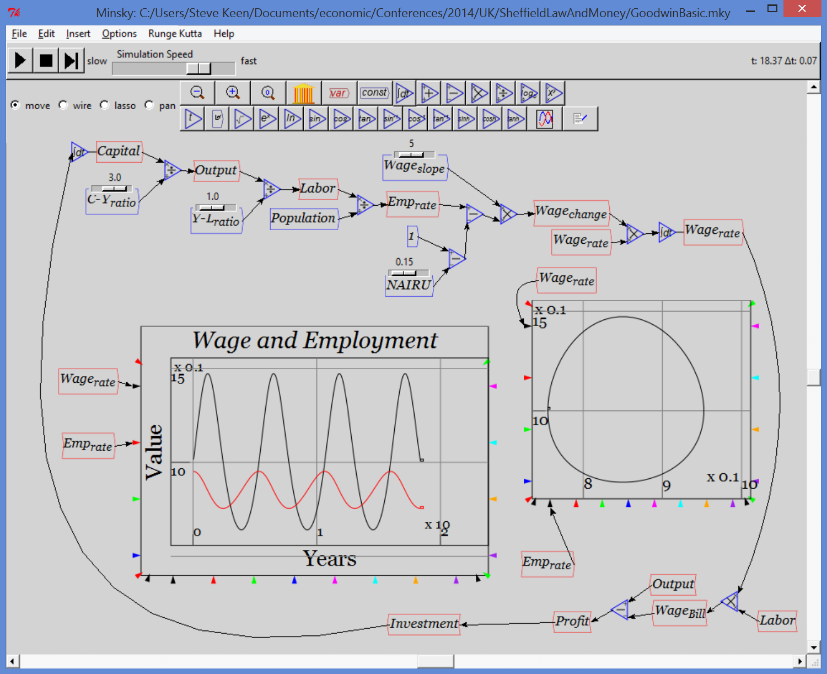
Minsky’s “Financial Instability Hypothesis”
Goodwin’s non-monetary model…

Slide 22
Minsky’s “Financial Instability Hypothesis”
Adding monetary realism…
  Investment exceeds profits during boom
  Investment less than profits during a slump
  Difference financed by change in debt
  Banks charge interest on debt…
Endogenous money key here—debt financed spending boosts demand
Crucial features of extended model
  Complexity: regular behaviour of base model replaced by potential for complex behaviour
    “Stability leads to instability”
  Rising debt to GDP ratio: instability
  With rising ratio comes apparent “Great Moderation”
    Declining volatility in employment & inflation (proxy)
  Then subsequent breakdown
  Rising inequality with falling workers’ share of output
    Even though firms borrow, not workers…

Slide 23
Goodwin’s cyclical growth model
Empirically realistic with nonlinear Phillips curve
  Forthcoming paper by Grasselli
    (Contra Harvie 2000—simple error in econometrics)
    Average of cycle conforms to average of 8/10 OECD countries
My Minsky extension
  (Nonlinear) Investment function based on rate of profit
    Capitalists invest more than profits during boom
    Less than profits during slump
      Linear function used here for simplicity
  Investment minus profit gap financed by change in debt
  Profit net of interest on debt
Reduces to 3-dimensional system where “Period Three Implies Chaos” (Li and Yorke 1975)…

Slide 24
Goodwin + Minsky = Chaos
Third system state is debt to output ratio d:
Employment rises if growth exceeds population growth + technical change
Wage share rises if wage demand exceed productivity
Debt rises if Investment>Profits or Growth negative with positive debt
Two non-trivial equilibria:
  “Good” (Grasselli & Costa Lima 2013)
    Positive wages share & employment rate, finite debt
  “Bad”
    Zero wages share & employment rate, infinite debt
  Bad equilibrium stable under some parameter & initial conditions
Peculiar nature of cycles towards “Bad” equilibrium
  Debt to GDP rises
  Cycles in employment & wages diminish and then grow
  Wages share of output declines…

Slide 25
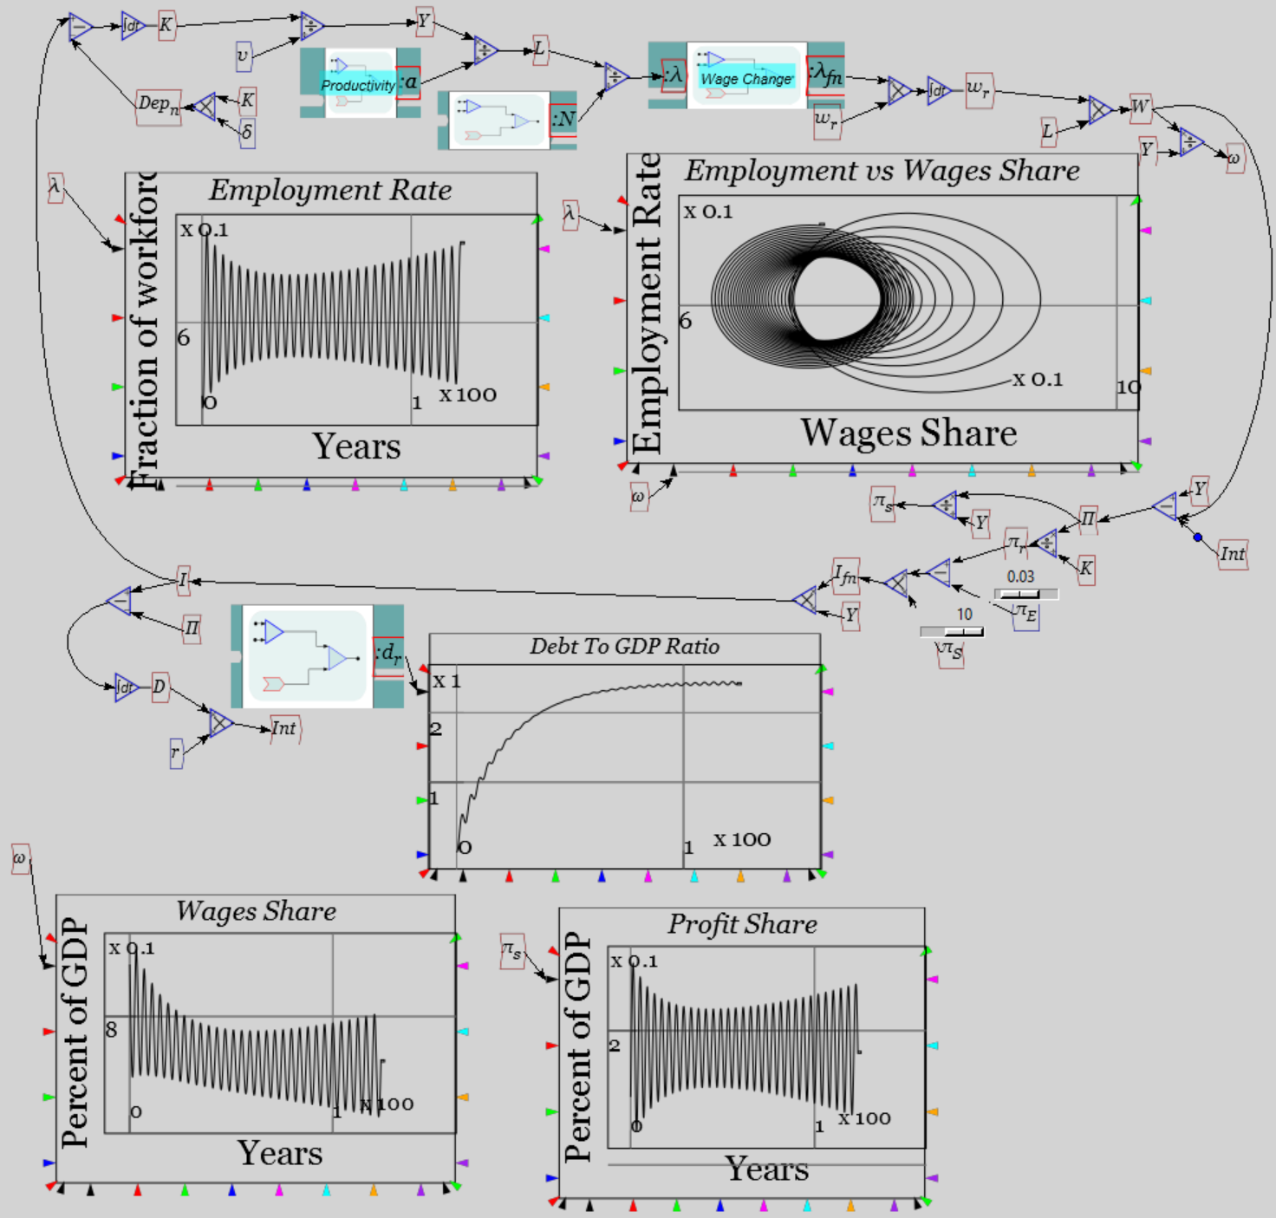
Goodwin + Minsky = Chaos
Systemic behaviour applies even with linear behavioural functions…
Initially diminishing cycles
Then increasing volatility
With cyclically rising debt ratio
And diminishing wages share
Inequality rises as crisis approaches
Workers pay for higher debt in lower wages share
Even though they do not borrow…

Slide 26
Emergent inequality
Goodwin model’s equilibria involve 2 system states λ and ω
  With linear Phillips curve:
Minsky model equilibria involve λ, d and profit share π_{s}
Wages share a residual negative function of π_{s} and d:

Slide 27
Emergent inequality
Model dynamics involve
  Cycles around equilibrium values for λ and π_{S}
  Falling wages share compensates for rising debt servicing costs
    Declining workers’ share lulls capitalists into false sense of security as debt level rises
  Profits cyclical around equilibrium level…
  Until exponential debt relation overwhelms falling wages share
  Then collapse: zero employment, zero wages, infinite debt, infinitely negative profit rate
  Fundamentally unstable dynamics of pure credit economy without government or bankruptcy…

Slide 28
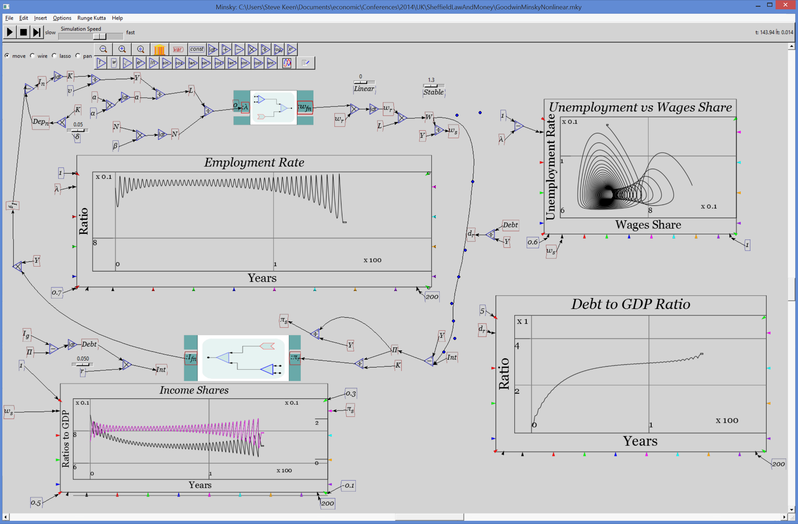
Minsky’s “Financial Instability Hypothesis”
Minsky cycle in extended model

Slide 29
Minsky’s “Financial Instability Hypothesis”
1995 paper Conclusion (written in 1992 before end of 1990s recession):
  “From the perspective of economic theory and policy, this vision of a capitalist economy with finance requires us to go beyond that habit of mind which Keynes described so well, the excessive reliance on the (stable) recent past as a guide to the future.
  The chaotic dynamics explored in this paper should warn us against accepting a period of relative tranquility in a capitalist economy as anything other than a lull before the storm.”
Post 1992 economic history…

Slide 30
The “Great Moderation”?
Declining levels of & volatility in employment and inflation

Slide 31
The “Great Moderation”?
Neoclassicals saw “The End of History”
  Lucas in 2003
    “Macroeconomics was born as a distinct field in the 1940's, as a part of the intellectual response to the Great Depression.
    The term then referred to the body of knowledge and expertise that we hoped would prevent the recurrence of that economic disaster.
    My thesis in this lecture is that macroeconomics in this original sense has succeeded:
    Its central problem of depression prevention has been solved, for all practical purposes, and has in fact been solved for many decades. (Lucas 2003 , p. 1 ; emphasis added)..
  Bernanke in 2004…

Slide 32
The “Great Moderation”?
  “As it turned out, the low-inflation era of the past two decades has seen not only significant improvements in economic growth and productivity but also a marked reduction in economic volatility, both in the United States and abroad, a phenomenon that has been dubbed "the Great Moderation."
  Recessions have become less frequent and milder, and quarter-to-quarter volatility in output and employment has declined significantly as well.
  The sources of the Great Moderation remain somewhat controversial, but as I have argued elsewhere, there is evidence for the view that improved control of inflation has contributed in important measure to this welcome change in the economy.” (Bernanke 2004; emphasis added)
The OECD in June 2007…

Slide 33
The “Great Moderation”?
“In its Economic Outlook last Autumn, the OECD took the view that the US slowdown was not heralding a period of worldwide economic weakness, unlike, for instance, in 2001.
Rather, a “smooth” rebalancing was to be expected, with Europe taking over the baton from the United States in driving OECD growth.
Recent developments have broadly confirmed this prognosis. Indeed, the current economic situation is in many ways better than what we have experienced in years. Against that background, we have stuck to the rebalancing scenario.
Our central forecast remains indeed quite benign: a soft landing in the United States, a strong and sustained recovery in Europe, a solid trajectory in Japan and buoyant activity in China and India. In line with recent trends, sustained growth in OECD economies would be underpinned by strong job creation and falling unemployment.” (Cotis 2007 , p. 7)

Slide 34
The “Great Moderation”?
Rising private debt: the factor ignored by Neoclassical economists

Slide 35
Breakdown
Crisis began when rate of growth of debt collapsed…

Slide 36
Breakdown
Unemployment exploded, inflation became deflation (before rescue)

Slide 37
Debt & macroeconomic dynamics
Change & acceleration of aggregate private debt drive economic cycle
Correlation -0.9

Slide 38
Debt & macroeconomic dynamics
Change & acceleration of aggregate private debt drive economic cycle
Correlation -0.89

Slide 39
Debt & macroeconomic dynamics
Change & acceleration of aggregate private debt drive economic cycle
Correlation 0.61

Slide 40
Debt & macroeconomic dynamics
Change & acceleration of aggregate private debt drive economic cycle
Correlation 0.79

Slide 41
Role of debt in aggregate demand & income
Key aspect of Minsky model is change in debt boosts aggregate demand
Shown to be stock-flow consistent by Grasselli & Costa Lima 2013
But some Post Keynesians believe wrong in accounting:
  “Unless Keen (2014a) can explain how a purchase of a good or service does not provide income for the seller, then he should rethink his claim that debt extensions can force an inequality between expenditure and income at the aggregate level” (Fiebiger 2014)
Not inequality, but causal role for change in debt in both demand & income…

Slide 42
Role of debt in aggregate demand & income
Deriving role of change in debt in aggregate demand & income from an expenditure table
  3 sectors, 3 situations
    No borrowing is possible (“Say’s Law”)
    Borrowing from other agents is possible (“Loanable Funds”)
    Banks lend to non-banks (“Endogenous Money”)
  2 types of expenditure:
    Financed out of existing money
      E_{xy}: Expenditure by sector x to buy from sector y
    Financed by borrowing
      ΔD for single instance
      dD/dt for flow of debt in continuous time

Slide 43
Role of debt in aggregate demand & income
Expenditure Table
  Rows show expenditure by each sector
  Columns show net income
  Negative sum of diagonal is aggregate demand
  Sum of off-diagonal elements is aggregate income
Aggregate demand
Simplest “Say’s Law” (really “demand creates its own supply…”)
Sector 1 Net Income
Aggregate income
Aggregate income
Aggregate demand
Aggregate income

Slide 44
Role of debt in aggregate demand & income
Loanable Funds: Sector 1 borrows ΔD from Sector 2
  Sector 1 spends borrowed funds in proportion α,1-α on 2 & 3
  Sector 2 spends that much less in proportions β,1-β on 1 and 3
Aggregate demand
Aggregate income
Increase in spending power of borrower offset by decrease in spending power of lender
Neoclassicals logically correct that, if this accurately describes lending, “pure redistributions should have no significant macroeconomic effects”…

Slide 45
Role of debt in aggregate demand & income
Endogenous Money: Sector 1 borrows ΔD from banking sector
  Sector 1 spends borrowed funds in proportion α,1-α on 2 & 3
Aggregate demand
Aggregate income
Both Aggregate demand and aggregate income include change in debt
How to interpret?
  Aggregate demand & aggregate income include
    Expenditure/Income from currently existing money
    Plus expenditure/income from newly created debt-money
Next, Loanable Funds & Endogenous Money in continuous time

Slide 46
Role of debt in aggregate demand & income
Loanable funds: flow of lending from Sector 2 to Sector 1
Sector 1 pays interest to Sector 2
Aggregate demand
Interest is part of aggregate demand/income
Aggregate income

Slide 47
Role of debt in aggregate demand & income
Endogenous Money: Bank loans flow to Sector 1
Sector 1 pays interest to Banking sector
Banking sector pays deposit interest to non-bank sectors
Aggregate demand
Aggregate income
Change in debt (+ deposit & loan interest) components of both

Slide 48
Role of debt in aggregate demand & income
Corrected insights on role of debt in aggregate demand & income
  Expenditure/Income is
    That financed by existing money
    Plus that financed by the change in debt
      Plus gross financial transactions
Which implies:

Slide 49
Role of debt in aggregate demand & income
So the change in aggregate demand is…
Product rule expansion
All there is in Loanable Funds macro
Substituting that dM/dt=dD/dt
Change & acceleration of debt affect change in aggregate demand
Explanation for high correlations between change in debt & level of unemployment, acceleration in debt & change in unemployment…

Slide 50
Debt & macroeconomic dynamics
So rather than being an unpredictable “Black Swan”
Crisis was a predictable consequence of lending-driven boom
Is this all history? Will “It” never happen again?
Trivial deleveraging
Rising trend (amid systemic crises)

Slide 51
Is this all history? Will “It” never happen again?
Current revival beginning from highest level of private debt in history
“It” will happen again, & sooner than last time (15 years 1992-2007)

Slide 52

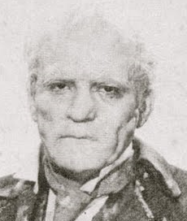
The “Ptolemy” in mainstream economics
Many other flaws of mainstream economics
  Sraffa’s critique of aggregation of capital
    Profit can’t be “marginal product” of capital
  McCombie’s critique of Cobb-Douglas production function
    A tautology that simply transforms Income=Wages + Profits
Textbook teaching mendacious: teaches theory minus flaws
You are shown Dorian Gray
The reality is more like his portrait…
Some examples…

Slide 53
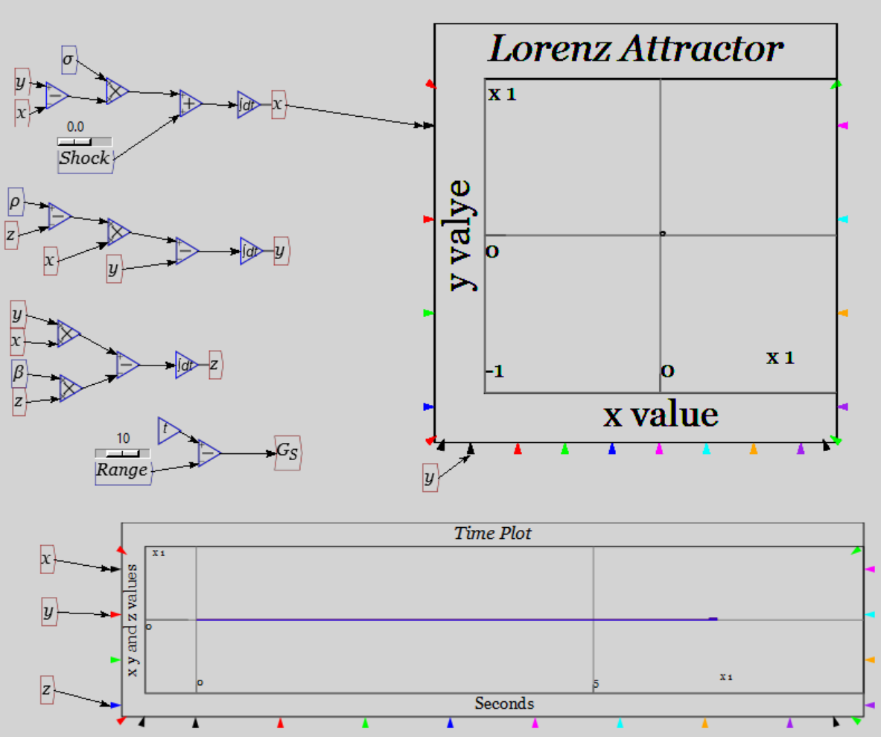
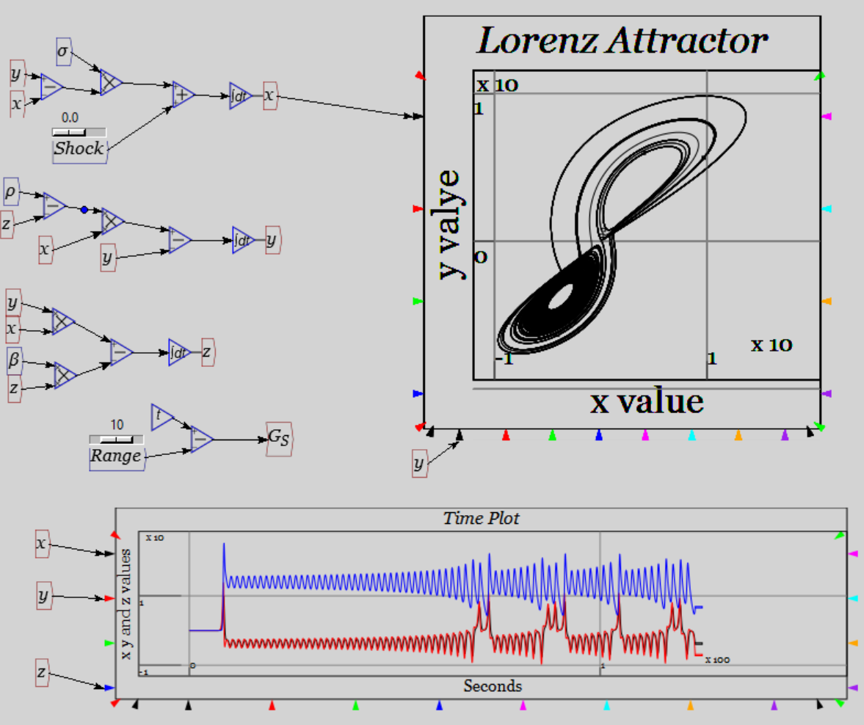
The “Ptolemy” in mainstream economics
Equilibrium fixation. Yesterday CGE, today DSGE…
  “If I drop a ripe watermelon from this 15th-floor window, I suppose the whole process from t₀ to the mess on the sidewalk could be described as some sort of dynamic equilibrium. But that may not be the most fruitful—sorry—way to describe the falling-watermelon phenomenon.” (Solow “Dumb & Dumber in Macro”)
Modern dynamics is “far from equilibrium”… E.g., Lorenz’s “butterfly”

Slide 54
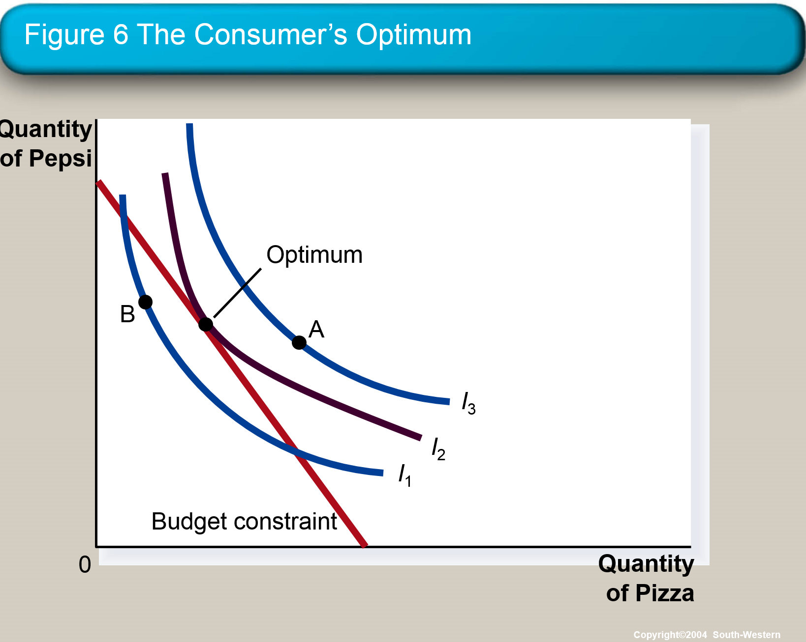
The “Ptolemy” in mainstream economics
Theory: utility maximizing consumers choosing optimum consumption bundles subject to income constraint
“the evidence for the utility maximization hypothesis is at best mixed.
While there are subjects who appear to be optimizing, the majority of them do not.
The high power of our test might explain why our conclusions differ from those of other studies where optimizing behavior was found to be an almost universal principle applying to humans and non-humans as well.
In contrast to this, we would like to stress the diversity of individual behavior and call the universality of the maximizing principle into question…”
Reality: Sippel’s 1997 realistic test of revealed preference theory:

Slide 55
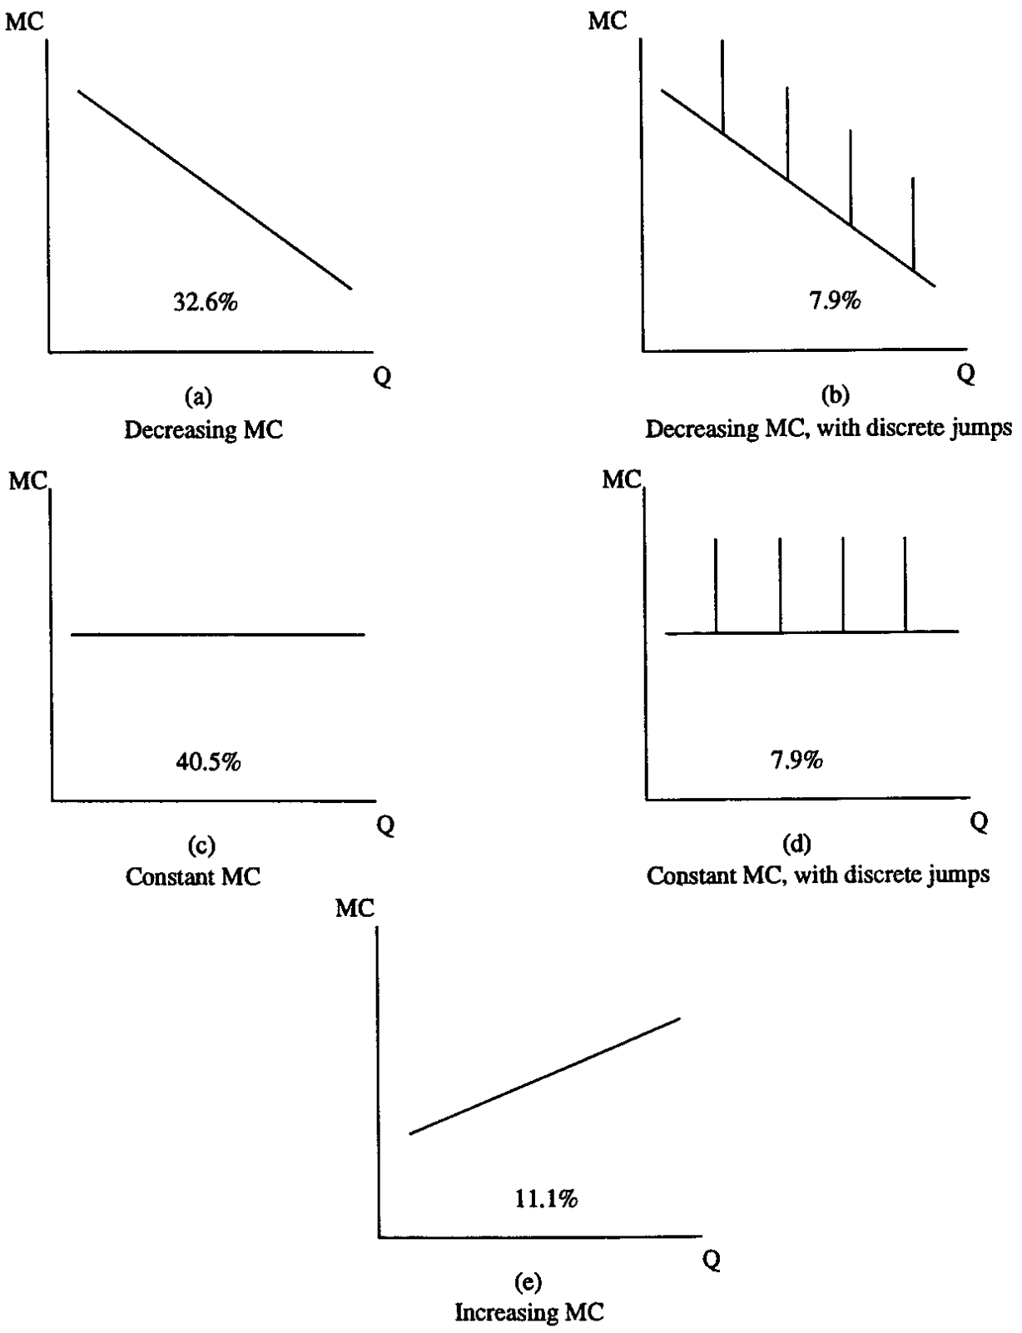
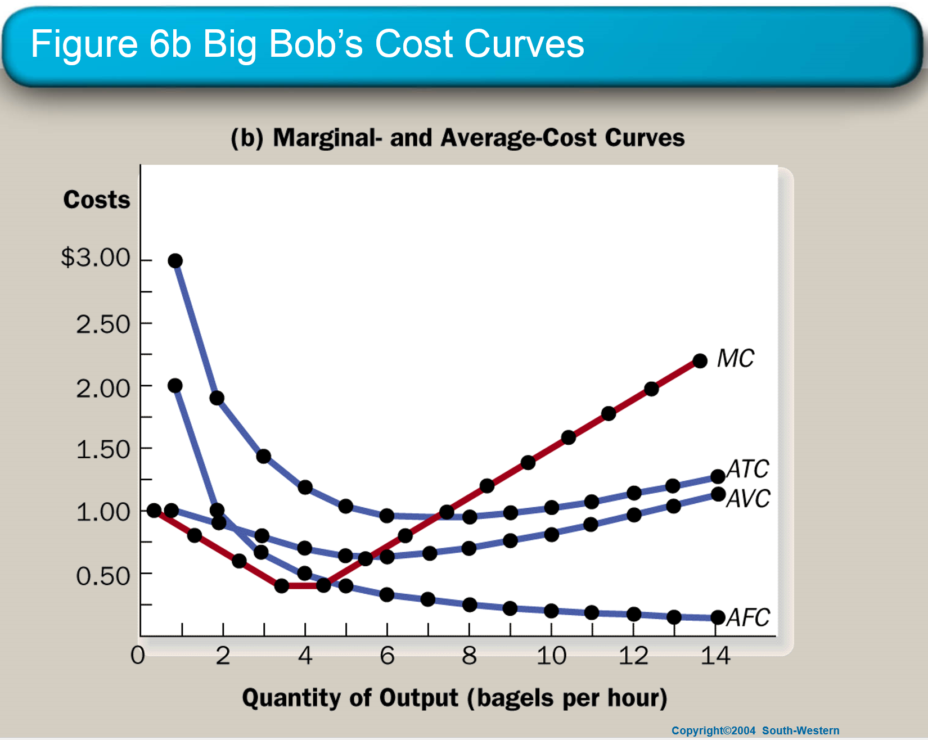
The “Ptolemy” in mainstream economics
Theory: upward supply curve…
  Rising marginal cost as a natural consequence of fixed & variable inputs…
Empirical observation: most firms have declining or constant marginal costs
Alan Blinder 1999 survey:

Slide 56
The “Ptolemy” in mainstream economics
“Another very common assumption of economic theory is that marginal cost is rising. This notion is enshrined in every textbook and employed in most economic models.
It is the foundation of the upward-sloping supply curve.
However, as we have noted already, Hall has used constant MC as the basis for one family of models of price stickiness. What do business people have to say about their own cost structures?”
“Firms report having very high fixed costs—roughly 40 percent of total costs on average.
And many more companies state that they have falling, rather than rising, marginal cost curves. While there are reasons to wonder whether respondents interpreted these questions about costs correctly,
their answers paint an image of the cost structure of the typical firm that is very different from the one immortalized in textbooks.”
  Alan Blinder, ex-Vice President of American Economic Association
  (Click here for downloadable chapters—Chapter 4 the core)

Slide 57
The “Ptolemy” in mainstream economics
The “downward sloping market demand curve”
“Can an arbitrary continuous function … be an excess demand function for some commodity in a general equilibrium economy?...
we prove that every polynomial … is an excess demand function for a specified commodity in some n commodity economy…
every continuous real-valued function is approximately an excess demand function.
  Sonnenschein 1972 , pp. 549-550
“The market demand curve is found by adding together the quantities demanded by all individuals at each price.
Does the market demand curve obey the law of downward-sloping demand?
It certainly does.”
  Samuelson and Nordhaus 2010, p. 48
Doesn’t assert that demand doesn’t normally fall with price
Says Neoclassical theory can’t explain why
Emergent phenomenon: aggregate individuals with downward-sloping demand curves…
Get any (polynomial) shaped demand curve at all

Slide 58
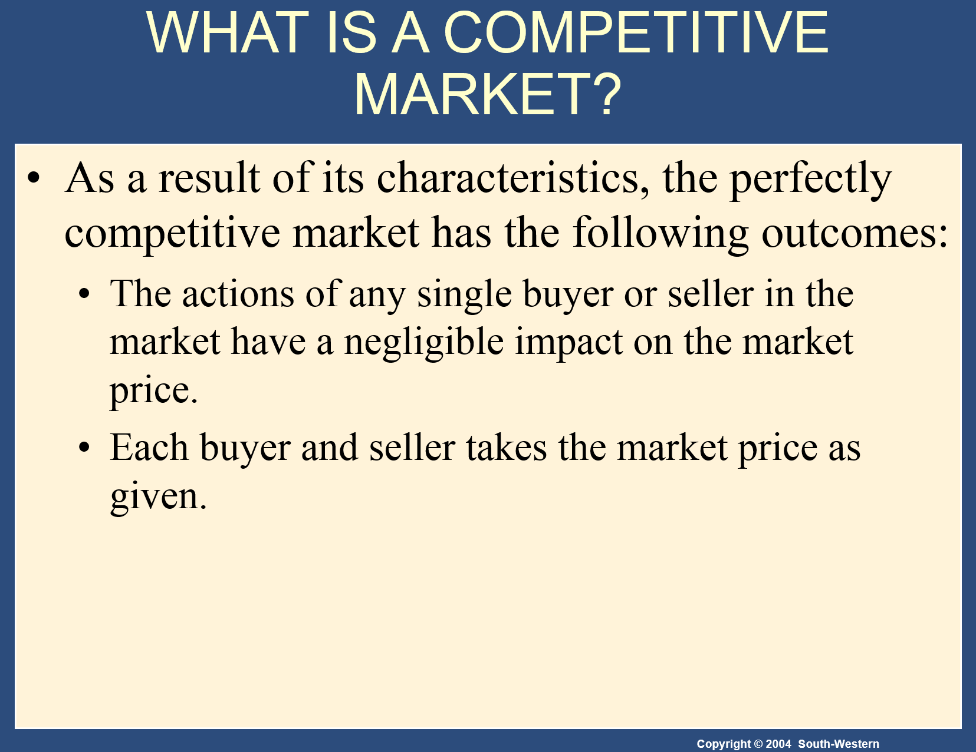
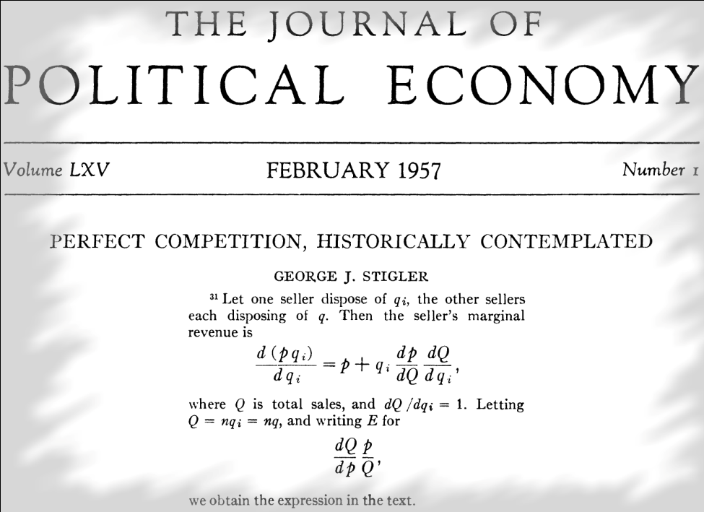
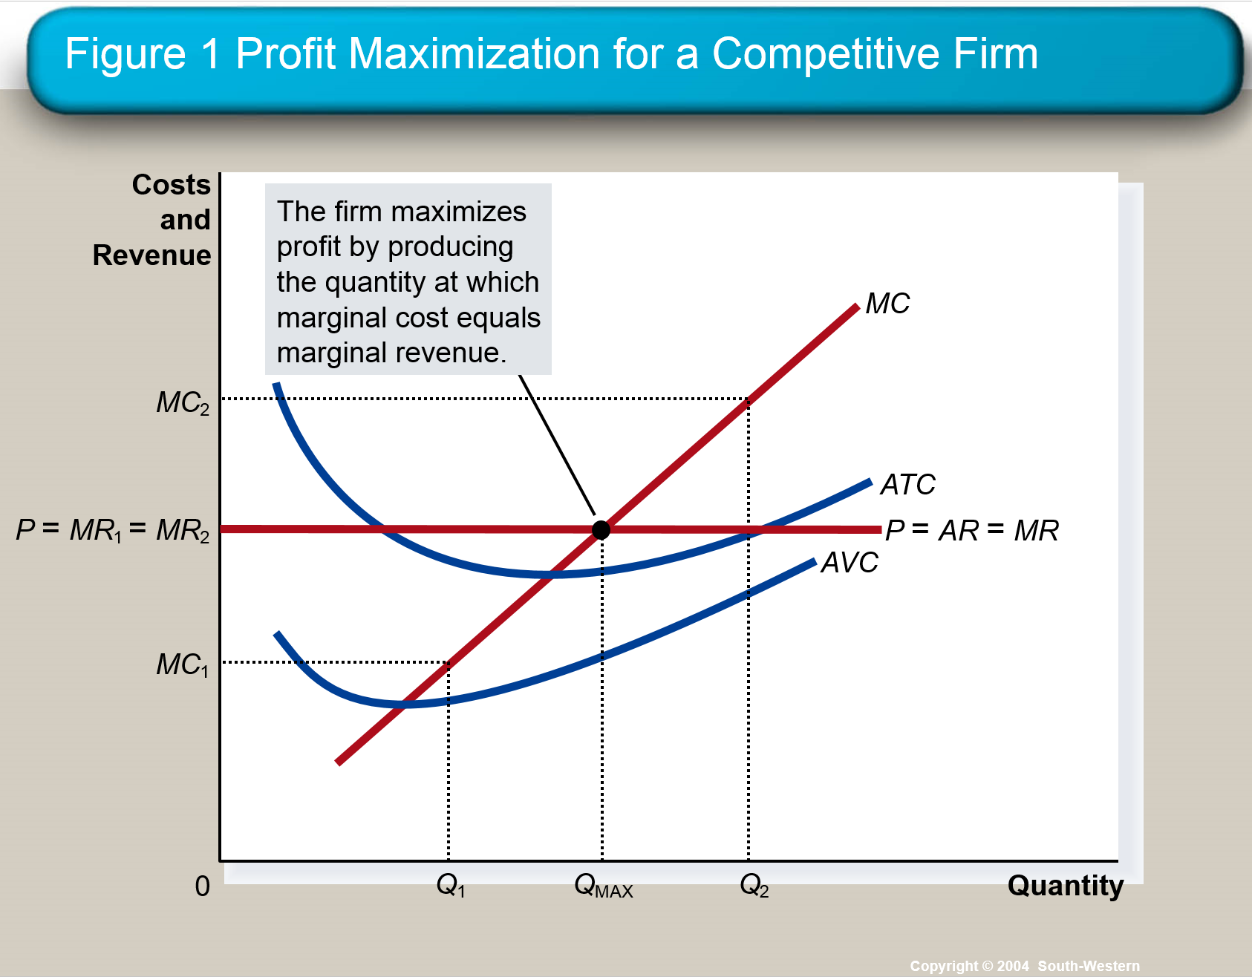
The “Ptolemy” in mainstream economics
“Perfect” competition…
So the demand curve P(q) for the single firm is flat, so thatdP/dq=0?
Not according to Stigler…
where
So without strategic interaction (i.e. Cournot or Bertrand competition)
Demand curve for “competitive firm” has same slope as market demand curve
Marshallian “Perfect competition” a mathematical error
Cournot equilibrium locally unstable (mathematically, & not equilibrium in repeated games)
See Keen & Standish 2010

Slide 59
Conclusion
We need an empirically realistic, logically sound, theory of economics
Neoclassical equilibrium/barter model like Ptolemy’s theory of cosmos
  We need a Copernican replacement
In the meantime, you should learn all theories, not just Neoclassical
  And if that doesn’t happen at your University, then…
For a pluralist education in economics
Come to Kingston
School of Economics, History & Politics
Kingston
University
London

Slide 60
References
Bernanke, B. S. (2004). Panel discussion: What Have We Learned Since October 1979? Conference on Reflections on Monetary Policy 25 Years after October 1979, St. Louis, Missouri, Federal Reserve Bank of St. Louis.
Bezemer, D. J. (2009). “No One Saw This Coming”: Understanding Financial Crisis Through Accounting Models. Groningen, The Netherlands, Faculty of Economics University of Groningen.
Cotis, J.-P. (2007). Editorial: Achieving Further Rebalancing. OECD Economic Outlook. OECD. Paris, OECD. 2007/1: 7-10.
Eggertsson, G. B. and P. Krugman (2012). "Debt, Deleveraging, and the Liquidity Trap: A Fisher-Minsky-Koo approach." Quarterly Journal of Economics 127: 1469–1513.
Eggertsson, G. B. and P. Krugman (2012). "Supplementary material to Debt, Deleveraging and the Liquidity Trap." Quarterly Journal of Economics 127: Appendix.
Fama, E. F. and K. R. French (1999). "The Corporate Cost of Capital and the Return on Corporate Investment." Journal of Finance 54(6): 1939-1967.
Fiebiger, B. (2014). "Bank credit, financial intermediation and the distribution of national income all matter to macroeconomics." Review of Keynesian Economics 2(3): 292-311.
Godley, W. and L. R. Wray (2000). "Is Goldilocks Doomed?" Journal of Economic Issues 34(1): 201-206.
Goodwin, R. M. (1967). A growth cycle. Socialism, Capitalism and Economic Growth. C. H. Feinstein. Cambridge, Cambridge University Press: 54-58.
Keen, S. (1995). "Finance and Economic Breakdown: Modeling Minsky's 'Financial Instability Hypothesis.'." Journal of Post Keynesian Economics 17(4): 607-635.

Slide 61
References
Keen, S. (2006). "The Recession We Can't Avoid?" Steve Keen's Debtwatch, from http://debtdeflation.com/blogs/wp-content/uploads/2007/03/SteveKeenDebtReportNovember2006.pdf.
Keen, S. (2007). Deeper in Debt: Australia's addiction to borrowed money. Occasional Papers. Sydney, Centre for Policy Development.
Keen, S. (2014). “Endogenous money and effective demand.” Review of Keynesian Economics 2(3): 271–291.
Krugman, P. (2012). End this Depression Now! New York, W.W. Norton.
Lavoie, M. (2014). "A comment on ‘Endogenous money and effective demand’: a revolution or a step backwards?" Review of Keynesian Economics 2(3): 321 - 332.
McLeay, M., A. Radia and R. Thomas (2014). "Money creation in the modern economy." Bank of England Quarterly Bulletin 2014 Q1: 14-27.
Martin, F. (2013). Money: The Unauthorised Biography. London, The Bodley Head Ltd.
Minsky, H. P. (1982). Can "it" happen again? : essays on instability and finance. Armonk, N.Y., M.E. Sharpe.
Wray, L. R. (2002). "What Happened to Goldilocks? A Minskian Framework." Journal of Economic Issues 36(2): 383-391.
Data in presentation:

