Slide 1

Economics beyond the straight & narrow
Professor Steve Keen
Head of Economics, History & Politics
Kingston University London
IDEAeconomics
Minsky Open Source System Dynamics
www.debtdeflation.com/blogs

Slide 2

What’s the point in studying economics?
Economics has been “on the nose” in recent years…
Is economics wrong about how an economy works?
Only one approach has dominated economics for past 50 years:
“Neoclassical” economics is “the mainstream”
Students calling for “pluralism”—teach other approaches as well…

Slide 3
How do other schools of thought differ
Many other approaches to economics apart from Neoclassical
  “Austrian”
  “Post Keynesian”
  Ecological/Evolutionary
  Complexity
  Marxian
  Feminist…
Many points of divergence from mainstream
I’ll focus on three that define how I “Think Like An Economist”
  Non-equilibrium modelling
  Taking banks, debt & money seriously
  Analysing monetary flows between economic sectors…

Slide 4
Supply & Demand Analysis: Equilibrium Rules!
Almost all economic models ask “What happens in equilibrium?”…
Price
Supply
Equilibrium price
Demand
Equilibrium quantity
Quantity
But does everything have to happen in equilibrium?
Many leading mainstream economists think so…

Slide 5
Does everything happen “in equilibrium”?
George W. Bush’s Chief Economic Advisor Ed Lazear in 2000:
  “Economic models adhere strictly to the importance of equilibrium as part of any theory”
Federal Reserve economist V.V. Chari speaking to US Congress in 2010
  “If you have an interesting and coherent story to tell, you can tell it in a Dynamic Stochastic General Equilibrium model.
  If you cannot, your story is incoherent.”
Leading American economist Roger Farmer in 2014:
  “Robert Lucas was exactly right when he argued (here) that markets are always in equilibrium”
So is any model that doesn’t generate an equilibrium “incoherent”?
Let’s consider a social example: “star-crossed lovers” Romeo & Juliet…

Slide 6
Does everything happen “in equilibrium”?
“Romeo & Juliet”
  Romeo: “When Juliet’s not around I kind of forget her”
    “But I like it when she’s with me”
  Juliet: “Absence (of Romeo) makes the heart grow fonder”
    “But when he’s around he really bugs me…”
Simple model: current state of love affects change in love…
  Change in Romeo’s love = a times Romeo’s love + b times Juliet’s
  Change in Juliet’s love = c times Juliet’s love + d times Romeo’s
    a,b,c,d constants ranging from +1 to -1
    Love shown by positive number (bigger the better)
    Indifference by zero
    Hate by negative number (bigger the stronger)
Modelling this in Minsky—Open Source systems dynamics program
  Based on what engineers do (“systems engineering”)
  I designed Minsky to model banks, money & debt in economics
  Downloadable for free from https://sourceforge.net/p/minsky/

Slide 7
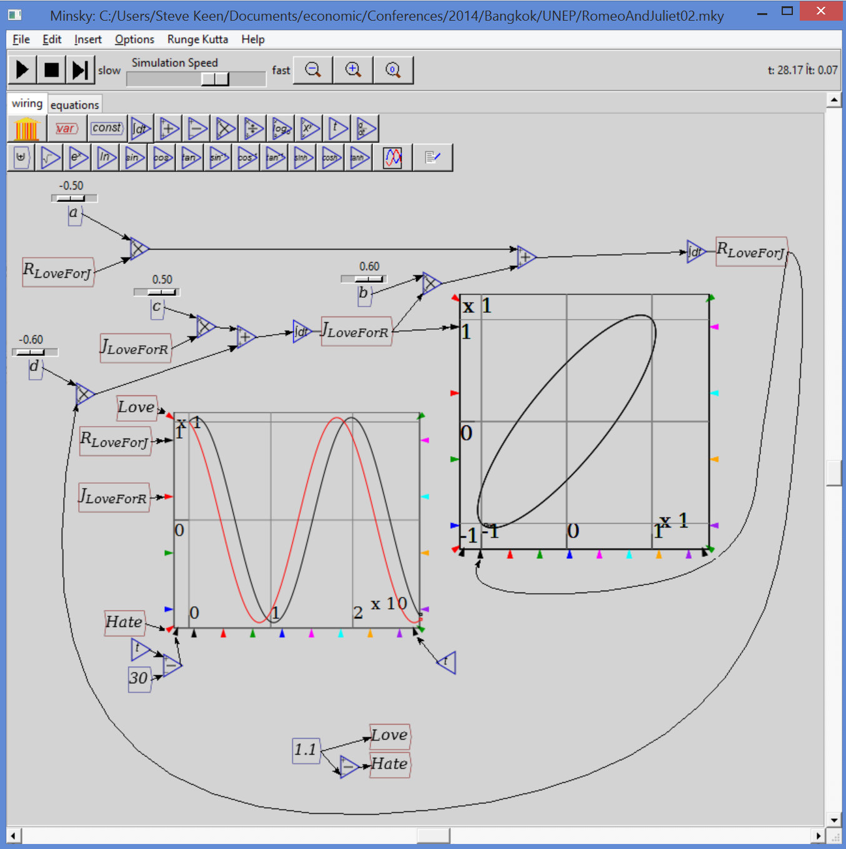
Non-equilibrium modelling
A love-hate cycle… “Equilibrium” never happens:
So the relationship never has to “reach equilibrium”
  i.e., stop changing with some constant level of love or hate
Does that make it unrealistic or incoherent?...
Or is it like relationships you know?
Back to economics…
Many economists believe equilibrium means coherence
But equilibrium doesn’t have to happen in a coherent dynamic system
Can keep cycling indefinitely
Mainstream mistakes equilibrium for “internal consistency”

Slide 8
An economic model
Economy is dynamic: involves change over time
This change doesn’t have to terminate in “equilibrium”
Can continue cycling indefinitely
Example: a simple coherent dynamic model
  Capital stock (roughly speaking) determines output
  Output (roughly speaking) determines Employment
  Employment determines rate of change of wages
  Output minus wages determines profit
  Profit determines investment
  Investment determines capital stock
Does this generate equilibrium?
Let’s build it in Minsky and see…

Slide 9
Click to start movie; click after text boxes to continue

Slide 10
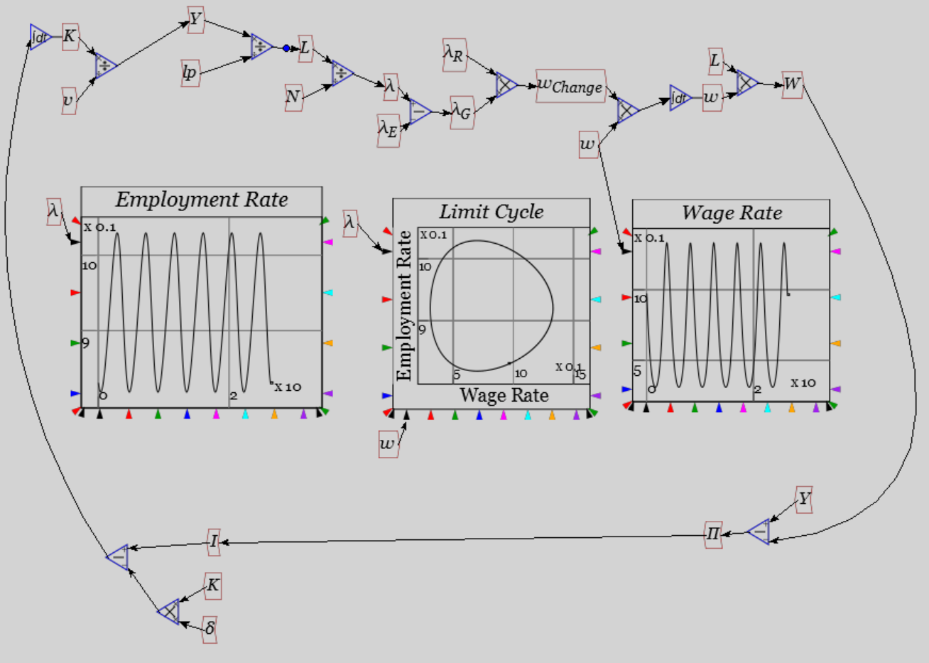
Economics without Equilibrium

Slide 11
Economics without Equilibrium
So economic models don’t have to be in equilibrium
And neither does the economy
“Complex systems” economists build non-equilibrium models
Use them for insights into the actual economy
For example, what if capitalists don’t invest all their profits? Instead
  Invest more during a boom
  Less during a slump
  Borrow money to fund the difference
  Pay interest on outstanding debt…
How does this compare to the actual economy?...

Slide 12
An economic application—the economic crisis
From “The Great Moderation” to “The Great Recession”…
  “improved control of inflation has contributed in important measure to this welcome change in the economy.” (Bernanke 2004)
Falling then rising unemployment
Rising private debt to GDP

Slide 13
An economic application—the economic crisis
Blanchard concedes mainstream obsessed with linear models:
  “We in the field did think of the economy as roughly linear, constantly subject to different shocks, constantly fluctuating, but naturally returning to its steady state over time.
  Instead of talking about fluctuations, we increasingly used the term “business cycle.”
  Even when we later developed techniques to deal with nonlinearities, this generally benign view of fluctuations remained dominant.” (Blanchard 2014)
But cops out on embracing nonlinearity:
  “should we modify our benchmark … (DSGE) models … to describe how the economy behaves in the dark corners?...
  Trying to create a model that integrates normal times and systemic risks may be beyond the profession’s conceptual and technical reach at this stage.…”
No it’s not—it’s just beyond a linear equilibrium paradigm.
Embracing nonlinearity even in simplest way generates such a model…

Slide 14
Simple rules, complex behaviour
My 1995 Minsky model can be stated as strict identities:
    The employment rate will rise if economic growth exceeds the sum of growth in labor productivity and population growth;
    The wages share of output will rise if wage demands exceed the growth in labor productivity; and
    The private debt to GDP ratio will rise if private debt growth exceeds the rate of economic growth
  In equations:

Slide 15
Simple rules, complex behaviour
Equations are simply expansions of definitions
When put into simplest possible model
  Generates both “Great Moderation” & Great Recession
  Rising private debt
  Rising inequality
Simplest possible model:
  Output Y_{R} a linear function of capital K_{R}
  Investment I_{R} a linear function of profit rate π_{r} & depreciation
  Employment a linear function of output
  Wage change a linear function of employment rate
  Change in debt equal to investment minus profits
  No government sector, no Ponzi Finance, no bankruptcy

Slide 16
Simple rules, complex behaviour
Generates deceptively simple model:
3 variables
9 parameters (including r)
But complex behaviour…
Equilibria not the same as variables
  Variables employment rate, debt ratio, wages share of output
  Equilibria employment rate, debt ratio, profit share of output
    Wages share a residual directly negatively related to debt service share (r.d)
      Workers pay for rising debt via lower income share
      Even without borrowing by workers in the model…

Slide 17
Simple rules, complex behaviour
“Good” equilibrium is:
Lower growth means higher equilibrium debt level
And makes equilibrium more unstable
Two possible outcomes depending on parameter values
  Equilibrium stable
    Cyclical convergence to positive employment rate, profit share, finite debt ratio over time…

Slide 18
Simple rules, complex behaviour
    Not what we have experienced in the real world

Slide 19
Simple rules, complex behaviour
  Equilibrium unstable: rising debt, rising inequality, moderation then breakdown:
    Similar to what we have experienced in the real world…
Falling then rising cycles
Cyclically Rising Private Debt Ratio

Slide 20
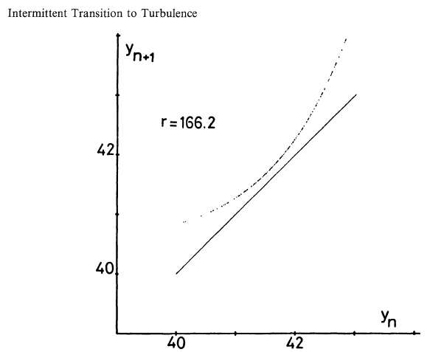
Simple rules, complex behaviour
Model follows Pomeau-Manneville “inverse-tangent route to chaos”
First seen in transition from laminar to turbulent flow in fluids
Modeled as Poincare Map in y-coordinate of Lorenz system where system bounces between a curve and a line:
Dynamics of system determined by whether line intersects curve
For intersection
  No fluid turbulence
  Economic stability
For non-intersection
  Turbulence
  Instability preceded by diminishing cycles

Slide 21
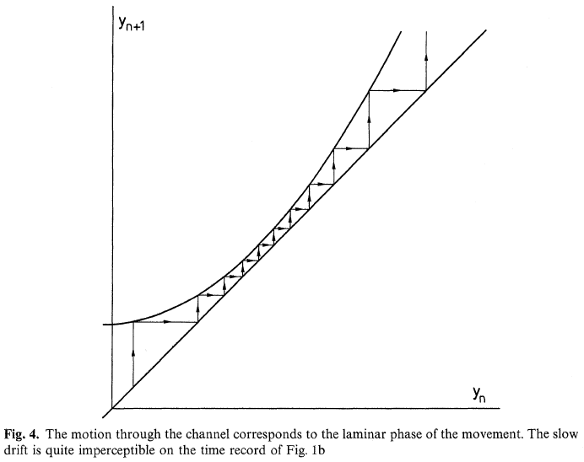
Simple rules, complex behaviour
Dynamics of system determined by whether line intersects curve
If it does, stable equilibrium; cycles diminish to zero
If it doesn’t,
Unstable equilibrium
Cycles diminish at first and then increase
“Great Moderation” followed by “Great Recession”
Not 2 separate events but two stages in the same process…

Slide 22
Simple rules, complex behaviour
Weakness of model: even-handed nature of crisis—booms & busts
Real world experience: apparent moderation then bust only
Generated by generalizing earlier identities to include inflation:
  The employment rate will rise if real economic growth exceeds the sum of population growth and growth in labor productivity;
  The wages share of output will rise if money wage demands exceed the sum of inflation and growth in labor productivity; and
  The private debt to GDP ratio will rise if the rate of growth of private debt exceeds the sum of inflation plus the rate of economic growth.
Additional equations needed for
  Rate of inflation
  Variable nominal interest rate
  Simplest relationships used again:
    Lagged convergence to equilibrium prices in monetary economy
    Lagged inflation premium to base interest rate if inflation > 0

Slide 23
Simple rules, complex behaviour
Inflation formula derived from monetary flow logic
Depends on wages share of output & firms’ markup…
Inflation-adjusted nominal interest rate
1st order time lag determines inflation
Inflation affects wages share
Inflation affects debt growth
Lagged interest rate reaction to inflation

Slide 24
Simple rules, complex behaviour
4D model, so formal stability analysis much more challenging
Empirical appears to yield fundamental instability. Linear functions…

Slide 25
Simple rules, complex behaviour
Nonlinear functions:
Without recent financial crisis, model could be dismissed as “just a mathematical curiousity”
But real world actually followed pattern in this stylized, simple model
Apparent period of tranquillity “Great Moderation”
Then sudden crisis “Great Recession”…

Slide 26
Simple rules, complex behaviour
Income distribution dynamics of model:
  Profit share cycles around equilibrium level (before collapse)
    Declining workers share offsets rising bankers share
  Falling workers’ share signals approaching crisis (& causes deflation)
Equilibrium profit rate
Average profit below equilibrium with nonlinear behaviour

Slide 27
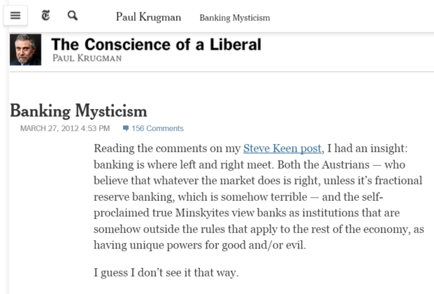
Do banks, debt and money matter in economics?
Notice how banks, debt and money don’t feature in mainstream macro?
Why is this?
Mainstream economists argue they don’t matter…

Slide 28
Do banks, debt and money matter in economics?
Minsky developed to allow models with banks & money to be built
Mainstream vision of lending:
  “Think of it this way: when debt is rising, it’s not the economy as a whole borrowing more money.
  It is, rather, a case of less patient people—people who for whatever reason want to spend sooner rather than later—borrowing from more patient people”
Modeling the mainstream view of lending from one agent (“Patient” consumer sector) to another (“Impatient” investment sector)
  Patient consumer sector lends to impatient Investment sector
  Investment sector pays interest to consumer sector
  Consumer sector pays fee to bank for arranging loan…

Slide 29
Thinking in terms of sectoral money flows
Should government budget be balanced or in surplus?
Politicians obviously think “surplus of course!”
2015 Election Campaign in a nutshell:
  “My surplus is bigger than your surplus”
Mainstream economists think balanced: “Ricardian equivalence”
  Deficit today must be financed by future taxes

Slide 30
Should government budget be balanced or in surplus?
Robert Barro (1989): “The Ricardian Approach to Budget Deficits”
  “a deficit-financed cut in current taxes leads to higher future taxes.
  a cut in today’s taxes must be matched by a corresponding increase in the present value of future taxes.
  Suppose now that households’ demands for goods depend on the expected present value of taxes.
  Therefore, the substitution of a budget deficit for current taxes has no impact on the aggregate demand for goods.
  A current budget deficit leads to an offsetting increase in desired private saving, and hence to no change in desired national saving…”
  IF! … we assume …
  “a network of intergenerational transfers makes the typical person a part of an extended family that goes on indefinitely.
  In this setting, households capitalize the entire array of expected future taxes, and thereby plan effectively with an infinite horizon.”

Slide 31
Should government budget be balanced or in surplus?
Notice Barro argues that less government saving today (a deficit) results in more private saving today:
  “A current budget deficit leads to an offsetting increase in desired private saving, and hence to no change in desired national saving…”
Thinking in strictly monetary terms, easy to show this wrong
Divide society into Government & Private
Consider government running a surplus—as politicians want to do now
Surplus means Government Taxes > Spending
Surplus means net flow of money from Private to Government
  Call this “NetGov”. Then Government surplus means Private deficit
Put this in a diagram:
Private:
deficit = NetGov
Government:
surplus = NetGov

Slide 32
Should government budget be balanced or in surplus?
One off, not a major problem
  Public just has to reduce its savings or go into debt…
    But this the opposite of what surplus proponents believe!
      Think Government saving will encourage private saving
    As a matter of accounting, there are only two possibilities
      Either public reduces its bank balances; or
      Public borrows £ needed from banks
Banks must “run a deficit”: Loans > Repayments + Interest
  Call this “NetBank”. Then:
Private Banks:
Deficit = NetBank
Government: Surplus = NetGov = NetBank
But this is incompatible with a growing economy
Public’s holdings of money remains constant
Only other way for economy to grow is for velocity of money to rise constantly
That’s not what it does…
Private Non-Bank:
Balance = NetGov + NetBank

Slide 33
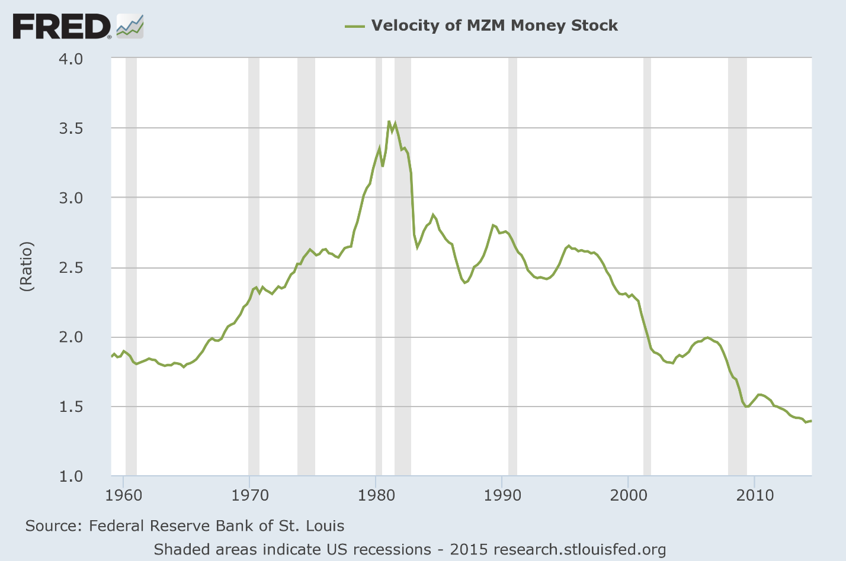
Should government budget be balanced or in surplus?
Velocity trending down for last 3 decades…
So government surplus with NetGov=NetBank means
  At best, no economic growth (maybe even contraction); and
  Rising private debt to GDP (since NetBank > 0 for public)
Only way to get economic growth with a government surplus is…

Slide 34
Should government budget be balanced or in surplus?
If NetBank > NetGov: if public borrows enough to pay government surplus and accumulate more money itself:
But this requires private debt to banks to grow:
  Faster than GDP (given constant or falling velocity of money); and
  Faster than in no-growth case
So medium-term consequence of sustained government surplus is
  Rising private debt to GDP; and…
Private Banks
Deficit = NetBank
Government Surplus = NetGov
Private Non-Bank
Surplus = NetGov + NetBank
Growth
Eventually, an economic crisis when private sector stops borrowing!
This is the opposite of what government surplus fans believe
  If private sector becomes averse to rising debt/income ratio, then
    Private sector will try to reduce debt (delever), leading to…

Slide 35
Should government budget be balanced or in surplus?
Both private banks and government running surplus
Private non-bank sector running a deficit
Economy contracting as money supply and velocity fall
Private Banks:
Surplus = NetBank
Government: Surplus = NetGov
Private Non-Bank:
Deficit = NetGov + NetBank
Contraction

Slide 36
Should government budget be balanced or in surplus?
Not just hypothetical situation: this is what is happening in Europe…

Slide 37
Should government budget be balanced or in surplus?
Balanced budget over long term almost as bad
  Private debt growth at least as fast as GDP
Only sustainable situation is government should normally run deficits
External: Balance= 0
Private Banks:
Deficit = NetBank
Government: Deficit = NetGov
Private Non-Bank:
Surplus = NetGov + NetBank
Growth
My main economic concern: level of private debt today
Need to reduce private debt to enable economy to function well…

Slide 38
Why deflation now?
Highest levels of debt in the history of capitalism…

Slide 39
We’re all “Turning Japanese”
Focus on Japan’s public debt, but private debt caused “Lost Decade”

Slide 40
We’re all “Turning Japanese”
Change in private debt & level of unemployment…

Slide 41
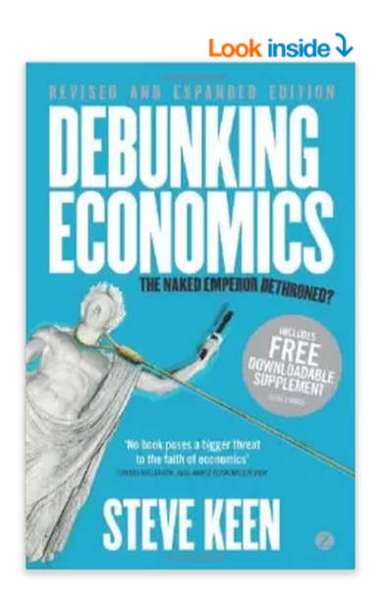


Your future economic education
Read critical books on economics
Learn from other disciplines—physics, biology, ecology
Above all, keep an open mind…
  “There are more things in heaven and earth, Horatio, Than are dreamt of in your philosophy.” (Hamlet to Horatio in Hamlet)

Slide 42


Your future economic education
And if you don’t like what you’re being taught now…
Kingston
University
London
For a pluralist education in economics
Come to Kingston
School of Economics, History & Politics

